Slide 1
OPERATING SYSTEMS (CS F372) Introduction
Barsha Mitra
CSIS Dept., BITS Pilani, Hyderabad Campus

Slide 2
Topics to be covered
Introduction
OS Structures
Processes
Threads
CPU Scheduling
Process Synchronization
Deadlocks
Main Memory Management
Virtual Memory
Mass Storage File System Interface
File System Implementation
I/O Systems

Slide 3
Handout Overview
Text Book:
T1. Silberschatz, Galvin, and Gagne, “Operating System Concepts”, 9th edition, John Wiley & Sons, 2012.
Reference Books:
R1. W. Stallings, “Operating Systems: Internals and Design Principles”, 6th edition, Pearson, 2009.
R2. Tanenbaum, Woodhull, “Operating Systems Design & Implementation”, 3rd edition, Pearson, 2006.
R3. Dhamdhere, “Operating Systems: A Concept based Approach”, 2nd edition, McGrawHill, 2009.
R4. Robert Love, “Linux Kernel Development”, 3rd edition, Pearson, 2010.

Slide 4
Handout Overview
Reference Books:
R5. Russ Cox, Frans Kaashoek, Robert Morris, “xv6 a simple, Unix-like teaching operating system”. Online Draft, 2021. https://pdos.csail.mit.edu/6.828/2021/xv6/book-riscv-rev2.pdf
R6. Daniel P. Bovet, Marco Cesati “Understanding the Linux Kernel”, 3rd Edition.
R7. Jonathan Corbet, Alessandro Rubini, Greg Kroah-Hartman “Linux Device Drivers”, 3rd Edition.

Slide 5
Evaluation
Component | Duration | Weightage (%) | Date & Time | Nature of Component
Mid Semester Examination | 90 minutes | 35% | As per Time Table | Closed Book
Assignment (2 Nos.) | Take Home | 25% | TBA | Open Book
Comprehensive Examination | 120 minutes | 40% | As per Time Table | Closed Book

Slide 6
Handout Overview
Chamber Consultation – Tuesdays 3 pm to 3:50 pm
Notices
Make-up Policy

Slide 7
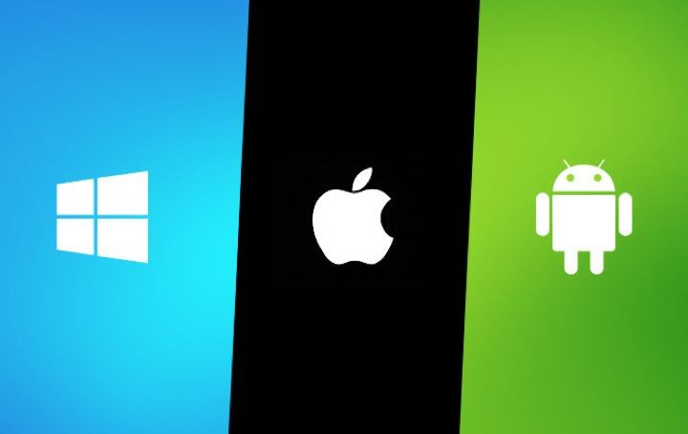
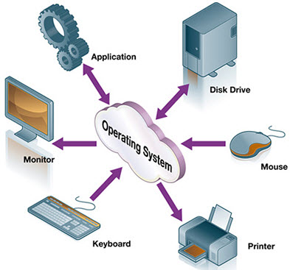
What is an Operating System

Slide 8
Introduction
program that manages computer’s hardware
acts as an intermediary between computer user and computer h/w
Types
mainframe operating systems
personal computer (PC) operating systems
operating systems for mobiles

Slide 9
Computer System Architecture
Hardware – provides basic computing resources
CPU, memory, storage, I/O devices
Operating system
Controls and coordinates use of hardware among various applications and users
Application programs – solve computing problems of users
word processors, email, web browsers, database systems, video games, media player
Users
People, machines, other computers

Slide 10
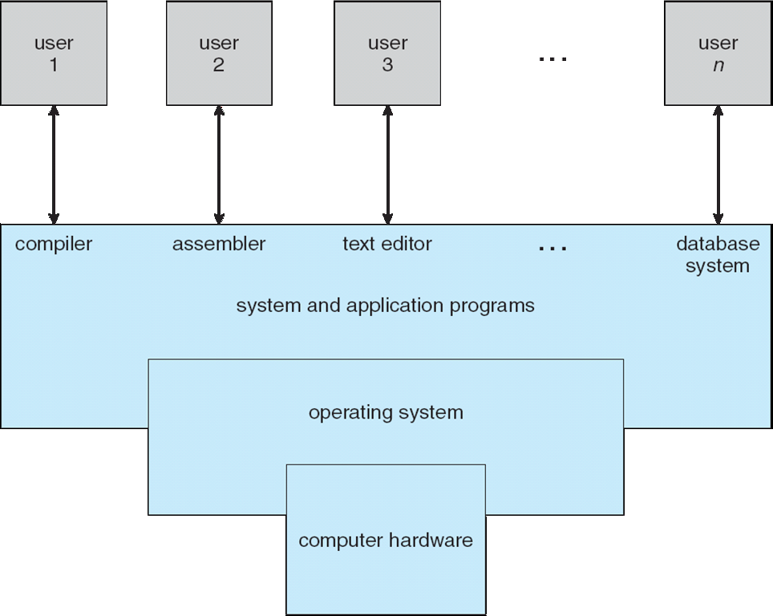
Computer System Architecture

Slide 11
What OS Does? : User View
Users want convenience, ease of use and good performance
Don’t care about resource utilization
Shared computer such as mainframe/minicomputer must keep all users happy
Dedicated systems like workstations have dedicated resources, also use shared resources from servers
Handheld computers are resource poor, optimized for individual usability and battery life
Some computers have little or no user interface, such as embedded computers in devices and automobiles

Slide 12
What OS Does? : System View
OS is a resource allocator
Manages all resources
Decides between conflicting requests for efficient and fair resource use
OS is a control program
Controls execution of user programs
Prevent errors and improper use of computer

Slide 13
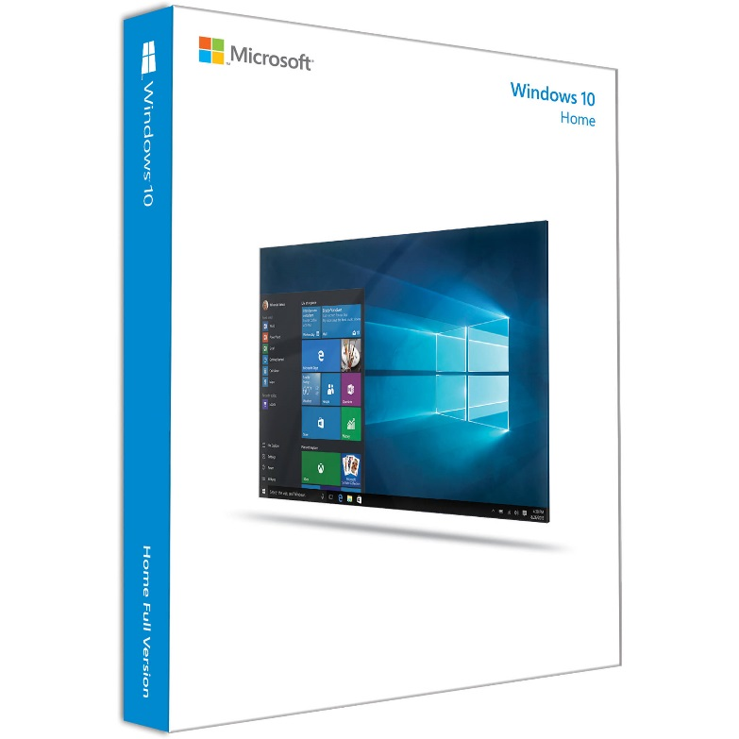
How do we define OS?
Everything a vendor ships when you order an operating system
“The one program running at all times on the computer”

Slide 14
OS vs. Kernel
Disk Management
Memory Management
Process Management
Task Management
OS
KERNEL
DEVICE DRIVERS
UTILITIES
SYSTEM LIBRARIES
USER INTERFACE
https://www.geeksforgeeks.org/difference-between-operating-system-and-kernel/
https://www.gnu.org/gnu/linux-and-gnu.html#:~:text=Linux%20is%20the%20kernel%3A%20the,of%20a%20complete%20operating%20system.
https://www.tutorialspoint.com/difference-between-operating-system-and-kernel

Slide 15
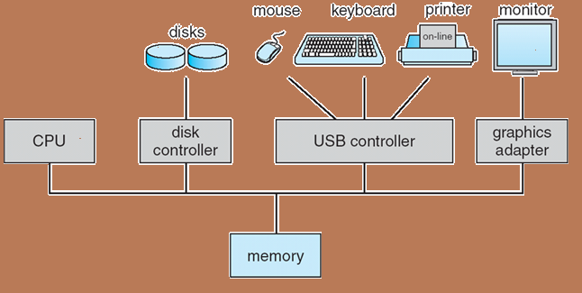
Computer System Operation
Computer-system operation
One or more CPUs, device controllers connect through common bus providing access to shared memory
Concurrent execution of CPUs and devices competing for memory cycles
device controller is a hardware component that works as a bridge between the hardware device and the operating system or an application program

Slide 16
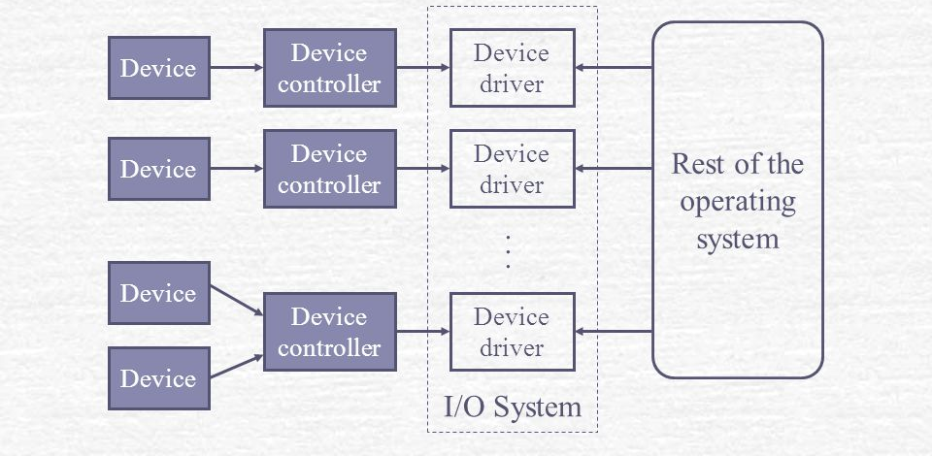
Computer-System Operation
device controller
maintains some local buffer storage and a set of special-purpose registers
moves data between the devices that it controls and its local buffer storage
operating systems have a device driver for each device controller
device driver
understands the device controller
provides the rest of the OS with a uniform interface to the device
I/O devices and the CPU can execute concurrently
Device controller informs CPU that it has finished its operation by causing an interrupt

Slide 17
Interrupt Handling
Sequential program execution by CPU
IVT - table of pointers containing addresses of all service routines
Control transfer to ISR
Execute ISR
Examine Interrupt Vector Table (IVT)
Interrupt received
Save contents of CPU registers & PC on system stack
Control returns to interrupted program

Slide 18
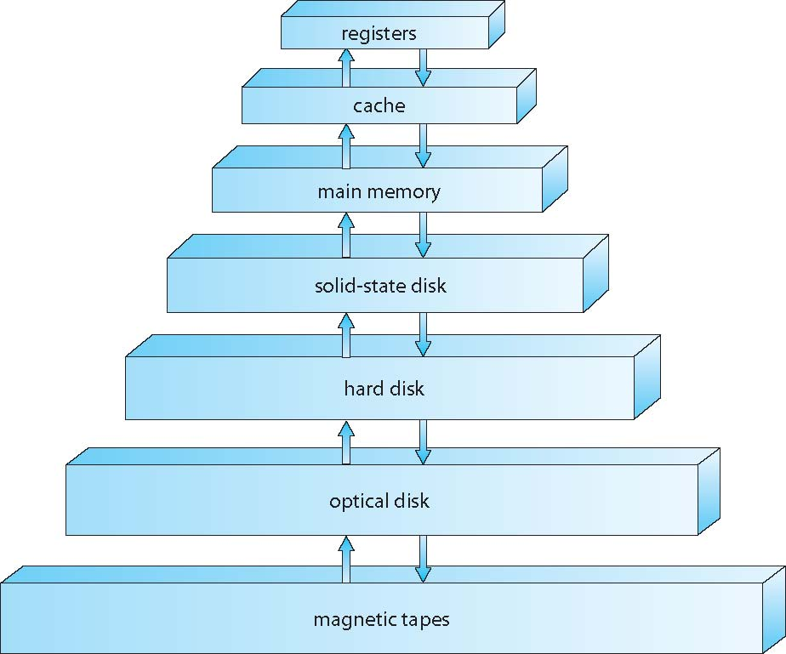
Storage Structure

Slide 19
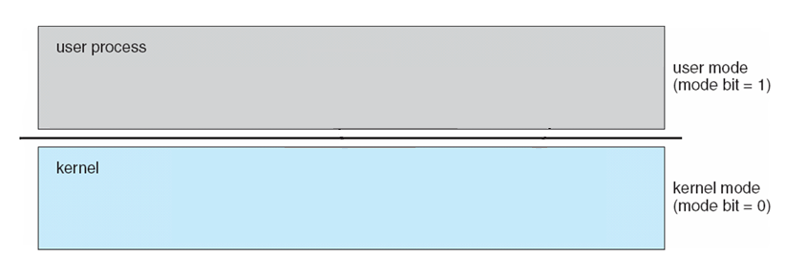






Operating System Operations
Dual-mode operation allows OS to protect itself and protect users from one another
User mode and Kernel/Supervisor/System/Privileged mode
Mode bit provided by hardware
Provides ability to distinguish when system is running user code or kernel code
Some instructions designated as privileged, only executable in kernel mode
System call changes mode to kernel, return from call resets it to user
locate ISR via interrupt vector and excecute

Slide 20
Operating System Operations
Boot time → hardware starts in kernel mode
After loading OS, user applications are started in user mode
When trap/interrupt occurs, hardware switches from user mode to kernel mode
examples of privileged instructions – I/O control, timer management, interrupt management

Slide 21
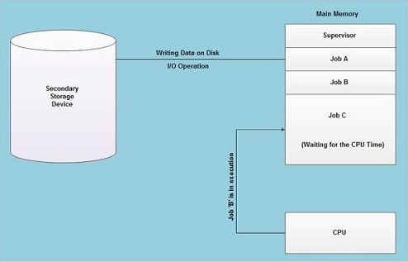
Multiprogramming (Batch system)
Job Pool

Slide 22
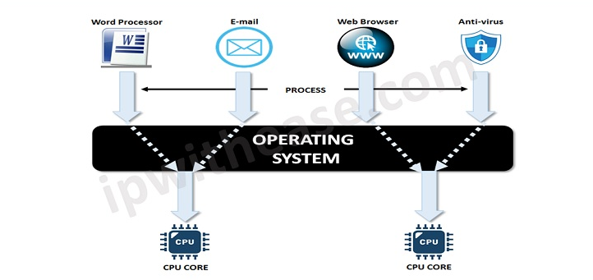
Multitasking
Source: https://networkinterview.com/time-sharing-and-multi-tasking/

Slide 23
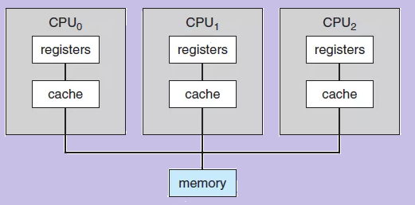
Computing Environments
Multiprocessor Systems

Slide 24
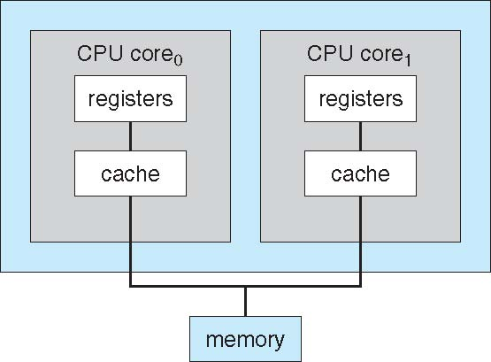
Computing Environments
Multicore Systems
dual-core design with both cores on same chip

Slide 25
Thank You

