Slide 1
Computers and software are changing everything…

Slide 2
…but the majority of schools don’t teach computer science:
9 in 10
parents want their child to study computer science
1 in 4
schools teach computer programming
Source: Gallup

Slide 3
Some may think:
Our students should learn to code…

Slide 4
Our students should learn to code…
Our schools should teach computer science

Slide 5
Some may think:
Computer science education is on the rise…

Slide 6
Computer science education is on the rise…
Computer science education is recovering from a 10-year decline

Slide 7
Fewer computer science graduates than 10 years ago (and half as many women):
MALE
FEMALE
Source: National Science Foundation, National Center for Education Statistics

Slide 8
Some may think:
Computer science is just about learning technology

Slide 9
Some may think:
Computer science is just about learning technology
Computer science is about logic, problem solving, and creativity

Slide 10
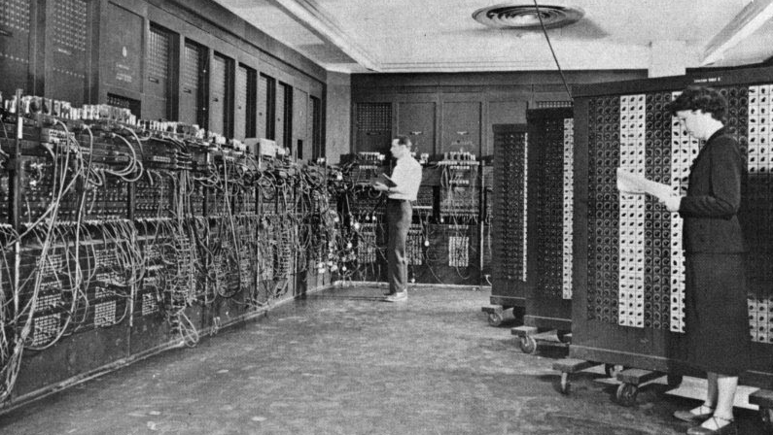
First computer: 1943

Slide 11
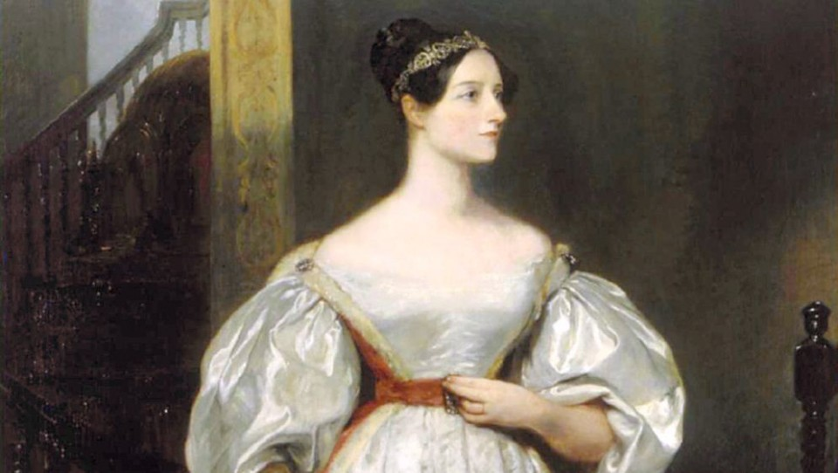
Ada Lovelace
First computer: 1943
First computer program: 1843

Slide 12
Some may think:
Computer science is vocational

Slide 13
Some may think:
Computer science is vocational
Computer science is foundational

Slide 14
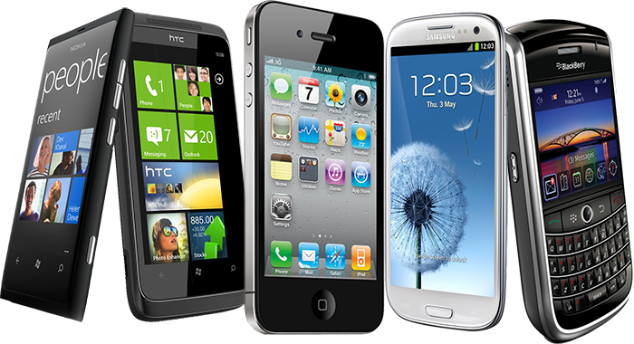
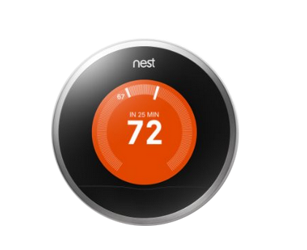
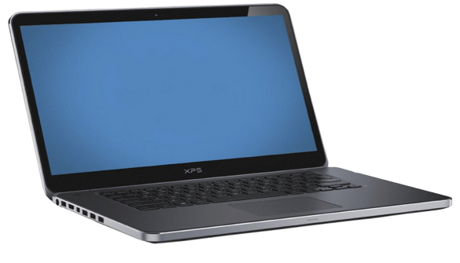
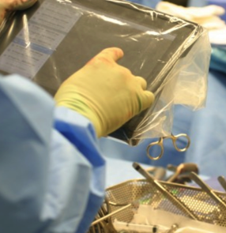


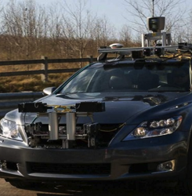
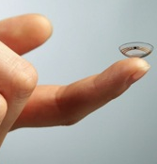
Technology affects every field:

Slide 15
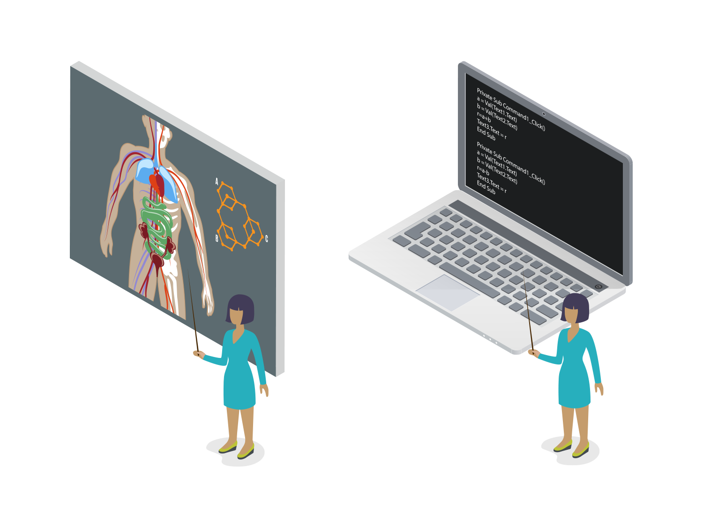
Every 21st century student should have a chance to learn about algorithms, how to make apps, or how the internet works.
Just like they learn about the digestive system, photosynthesis, or electricity.

Slide 16
Some may think:
The tech industry is desperately trying to hire computer programmers in California

Slide 17
The tech every industry is desperately trying to hire computer programmers in California everywhere

Slide 18
To present this slide – right-click it in the slide-sorter and un-hide it.
And update the stats and localize to wherever you’re presenting using data from fact-sheets at http://code.org/promote
The picture in Ohio:
21,000 open computing jobs
1,000 computer science graduates
67 high schools teach AP CS
Sources: Conference Board, National Science Foundation, College Board
Notes:
When giving this presentation, update the stats and localize to wherever you’re presenting using data from fact-sheets at http://code.org/promote

Slide 19
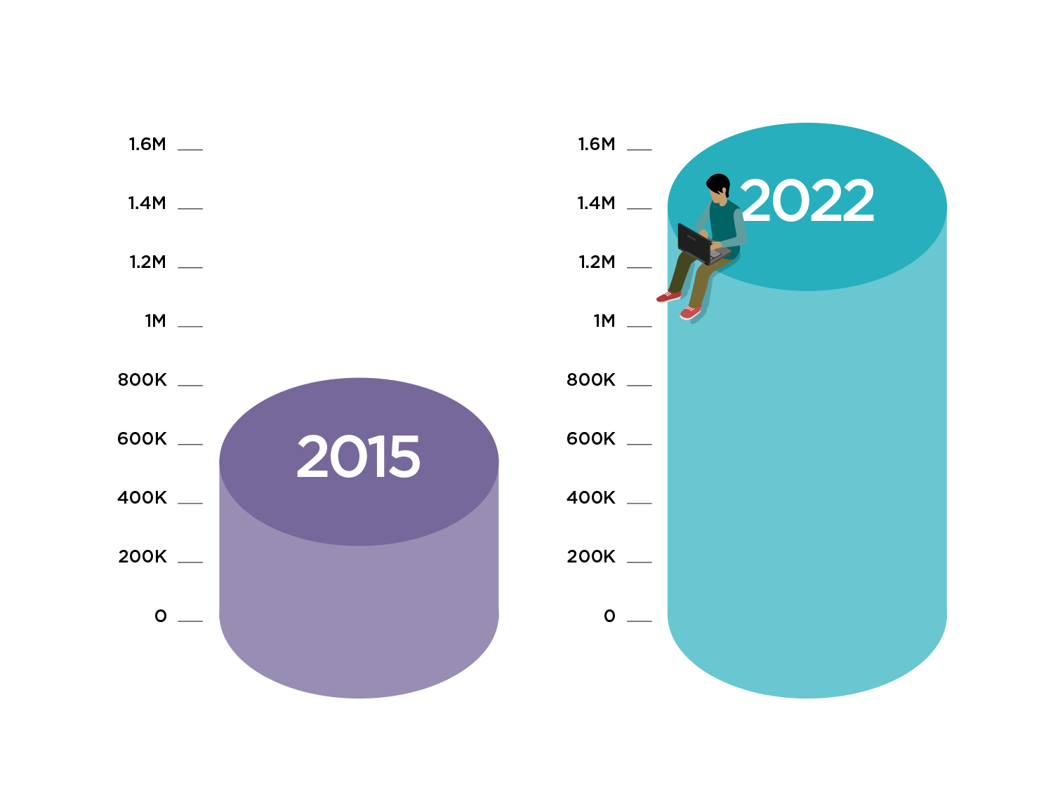
The Bureau of Labor Statistics predicts 1 million open computing jobs in the U.S. by 2022
These are jobs in every industry and every state.
Sources: Conference Board, Bureau of Labor Statistics

Slide 20
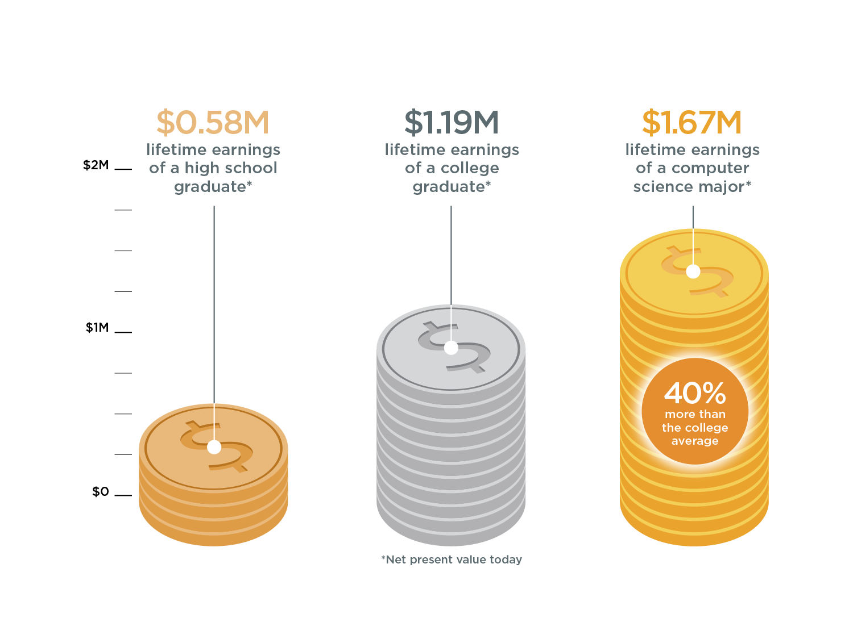
The value of a computer science education
Source: Brookings

Slide 21
Some may think:
This problem is about “STEM” (Science, Technology, Engineering, and Math)…

Slide 22
The STEM problem is in computer science:
67%
of all new jobs in STEM are in computing
8%
of STEM graduates
are in computer science
Sources: Bureau of Labor Statistics, National Center for Education Statistics

Slide 23
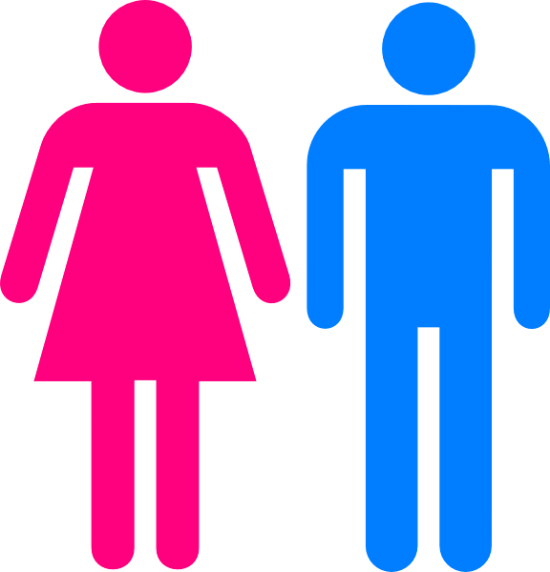
Tech’s diversity problem is also in CS
High School Computer Science
University Computer Science
Software Workforce
Women who try AP Computer Science in high school are ten times more likely to major in it in college, and Black and Hispanic students are seven times more likely.
Sources: College Board, National Center for Education Statistics, Bureau of Labor Statistics

Slide 24
Our state policies can help fix this picture…

Slide 25
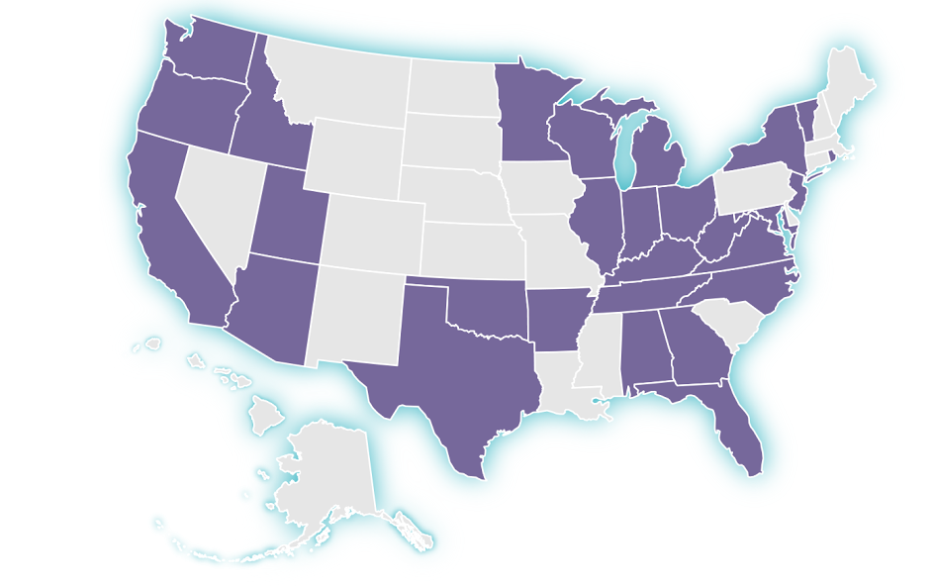
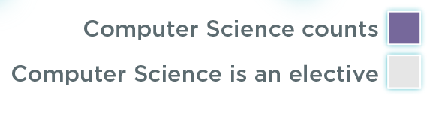
CS can count for graduation in 28 states
In 27 states plus DC, computer science can count towards high school graduation math or science requirements - up from 12 states in 2013.

Slide 26
But fundamentally, this is the picture we need to solve:
9 in 10
parents want their child to study computer science
1 in 4
schools teach computer programming
Source: Gallup

