Slide 1
The majority of schools don’t teach Computer Science
9 in 10
parents want their child to study computer science
1 in 4
schools teach computer programming
Source: Gallup

Slide 2
The “STEM” problem is in Computer Science
67%
of all new jobs in STEM are in computing
8%
of STEM graduates
are in Computer Science
Sources: Bureau of Labor Statistics, National Center for Education Statistics

Slide 3

The diversity problem starts in K-12
High School Computer Science
University Computer Science
Software Workforce
Women who try AP Computer Science in high school are ten times more likely to major in it in college, and Black and Hispanic students are seven times more likely.
Sources: College Board, National Center for Education Statistics, Bureau of Labor Statistics

Slide 4
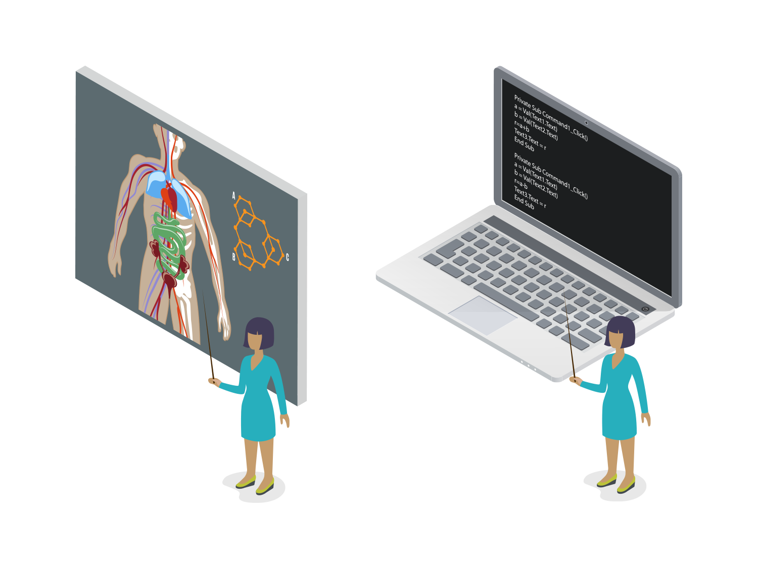
Computer Science is Foundational
Every 21st century child should have a chance to learn about algorithms, how to make an app, or how the internet works.
Just like they learn about photosynthesis, the digestive system, or electricity.

Slide 5
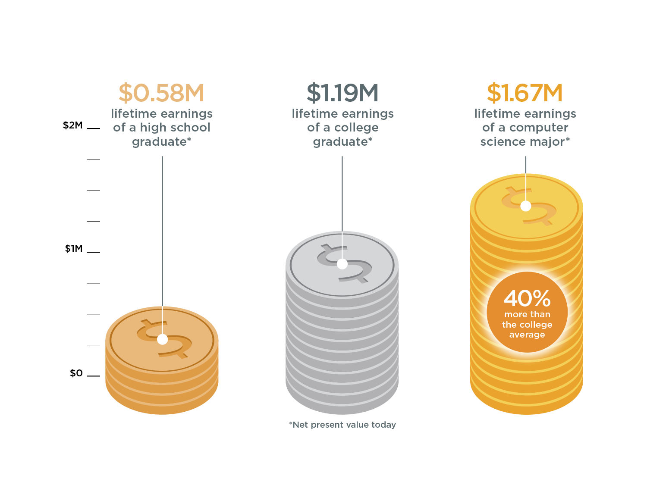
The Value of a Computer Science Education
Source: Brookings

Slide 6
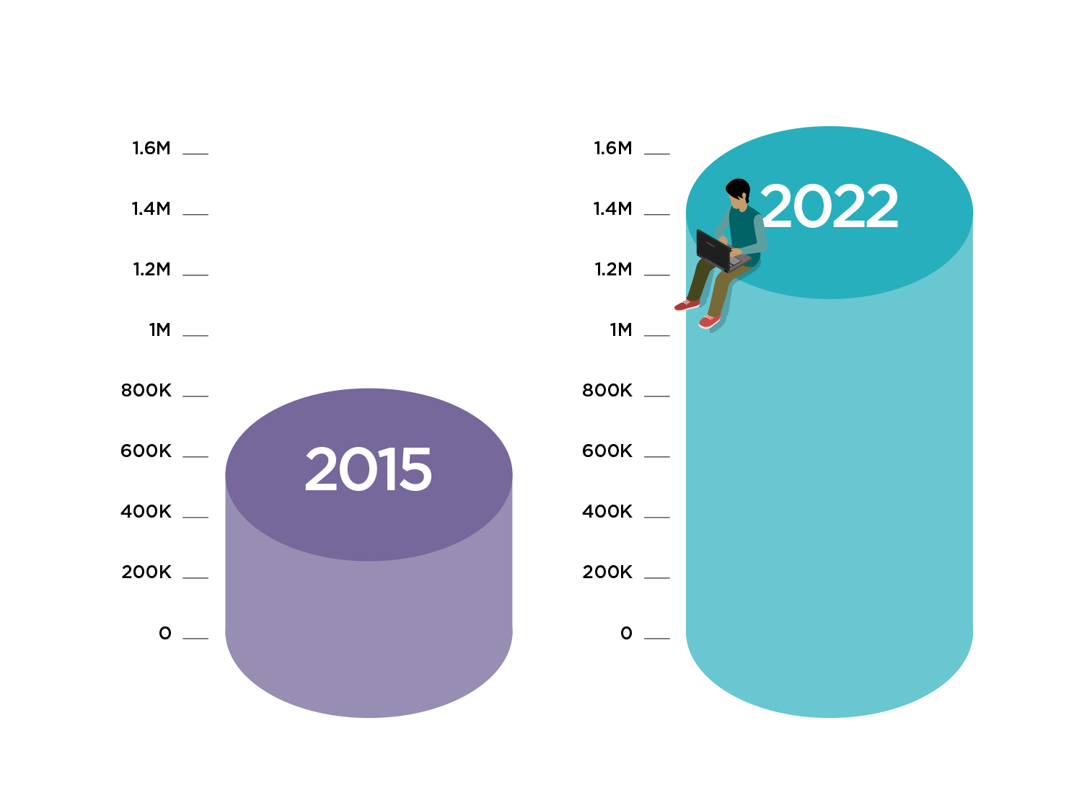
1 Million Open Computing Jobs
The Bureau of Labor Statistics predicts that there will be over 1 million computing job openings by 2022.
These are jobs in every industry and every state.
Sources: Conference Board, Bureau of Labor Statistics

Slide 7
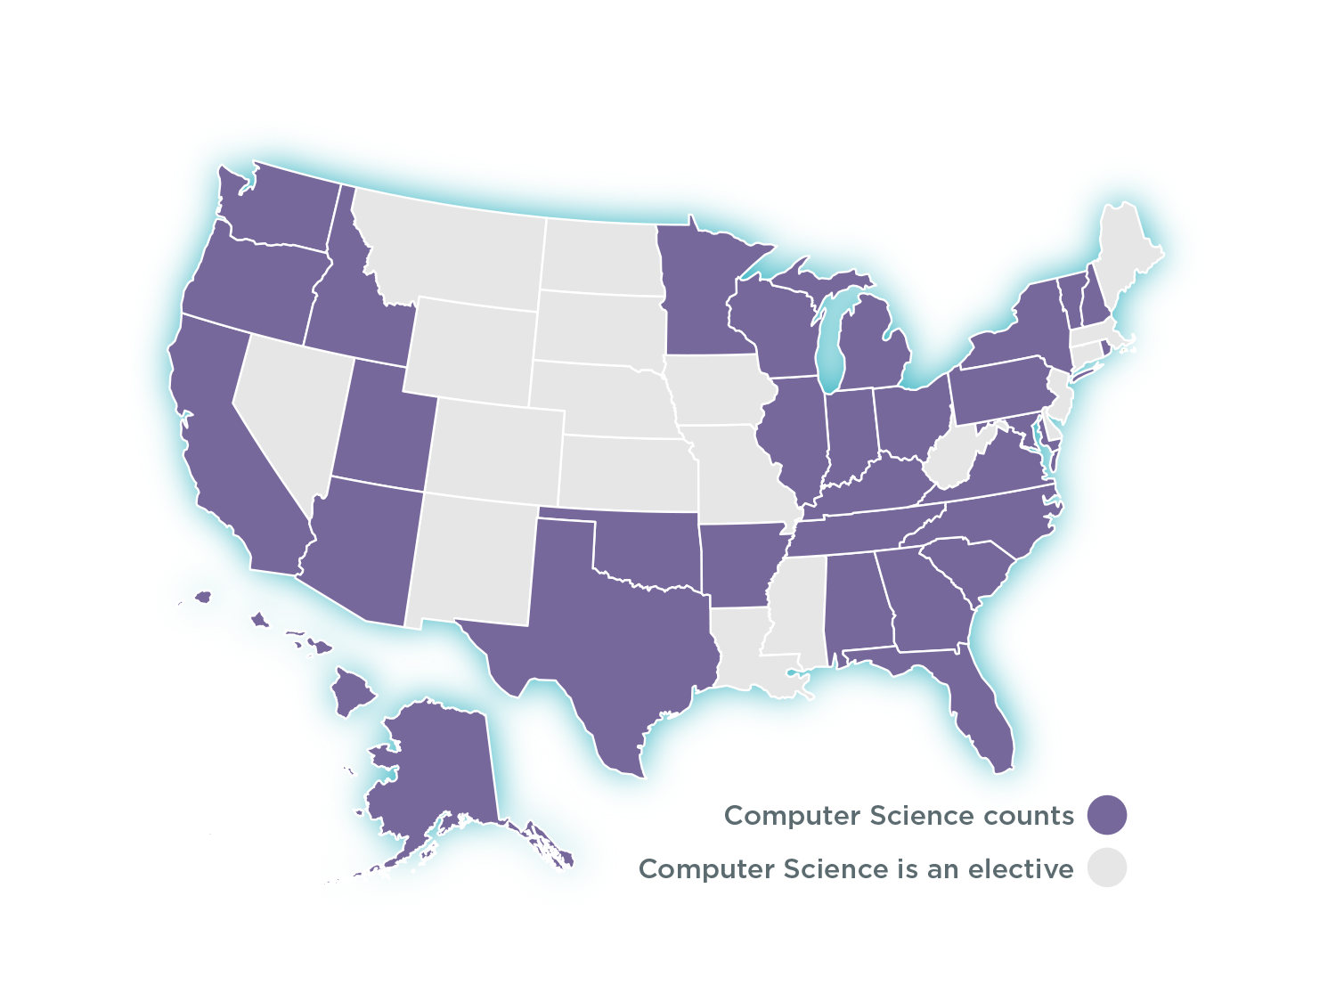
A graduation requirement now in 27 states
In 27 states plus DC, computer science can count towards high school graduation math or science requirements- up from only 9 states in 2013.

