Slide 1
Computers and software are changing everything…
Notes:
Let’s talk about getting computer science into our K-12 schools
But let’s start by talking about dreams
Opportunities for you
Opportunities for your community
And most importantly, an opportunity to create something
The beauty of computer science is that imagination and creation lie at the heart of the field
This smart phone I have here or the laptop driving this presentation are innovation platforms
They allow dreamers, idealists and entrepreneurs anywhere in world to bring their ideas into reality IF they know how to write the software that drives our modern world

Slide 2
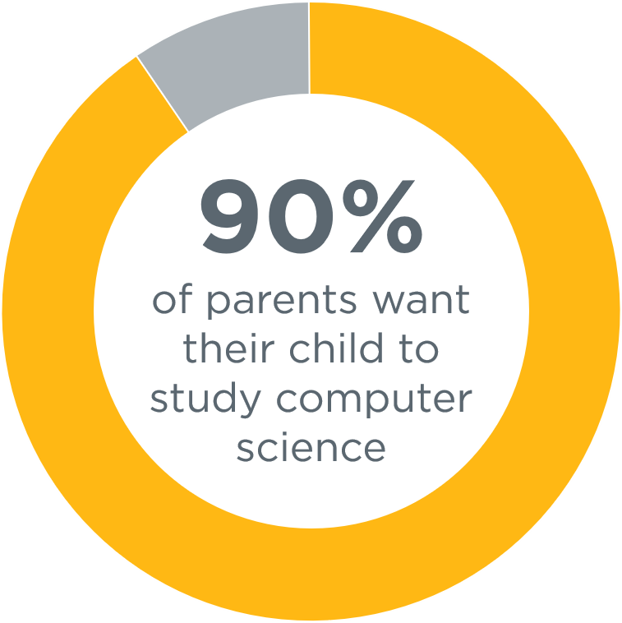
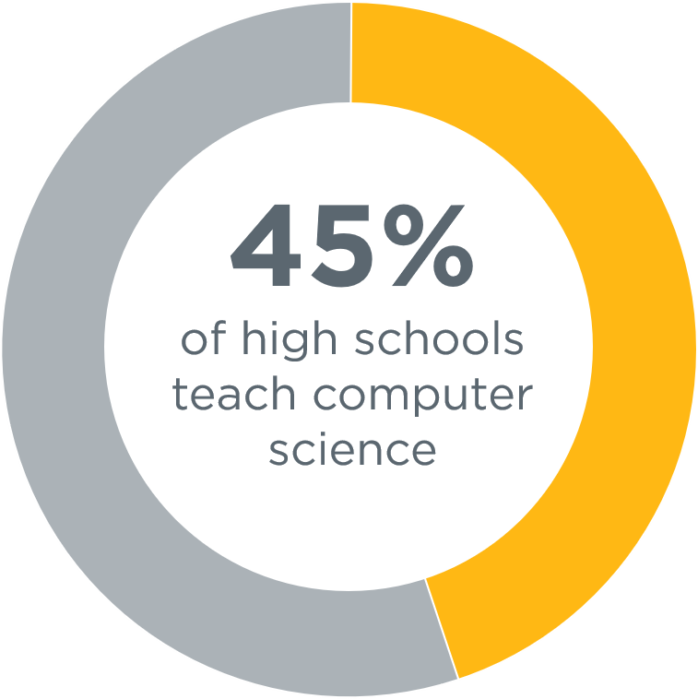
…but the majority of schools don’t teach computer science
Source: Access Report
Notes:
But the reality of our education system today is that it is not set up for everyone to participate in the new American economy and opportunity
Computer science isn’t widely taught in our schools
A recently released comprehensive Gallup survey of parents and school administrators shows the stark gap between what parents want and what is happening in our schools
9 out of 10 parents surveyed WANT their child to learn computer science
But according to our Access Report, just 35% of high schools teach computer science courses
Our education system clearly needs to evolve to bring computer science to students that want to learn this subject
And this evolution isn’t something the tech industry wants, it is clearly something that parents and students want

Slide 3
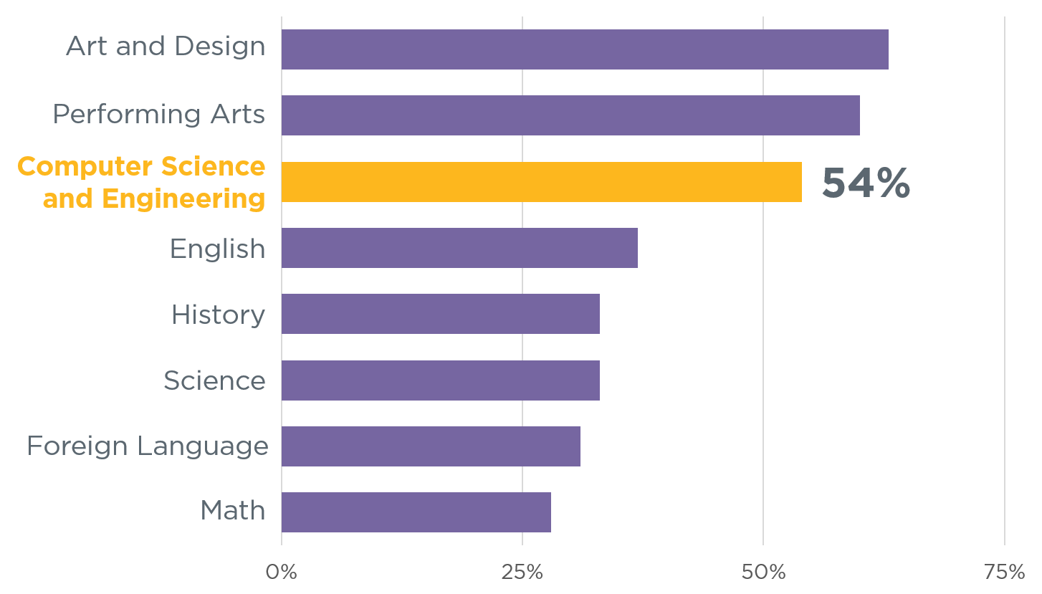
Even when students enjoy computer science and the arts the most
Source:
Change the Equation

Slide 4
Some may think:
Our students should
learn to code…
Notes:
Let’s address a few misconceptions and themes we consistently hear from our advocacy for students across the country
The first is that we should be teaching our kids to code

Slide 5
Our students should
learn to code…
Our schools should teach computer science
Notes:
Our view is that schools should be teaching computer science
Coding is an important TOOL for computer science but it is a bit like arithmetic is a TOOL for doing mathematics, and words are a TOOL for English
Coding creates software, but computer science is a broad field encompassing deep concepts that go well beyond coding.
And all students should have access to computer science courses in their schools.

Slide 6
Some may think:
Computer science is just about learning technology
Notes:
When people hear the term computer science, they often simply think of the technology it creates
What they don’t realize is that the beauty of computer science lies in the process to create that technology

Slide 7
Computer science is just
about learning technology
Computer science is about logic, problem solving, and creativity
Notes:
The reality is that computer science is about logic, problem solving, and creativity
It teaches students how to think differently about problems they are trying to solve in any context
It teaches kids how to create digital artifacts and how those artifacts impact the world around them by looking at issues such as privacy and security
A very simple way to think about this is CS teaches kids how to CREATE new technologies instead of just being consumers of technology
Just as important as recognizing what computer science is, is recognizing what it is not
It is not basic HTML design, it is not learning to use applications or a photoshop course
Many of these thing CAN be part of a computer science course, but they are not the foundation of the curriculum
We can do better than simple technology literacy – we can make kids creators of technology

Slide 8
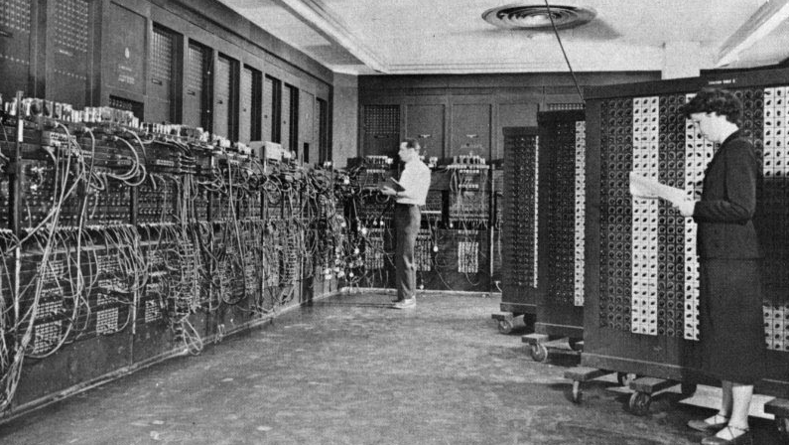
First computer: 1943
Notes:
For example, consider the fact that the first computer was built in 1943….

Slide 9
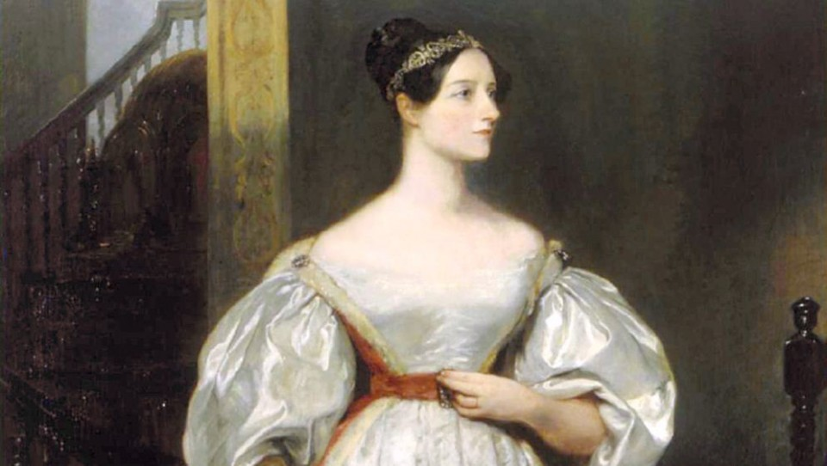
Ada Lovelace
First computer: 1943
First computer program: 1843
Notes:
…but the first computer program was written in 1843, by Ada Lovelace.
Writing a computer program is about using logic to creatively solve a problem...
Not just about the technology that carries out that program.

Slide 10
Some may think:
Computer science is vocational
Notes:
We hear a lot about the number of computing jobs in the US economy
And many view computer science as simply vocational,
That learning computer science is just about getting a great job

Slide 11
Computer science is vocational
Computer science is foundational
Notes:
The right way to think about computer science in our education system is that it is foundational

Slide 12
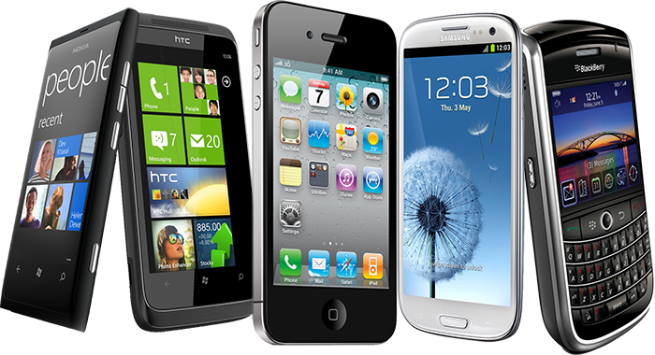
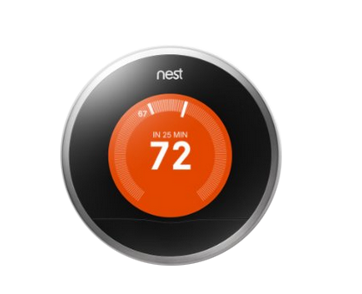
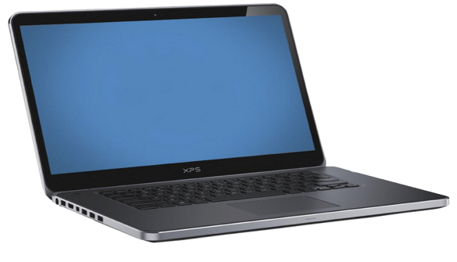
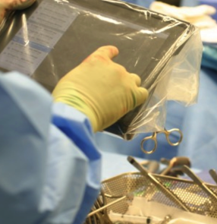


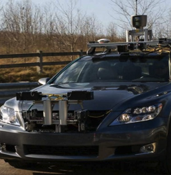

Technology affects every field
Notes:
The reality is that technology affects every field of commerce
In healthcare – computing is part of operating rooms every day and it is enabling breakthroughs like these contact lenses that detect levels of insulin for people with diabetes
In space – we are depending on a generation of robots to explore where humans cannot now
In our homes -- we are automating everyday things like our heating systems
On our roads – we depend on navigation systems to get us home and now we are experimenting with bringing self-driving cars into our everyday lives
In entertainment – blockbuster movies depend on computer science to bring new characters to life and provide us new completely animated worlds
And every single day this trend is growing across every single industry

Slide 13
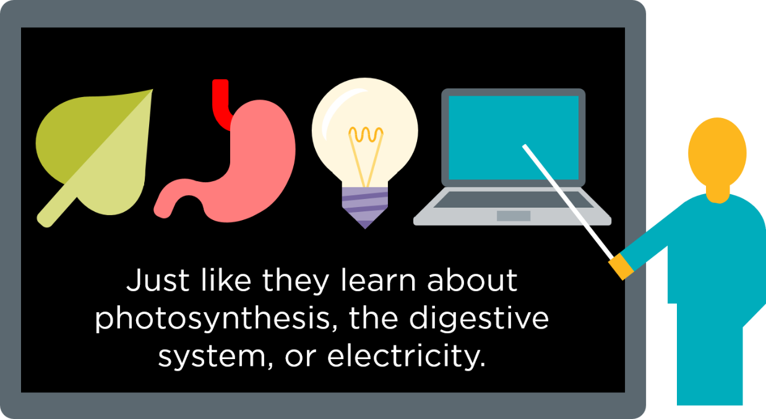
Every 21st century student should have a chance to learn about algorithms, how to make apps,
and how the internet works.
Notes:
So let’s take a little audience pop-quiz
How many of you can answer these questions?
What is photosynthesis?
Or what is H2O?
These are all things that we expect kids to graduate high school knowing
Every 21st century student should also have a chance to learn about algorithms, how to make an app, or how the internet works.
Right now there’s no expectation in our schools that students will even have a basic understanding of these concepts, even though they are driving a large part of our society.
It is equally important that students understand what a “for loop” is and how it is used and how to design algorithms is as it is that they understand how to solve an equation or how plants live
The main reason that computer science is now foundational knowledge necessary in every school is because it will allow students to think about problems differently
Students will gain computational thinking skills, which embody a more robust way to think about problems
And the problem solving process can be applied to any field of study and to any problem
If you are facing a big, ambiguous project at home or at work, computational thinking and problem solving processes can help you break this problem into smaller chunks. Recognizing what’s important and what needs to be solved first are critical thinking skills that are valuable in ANY context

Slide 14
Some may think:
The tech industry is desperately trying to hire computer programmers in California
Notes:
There’s a temptation to think that this is only about the IT industry
That only Google, Microsoft, Facebook, Twitter are participating in this new opportunity

Slide 15
The tech every industry is desperately trying to hire computer programmers in California everywhere
Notes:
But in fact, computer programmers are needed in every industry and across the country.
So what will a career look like in 2030?
It will be a workforce that is very data driven, that leverages technology to bring new ideas into the marketplace
Employers will need workers that understand not only how to use technology, but how to create and manipulate it
Just being facile with technology will NOT be enough
Simply put, our students will need to be innovators and creators
And to do this they need opportunities to learn CS

Slide 16
To present this slide – right-click it in the slide-sorter and un-hide it.
And update with local stats by filing in the [bracketed] text below using data for your state fact-sheets at http://code.org/promote
The picture in [YOUR STATE]:
[insert #] open computing jobs
[insert #] computer science graduates
[insert #] high schools teach AP CS
Sources: Conference Board, National Science Foundation, College Board
Notes:
When giving this presentation, update the stats and localize to wherever you’re presenting using data from fact-sheets at http://code.org/promote

Slide 17
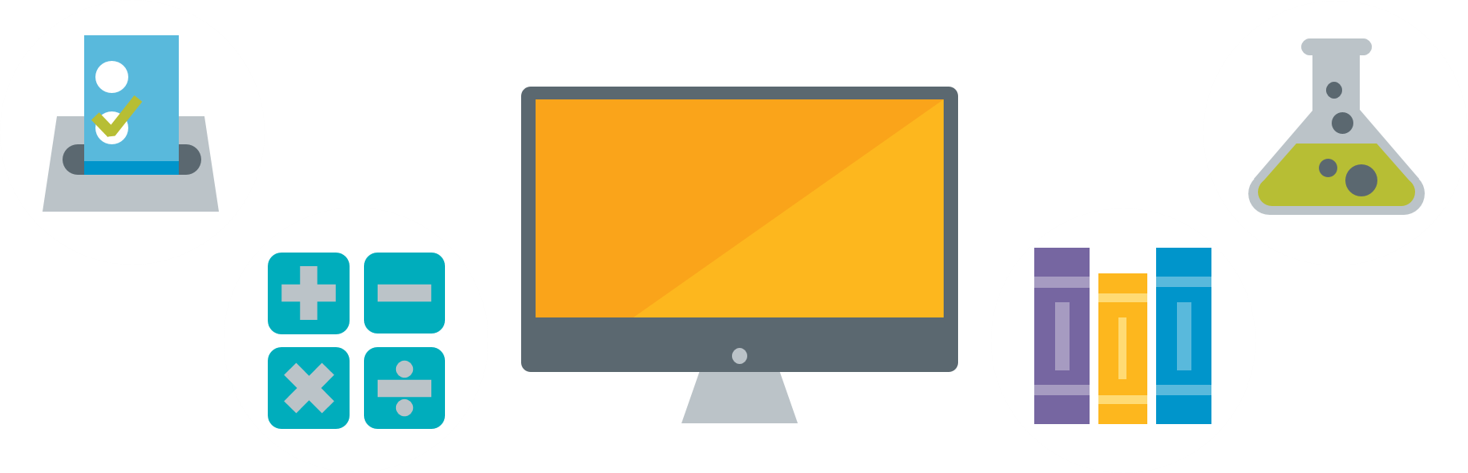
83% of parents and 64% of principals in rural and small towns
believe offering computer science is more or equally as important as any required course.

Slide 18
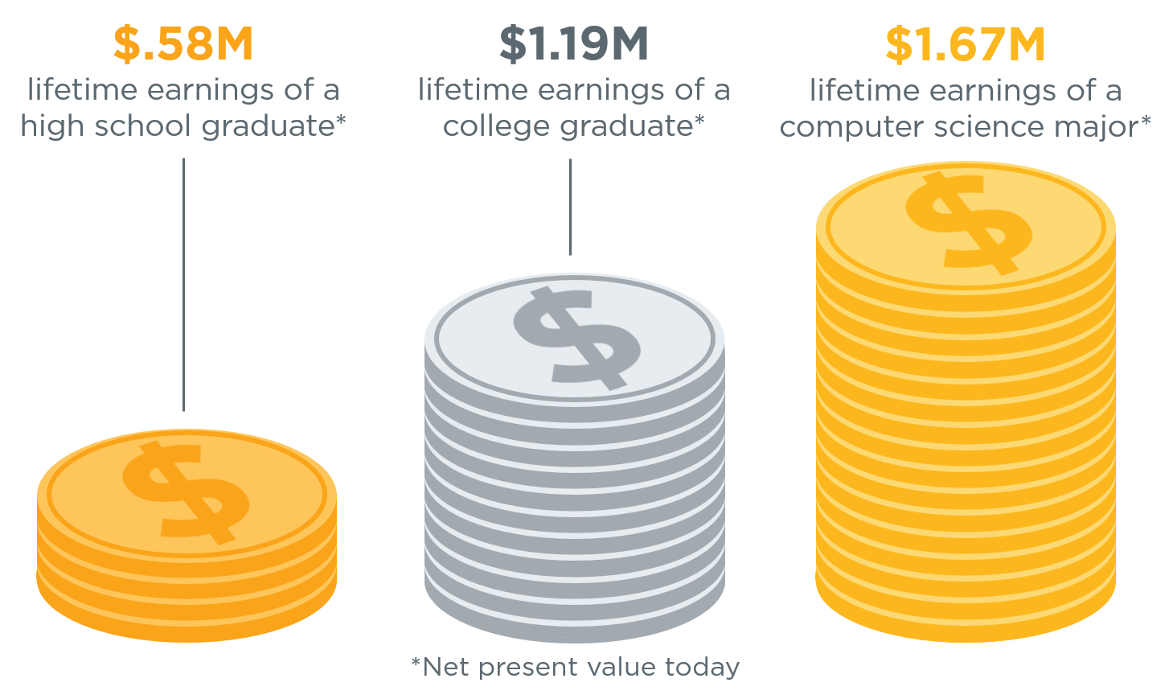
The value of a computer science education
Source: Brookings
Notes:
A computer science major can earn 40% more than the college average.

Slide 19
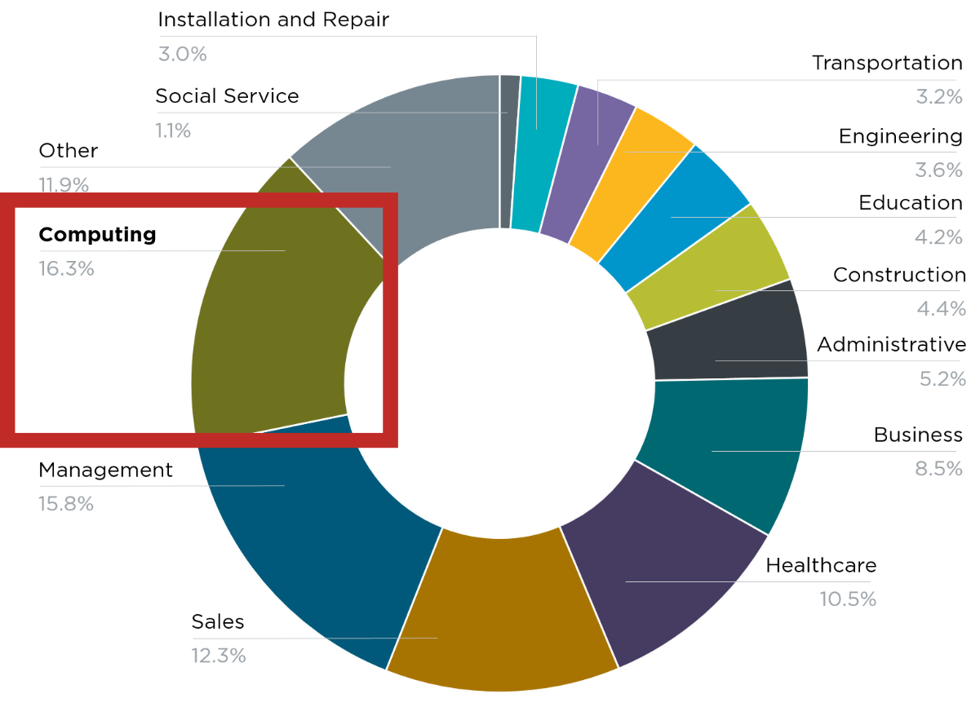
Computing jobs are the #1 source of new wages in the United States
500,000 current openings:
These jobs are in every industry and every state, and they’re projected to grow at twice the rate of all other jobs.
Notes:
And there are job openings across all industries and in every state. There are more than 500,000 open jobs in computing right now, representing the #1 source of new wages in the United States, and these jobs are projected to grow at twice the rate of all other jobs.

Slide 20
Some may think:
This problem is
about “STEM”
(Science, Technology, Engineering, and Math)…
Notes:
Everywhere from the President of the US to local school boards have identified STEM education as a major issue in facing the US

Slide 21
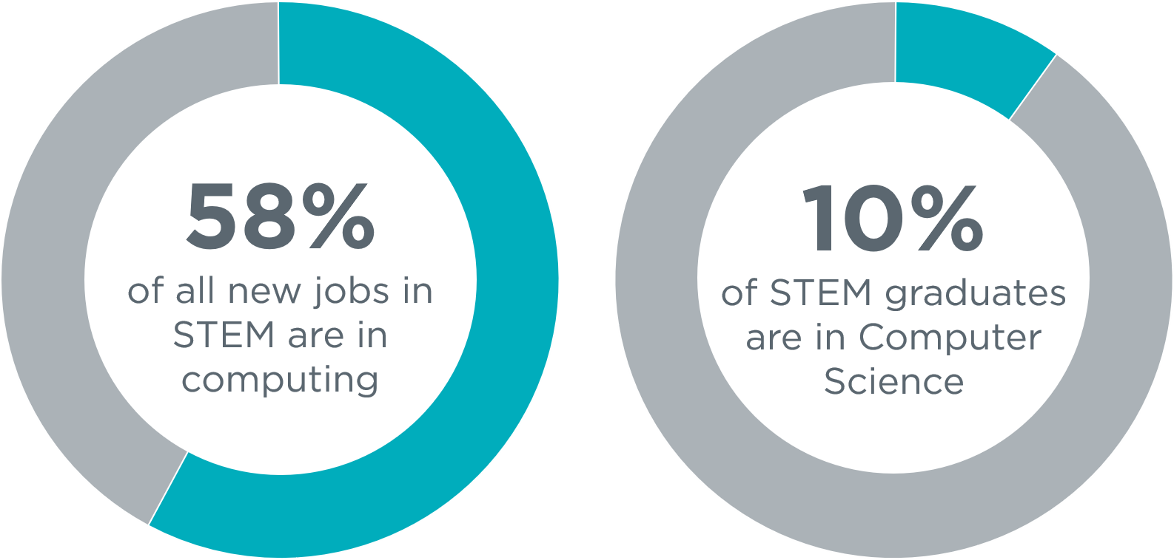
The STEM problem is in computer science
Sources: Bureau of Labor Statistics, National Center for Education Statistics
Notes:
What I’d suggest is that we have a major computer science problem when it comes the alignment between access to K-12 CS science education and opportunities in our modern economy.
This chart shows the projected STEM jobs in our US economy broken out by computing jobs and all other STEM jobs
And this chart shows students graduating with STEM degrees broken out by CS versus all other math/science subjects
These graphs generally speak for themselves – we clearly have a disconnect in our education system

Slide 22
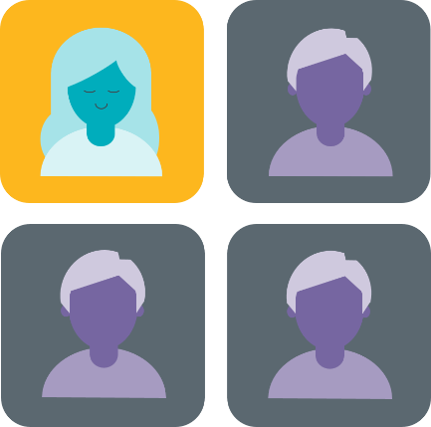
Solving the diversity problem begins in K–12
K-12 computer science
University computer science
Software workforce
Women who try AP Computer Science in high school are ten times more likely to major in it in college, and Black and Hispanic students are seven times more likely.
Sources: College Board, National Center for Education Statistics, Bureau of Labor Statistics
Notes:
Generally, VERY few students are taking AP high school computer science relative to all other AP tests
But even more troubling is that only 23% of total students taking AP CS are female.
Similar trends are found in computer science majors in college.
And the diversity problem in computing is now something that makes front page news about major tech companies struggling to create a diverse workforce
Out of all the computing jobs in our entire economy, women only make up a quarter of that workforce
Consider that these are the fastest growing, highest paying, most in-demand jobs in America
And if current trends continue, only one of out four of those jobs will be filled by women
And the stats about Black and Hispanic students tell a very similar story as well.

Slide 23
Our state policies can help fix this picture…
Notes:
Often, the reason that students don’t take computer science is that they don’t have access to it.
We need to think differently about the diversity problem in tech
And that needs to start with exposing all students early on to CS, by starting in the FORMAL education space

Slide 24
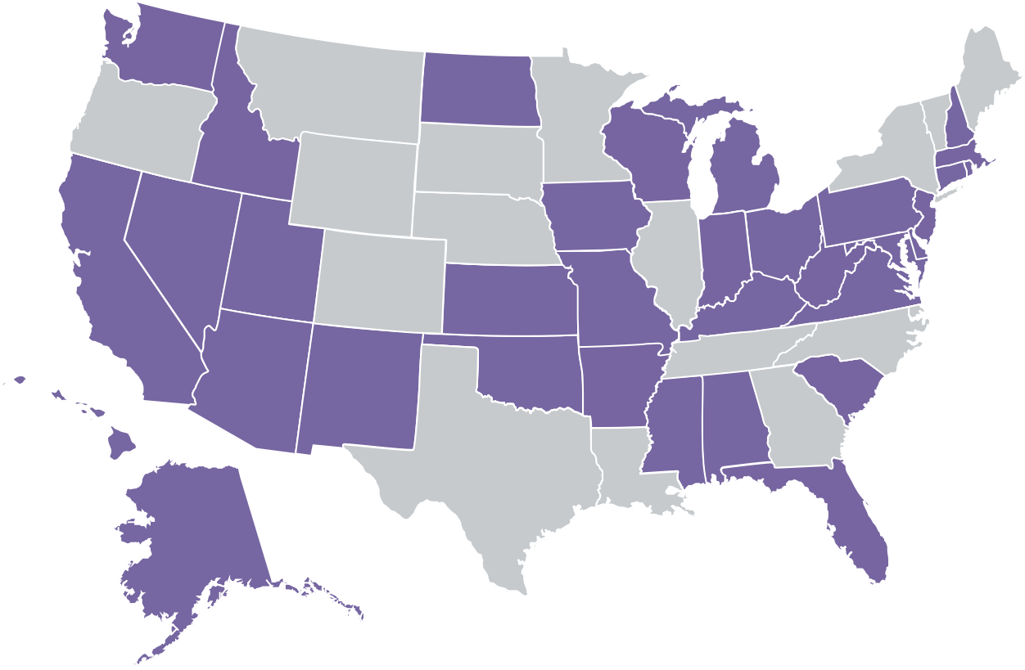
The state of K–12 computer
science standards
Only 34 states have created K–12 computer science standards.
Momentum is building, but we still have a long way to go.
States with K–12 CS standards
States without K–12 CS standards
Notes:
The question is, what to do about the lack of access to K-12 computer science?
What can we do when a student’s access to CS is determined largely on whether or not the school is lucky enough or forward thinking enough to have a computer science teacher?
What can we do when girls are not participating in this field or thinking that computer science is “not for them”?
The real question we face is how can our education system evolve to ensure that computer science is part of our student’s daily lives?
I’m here to tell you that it is already evolving
Already, several states have created K-12 computer science standards, all but one of those in the past two years, and several more are in progress.

Slide 25
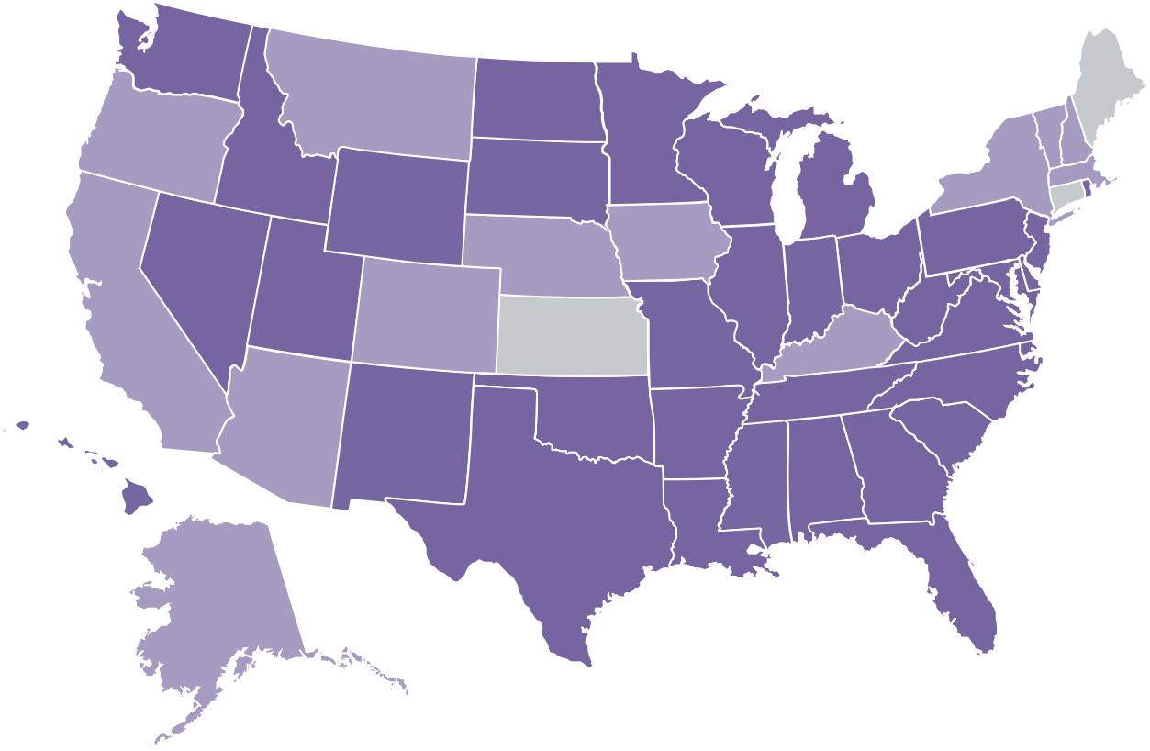
CS can count for graduation in
47 states + DC
In 47 states plus DC, computer science can count towards high school graduation math or science requirements - up from 12 states in 2013.
Computer science counts statewide
Computer science can count (school decides)
Computer science is an elective
Notes:
And in the past four years, we’ve changed policies to allow computer science to count for graduation in 25 states, bringing the total number of states that allow CS to count to 35 plus DC.

Slide 26
And, in schools that teach CS, enrollment is through the roof…
Underrepresented minorities taking an AP CS exam
Female students taking an AP CS exam
2007
2018
2007
2018
Notes:
And in schools that offer computer science, enrollment is through the roof.
AP Computer Science A is the fastest growing course of the decade.
And both female and underrepresented minority participation has been increasing

Slide 27
But fundamentally, this is the picture we need to solve
Source: Access Report
Notes:
Education today has numerous controversial topics
But computer science isn’t one of them
At a time that we are fighting about what should or shouldn’t be taught in our schools, 90% of parents are asking for computer science in their schools
We have momentum
We have grassroots support
What we need now is schools to put two things into place:
First, high-quality, rigorous curriculum and courses
Second, we need to prepare teachers to teach our students
We need states to launch initiatives build on these two goals and focused on improving access to CS education

