Slide 1
Capstone Project-1
Project: Global Terrorism Analysis By-Sanchit Misra

Slide 2

Mission Statement
Information provided by GTA:- The Global Terrorism Database (GTD) is an open-source database including information on terrorist attacks around the world from 1970 through 2017. The GTD includes systematic data on domestic as well as international terrorist incidents that have occurred during this time period and now includes more than 180,000 attacks. The database is maintained by researchers at the National Consortium for the Study of Terrorism and Responses to Terrorism (START), headquartered at the University of Maryland.
The objective of this project is to explore and analyze the data to discover key findings pertaining to terrorist activities all over the world. In this dataset, we have done experiment to find the most affected countries, the most notorious groups & their motives. In order to achieve this, we categorized the complete analysis into four parts as follows:

Slide 3
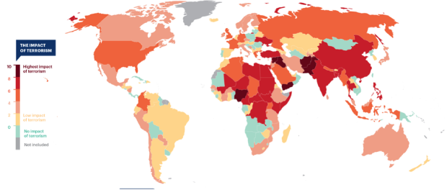
Let's see how terrorism afflicted the world:
Defining problem statement
Preparing dataset for EDA
Feature engineering & feature selection
Applying Exploratory data analysis technique.
The GTD defines terrorism as:
“The threatened or actual use of illegal force and violence by a non-state actor to attain a political, economic, religious, or social goal through fear, coercion, or intimidation.”

Slide 4
Data Pipeline
Data processing-1: In this part, we have removed unnecessary features. Since there were nearly many columns with all null values.
Data processing-2: In this part, we manually went through each features that are selected from part-1, And encoded the numerical as well as categorical features accordingly.
Exploratory data analysis: Next, we have done some EDA on the features selected in part-1 and 2 to see the trend.
Conclusion: Finally, we have expressed insights derived from our exploratory data analysis.

Slide 5
Data Summary
Country
Province
DATASET
location
Year
Region
Month
City
Day
Success
Numerical
Categorical
Nationality
Killed
Wounded
AttackType
Casualties
Target
Group
Target_type
Weapon_type

Slide 6
Data Summary
Casualties: During renaming the column names (to have a cleaner vision), I just don't specify them as a column. Also, I create a new column called Casualties which is made out of the summation of 'Killed' and 'Wounded’.
Success: The success of the attack makes it possible to determine the brutality, harshness and the deadliest terrorist group in the world.
AttackType: This brings us to face the cruelty of the attacks and the massive destruction that have been perpetrated all over the world. The characteristic of losses is highly influenced by the type of attack.

Slide 7
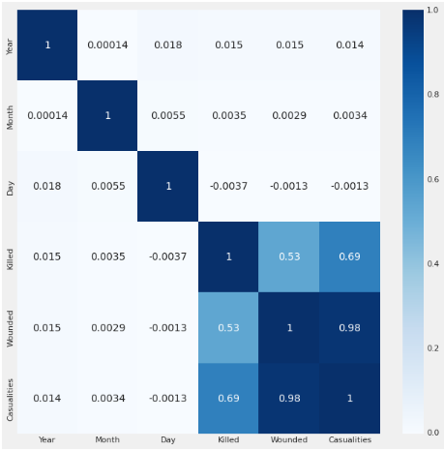
Exploratory Data Analysis
Correlated all the features of dataset to proceed further.

Slide 8
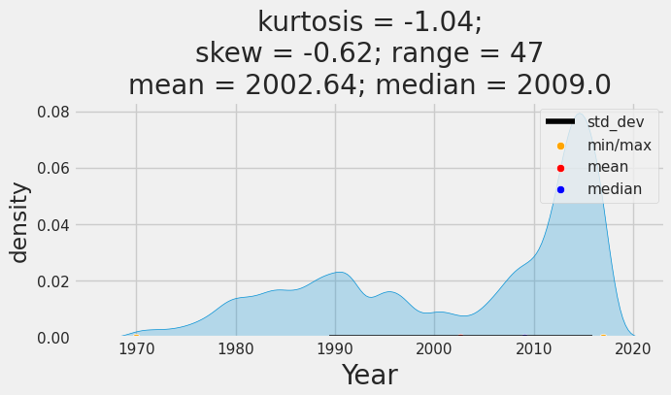
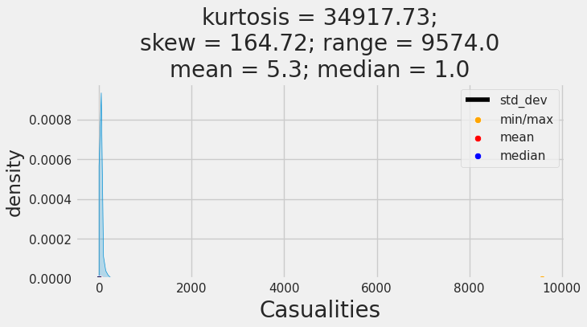
Exploratory Data Analysis
Executed univariate analysis on features.

Slide 9
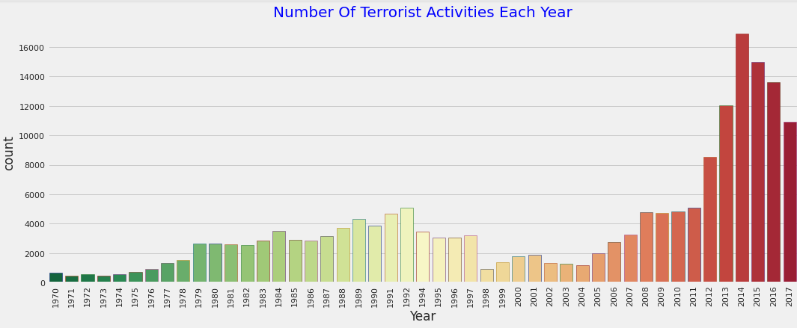
Exploratory Data Analysis

Slide 10
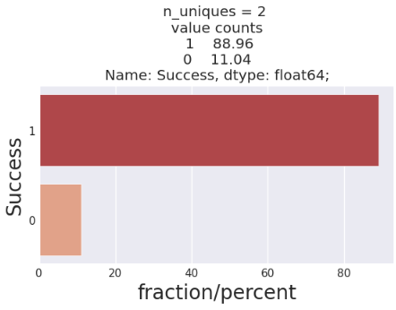
Exploratory Data Analysis

Slide 11
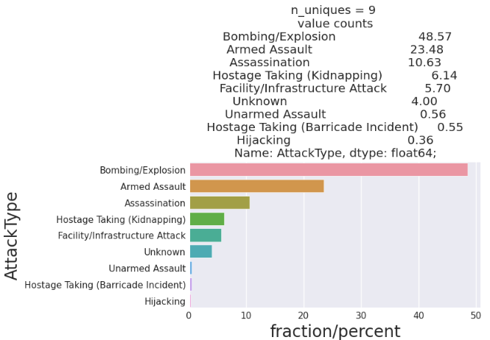
Exploratory Data Analysis

Slide 12
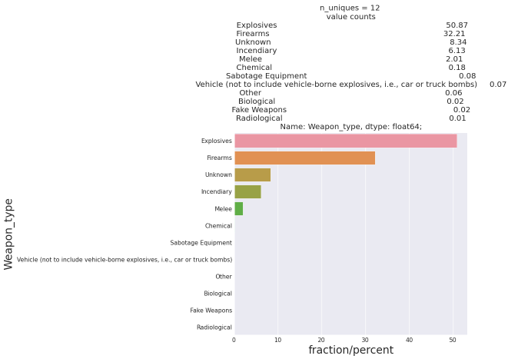
Exploratory Data Analysis
Sub-category as Weapon_type.

Slide 13
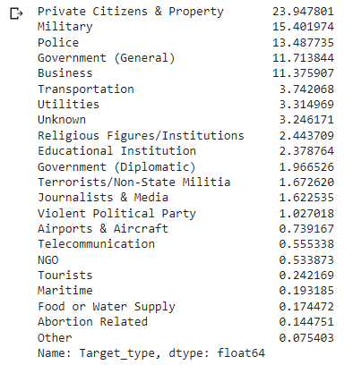
Exploratory Data Analysis
Let us see some of categorical features in normalize form.

Slide 14
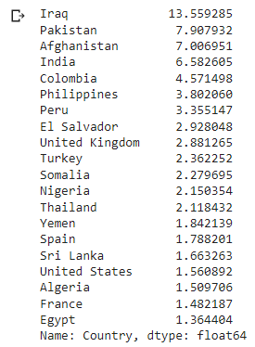
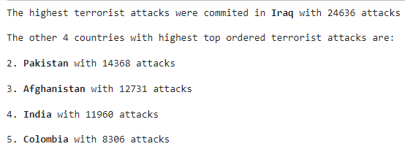
Exploratory Data Analysis
Here we can see some insights in values.

Slide 15
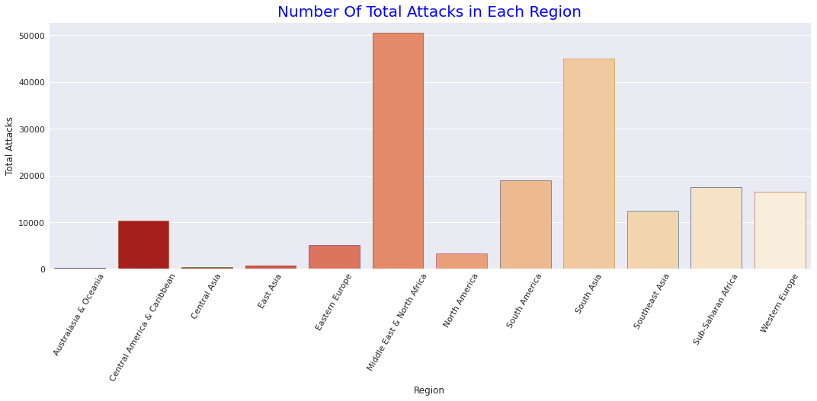
Exploratory Data Analysis

Slide 16
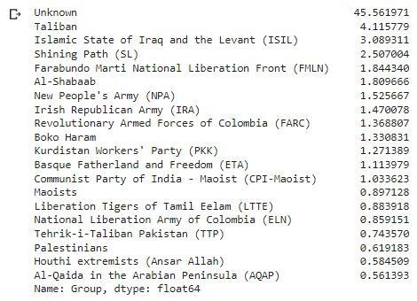
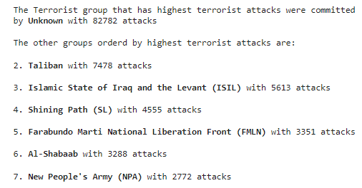
Exploratory Data Analysis
Perceived stats from groups.

Slide 17
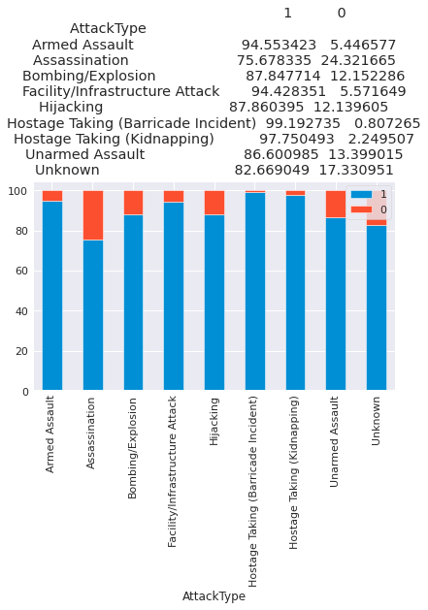
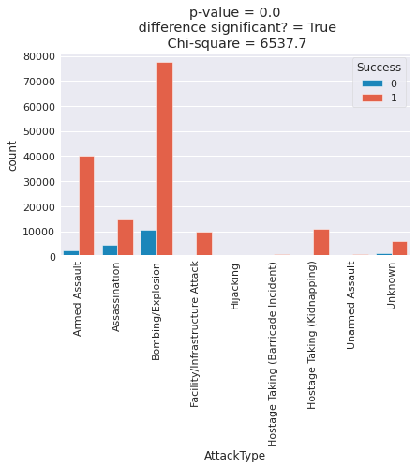
Exploratory Data Analysis
Executed bivariate analysis.

Slide 18
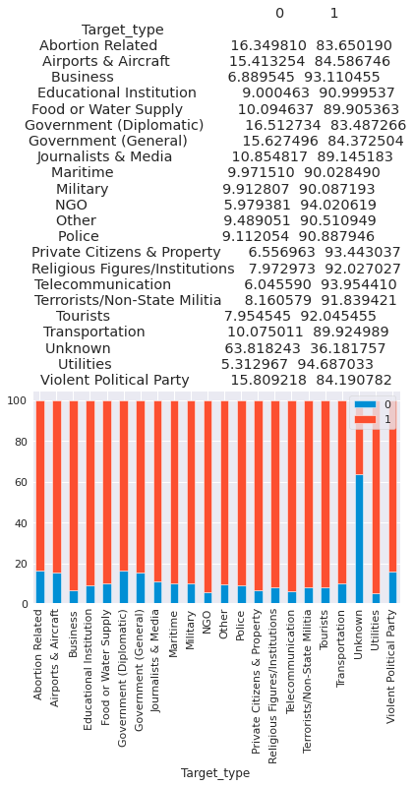
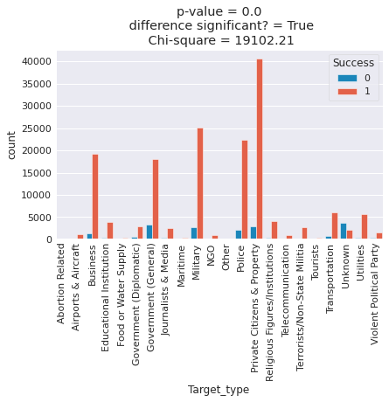
Exploratory Data Analysis

Slide 19
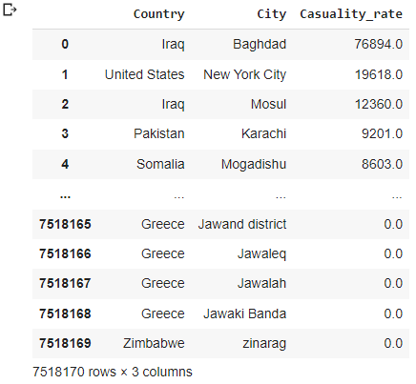
Exploratory Data Analysis
Finally, examine the multivariate analysis on some features.

Slide 20
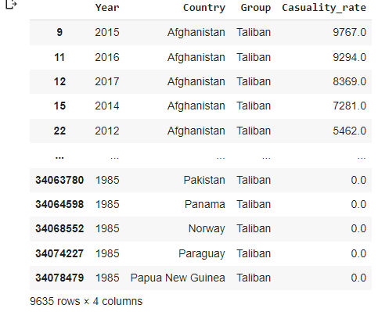
Exploratory Data Analysis
Analysis done on casualties by a specific group at a particular area in certain year.

Slide 21
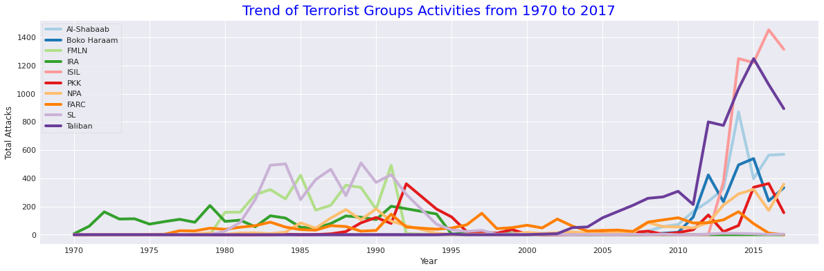
Exploratory Data Analysis

Slide 22
Conclusion:
Terrorist operations have increased since 2005.
The number of casualties goes higher as attacks increased.
As we have seen, weapons are used in 50% of bombings and explosions, resulting in higher fatalities.
The security arrangements should be improvised for the Private Citizens & Property as 24% of attacks were seen on them.
Middle East region, specifically Iraq should be a major concern for the terrorism activities.
One can conclude that the Taliban predominated after year – 2000. But from 1970 to 1990 a Peru based terrorist organization called Shining Path(SL) and Irish Republican Army (IRA) was highly dominating among them.

Slide 23
Challenges
Refining the dataset and also many of features doesn’t suit’s my purpose in this analysis.
Selecting the dependent and independent features, so it could help us to deep dive using a more efficient method.
Combining multiple features to visualize and get the optimum insights from the data.

Slide 24
Thanks….!

