Slide 1

Mechanisms of Action(MoA) Prediction using Machine Learning
Purvi Jain
Sanchit Vijay

Slide 2

Introduction
Drug discovery has come a long way since its inception. In the past, scientists developed drugs from natural sources or traditional remedies without a clear understanding of their biological mechanisms.
Predicting mechanisms of action (MoA) is crucial in drug discovery
Understanding how compounds interact with biological targets provides insights into potential therapeutic effects and side effects
Accurate MoA predictions facilitate the selection of promising drug candidates
Reduces time and costs associated with drug development
Knowledge of a compound's MoA aids in identifying new therapeutic applications for existing drugs (drug repurposing)

Slide 3

Project Overview
Objective: Develop a machine learning model to predict mechanisms of action (MoA) for compounds based on gene expression and cell viability profiles
Dataset: LISH-MoA competition on Kaggle
Machine Learning Algorithms: Logistic Regression, SVM, Random Forest
Evaluation Metric: Log Loss

Slide 4
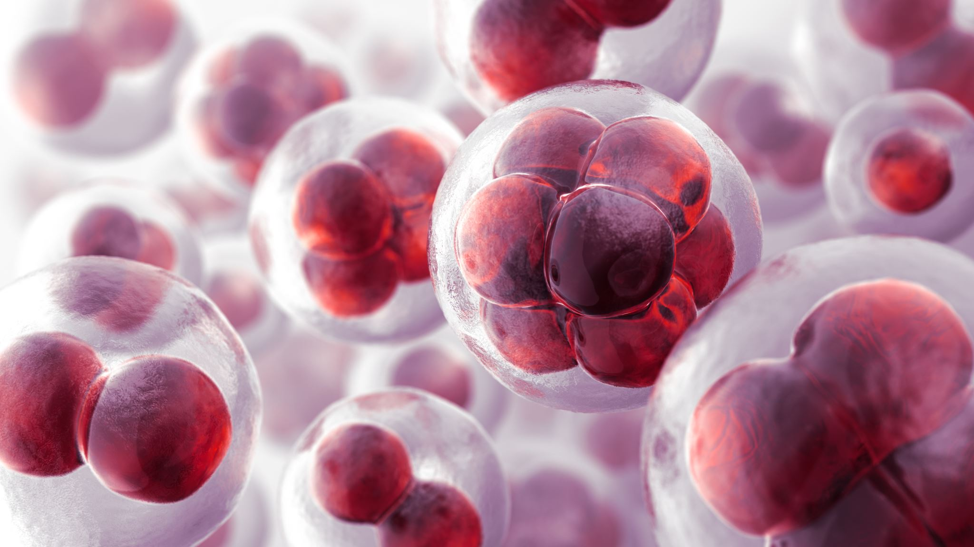
Dataset
Source: LISH-MoA competition on Kaggle
23,000+ compounds with gene expression and cell viability data
Binary MoA annotations
Features: gene expression (g-0 to g-771) and cell viability (c-0 to c-99)

Slide 5

Data Exploration and Visualization

Slide 6
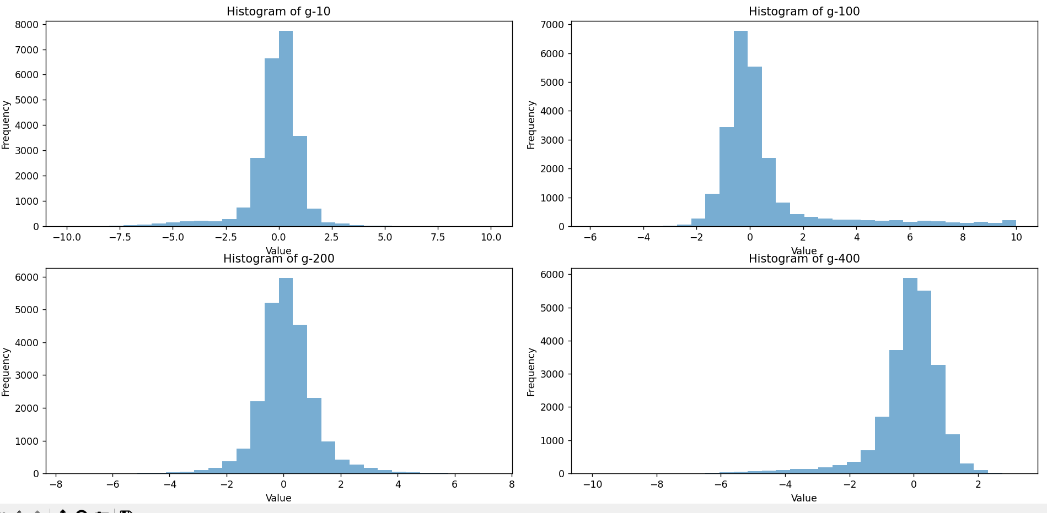
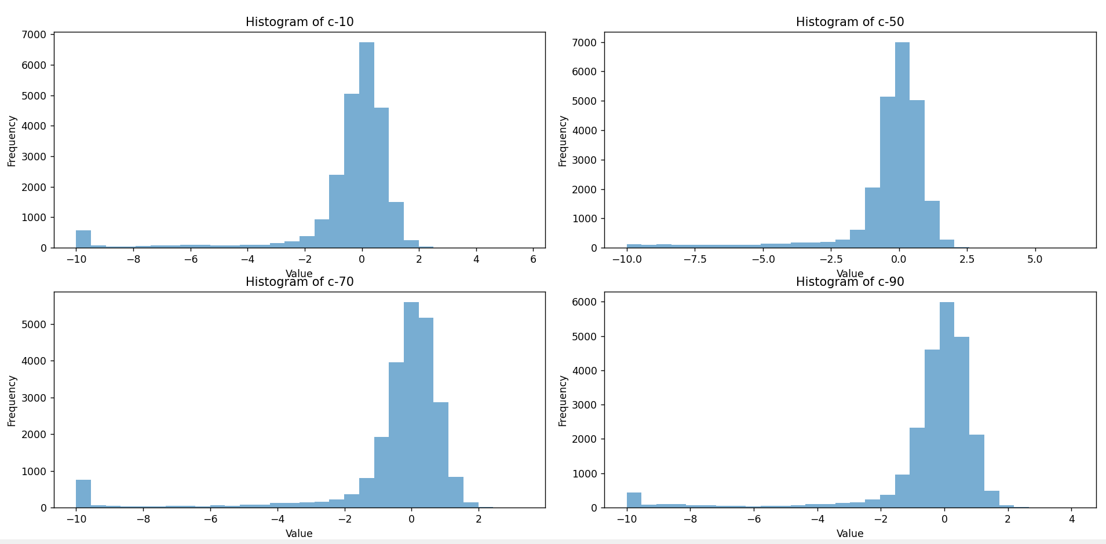
Histograms for gene expression and cell viability features

Slide 7
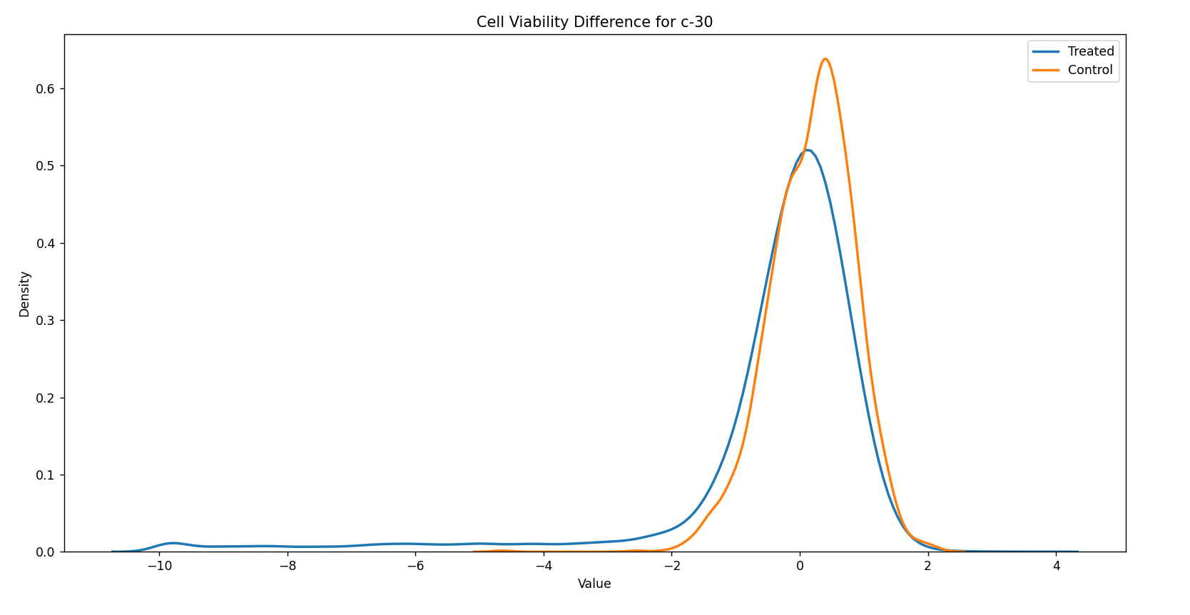
Mean cell viability comparison between treated and control samples

Slide 8
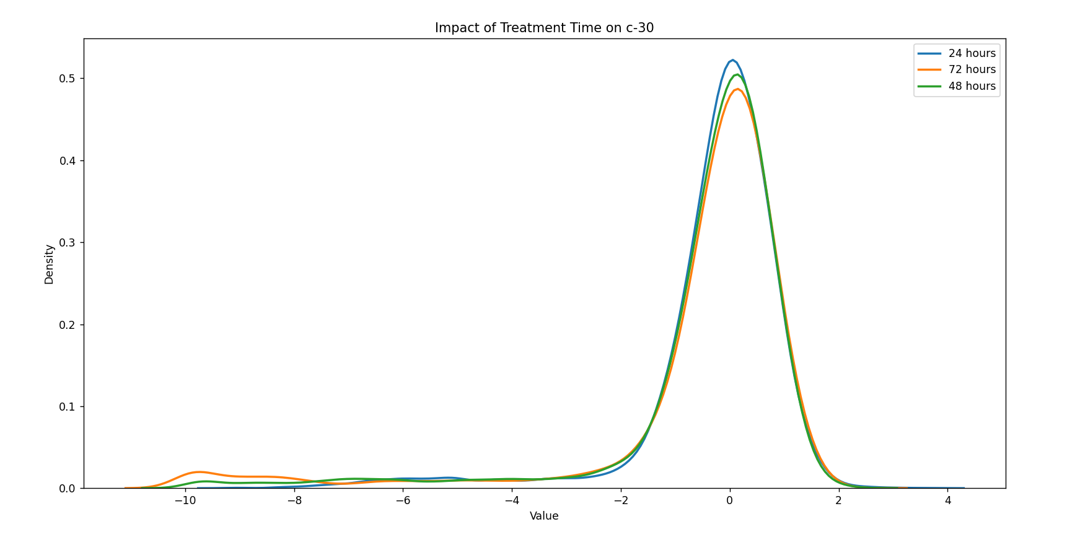
Impact of treatment time on cell viability

Slide 9
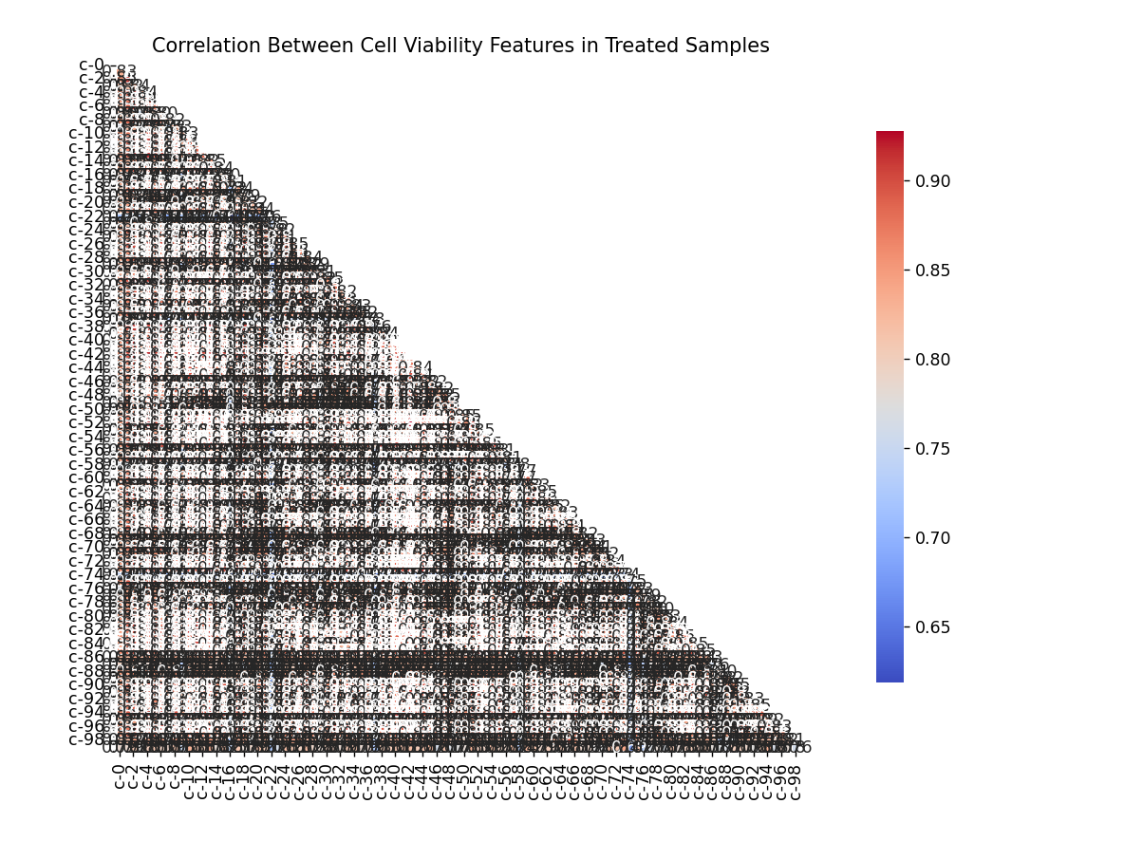
Correlation matrices for gene expression and cell viability features

Slide 10

Data pre-processing
Merging the data from different sources
Separating categorical columns (e.g., treatment time) and numerical columns (e.g., gene expression and cell viability features)
Standardizing the numerical data to ensure equal contribution of all features
Dimensionality reduction using PCA to reduce noise and complexity
Merging preprocessed data back into a single dataset
Splitting the data into training and validation sets to evaluate model performance

Slide 11

Machine Learning Algorithms
Logistic Regression: A simple yet powerful linear classifier for binary MoA prediction
Support Vector Machine (SVM): Effective in high-dimensional feature spaces, suitable for gene expression and cell viability data
Random Forest: An ensemble method that constructs multiple decision trees and combines their predictions for robust results
Deep Learning (Neural Networks): Capable of modeling complex patterns in high-dimensional data, ideal for large datasets with numerous features

Slide 12
Experimental Setup
Data Splitting:
Train-Validation split: 80-20 ratio
Stratified splitting based on the target variable distribution
Feature Scaling:
Standardization of numerical features using Z-score normalization
Dimensionality Reduction:
PCA with n components=50
Performance Evaluation:
Log loss metric for multi-label classification
Code Organization:
Modular code structure with separate modules for data pre-processing, model training, and evaluation.

