Slide 1
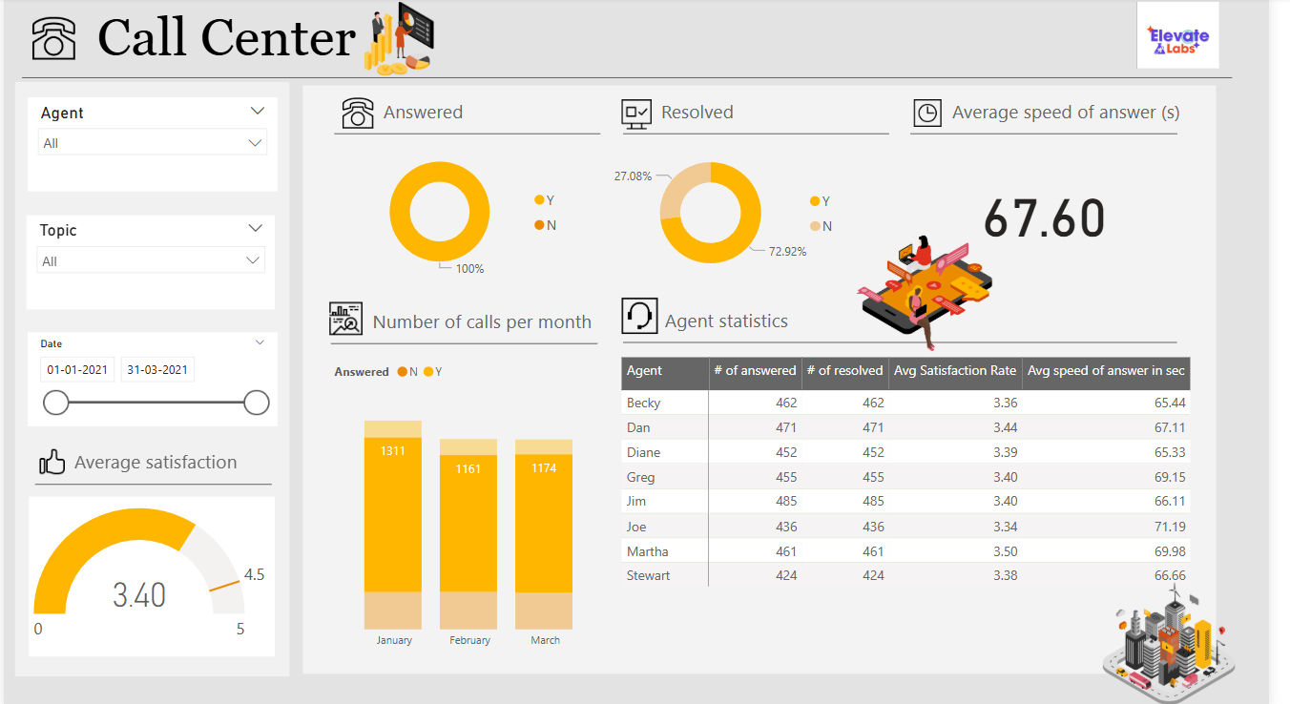
Call Center Performance Summary

Slide 2

Key Performance Indicators (KPIs)
• Answered Calls: 100%
• Resolved Calls: 72.92%
• Average Speed of Answer: 67.60 seconds
• Average Satisfaction Score: 3.40 / 5

Slide 3

Monthly Call Trends
• January: 1,311 calls – Highest call volume
• February: 1,161 calls – Decrease by 11.4%
• March: 1,174 calls – Slight recovery from February

Slide 4

Agent Performance Summary
• Top Performer (Satisfaction): Martha – 3.50 / 5
• Fastest Agent: Jim – Avg Speed 64.60 seconds
• Consistent Performance: Greg, Dan, Becky around 3.4 score
• Lowest Speed: Joe – Avg Speed 69.98 seconds

Slide 5
Agent Detailed Stats
Agent | Calls Answered | Calls Resolved | Avg Satisfaction | Avg Speed of Answer (s)
Becky | 462 | 462 | 3.36 | 65.44
Dan | 471 | 471 | 3.44 | 67.11
Diane | 452 | 452 | 3.39 | 65.33
Greg | 455 | 455 | 3.4 | 69.15
Jim | 485 | 485 | 3.36 | 64.6
Joe | 436 | 436 | 3.34 | 69.98
Martha | 461 | 461 | 3.5 | 66.06
Stewart | 424 | 424 | 3.38 | 66.6
- PPT by Sanchita shejwal

