Slide 1
Computation and Visualization
Project 3
Analysis OF YOUTUBE PLATFORM STATISTICS
Members:
Harsh KHOT
SHUBHI SINHA
SANCIA SALDHANA
CHARAN KUMAR DOLAMPATTI

Slide 2
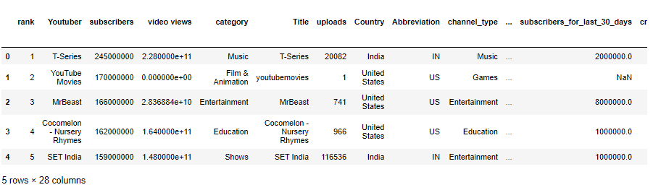
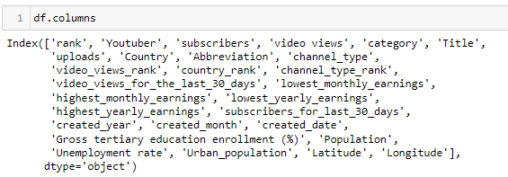
Dataset

Slide 3
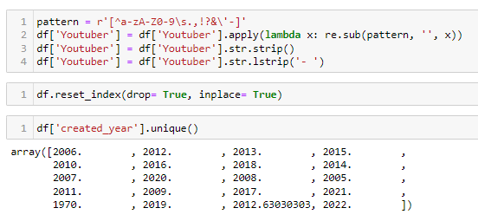
Data pre-processing

Slide 4
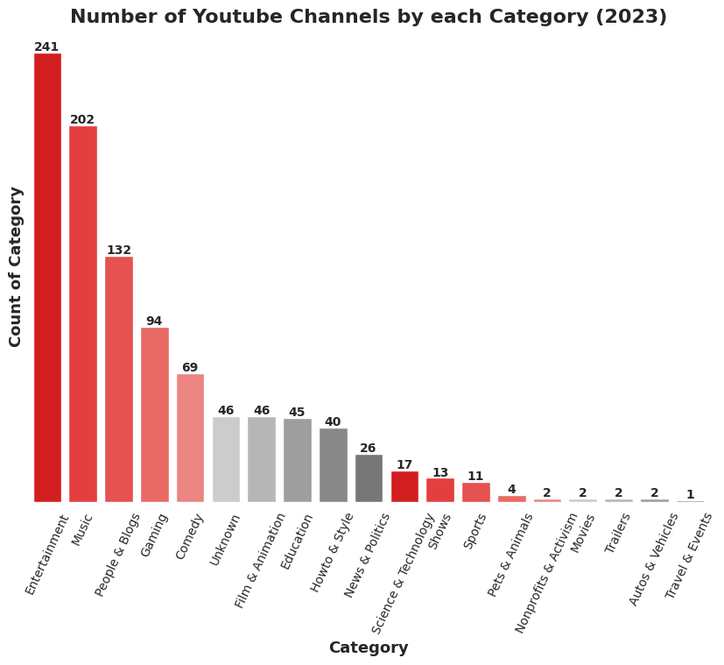
Data Visualisation

Slide 5
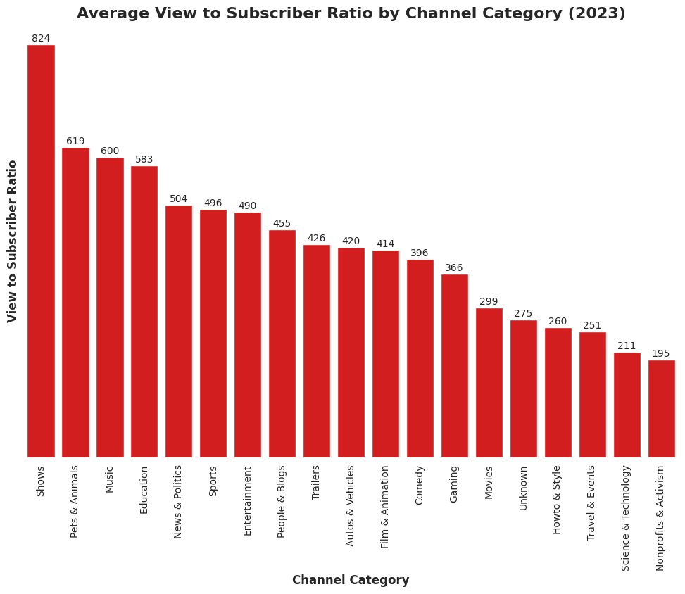
Data Visualisation

Slide 6
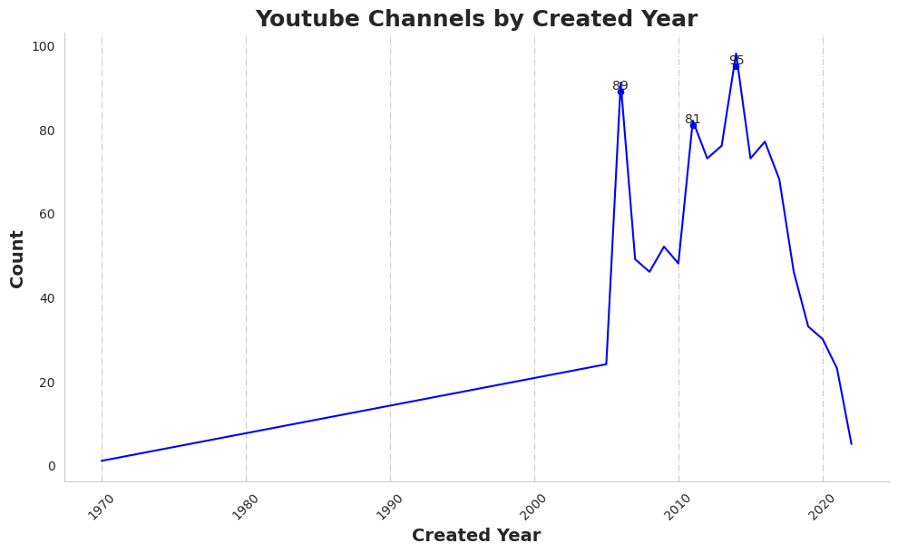
Data Visualisation

Slide 7
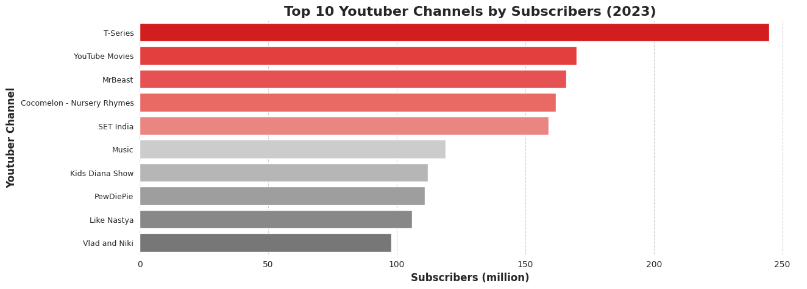
Data Visualisation

Slide 8
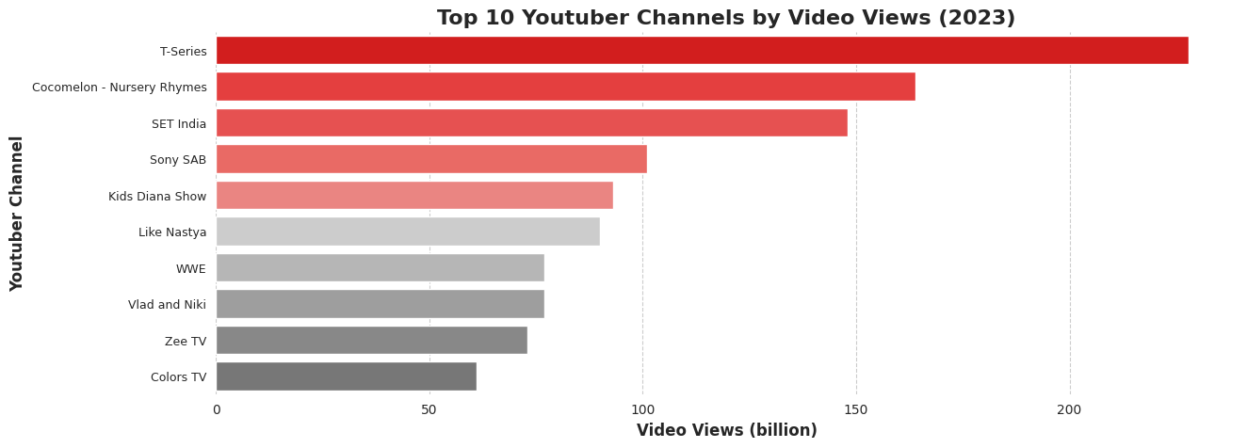
Data Visualisation

Slide 9
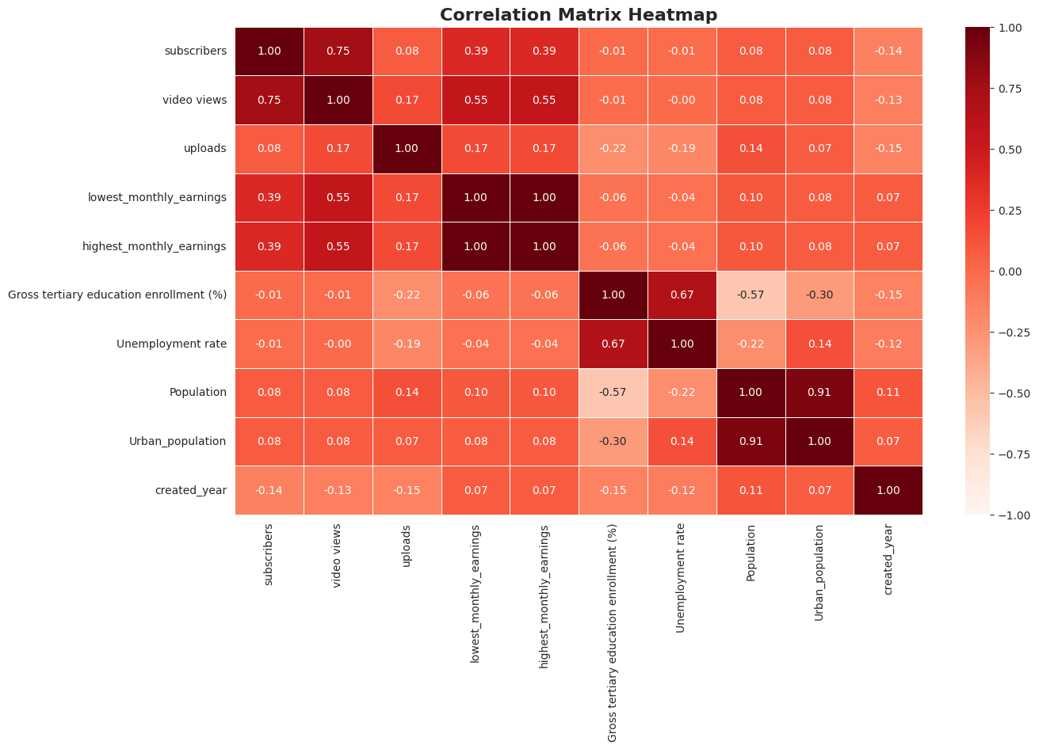
Data Visualisation

Slide 10
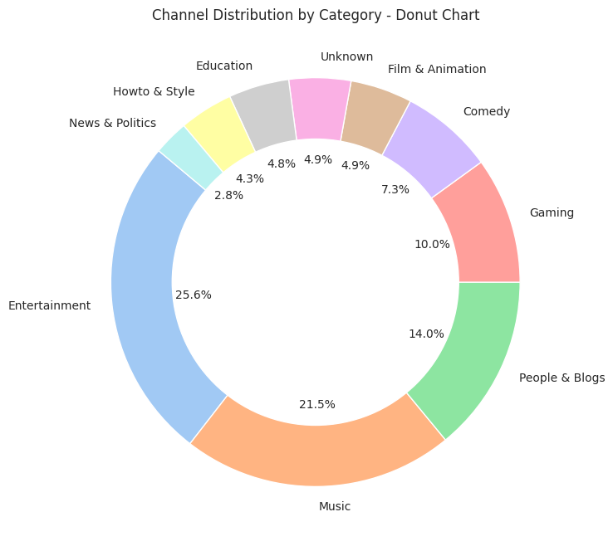
Data Visualisation

Slide 11
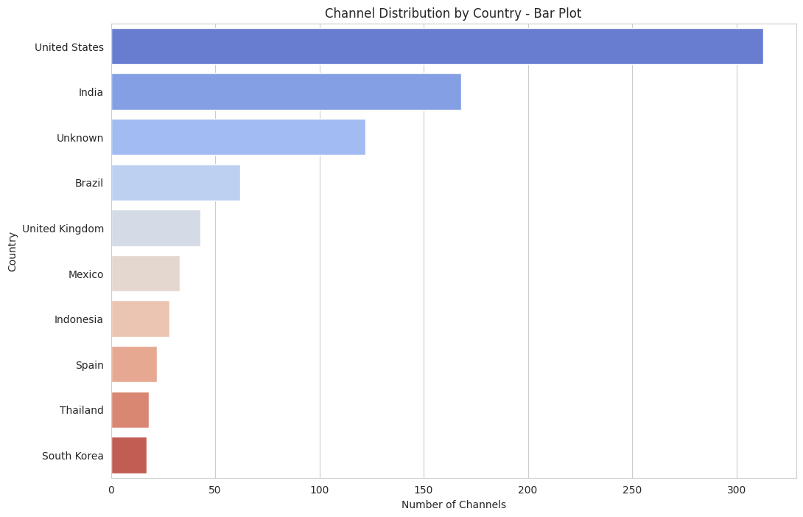
Data Visualisation

Slide 12
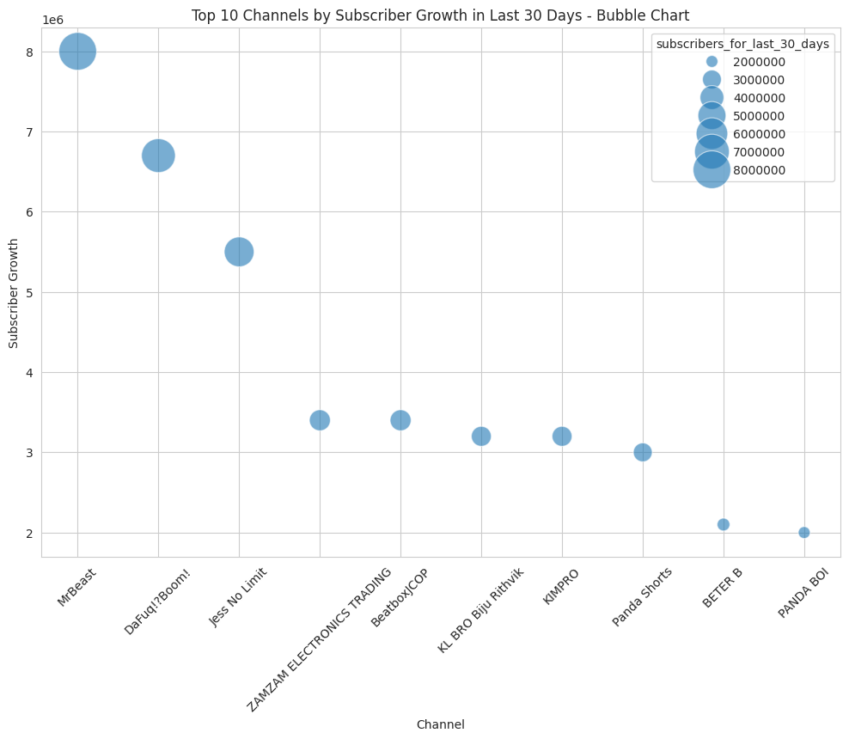
Data Visualisation

Slide 13
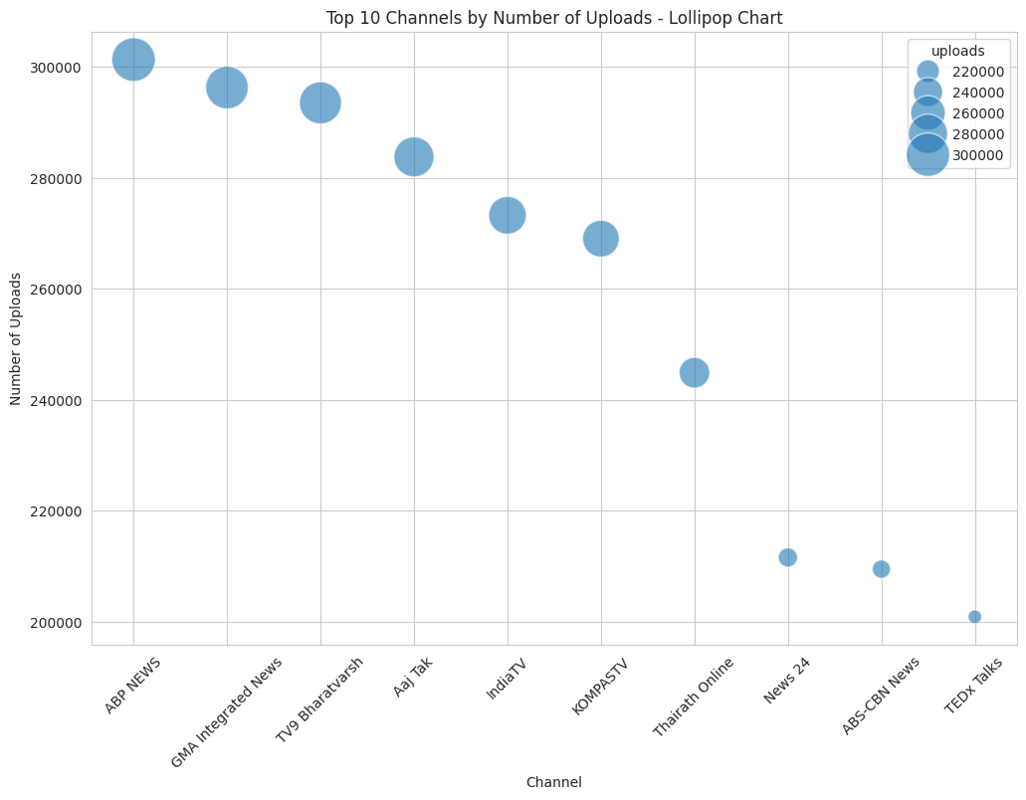
Data Visualisation

Slide 14
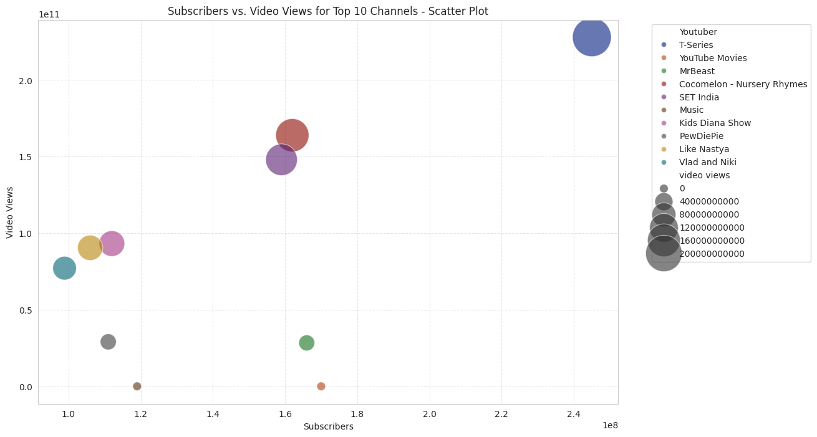
Data Visualisation

Slide 15
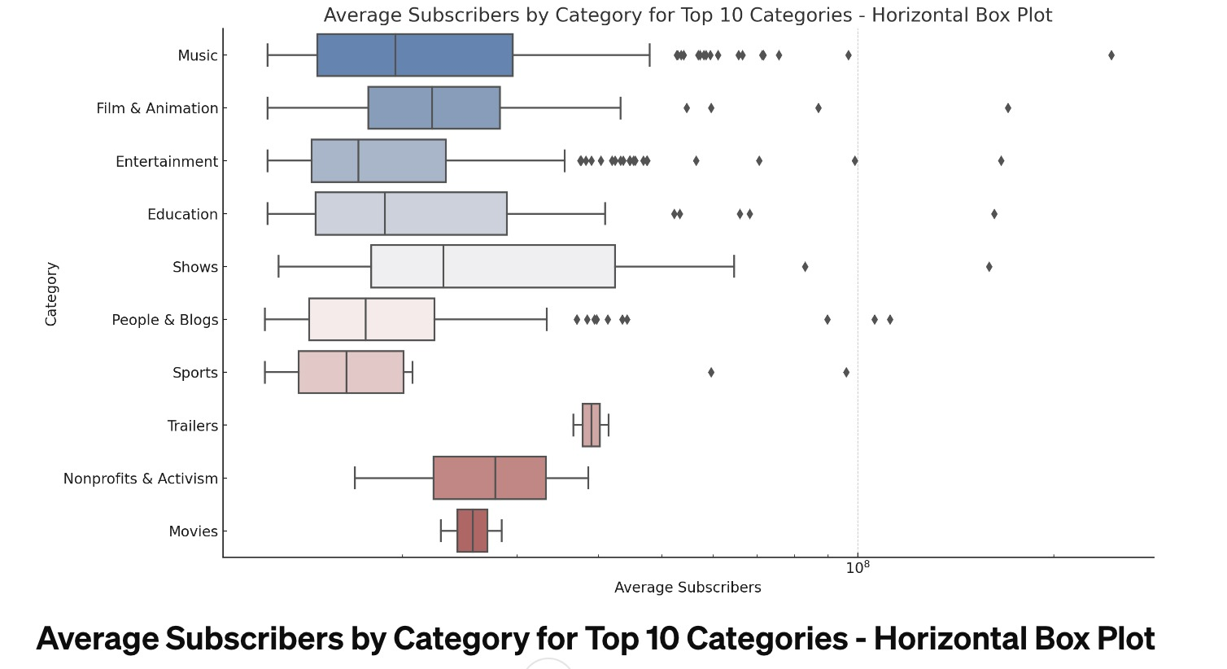
Data Visualisation

Slide 16
Insights
Entertainment and Music are leading categories across all metrics
A spike in channel growth observed from 2000 to 2010 as a result of monetisation policy in 2007
T-Series, YouTube music and Set India lead across all metrics
High correlation between uploads and subscribers
Majority channels fall under entertainment and music
United States and India lead the world in YouTube presence
Non-profits have high median subscribers but less outliers as opposed to entertainment and music

Slide 17
References
https://catalog.data.gov/dataset/social-media-channels-and-statistics-at-the-national-archives

