Slide 1
Lecture #11
HPC, HTC, CLUSTERS & GRIDS
ΚΑΤΑΝΕΜΗΜΕΝΑ ΣΥΣΤΗΜΑΤΑ

Slide 2
Distributed & Internet Computing
Δισεκατομμύρια άνθρωποι χρησιμοποιούν καθημερινά το Internet. Ως αποτέλεσμα, οι υπερυπολογιστές και τα μεγάλα data centers πίσω από αυτό καλούνται να παρέχουν υψηλής απόδοσης υπολογιστικές υπηρεσίες σε τεράστιο αριθμό χρηστών ταυτόχρονα.
Δεδομένης (και διαρκώς αυξανόμενης) της απαίτησης αυτής τα στενά (τυπικά) κριτήρια υψηλής απόδοσης (παράλληλου) υπολογισμού (high-performance computing – HPC) δεν αρκούν πλέον ως μέτρα καθορισμού απαιτήσεων για τα αντίστοιχα συστήματα εξυπηρέτησης.
H εμφάνιση και διαρκής εξάπλωση των υπολογιστικών νεφών απαιτεί όλο και περισσότερο high-throughput computing (HTC) (υψηλής διεκπεραιωσιμότητας) συστήματα, στη βάση συνδυασμού παράλληλων και κατανεμημένων υπολογιστικών τεχνολογιών.
Τα data centers πρέπει να αναβαθμίζονται συνεχώς με ολοένα και πιο πολλούς και γρήγορους εξυπηρετητές, συστήματα αποθήκευσης, και υψηλού εύρους ζώνης και ταχύτητας μετάδοσης δίκτυα. Απαραίτητη επίσης είναι η συνεχής εξέλιξη και ολοκλήρωση των δικτυακών υπηρεσιών και των υπηρεσιών διαδικτύου (network and web services) στο πλαίσιο των παραπάνω νέων τεχνολογιών.

Slide 3
Distributed & Internet Computing
High Throughput Computing (HTC) - Υπολογισμός Υψηλής Διεκπεραιωσιμότητας: υποδηλώνει τη χρήση πολλαπλών πόρων για μεγάλα χρονικά διαστήματα προκειμένου να διεκπεραιωθεί αποδοτικά μεγάλος αριθμός εργασιών (jobs) χρησιμοποιώντας η κάθε μία ένα μέρος αυτών (είτε ακολουθιακά είτε παράλληλα).
High Performance Computing (HPC) – Υπολογισμός Υψηλής Απόδοσης: υποδηλώνει τη χρήση πολλαπλών πόρων για μικρά χρονικά διαστήματα προκειμένου να διεκπεραιωθούν αποδοτικά μεμονωμένες εργασίες (jobs), κατάλληλα διαχωρισμένες σε tasks, χρησιμοποιώντας παράλληλα τους πόρους αυτούς.
Στα HPC περιβάλλοντα μας ενδιαφέρει κυρίως πόσο γρήγορα μπορεί να ολοκληρωθεί μια μεμονωμένη εργασία, ενώ στα HTC περιβάλλοντα μας ενδιαφέρει πόσες εργασίες μπορούν να διεκπεραιωθούν μέσα σε μια δεδομένη (μεγάλη) χρονική περίοδο.
Το HTC εστιάζει στην αποδοτική εκτέλεση μεγάλου αριθμού χαλαρά συνδεδεμένων έργων/εργασιών, ενώ το HPC εστιάζει στην αποδοτική εκτέλεση στενά συνδεδεμένων παράλληλων έργων/εργασιών (και για το λόγο αυτό χρειάζονται και δικτυακές διασυνδέσεις υψηλού εύρους/ρυθμού μετάδοσης).

Slide 4
Distributed & Internet Computing
The general computing trend is to leverage shared web resources and massive amounts of data over the Internet.
On the HPC side, supercomputers (MPPs) are gradually replaced by clusters of cooperative computers out of a desire to share computing resources. The cluster is often a collection of homogeneous compute nodes that are physically connected in close range to one another.
On the HTC side, peer-to-peer (P2P) networks are formed for distributed file sharing and content delivery applications. A P2P system is built over many client machines. Peer machines are globally distributed in nature.
P2P, cloud computing, and web service platforms are more focused on HTC applications than on HPC applications.
Clustering and P2P technologies lead to the development of computational grids or data grids.

Slide 5
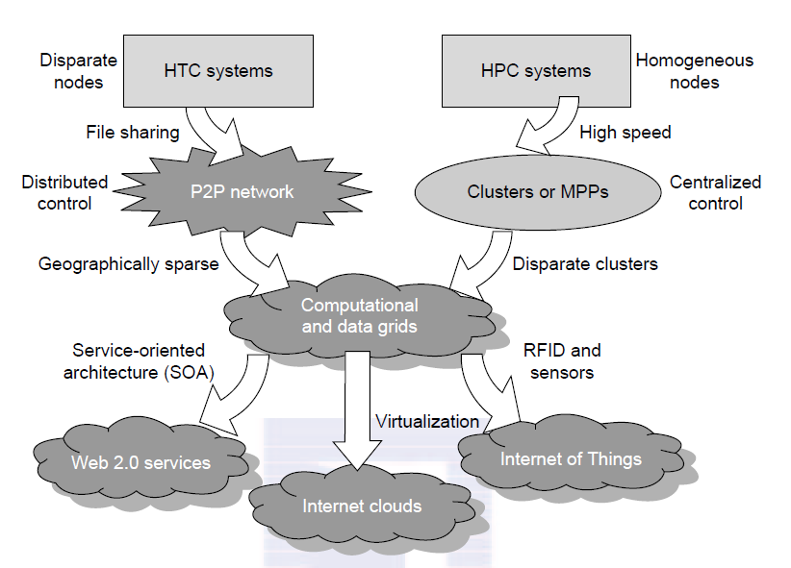
Distributed & Internet Computing

Slide 6
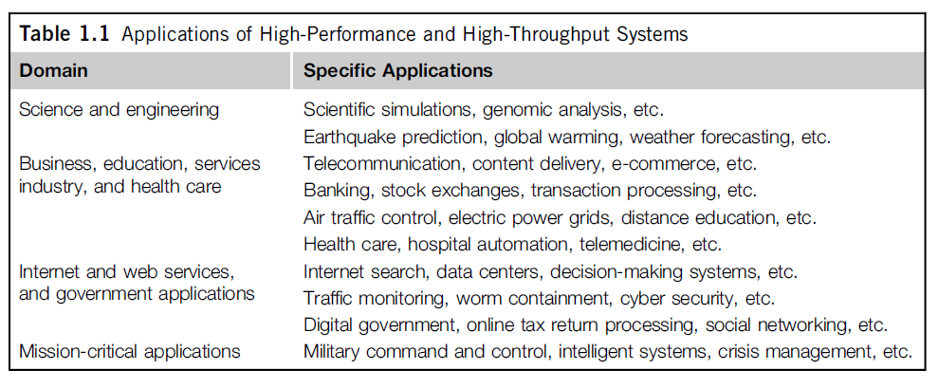
HPC and HTC Applications

Slide 7
New Computing Paradigms
With the introduction of SOA, Web 2.0 services become available.
Advances in virtualization make it possible to see the growth of Internet clouds as a new computing paradigm.
The maturity of
  Radio-frequency identification (RFID),
  Global Positioning System (GPS), and
  Sensor technologies
has triggered the development of the Internet of Things (IoT).

Slide 8
Computing moves…
When the Internet was introduced in 1969, Leonard Klienrock of UCLA declared: “As of now, computer networks are still in their infancy, but as they grow up and become sophisticated, we will probably see the spread of computer utilities, which like present electric and telephone utilities, will service individual homes and offices across the country.”
Many people have redefined the term “computer” since that time. In 1984, John Gage of Sun Microsystems created the slogan, “The network is the computer.”
In 2008, David Patterson of UC Berkeley said, “The data center is the computer. There are dramatic differences between developing software for millions to use as a service versus distributing software to run on their PCs.”
In 2011, Rajkumar Buyya of Melbourne University simply said: “The cloud is the computer.”

Slide 9
Kinds of computing…
Centralized computing
Parallel computing
Distributed computing
Grid computing
Cloud computing
…distinctions…?

Slide 10
Kinds of computing…(cont.)
Utility computing
Service computing
Ubiquitous computing (refers to computing with pervasive devices at any place and time using wired or wireless communication)
The Internet of Things (IoT) is a networked connection of everyday objects including computers, sensors, humans, etc.
The IoT is supported by Internet clouds to achieve ubiquitous computing with any object at any place and time.
Moreover, the term Internet Computing is even broader and covers all computing paradigms over the Internet.

Slide 11
Enabling Technologies
Processors:
Speed (MIPS) doubling every 18 months
Clock frequency limitations (~5GHtz)
Instruction Level Parallelism, superscalar architectures, simultaneous multithreading, hyperthreading
Multicore CPUs (2-32 cores) and co-processors
Manycore GPUs (thousands… of cores)
Thread Level Parallelism (TLP)

Slide 12
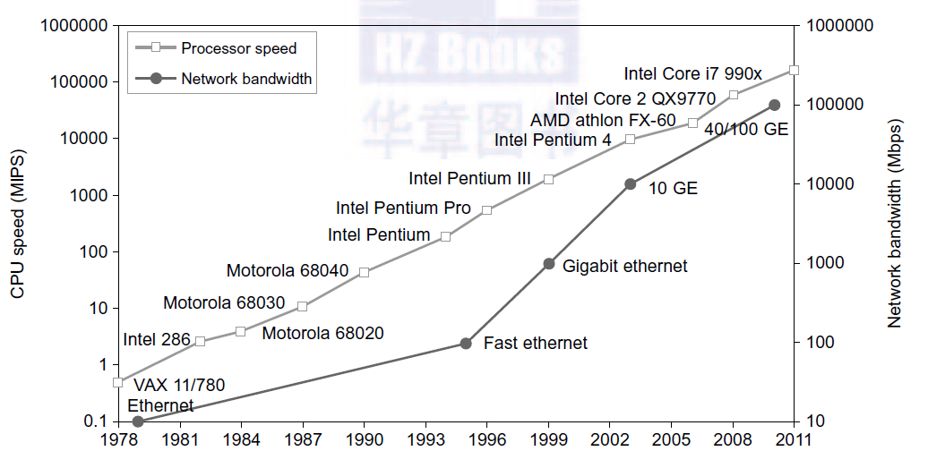
Processors & Networks the last 30 years

Slide 13
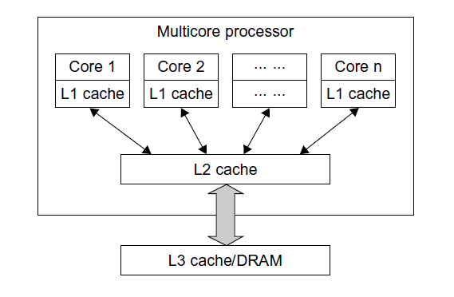
Multi-core CPUs
Schematic of a modern multi-core CPU chip using a hierarchy of caches, where L1 cache is private to each core, on-chip L2 cache is shared and L3 cache or DRAM Is off the chip.

Slide 14
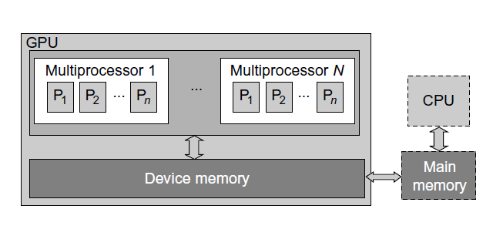
Many-core GPUs
The use of a GPU along with a CPU for massively parallel execution in hundreds or thousands of processing cores.

Slide 15
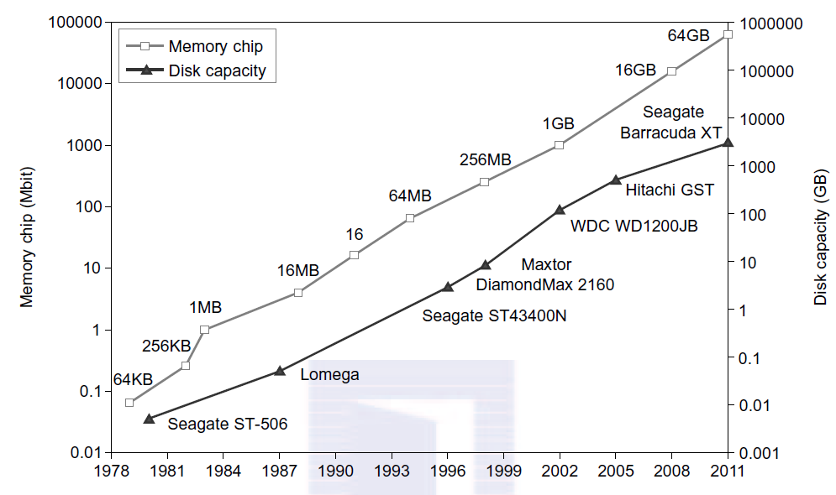
Memory & Storage the last 30 years

Slide 16
Memory, Storage, and Networking
Memory Technology ~4x increase every 3 years (> 1TB)
Storage Technology ~10x increase every 8 years (> 10TB)
Ethernet bandwidth: ~2x increase every 2 years (40/100 Gbps in 2011, 200 & 400 Gbps in 2015+, 800 and 1600 in 2020+)
System-Area Interconnects (LAN, SAN, NAS)
A LAN typically is used to connect client hosts to big servers.
A storage area network (SAN) connects servers to network storage such as disk arrays.
Network attached storage (NAS) connects client hosts directly to the disk arrays.
All three types of networks often appear in a large cluster built with commercial network components. If no large distributed
storage is shared, a small cluster could be built with a multiport Gigabit Ethernet switch etc.

Slide 17
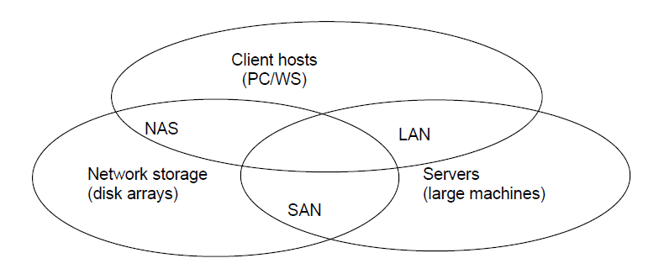
System Area Interconnects
Three interconnection networks for connecting servers, client hosts, and storage devices; the LAN connects
client hosts and servers, the SAN connects servers with disk arrays, and the NAS connects clients with large
storage systems in the network environment.

Slide 18
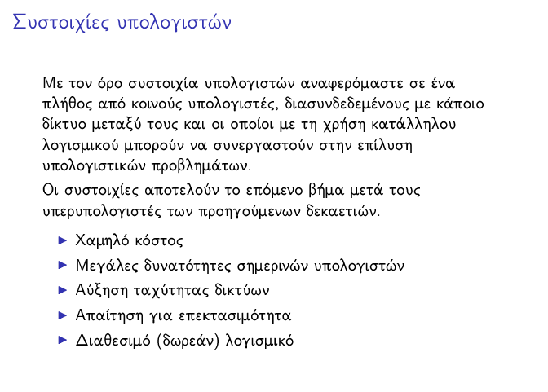
Cluster Computers = …

Slide 19
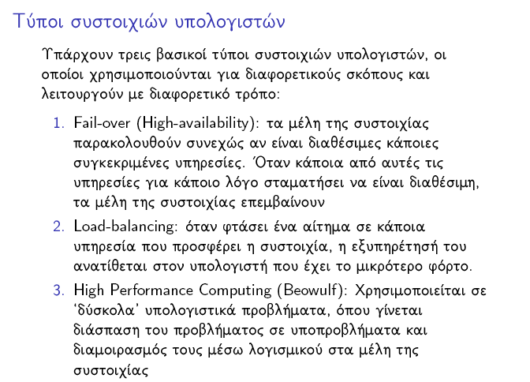

Slide 20
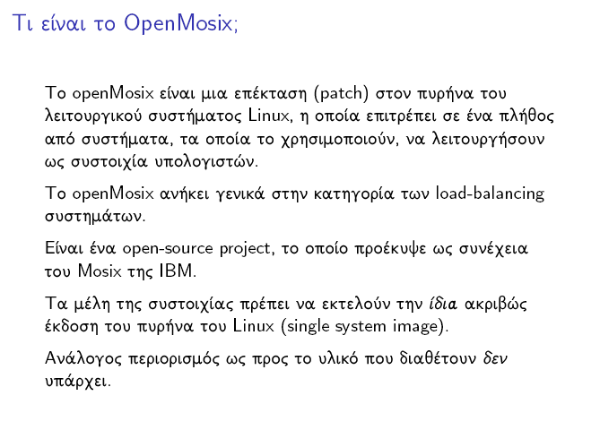

Slide 21
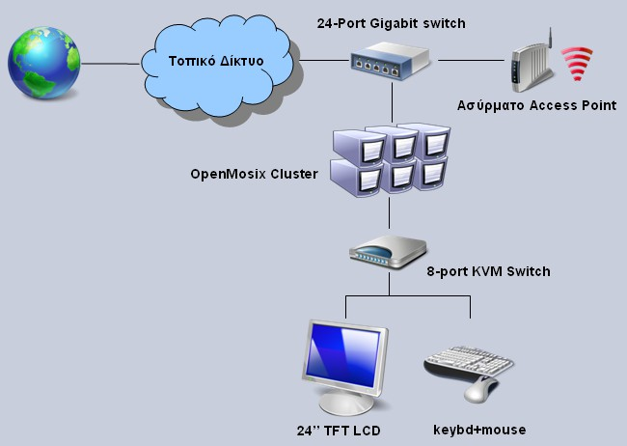
Cluster Computers
(ένα ‘μικρό’ παράδειγμα – 1^{ο} ΕΠΑΛ Αργυρούπολης)

Slide 22
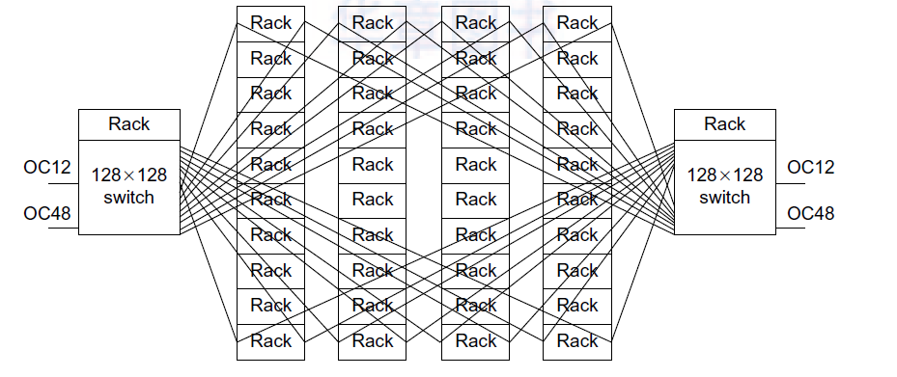
Και ένα μεγαλύτερο…(Google Cluster…)
(one of many…: 40 x 80 = 3200 nodes)

Slide 23
ΠΛΕΟΝΕΚΤΗΜΑΤΑ
Μείωση Κόστους: Η τιμή των προσωπικών υπολογιστών έχει μειωθεί σημαντικά τα τελευταία χρόνια, και η μείωση αυτή συνοδεύεται από εκρηκτική αύξηση των επιδόσεων και της υπολογιστικής ισχύος τους. Ένα σημερινό μεσαίων δυνατοτήτων επιτραπέζιο σύστημα είναι πολλές φορές ισχυρότερο από τους πρώτους μεγάλους υπολογιστές. Υπολογιστική Ισχύς: Η συνδυασμένη υπολογιστική ισχύς μιας συστοιχίας υψηλής απόδοσης μπορεί σε πολλές περιπτώσεις να αποδειχθεί αποτελεσματικότερη (σε σχέση με το κόστος) από αυτήν ενός μεγάλου υπολογιστή παρόμοιων δυνατοτήτων. Με τον τρόπο αυτό μια επιχείρηση αξιοποιεί καλύτερα τον εξοπλισμό της. Επεκτασιμότητα: Το σημαντικότερο πλεονέκτημα των συστοιχιών υπολογιστών είναι οι δυνατότητες επέκτασης που προσφέρουν. Ενώ οι μεγάλοι υπολογιστές έχουν συγκεκριμένη και σταθερή απόδοση, οι συστοιχίες μπορούν να επεκταθούν κατά βούληση με την απλή προσθήκη περισσότερων κόμβων στο δίκτυο. Διαθεσιμότητα: Όταν ένας μεγάλος υπολογιστής τίθεται εκτός λειτουργίας, καταρρέει όλο το σύστημα. Αν όμως χαλάσει ένας κόμβος μιας συστοιχίας, οι λειτουργίες που εκτελούσε θα μεταφερθούν σε κάποιον άλλο κόμβο, εξασφαλίζοντας την αδιάκοπη παροχή υπηρεσιών.

Slide 24
Cluster Computers
A computing cluster consists of interconnected stand-alone computers which work cooperatively as a single integrated computing resource.
Clustered computer systems have demonstrated impressive performance in handling heavy workloads with large data sets.
They are usually built around a low-latency, high-bandwidth interconnection network. This network can be as simple as a SAN or a LAN.
To build a larger cluster with more nodes, the interconnection network can be built with multiple levels of Gigabit Ethernet, Myrinet, or InfiniBand switches.

Slide 25
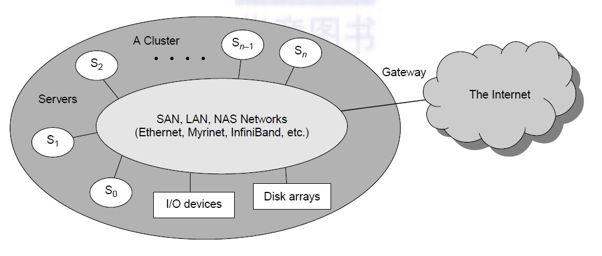
Cluster Architecture

Slide 26
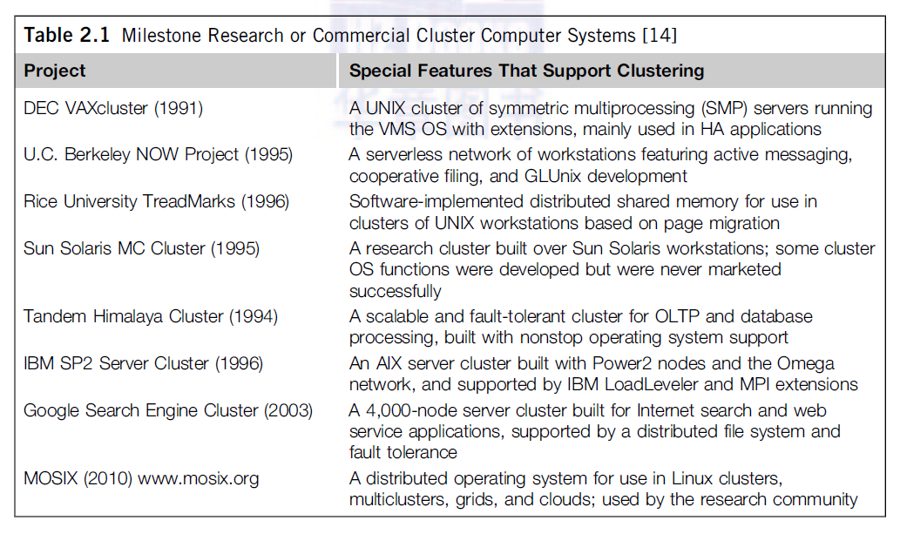
Milestone Cluster Systems

Slide 27
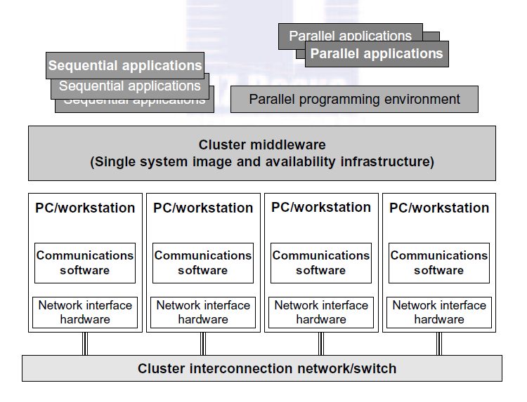
Basic Cluster Architecture

Slide 28
Cluster Systems Design Objectives
Scalability (modular)
Packaging (slack or compact)
Control (centralized or decentralized)
Homogeneity (homogeneous or heterogeneous)
Security (exposed or enclosed)
Dedicated vs. Enterprise clusters

Slide 29
Fundamental Cluster Design Issues
Clustering for Massive Parallelism
Scalable Performance
Single-System Image (SSI)
Availability Support
Cluster Job Management
Inter-node Communication
Fault Tolerance and Recovery

Slide 30
Cluster Family Classification
Compute clusters (HPC). These are clusters designed mainly for collective computation over a single large job.
  When communication needed --> mostly homogeneous and tightly coupled (Beowulf clusters).
  Heavy-duty nodes --> computational grids.
Tightly message-passing communication (eg MPI, PVM) interface used to port programs to a wide variety of clusters.
High-Availability clusters (HA). HA clusters are designed to be fault-tolerant and achieve HA of services. HA clusters operate with many redundant nodes to sustain faults or failures.
Load-balancing clusters. These clusters shoot for higher resource utilization through load balancing among all participating nodes in the cluster. Share the workload or function through Virtual Machines (VM).

Slide 31
Source: www.top500.org – Top List 2018
Rank | System | Cores | Rmax (TFlop/s) | Rpeak (TFlop/s) | Power (kW)
1 | Summit - IBM Power System AC922, IBM POWER9 22C 3.07GHz, NVIDIA Volta GV100, Dual-rail Mellanox EDR Infiniband, IBM DOE/SC/Oak Ridge National Laboratory United States (+fat-tree) | 2,282,544 | 122,300.0 | 187,659.3 | 8,806
2 | Sunway TaihuLight - Sunway MPP, Sunway SW26010 260C 1.45GHz, Sunway , NRCPC National Supercomputing Center in Wuxi China [hyper-tree] | 10,649,600 | 93,014.6 | 125,435.9 | 15,371
3 | Sierra - IBM Power System S922LC, IBM POWER9 22C 3.1GHz, NVIDIA Volta GV100, Dual-rail Mellanox EDR Infiniband, IBM DOE/NNSA/LLNL United States (+fat-tree) | 1,572,480 | 71,610.0 | 119,193.6
4 | Tianhe-2A - TH-IVB-FEP Cluster, Intel Xeon E5-2692v2 12C 2.2GHz, TH Express-2, Matrix-2000 , NUDT National Super Computer Center in Guangzhou China [fat-tree] | 4,981,760 | 61,444.5 | 100,678.7 | 18,482
5 | AI Bridging Cloud Infrastructure (ABCI) - PRIMERGY CX2550 M4, Xeon Gold 6148 20C 2.4GHz, NVIDIA Tesla V100 SXM2, Infiniband EDR , Fujitsu National Institute of Science and Technology, Japan (+fat-tree) | 391,680 | 19,880.0 | 32,576.6 | 1,649
http://www.top500.org

Slide 32
Top 500 Supercomputers
Petascale Systems:
Supercomputers with ≥ 1 petaFLOPS (peak) performance
PetaFLOPS = 10¹⁵ FLoating-point Operations Per Second
Tianhe-2 (MilkyWay-2)
16,000 computer nodes, each comprising two Intel Ivy Bridge Xeon processors and three Xeon Phi coprocessor chips, it represents the world's largest installation of Ivy Bridge and Xeon Phi chips, counting a total of 3.120.000 cores.
Each of the 16,000 nodes possess 88 gigabytes of memory (64 used by the Ivy Bridge processors, and 8 gigabytes for each of the Xeon Phi processors). The total CPU plus coprocessor memory is 1,375 TiB (approximately 1.34 PiB).

Slide 33
Source: www.top500.org – Top List 2024
Rank | System | Cores | Rmax (PFlop/s) | Rpeak (PFlop/s) | Power (kW)
1 | Frontier - HPE Cray EX235a, AMD Optimized 3rd Generation EPYC 64C 2GHz, AMD Instinct MI250X, Slingshot-11, HPE DOE/SC/Oak Ridge National Laboratory United States | 8,699,904 | 1,206.00 | 1,714.81 | 22,786
2 | Aurora - HPE Cray EX - Intel Exascale Compute Blade, Xeon CPU Max 9470 52C 2.4GHz, Intel Data Center GPU Max, Slingshot-11, Intel DOE/SC/Argonne National Laboratory United States | 9,264,128 | 1,012.00 | 1,980.01 | 38,698
3 | Eagle - Microsoft NDv5, Xeon Platinum 8480C 48C 2GHz, NVIDIA H100, NVIDIA Infiniband NDR, Microsoft Azure United States | 2,073,600 | 561.20 | 846.84
4 | Supercomputer Fugaku - Supercomputer Fugaku, A64FX 48C 2.2GHz, Tofu interconnect D, Fujitsu RIKEN Center for Computational Science Japan | 7,630,848 | 442.01 | 537.21 | 29,899
5 | LUMI - HPE Cray EX235a, AMD Optimized 3rd Generation EPYC 64C 2GHz, AMD Instinct MI250X, Slingshot-11, HPE EuroHPC/CSC Finland | 2,752,704 | 379.70 | 531.51 | 7,107

Slide 34
2022: ~1,1 ExaFLOPs -: Frontier, the world's first exascale supercomputer
Top 500 Supercomputers
Frontier (HPE Cray EX235a) has 8.730.112 cores (9.472 AMD Epyc 7A53s Trento 64-core CPUs and 37.888 AMD Instinct MI250X GPUs)

Slide 35
Cluster Job Scheduling
Cluster jobs may be scheduled to run:
at a specific time (calendar scheduling), or
when a particular event happens (event scheduling)
Jobs are scheduled according to priorities based on submission time, resource nodes, execution time, memory, disk, job type, and user identity.
With static priority, jobs are assigned priorities according to a predetermined, fixed scheme.
  A simple scheme: first-come-first-serve schedule
  Another scheme: assign different priorities to users
With dynamic priority, the priority of a job may change over time.

Slide 36
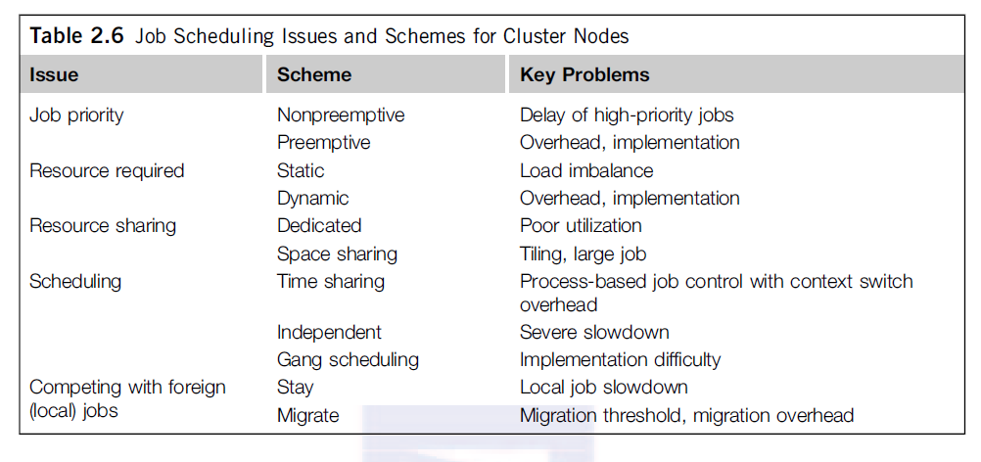
Job Scheduling Issues

Slide 37
Dedicated Mode
In the dedicated mode:
Only one job runs in the cluster at a time, and at most, one process of the job is assigned to a node at a time.
The single job runs until completion before it releases the cluster to run other jobs.
Note that even in the dedicated mode, some nodes may be reserved for system use and not be open to the user job. Other than that, all cluster resources are devoted to run a single job. This may lead to poor system utilization.
The job resource requirement can be static or dynamic.
Static scheme fixes the number of nodes for a single job for its entire period. Static scheme may underutilize the cluster resource. Problem when the needed nodes become unavailable.
Dynamic scheme allows a job to acquire or release nodes during execution. However, it is difficult to implement.

Slide 38
Space Sharing
Multiple jobs can run on disjointed partitions (groups) of nodes simultaneously.
At most, one process is assigned to a node at a time, and runs till the end of its execution.
All processes of a single parallel job are active simultaneously – good synchronization.
Although a partition of nodes is dedicated to a job, the interconnect and the I/O subsystem may be shared by all jobs.
Space sharing must solve the tiling problem and the large-job problem.

Slide 39
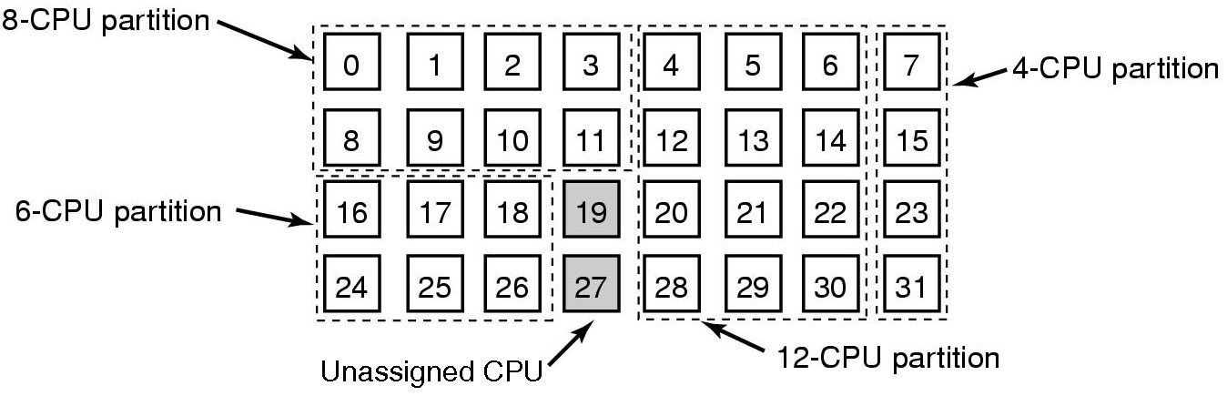
Space Sharing
  Multiple jobs at same time across
  multiple CPUs/nodes

Slide 40
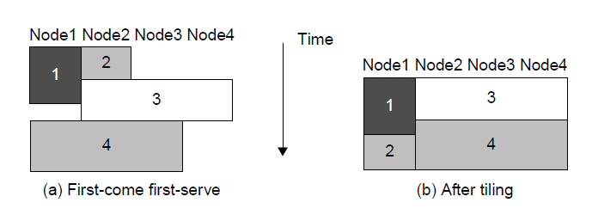
Space Sharing
The tiling technique for scheduling more jobs to cluster nodes to shorten the total makespan and thus increase the job throughput.

Slide 41
Time Sharing
In the time-sharing mode, multiple user processes are assigned to the same node. Scheduling policies:
Independent (or local) scheduling. The most straightforward implementation of time sharing is to use the operating system of each cluster node to schedule different processes as in a traditional workstation. However, the performance of parallel jobs could be significantly degraded, since processes of a parallel job need to interact.
Gang scheduling. The gang scheduling scheme schedules all processes of a parallel job together. When one process is active, all processes are active. The cluster nodes are not perfectly clock-synchronized. The execution time of a parallel job increases as the gang-scheduling skew becomes larger, We should use a homogeneous cluster, where gang scheduling is more effective. However, gang scheduling is not yet realized in most clusters, because of implementation difficulties.

Slide 42
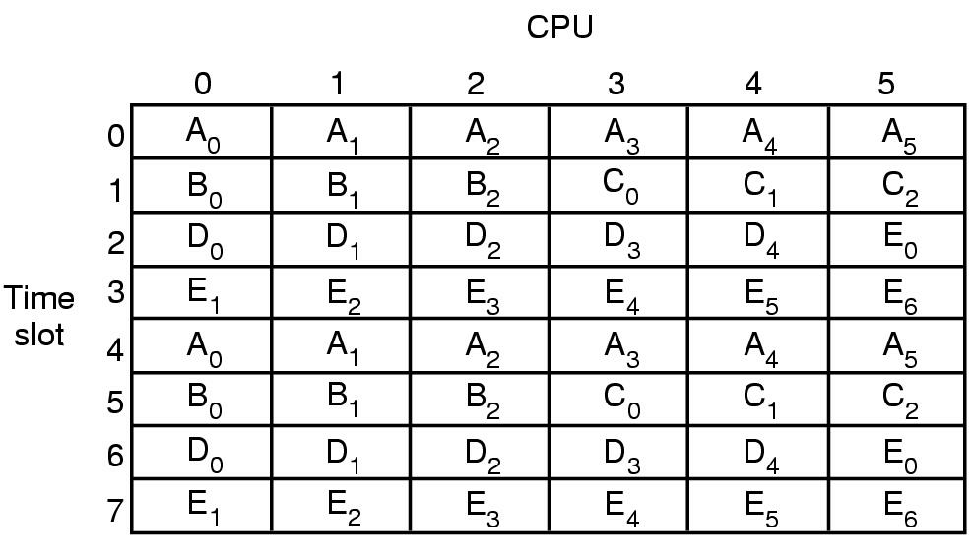
Time Sharing
Gang Scheduling

Slide 43
Time Sharing
Competition with foreign (local) jobs.
Scheduling becomes more complicated when both cluster jobs and local jobs are running. Local jobs should have priority over cluster jobs. With one keystroke, the owner wants command of all workstation resources. There are basically two ways to deal with this situation:
  The cluster job can either stay in the workstation node, or
  Migrate to another idle node
  A stay scheme has the advantage of avoiding migration cost. The cluster process can be run at the lowest priority. However, to stay slows down all jobs (mainly the cluster job)
  This leads to the migration approach to flow the jobs around available nodes, mainly for balancing the workload.

Slide 44
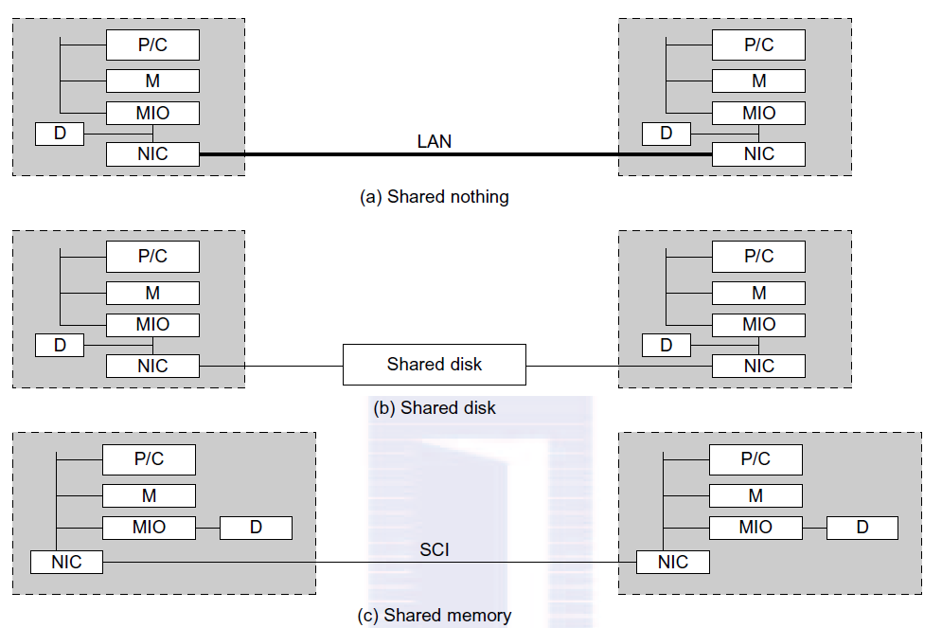
Three Ways to Connect Clusters
Without shared disks, checkpointing, rollback recovery, failover, and failback are not possible.
(P/C: Processor and Cache; M: Memory; D: Disk; NIC: Network Interface Circuitry; MIO: Memory-I/O Bridge.)

Slide 45
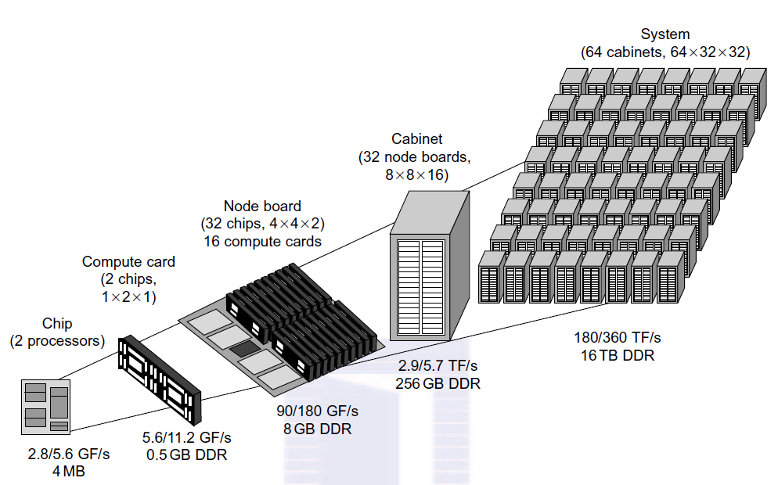
Modular Architecture – Packaging in Hierarchical Levels
The IBM Blue Gene/L modular architecture

Slide 46
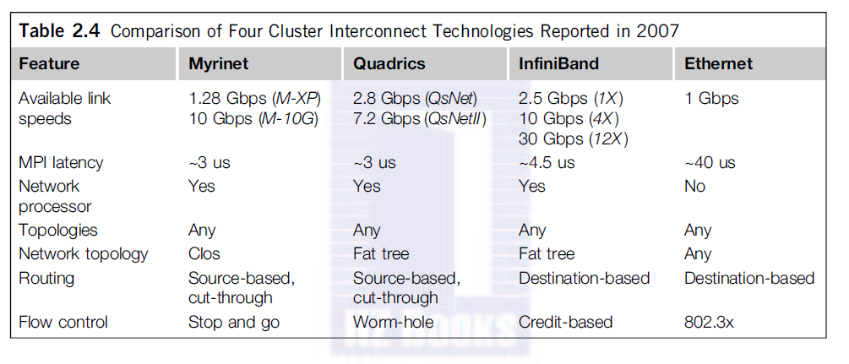
High Bandwidth Interconnects

Slide 47
Google Cluster Interconnect

Slide 48
Google Cluster Interconnect
Crossbar Switch in Google Search Engine Cluster (One of many data centers using clusters of low-cost PC engines).
Cluster interconnect of 40 racks of PC engines via two racks of 128 x 128 Ethernet switches.
Each Ethernet switch can handle 128 1-Gbps Ethernet links.
A rack contains 80 PCs. This is an earlier cluster of 3,200 PCs.
Today’s server clusters from Google are larger installed in data centers with container trucks.
Two switches are used to enhance cluster availability.
The front ends of the switches are connected to the Internet via 2.4 Gbps OC 48 links. The 622 Mbps OC 12 links are connected to nearby data-center networks.
In case of failure of the OC 48 links, the cluster is still connected to the outside world via the OC 12 links. Thus,
The Google cluster eliminates all single points of failure.

Slide 49
Fault-Tolerant Cluster Configurations
Three ascending levels of availability:
hot standby, active takeover, and fault-tolerant
Three issues of interest:
recovery time, failback feature, and node activeness
The level of availability increases from standby to active and fault tolerant cluster configurations. The shorter is the recovery time, the higher is the cluster availability.
Failback refers to the ability of a recovered node returning to normal operation after repair or maintenance.
Activeness of availability increases from standby to active and refers to whether the node is used in active work during normal operation.

Slide 50
Fault-Tolerant Cluster Configurations
Hot standby server clusters. In a hot standby cluster, only the primary node is actively doing all the useful work normally. The standby node is powered on (hot) and running some monitoring programs to communicate heartbeat signals to check the status of the primary node, but is not in active use. The primary node must mirror any data to shared disk storage.
Active-takeover clusters. In this case, the architecture is symmetric among multiple server nodes. Both servers are primary, doing useful work normally. When a node fails, the user applications fail over to the available node in the cluster. Users may experience some delays or may lose some data etc (checkpoint ? failback ?)
Failover / Fault tolerant clusters. Redundancy of system/hardware components. This is probably the most important feature demanded in current clusters for commercial applications. When a component fails, the remaining system is able (due to redundant components) to take over the services originally provided by the failed component.

Slide 51
Κατανεµηµένα συστήµατα αρχείων - Θέµατα σχεδίασης
Υπηρεσίες συστήµατος αρχείων
  Αποθήκευση και προσπέλαση λογικών αρχείων
  ∆ιαχείριση αρχείων και ιδιοτήτων τους
Οργάνωση αρχείων σε ευρετήρια
  Τα ευρετήρια είναι αρχεία ειδικού τύπου
  Αντιστοίχιση ονοµάτων σε αναγνωριστικά
  Ένα ευρετήριο µπορεί να περιέχει άλλα ευρετήρια
Κατανεµηµένη υπηρεσία αρχείων
  Προσπέλαση σε αποµακρυσµένα αρχεία
  Ίδια διεπαφή µε αυτή των τοπικών αρχείων
  Οι χρήστες βλέπουν τα αρχεία τους παντού
  Υλοποιούνται από πολλούς εξυπηρετητές
    Το πλήθος και η θέση τους πρέπει να είναι διαφανείς

Slide 52
Θέµατα σχεδίασης
Λειτουργίες συστήµατος αρχείων
  Άνοιγµα, κλείσιµο, δηµιουργία και διαγραφή
  Ανάγνωση και εγγραφή στοιχείων, αναζήτηση
Εξυπηρετητής Αρχείων
– Ανάγνωση και εγγραφή ιδιοτήτων
Κατανεµηµένη υλοποίηση
  Υπηρεσία αρχείων
  Υπηρεσία ευρετηρίων
  Κώδικας διεπαφής
Λειτουργίες κώδικα διεπαφής
Πελάτης
∆ιεπαφή Υπηρεσίας
Αρχείων
Κώδικας Πελάτη - Πληρεξούσιος
Εξυπηρετητής Ευρετηρίων
∆ιεπαφή Υπηρεσίας
Ευρετηρίων
Απόκρυψη αποµακρυσµένων κλήσεων
  Πρόταξη παραµέτρων και πρωτόκολλο επικοινωνίας
Παροχή κατάλληλης διεπαφής για κάθε πελάτη
  Επικοινωνία Windows και UNIX

Slide 53
∆ιεπαφή υπηρεσίας αρχείων
Μοντέλο αποµακρυσµένης πρόσβασης (NFS)
  Κάθε εντολή προσκοµίζει τα κατάλληλα δεδοµένα
  Συνεχής χρήση του δικτύου
Μοντέλο ανεβάσµατος - κατεβάσµατος (AFS)
  Παρέχονται µόνο εντολές για ολόκληρα αρχεία
  Οι απλές πράξεις υλοποιούνται τοπικά
  Χρήση δικτύου µόνο στην αρχή και στο τέλος
  Απαιτεί πολύ χώρο στο δίσκο και κίνηση στο δίκτυο
Πελάτης Εξυπηρετητής
Αρχείων
Άνοιγµ
α
Ά
νοιγµα
Ανάγνω
ση
Εγγραφ
ή
Κλείσιµ
ο
Κ
λείσιµο

Slide 54
Ενταµίευση αρχείων
Πελάτης ∆ίσκος |  | Εξυπηρετητής Αρχείων ∆ίσκος
Μνήµη
Μνήµη
Πιθανές θέσεις ενταµίευσης
  ∆ίσκος εξυπηρετητή, µνήµη εξυπηρετητή
  Μνήµη πελάτη, δίσκος πελάτη
∆ίσκος εξυπηρετητή
  Ουσιαστικά δεν έχουµε ενταµίευση!
Μνήµη εξυπηρετητή
  ∆εν αποφεύγει την κίνηση στο δίκτυο
  Ενταµίευση τµηµάτων ή ολόκληρων αρχείων
– Χρήση ακόµη και πολύ σύνθετων πολιτικών (όπως LRU)

Slide 55
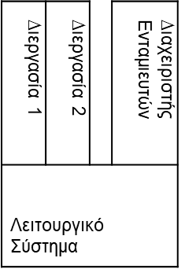





Ενταµίευση αρχείων
Πελάτης
Εξυπηρετητής Αρχείων
∆ίσκος
Μνήµη
∆ίσκος
Ενταµίευση στον πελάτη
  Αποφεύγει την ανταλλαγή µηνυµάτων µέσω δικτύου
  Μνήµη πελάτη: κατάλληλη για ενταµίευση τµηµάτων
  ∆ίσκος πελάτη: κατάλληλος για ενταµίευση αρχείων
(Κατα)µερισµός ενταµιευτών στη µνήµη
– ∆ιεργασία χρήστη, πυρήνας ή διεργασία ενταµίευσης

Slide 56
Συνέπεια συστήµατος αρχείων
Πελάτης 1 Εξυπηρετητής
Κρυφή Μνήµη
Αρχείων
Μνήµη
∆ίσκος
Πελάτης 2
Κρυφή Μνήµη
Προβλήµατα ασυνέπειας
  Η ενταµίευση στους πελάτης προκαλεί ασυνέπεια
  Μπορεί να έχουµε ασυνέπειες και στα ευρετήρια
Ενταµίευση µε άµεση εγγραφή
  Κάθε τροποποίηση στέλνεται στον εξυπηρετητή
    είτε ενηµερώνονται και όλοι οι πελάτες
    είτε ο πελάτης ρωτάει τον εξυπηρετητή πριν την ανάγνωση
– Μεγάλη κυκλοφορία στο δίκτυο

Slide 57
Σύστηµα αρχείων NFS
NFS: Network File System
  ∆ηµιουργήθηκε από τη Sun για το UNIX
  Κάθε µηχανή µπορεί να είναι πελάτης και εξυπηρετητής
Πρωτόκολλο NFS
  Χρησιµοποιεί αποµακρυσµένες κλήσεις διαδικασιών (RPC)
  Απεικονιστής θυρών RPC σε γνωστή διεύθυνση
  Χρήση UDP σε LAN ή TCP σε WAN
  Μηνύµατα ίσου µεγέθους µε τα τµήµατα των αρχείων
Χειριστήρια αρχείων NFS
  Αναγνωριστικά των αρχείων σε έναν εξυπηρετητή
  Περιέχουν πληροφορίες εντοπισµού κάθε αρχείου
  Στο UNIX: i-node, οµάδα αρχείων, αριθµός γενιάς
• Ο αριθµός γενιάς κάνει τα αναγνωριστικά µοναδικά

Slide 58
Σύστηµα αρχείων NFS
Πελάτης
Εξυπηρετητής
Κλήσεις πυρήνα
Κλήσεις πυρήνα
VFS
NFS |  | UFS
Πακέτο RPC |  | ∆ίσκος
VFS
UFS
NFS
∆ίσκος
Πακέτο RPC
∆ίκτυο ∆ιασύνδεσης
Εικονικό σύστηµα αρχείων
  Οι ίδιες κλήσεις χρησιµοποιούνται για όλα τα αρχεία
  Τα ευρετήρια εγκαθίστανται στον τοπικό χώρο ονοµάτων
    Κάθε ευρετήριο και ανοιχτό αρχείο περιγράφεται από µία δοµή
Πελάτης και εξυπηρετητής στον πυρήνα
  (Κατα)µερισµός όλων των ενταµιευτών
  Πιστοποίηση ταυτότητας χρήστη από πυρήνα
– Ο πελάτης στέλνει κάθε φορά την ταυτότητά του για έλεγχο
Κατανεµηµένα Συστήµατα
14-18

Slide 59
Ενταµίευση αρχείων στο NFS
Ενταµίευση στον εξυπηρετητή
  Ο εξυπηρετητής γράφει περιοδικά τις αλλαγές
  Προαιρετικά άµεση εγγραφή σε κάθε εντολή
  Οµαδική εγγραφή µε χωριστή εντολή
Ενταµίευση στον πελάτη
  Ενταµίευση µεµονωµένων τµηµάτων αρχείων ή ευρετηρίων
  Ο πελάτης ελέγχει την εγκυρότητα των ενταµιευτών
  Περιοδικός έλεγχος εγκυρότητας
    Το διάστηµα ελέγχου είναι ρυθµιζόµενο
    Ελέγχεται ο χρόνος τροποποίησης του αρχείου
Αποστολή αλλαγών στον εξυπηρετητή
  Όταν κλείνει το αρχείο ή όταν το ζητάει ο πελάτης
– Ασύγχρονα µέσω πρόσθετης διεργασίας

Slide 60
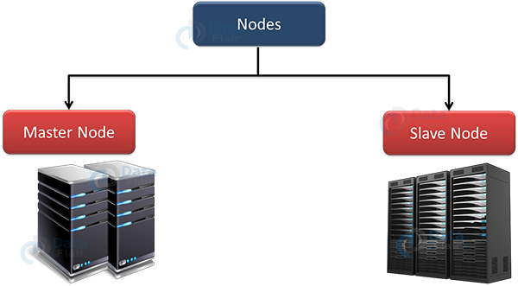
HDFS – Κατανεμημένο σύστημα αρχείων
(high scalability – high availability,
replication & rack awareness)

Slide 61
HDFS – Κατανεμημένο σύστημα αρχείων
Ένα κατανεμημένο κλιμακώσιμο σύστημα αρχείων για εφαρμογές που διαχειρίζονται μεγάλα σύνολα δεδομένων.
  Κατανεμημένο: τρέχει σε υπολογιστικό cluster
  Κλιμακώσιμο: >10Κ κόμβοι, >100Κ αρχεία >10PB storage
  Closed-source βελτιστοποιήσεις (MapR)
Ο χώρος των αρχείων είναι ενιαίος για όλο το cluster
Τα αρχεία διασπώνται σε blocks
Τυπικό μέγεθος block 64-128 MB.
Replication: Κάθε block αντιγράφεται σε πολλαπλούς κόμβους δεδομένων (DataNodes) - default 3 (rack aware).

Slide 62
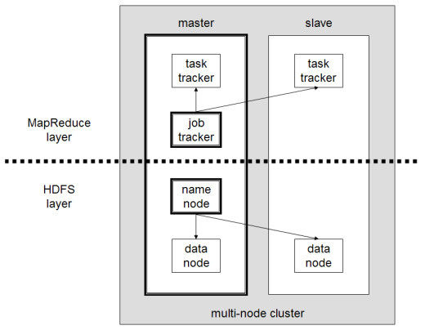
Αρχιτεκτονική HDFS/MapReduce
Αρχιτεκτονική Master/Slave
  HDFS: Ένας κεντρικός NameNode διαχειρίζεται πολλαπλούς DataNodes
    NameNode: κρατάει ποιος DataNode έχει πoιό αρχείο (σαν FAT)
    DataNodes: «χαζοί» servers που κρατάνε raw file chunks
  MapReduce: Ένας κεντρικός JobTracker διαχειρίζεται πολλαπλούς TaskTrackers
  NameNode και JobTracker
  τρέχουν στον master
  DataNode και TaskTracker
  τρέχουν στους slaves
  - Data locality

Slide 63
HDFS – Namenode & Datanodes
1. HDFS Master (Namenode)
NameNode regulates file access to the clients. It maintains and manages the slave nodes and assigns tasks to them. NameNode executes file system namespace operations like opening, closing, and renaming files and directories.
2. HDFS Slave (Datanode)
There are n number of slaves or DataNodes in the Hadoop Distributed File System that manages storage of data. These slave nodes are the actual worker nodes that do the tasks and serve read and write requests from the file system’s clients. They also perform block creation, deletion, and replication upon instruction from the NameNode.

Slide 64
HDFS Architecture
(splitting in blocks, replication & rack awareness)
Τα αρχεία διαχωρίζονται σε αλυσίδες (chunks) οι οποίες είναι τυπικά μεταξύ 64 και 128 Megabytes. Τα chunks αντιγράφονται π.χ. τρεις φορές, σε τρεις διαφορετικούς κόμβους.
Επιπρόσθετα, οι κόμβοι οι οποίοι κρατούν αντίγραφα ενός chunk, θα πρέπει να βρίσκονται σε διαφορετικά racks, έτσι ώστε αν χαθεί ένα rack να μην χάνονται όλα τα αντίγραφα κάποιου chunk.
Τυπικά, τόσο το μέγεθος της αλυσίδας όσο ο βαθμός της αντιγραφής προσδιορίζεται από το χρήστη
Για να είναι γνωστό που βρίσκονται τα chunks του κάθε αρχείου, υπάρχει ένα άλλο μικρό αρχείο (master node or name node) που κρατά την πληροφορία για κάθε αρχείο.
Ο master node επίσης αντιγράφεται και ένας κατάλογος (directory) για το σύστημα αρχείων στο σύνολό του γνωρίζει που βρίσκονται τα αντίγραφα.
Ο κατάλογος (directory) αυτός μπορεί επίσης να αντιγραφεί και όλοι οι συμμετέχοντες μπορούν να ξέρουν που είναι τα αντίγραφά του.

Slide 65
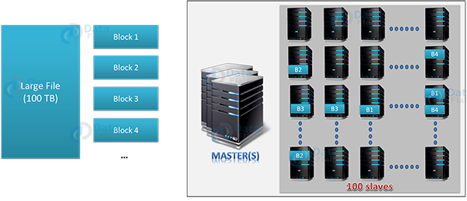
HDFS Architecture
(splitting in blocks)

Slide 66
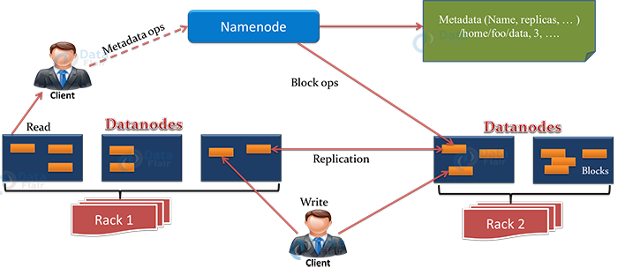
HDFS Architecture
(replication & rack awareness)

Slide 67
Programming Models & Tools
MPI
Message Passing, HPC
Condor
Job scheduling, HTC, Grid, Cloud
MapReduce
Large-scale, high-level, high-availability
Hadoop, Tera-HPC, MTC

