Slide 1
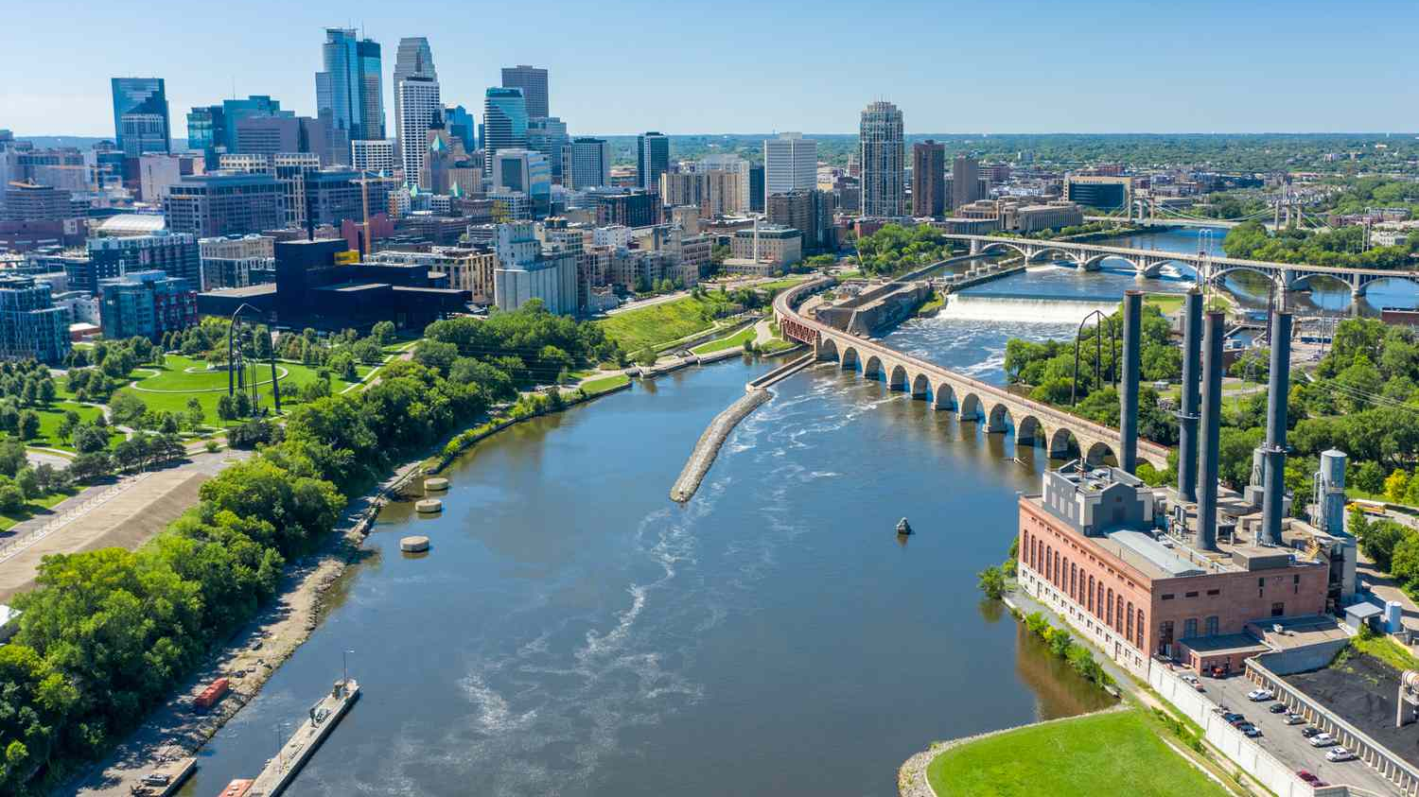
Biking to Work
Is there a fastest route?

Slide 2
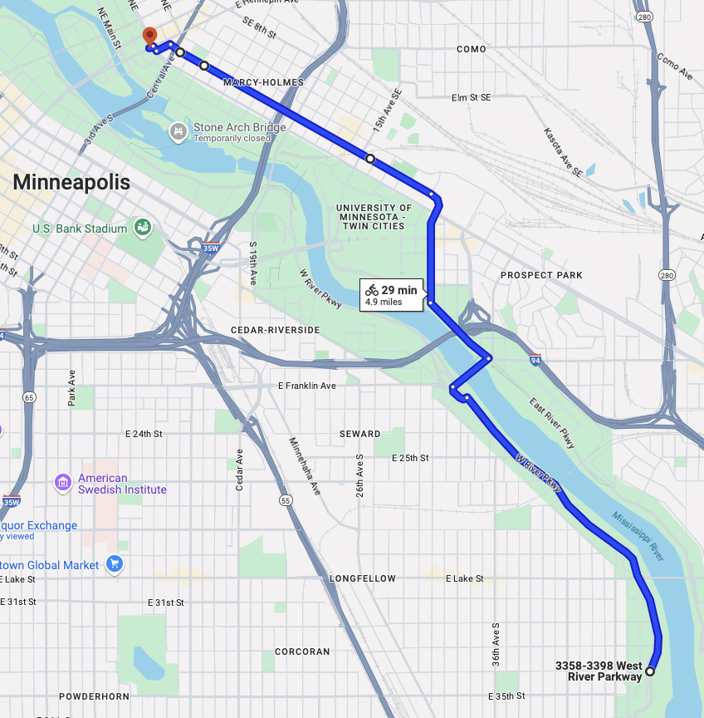
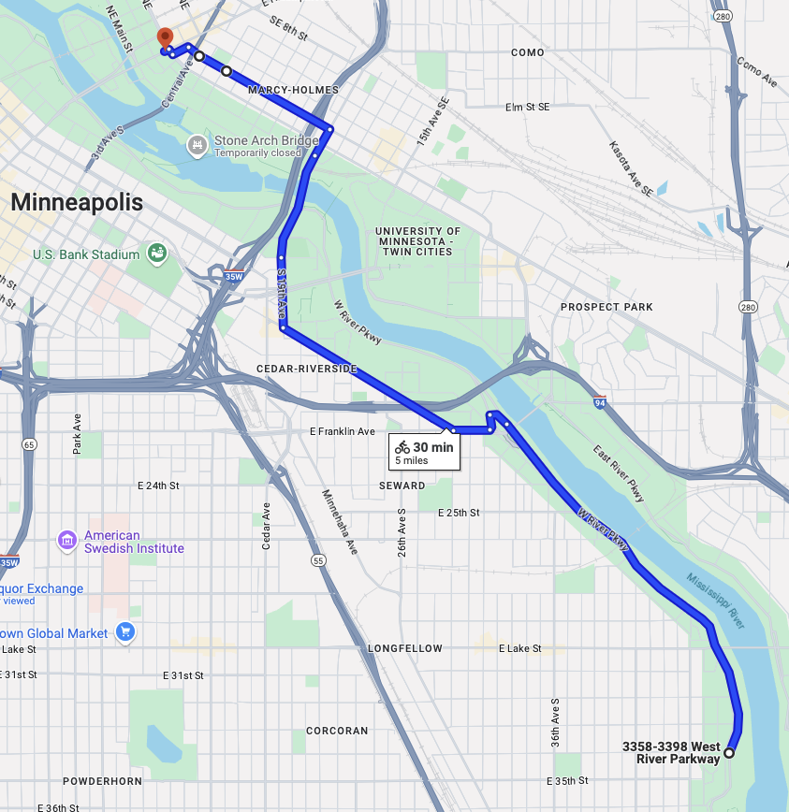
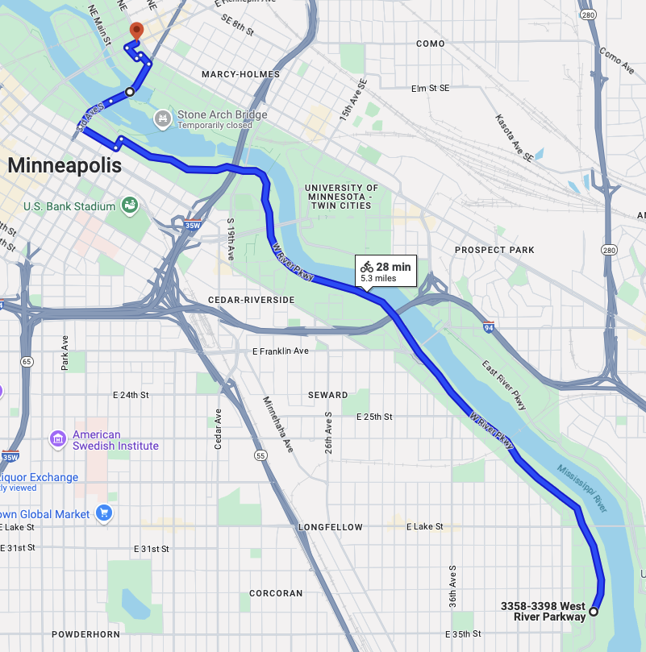
Which route is fastest?
Three routes I normally take to work
Is there a significant difference in my commute time?

Slide 3
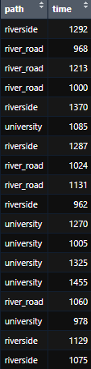
DATA
Independent variable is route
Riverside
River Road
University
Dependent Variable is time in seconds
Gathered with Apple Watch workouts

Slide 4
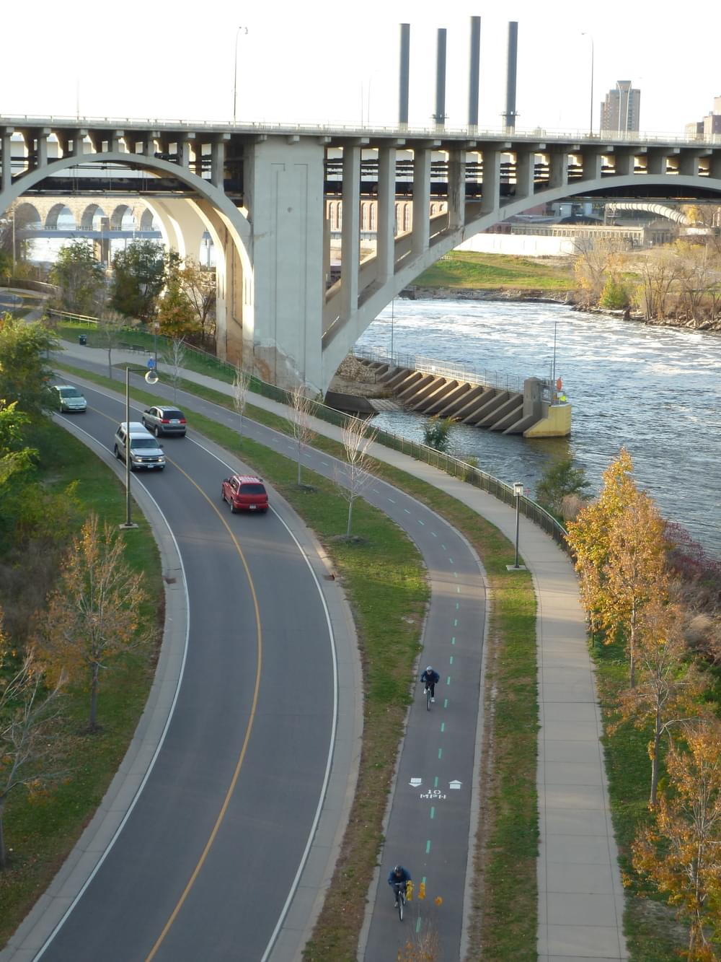
Hypotheses
Null Hypothesis: The mean time it takes to commute is the same for all routes
Alternative Hypothesis: The mean time it takes to commute is different for one of the routes

Slide 5

ANOVA test
P-Value = 0.316

Slide 6
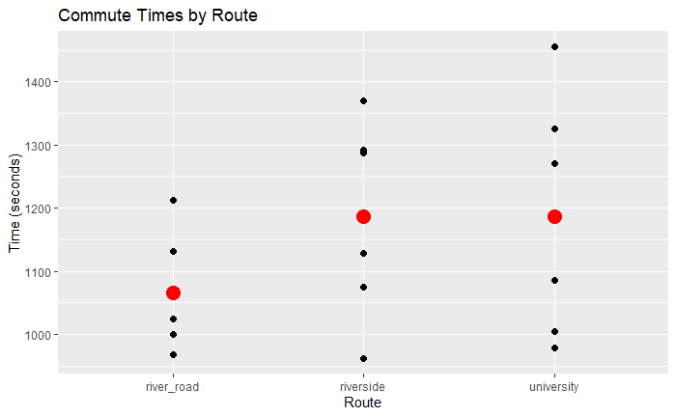
Conclusion
P-Value = 0.316 > α = 0.05
Reject null hypothesis

Slide 7
References
IMAGES
https://optimise2.assets-servd.host/material-civet/production/images/Tread_West-River-Parkway-Minneapolis.JPG?w=1000&q=82&auto=format&fit=clip&dm=1620062533&s=b90ad6ef0e783cfe011aa1f834060cea
https://www.travelandleisure.com/thmb/8iCrX_YGnN-jZjjDV1YjDp5Rp6g=/750x0/filters:no_upscale():max_bytes(150000):strip_icc():format(webp)/TAL-minnesota-GREATRIVERRD0923-50911cd3977e4e869e56e2153692af9f.jpg

