Slide 1



Flexibly configuring task and motion planning problems for mobile manipulators
Siddhant Saoji and Jan Rosell
Department of Mechanical Engineering
Institute of Industrial and Control Engineering

Slide 2
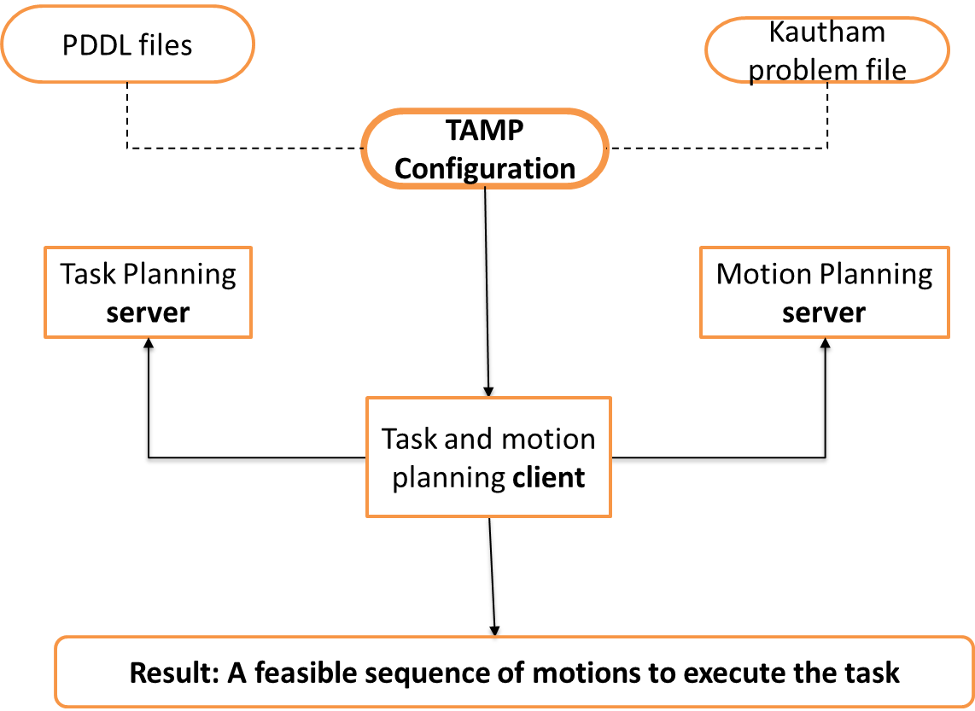
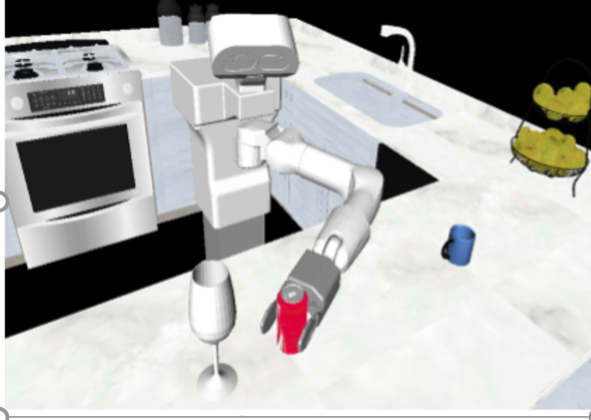
Problem statement and proposed solution
Mobile manipulators face different problems at the perception, planning and control levels.
task planning / motion planning
This paper presents a TAMP framework that includes an easy way to configure the interconnection between planning layers.

Slide 3
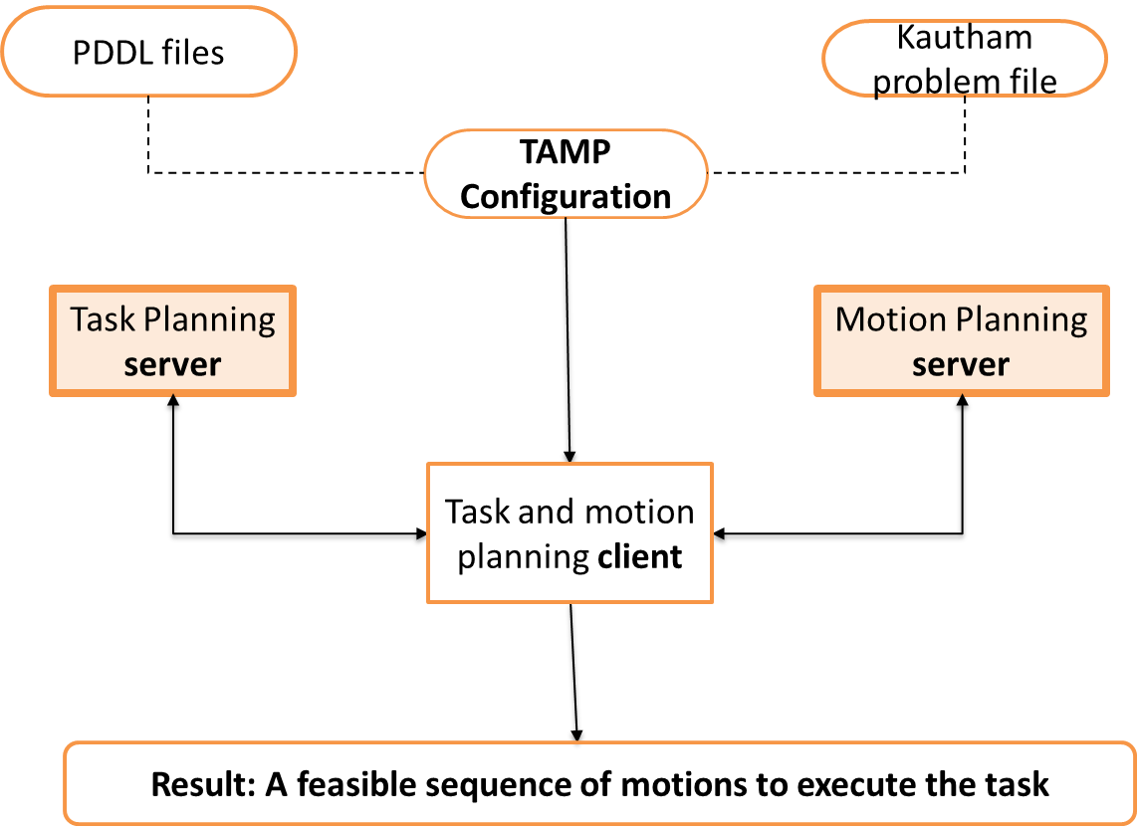
The motion planning server and the task planning server
Motion planning problems are modeled using an XML file with information on the models of the robot(s) and obstacles, the controls and the planner.
Some ROS services provided are:
OpenProblem / CloseProblem
SetRobotsConfig / GetObstaclePos / SetObstaclePos
AttachObstacle2RobotLink / DetachObstacle
SetPlannerByName / SetQuery / GetPath

Slide 4
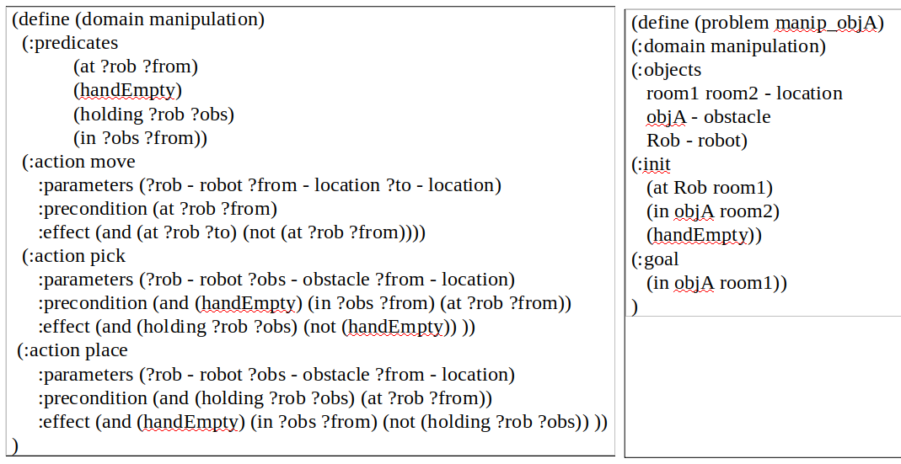
The motion planning server and the task planning server
The Fast Forward task planner has been wrapped as a ROS service that:
Uses PDDL domain and problem files as request
Returns the sequence of actions as a vector of strings

Slide 5
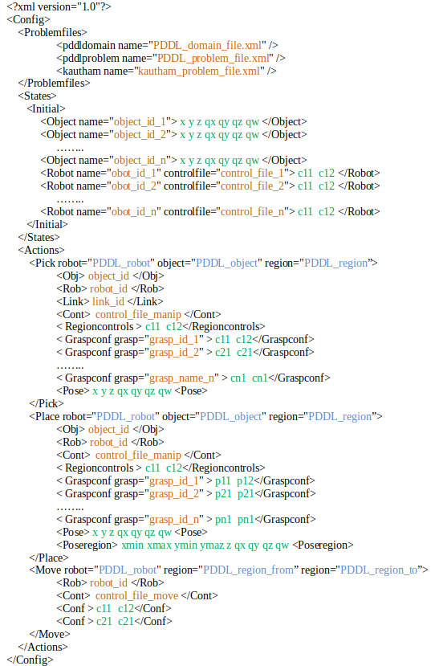
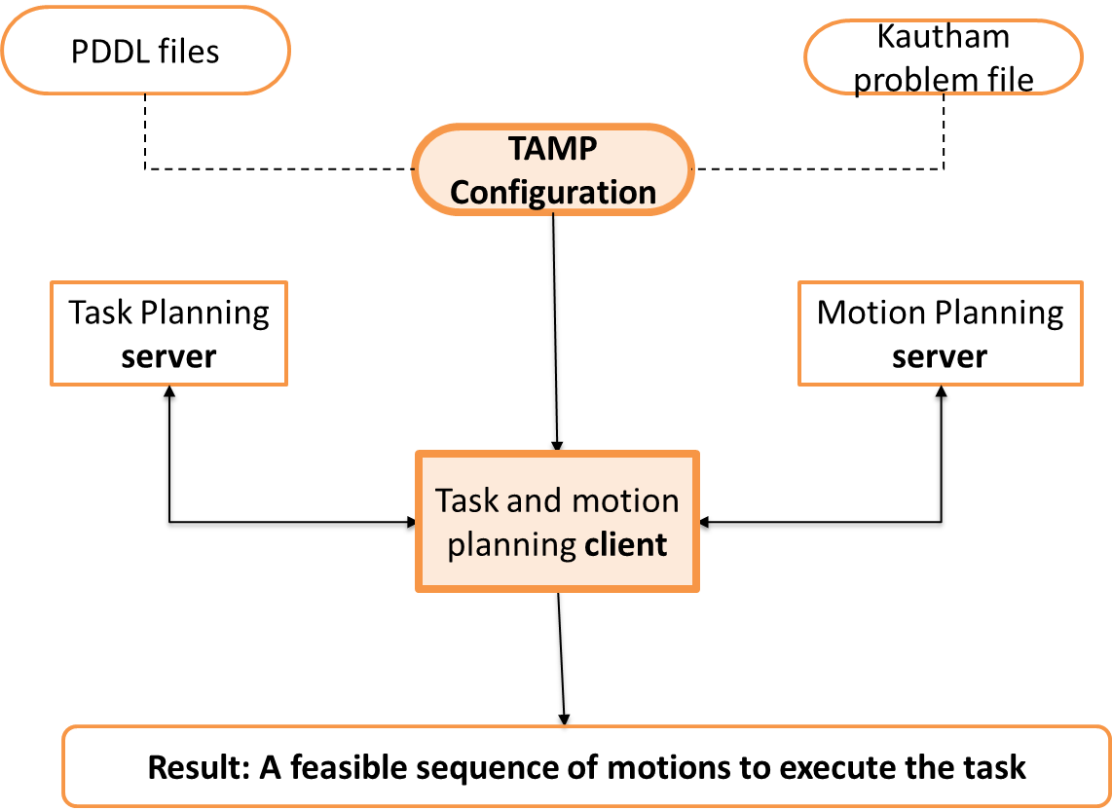
Interfacing layers proposal and the TAMP client
An XML file has been conceived as the intermediate layer for the flexible linkage between:
symbolic actions and
geometric data

Slide 6
Interfacing layers proposal and the TAMP client
The TAMP configuration file includes the files:
the PDDL domain and problem files
the Kautham problem file

Slide 7
Interfacing layers proposal and the TAMP client
The TAMP configuration file includes information on the initial state:
Objects to be manipulated and their poses
Robots, their control files and the controls values that define the robot initial configuration

Slide 8
Interfacing layers proposal and the TAMP client
The TAMP configuration file includes information linking the symbols involved in the PDDL Actions with the required geometric information to plan the motions that may allow to actually perform those actions.
Pick
Place
Move

Slide 9
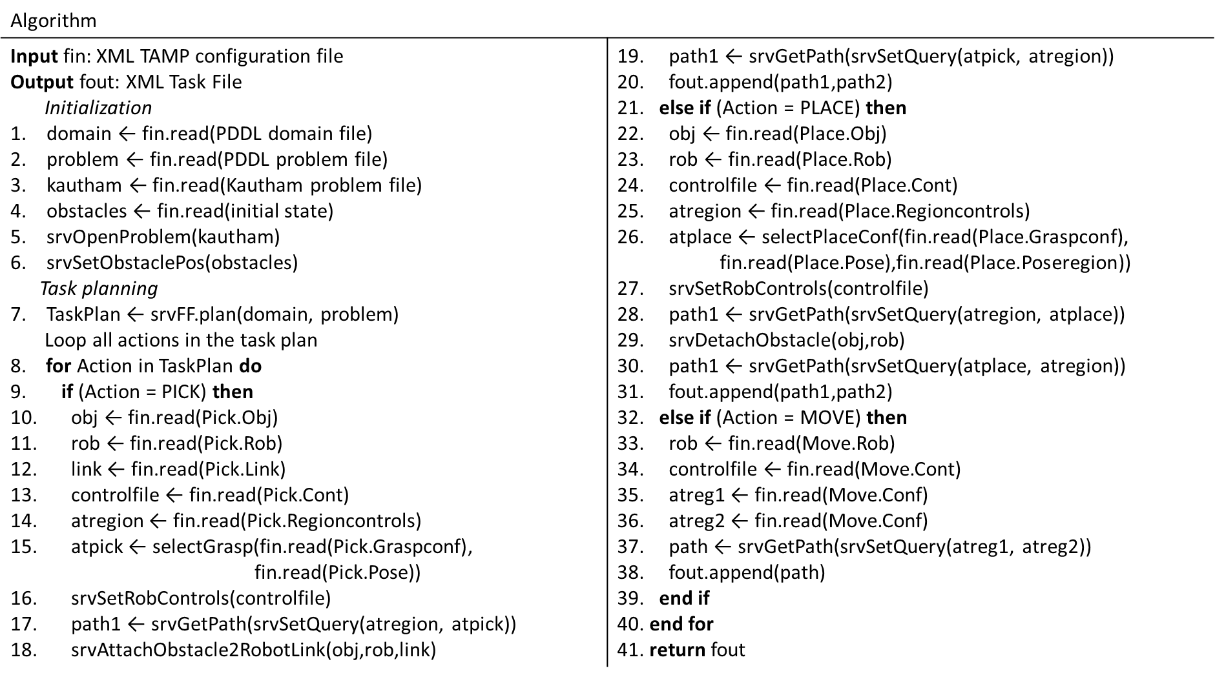
Interfacing layers proposal and the TAMP client
Initialization

Slide 10
Interfacing layers proposal and the TAMP client
Task planning

Slide 11
Interfacing layers proposal and the TAMP client
Motion planning (Pick)

Slide 12
Interfacing layers proposal and the TAMP client
Motion planning (Place)

Slide 13
Interfacing layers proposal and the TAMP client
Motion planning (Move)

Slide 14
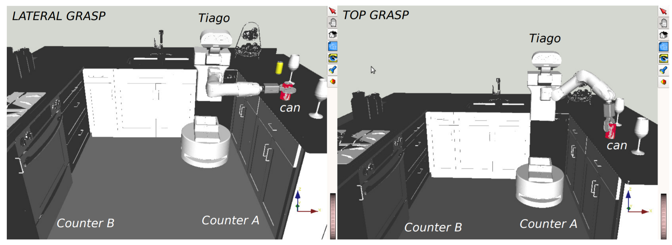
An example, discussion and future work

Slide 15
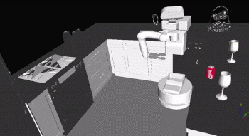
An example, discussion and future work
The framework presented gives the tools:
to get easy access to task and motion planning servers, and
to easily set manipulation problems through the simple interconnection between planning layers using an XML file
XML file is currently configured by hand, and the challenge is to automatically:
set the initial state by using deep learning vision techniques
set the PDDL problem file using reasoning procedures and ontological knowledge
generate action oriented grasp configurations, using learning techniques and a grasp generator

Slide 16

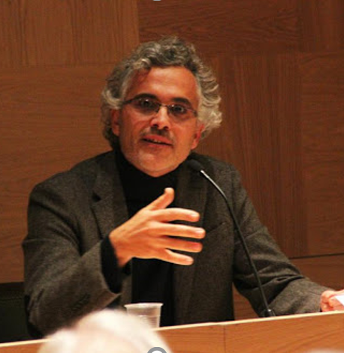
Flexibly configuring task and motion planning problems for mobile manipulators
Siddhant Saoji and Jan Rosell

