Slide 1

FitVista Sculpting Wellness, Shaping Lives
Group-14:
Sai Praneeth Veerapalli
Shubhang yadav Sandaveni
Swapna Vippaturi

Slide 2
Contents
Executive Summary
Background
Core Team & Stakeholders
Scope and Objective
Project Development Timeline
Development Strategy
Development Details
Results
Value and Future Scope
Socialization and Distribution

Slide 3

Executive Summary
Creating a predictive obesity model can help fitness professionals offer personalized solutions for weight management, attracting more clients looking for tailored fitness plans.

Slide 4
Background
The fitness industry has a big chance to thrive due to the growing focus on health and the rise of obesity-related health concerns
This aligns with the increasing demand for data-driven and personalized fitness solutions.

Slide 5
Core Team & Stakeholders
Our Role: Member of the Data Science team
Responsibility: Design and enhance the predictive obesity classification model
Internal Stakeholders: Collaborate with data engineers, and project managers
External Beneficiaries:
Fitness Professionals: Utilize the model for tailored client services
Healthcare Providers: Leverage insights for proactive health management
Individuals Seeking Fitness Guidance: Receive personalized recommendations

Slide 6
Scope and Objective
Project Deliverables:-
Obesity Classification Model
Deliver a robust machine learning model for classifying clients into obesity risk categories based on lifestyle and behavioral factors.
Actionable Reports
Provide regular, easy-to-interpret reports to stakeholders, offering insights into clients' obesity risk classifications and guiding professionals in tailoring fitness plans.
Future Scope (Not Delivering):-
Personalized Plans: The project does not currently include the delivery of personalized fitness plans. Recommending tailored plans is identified as a future scope for the pipeline.

Slide 7
Project Development Timeline
5–8 Oct.
Project Proposal (October 5-8, 2023): This initial phase was focused on defining the project scope, objectives, and deliverables.
9–16 Oct.
Data Collection (October 9-16, 2023): This stage involved gathering the necessary data for your project.
18–24 Oct.
Data Preprocessing (October 18-24, 2023): During this phase, the collected data was cleaned, transformed, and prepared for analysis.
24 Oct. – 2 Nov. 2023
Model Development (October 24 - November 2, 2023): Here, the focus was on developing the model based on the preprocessed data.
2–8 Nov.
Model Testing (November 2-8, 2023): This phase involved rigorously testing the model to ensure its accuracy and effectiveness.
9–14 Nov.
Performance Analysis (November 9-14, 2023)
15–21 Nov.
Recommendation Systems

Slide 8
Development strategy
Complex Patterns: Classification leverages supervised learning to recognize complex patterns in lifestyle and behavioral data, enabling accurate identification of obesity risk categories.
Personalized Interventions: By employing classification, we can tailor fitness plans based on individual risk levels, optimizing the effectiveness of interventions for weight management.
Actionable Insights: Classification provides actionable insights for fitness professionals, facilitating precise guidance and enhancing the overall impact on clients' health and wellness.

Slide 9
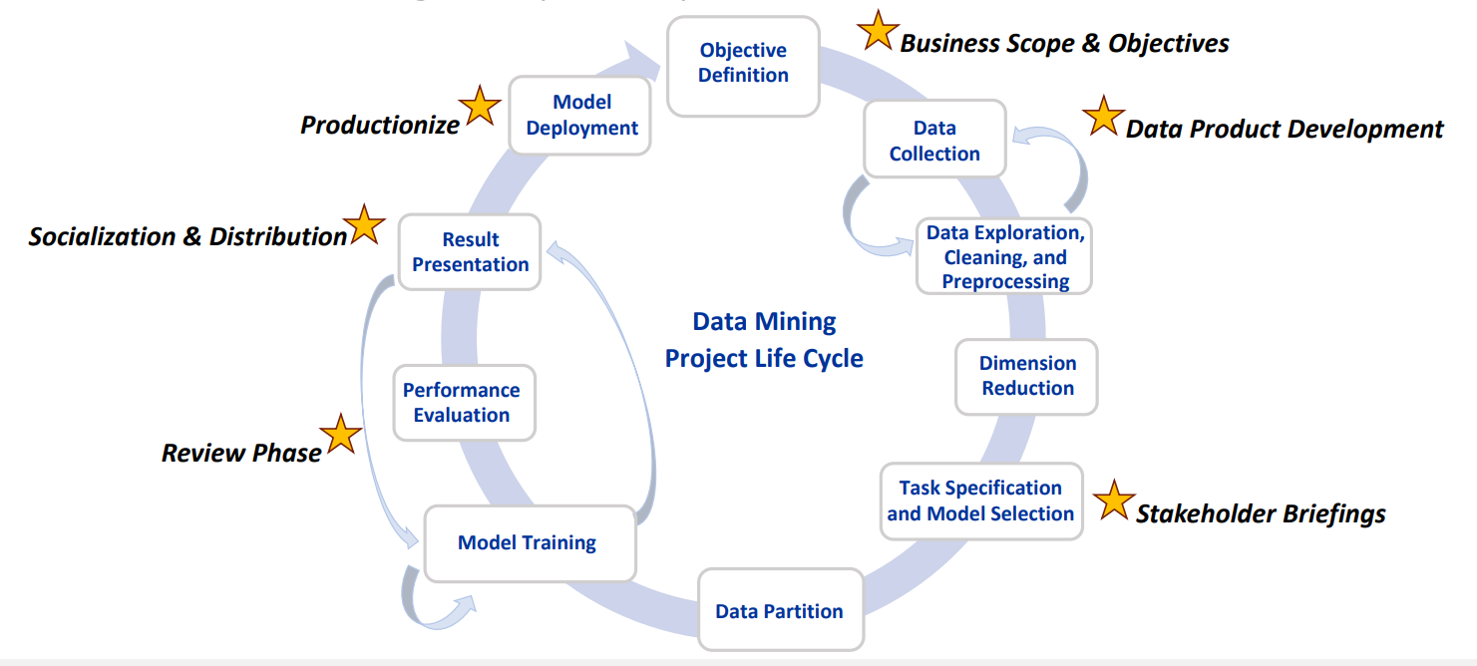
Development Details
This dataset comprises 2,111 entries and 17 features related to individuals' eating habits and physical condition from Mexico, Peru, and Colombia to estimate obesity levels. It includes seven classifications of weight status from Insufficient Weight to Obesity Type III. The majority (77%) of the data was synthesized using Weka and SMOTE, while the remainder (23%) was obtained directly from user inputs on a web platform.
Data Source: Estimation of obesity levels based on eating habits and physical condition. (2019). UCI Machine Learning Repository. https://doi.org/10.24432/C5H31Z.

Slide 10
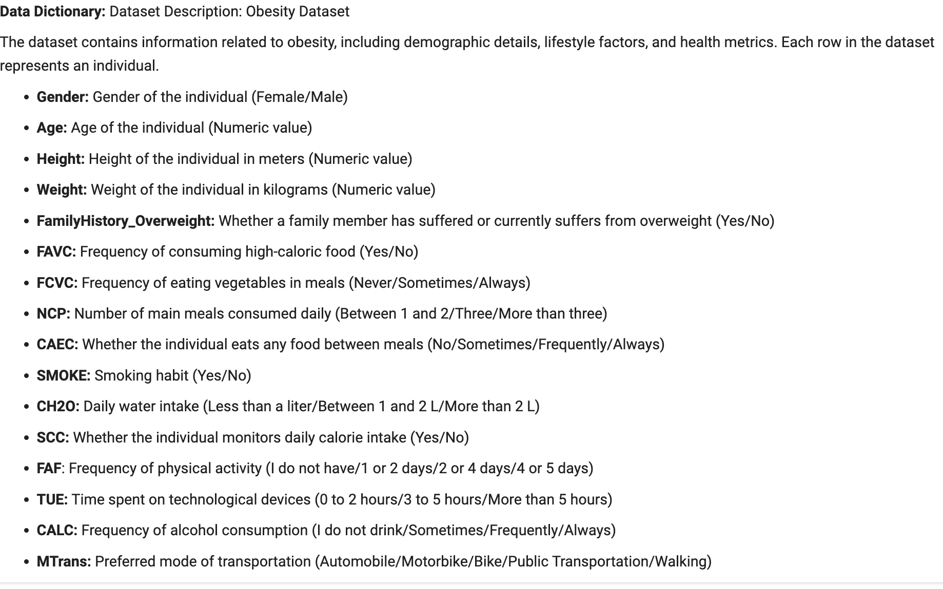

•Underweight Less than 18.5
•Normal 18.5 to 24.9
•Overweight 25.0 to 29.9
•Obesity I 30.0 to 34.9
•Obesity II 35.0 to 39.9
•Obesity III Higher than 40

Slide 11
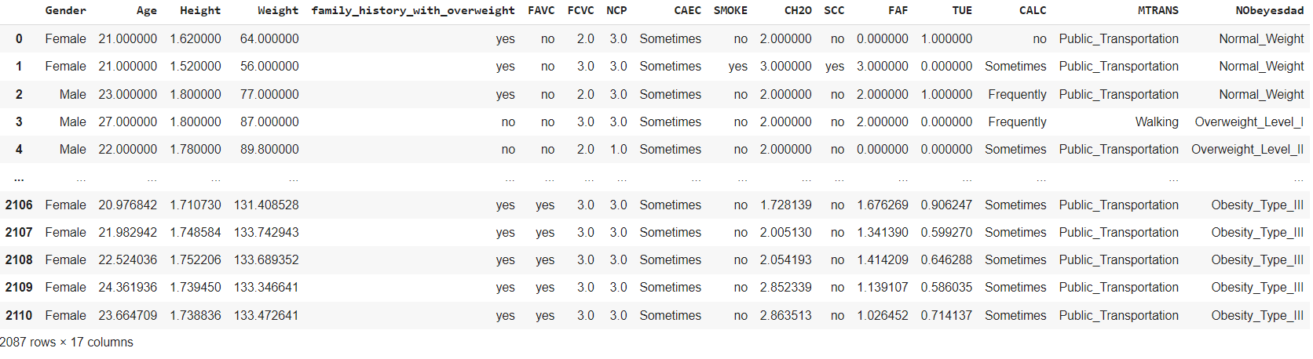
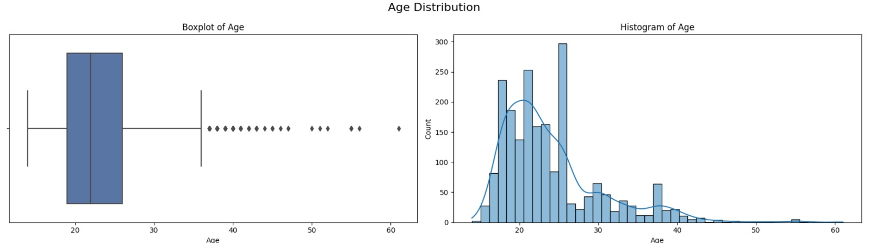
The outliers are observed in individuals aged 35 years or older; however, the majority of the dataset comprises individuals aged between 18 to 40. The histogram distribution is right-skewed so the mean age > median age.

Slide 12
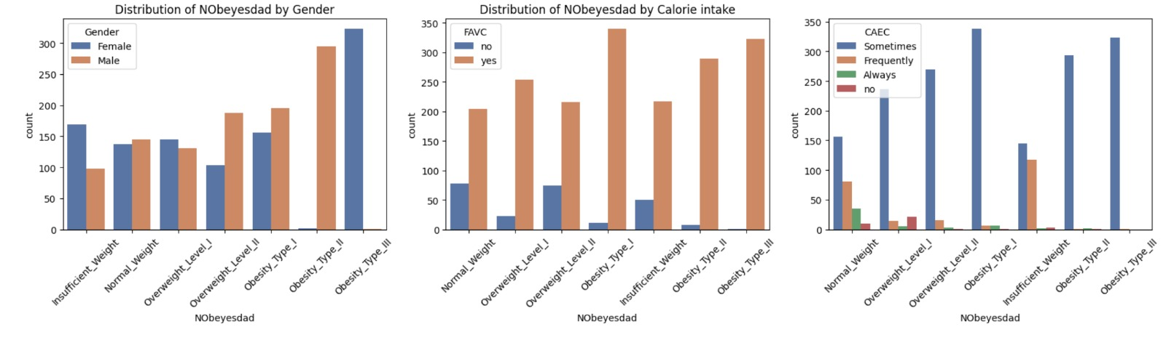
Gender: the distribution across different obesity levels is similar between genders, but the number of women in 'Obesity_Type_III’ and the number of men in ‘Obesity_type_II’ are higher.
High-calorie intake: The bar plot shows that individuals who frequently consume high-calorie foods are more likely to fall into higher obesity categories. This shows a potentially strong correlation between high-calorie food consumption and obesity levels.
This plot shows that those who eat between meals 'Sometimes' or 'Frequently' are more likely to have 'Normal_Weight' or 'Insufficient_Weight’. However, people who are 'Always' eating between meals are correlated with higher levels of obesity.

Slide 13
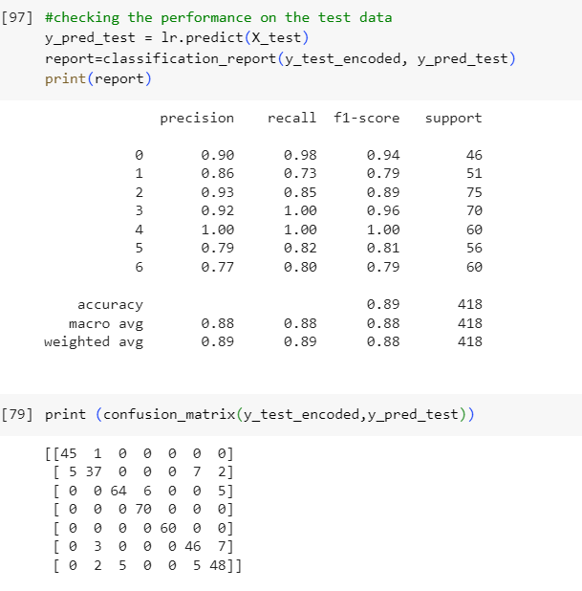
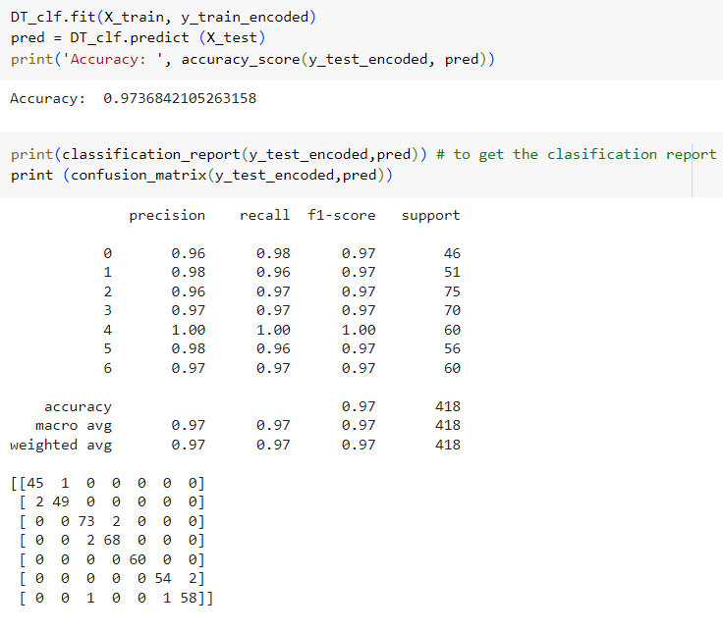
Results
Logistic Regression
Decision Tree

Slide 14
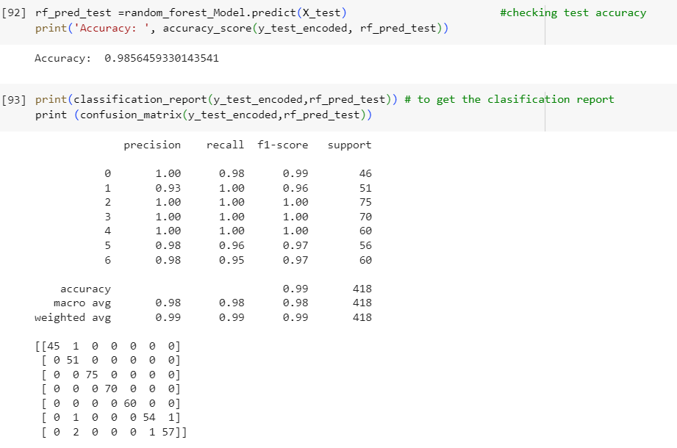
Results
Random Forest Classifier Model

Slide 15
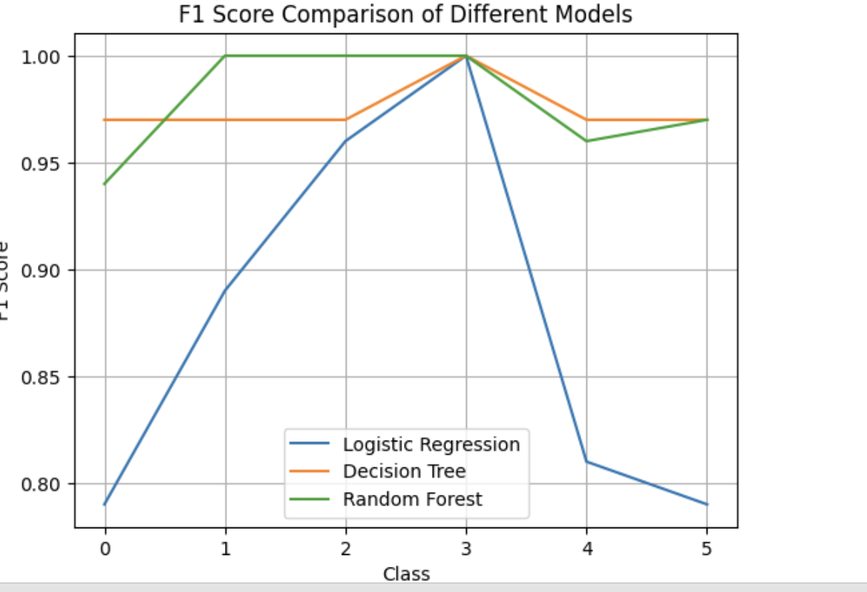
Results
Class-Specific Performance: Models vary in performance across classes, indicating specific strengths for each.
Random Forest Stability: Random Forest is consistently strong across all classes, suggesting robust classification.
Logistic Regression Improvement: Logistic Regression exhibits improved or consistent performance, showcasing strengths in certain classes.
Decision Tree Variability: The decision Tree shows variability, indicating potential overfitting to specific classes.
Model Selection: For overall performance, Random Forest is preferred as it predicted well for almost all the classes.
Notes:
How Stakeholders Cannot Use These Findings:
Personalized Plan Delivery: The current scope of the project does not include delivering personalized fitness plans, so stakeholders should not expect the model to provide this directly. However, it's identified as a future development area.
Stand-alone Diagnostic Tool: Healthcare providers should not use the model as a stand-alone diagnostic tool for medical treatments without professional medical assessments.
Assurance of Results: While the model provides classification, it does not guarantee health outcomes. Fitness professionals should use the classifications to supplement their expertise, not replace it.

Slide 16
Future Scope
Value
Data-Driven Insights into Obesity Levels
Targeted Health Programs
Preventive Healthcare
Expand Dataset
Real-World Integration
Personalized Fitness Plans & Dietary Guidance

Slide 17

Socialization & Distribution
Mobile Applications:
Develop mobile applications for on-the-go access, enabling fitness professionals and individuals to view real-time updates and recommendations.
Integrate push notifications for timely alerts and engagement

Slide 18

Thank You
Let's commit to staying active, eating right, and living healthy.

