Slide 1
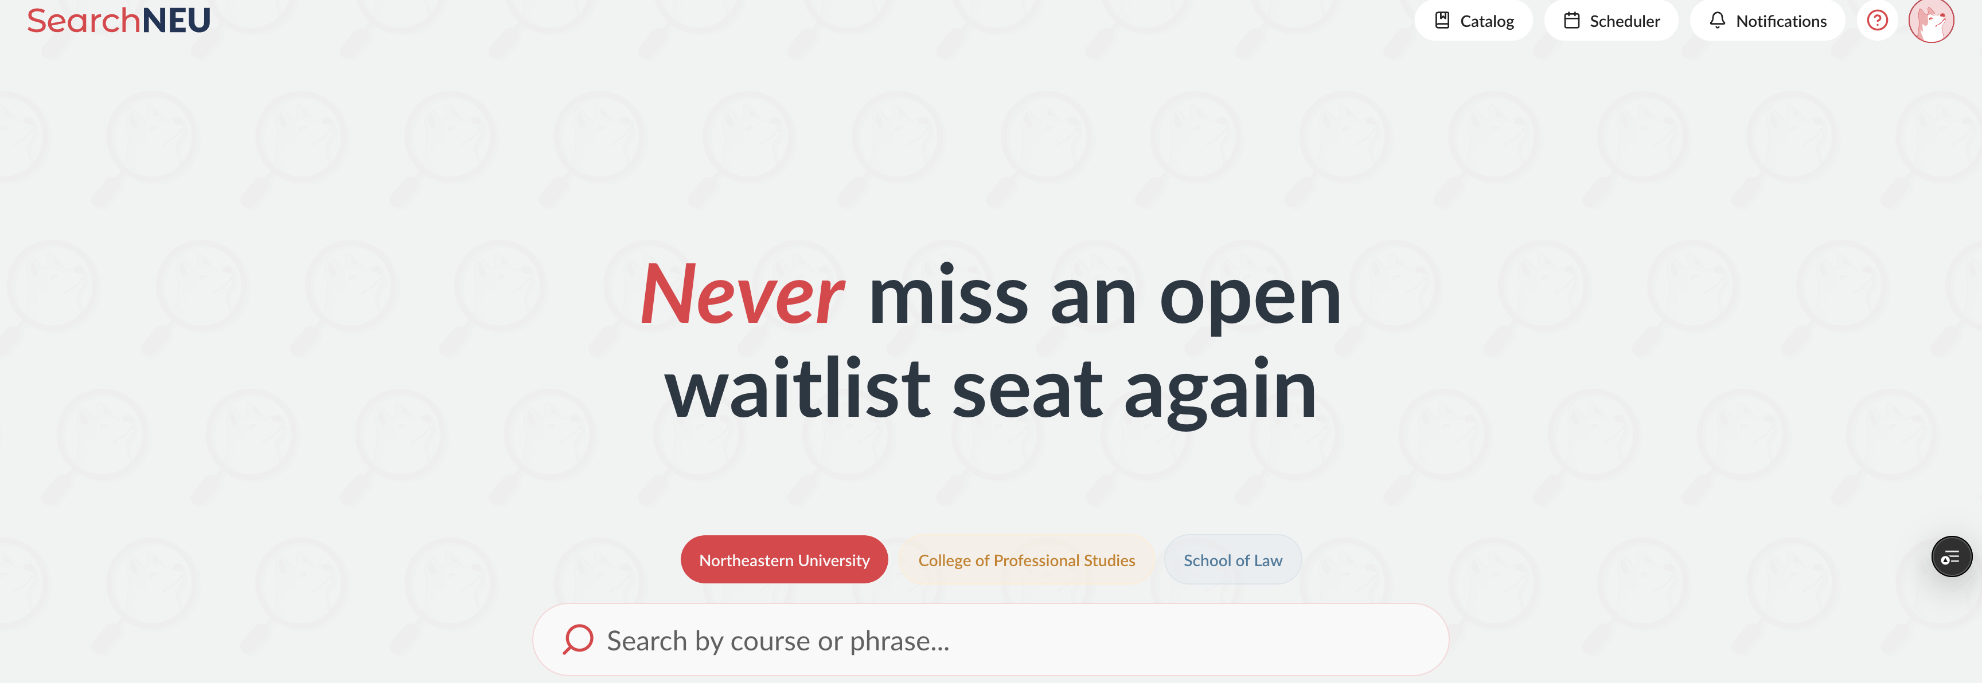
How the SearchNEU Database Works
By: Evan Bray

Slide 2
Please be warned, this is messy.

Slide 3
If you have questions, shout them out. But they may be answered later.

Slide 4
Let's Begin.

Slide 5
How to read our database.

Slide 6
My Assumptions
I am 99% sure they are correct (may be missing some edge cases).
If ever during development / design, you feel like the documentation may be off, please let me know and we can talk about it.
They mostly regard Plan / Graduate and user data. I'm essentially going off instinct and what makes sense.

Slide 7
Ask Yourself Questions Until it Makes Sense.
This is how I built it and how you should read it.

Slide 8
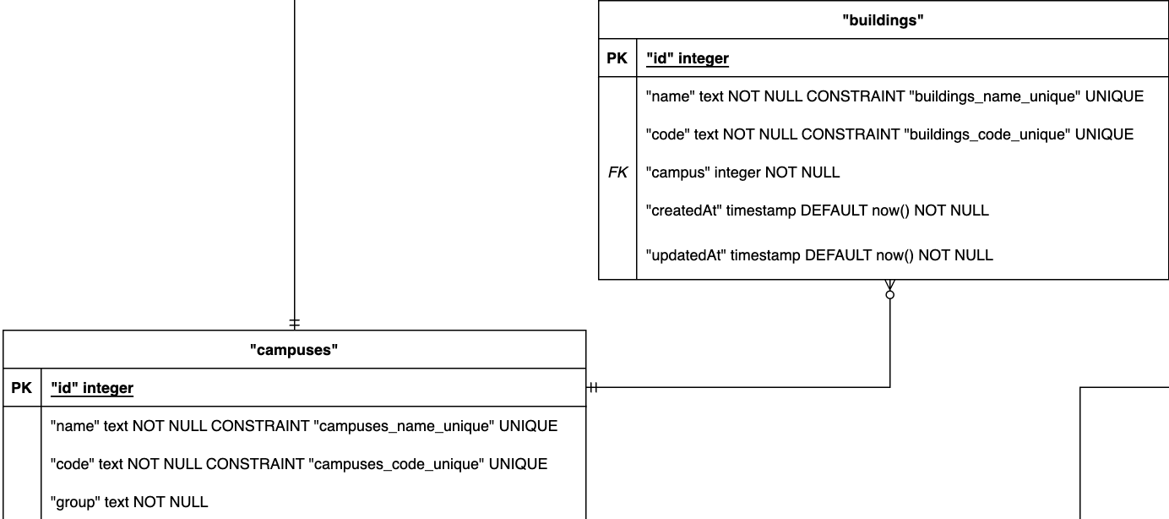
It makes sense that every building must be on a campus. However, not every campus has buildings.

Slide 9
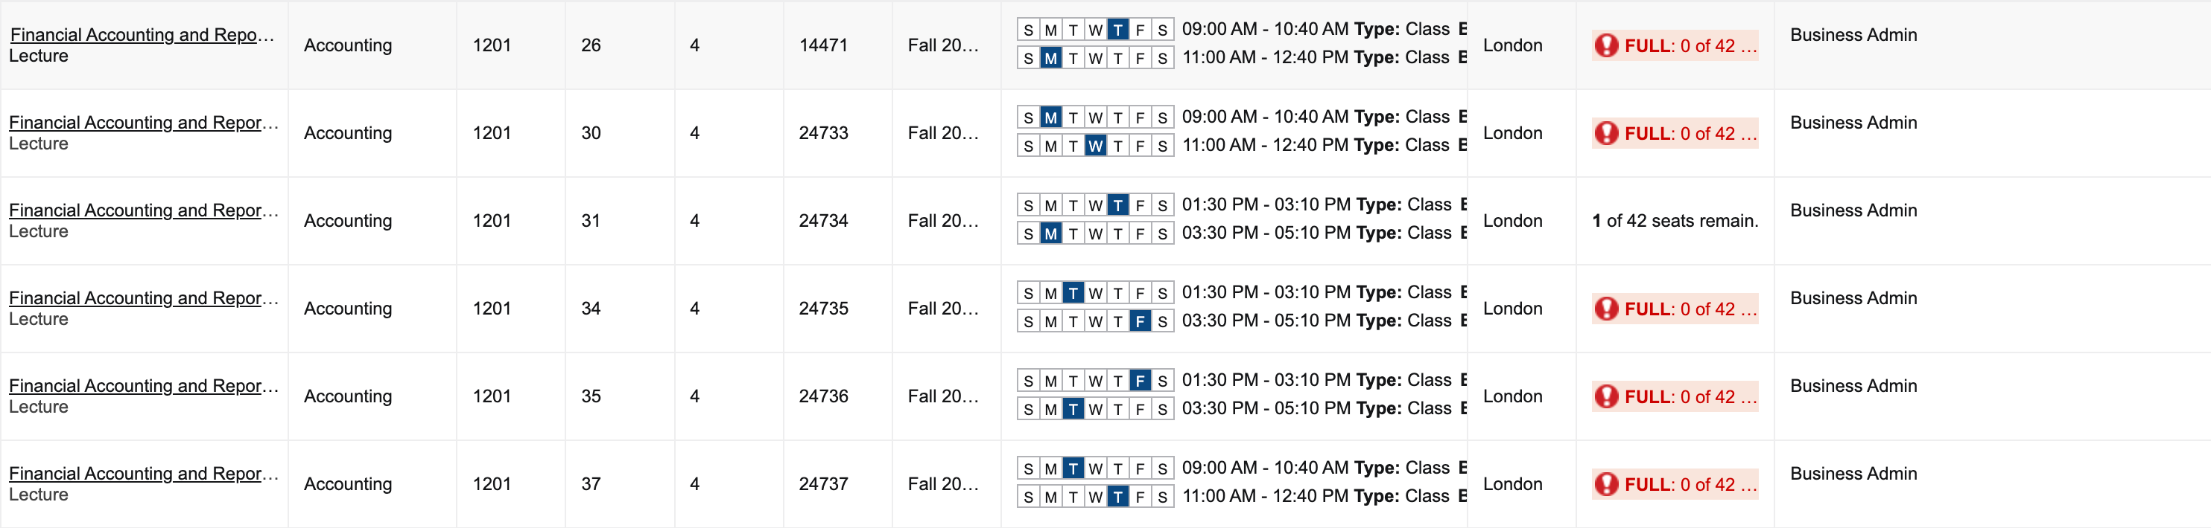
Notice how for the London campus, Banner doesn't state the building? Therefore, not all campuses have buildings.

Slide 10
Don't like that?
Take it up with Banner.
We use it as our source of truth (we literally scrape it), so don't hate on us.

Slide 11
The Search in SearchNEU.

Slide 12
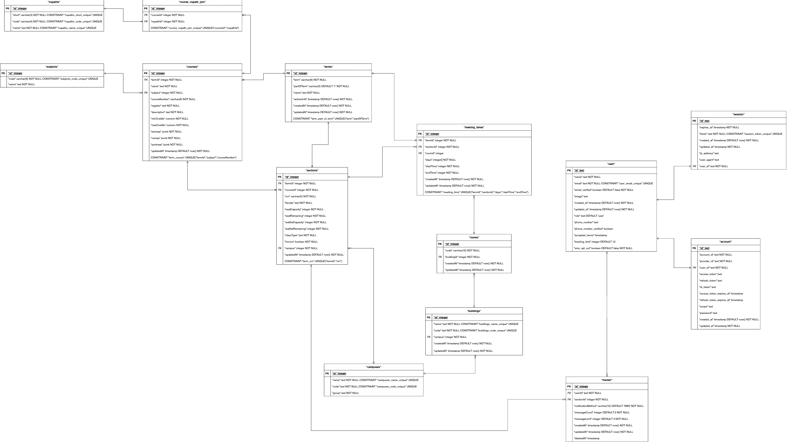

Slide 13
It's not too bad.

Slide 14
Let's go through it.

Slide 15
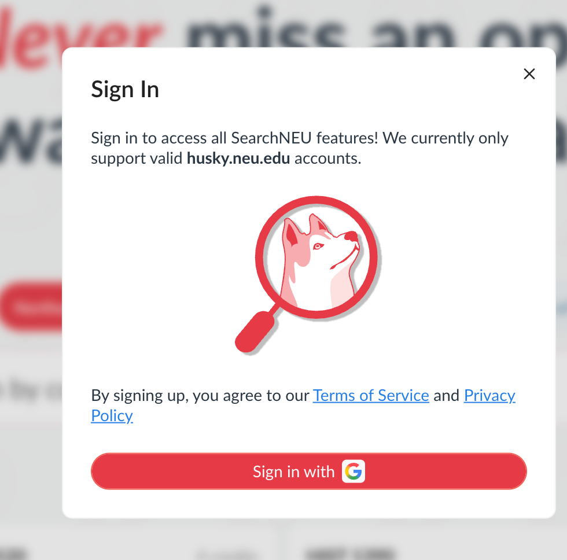
When a user signs in, 3 database tables are used.
A table that holds information about the user (name, email, phone number)
The user's account (account id, provider id from Google)
The user's session (IP address)
No longer noted in database but helps with understanding.

Slide 16
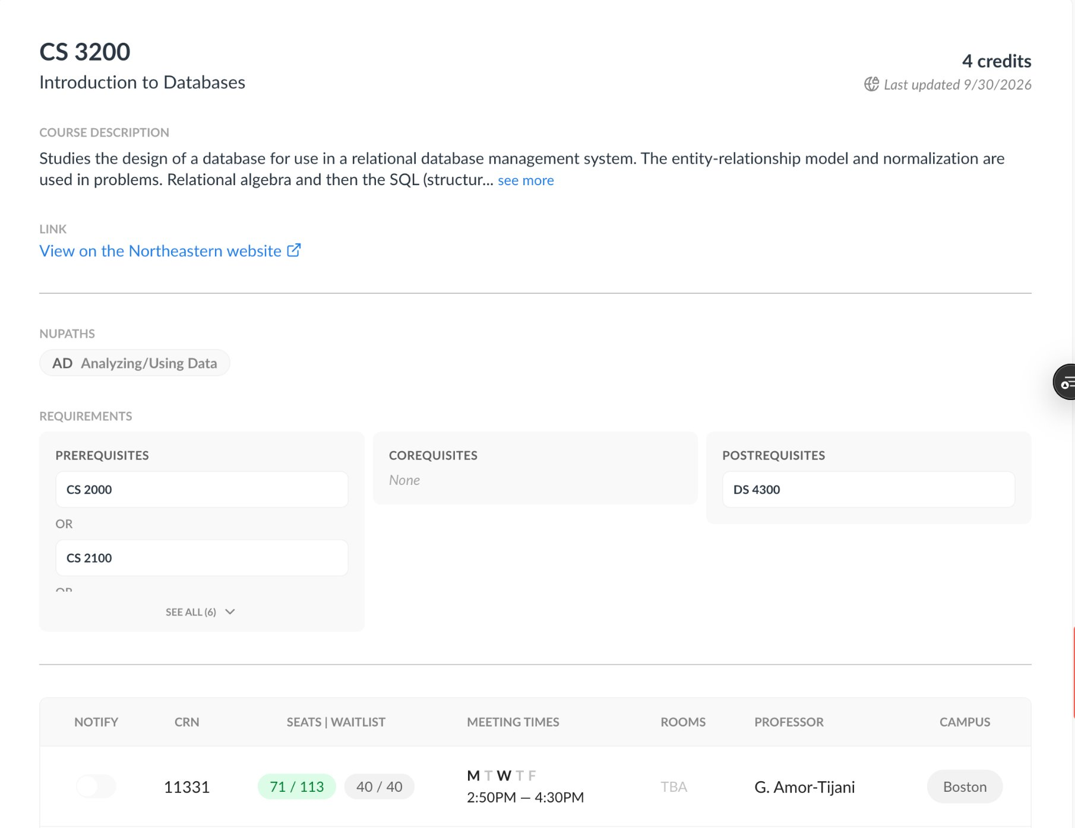
A course page uses a lot of databases.
Which is good! It would be much harder to code if we didn’t.

Slide 17
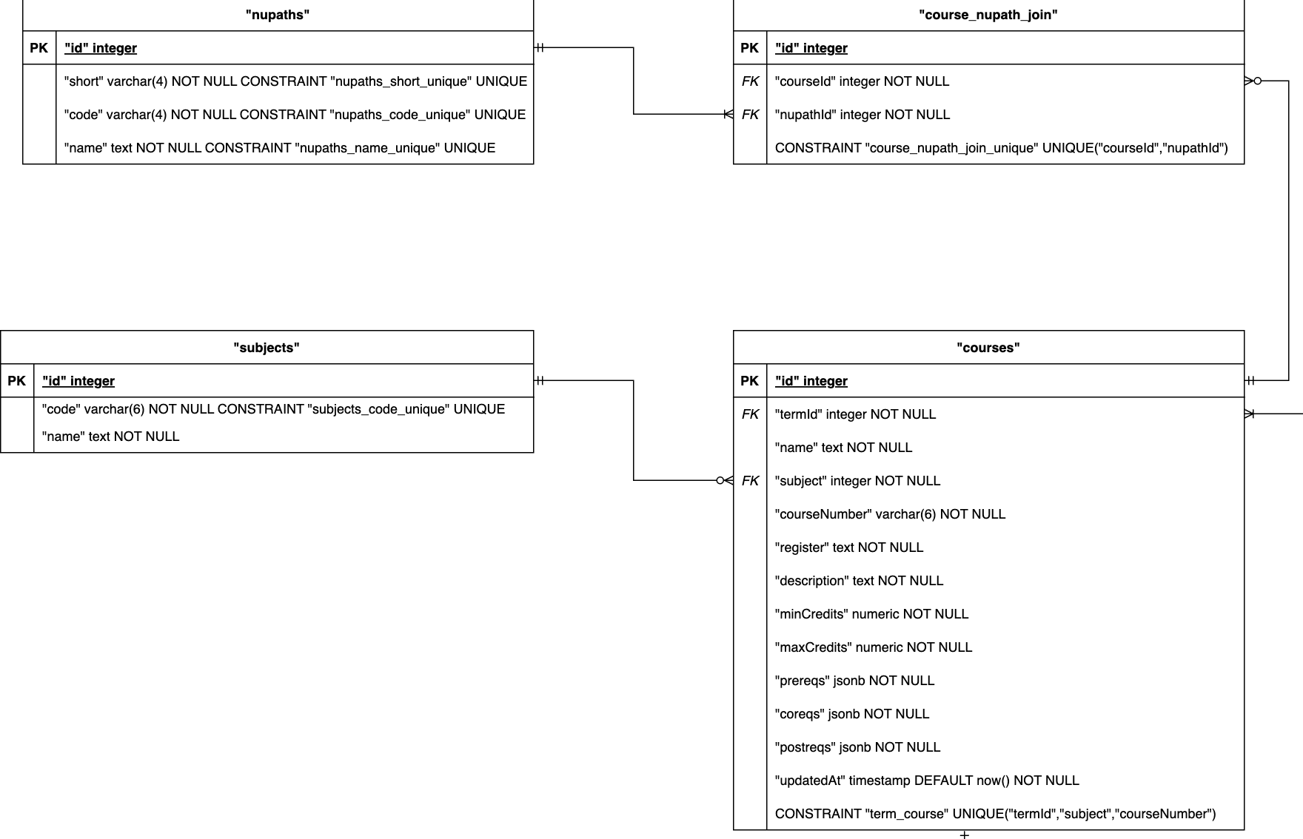
Done via JOIN on subjects.id and courses.subject
Used to only show courses for a specific term.
Used for notifications.

Slide 18
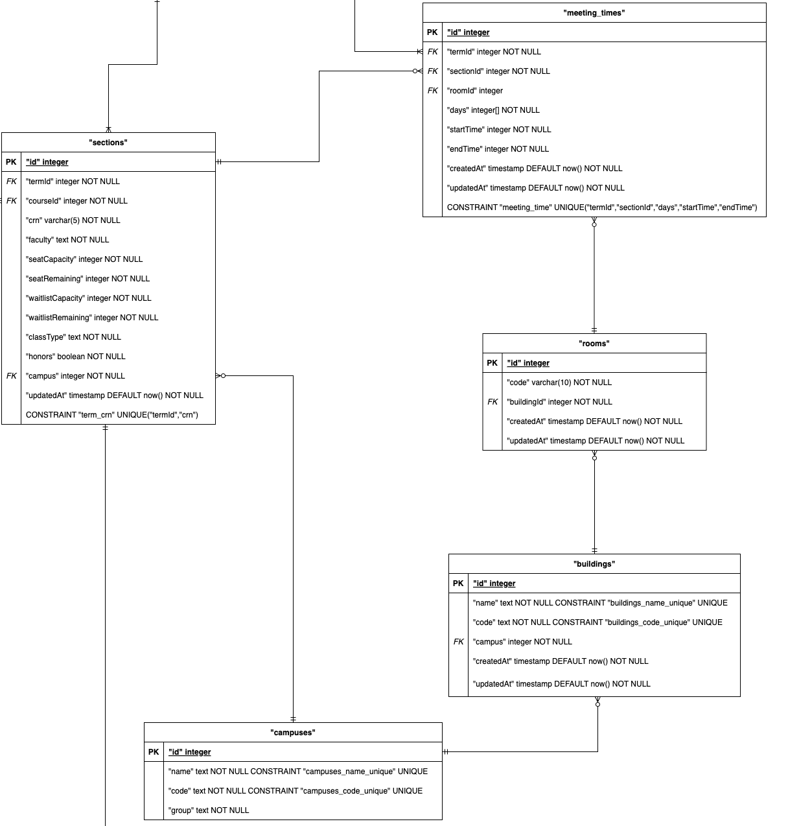
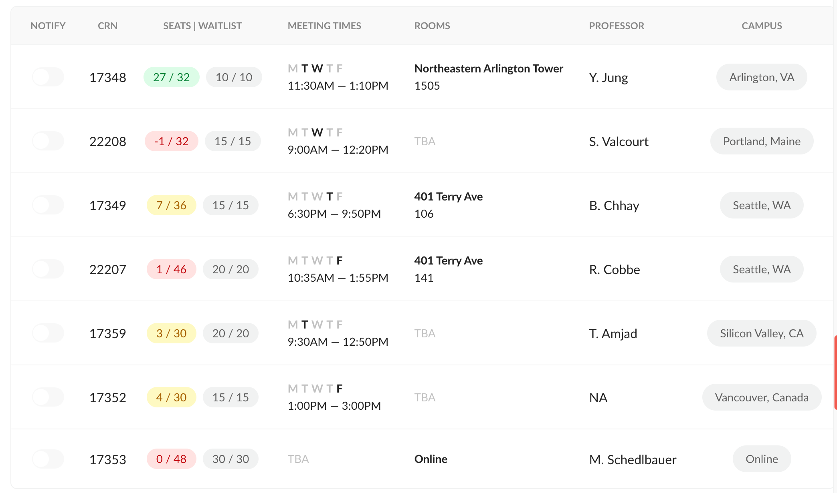
How "register" is used for notifications in the last slide.
But our term is currently not active, so we can't register.

Slide 19
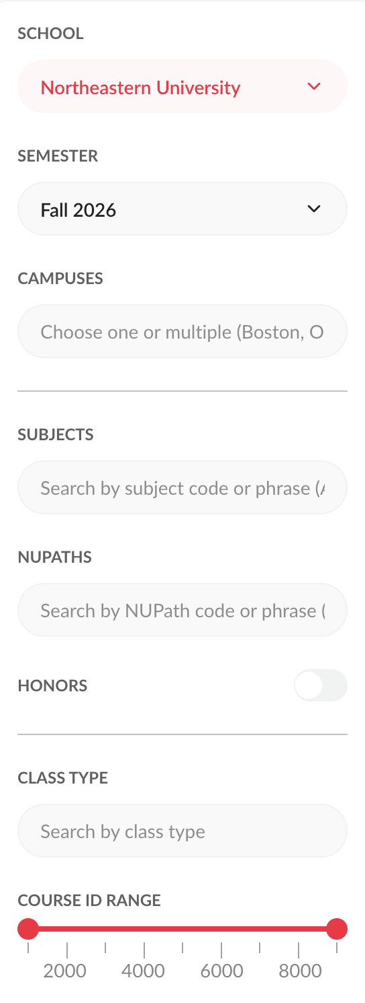
We use many different data tables to help users filter.
Tables Used:
"terms"
"campuses"
"subjects"
"nupaths"
"sections"

Slide 20
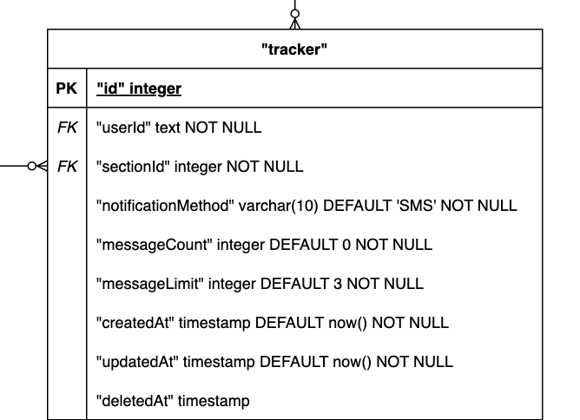
Notifications
Used whenever a user wants to be notified when a section becomes available. We store the user id, section id, and the means of notifying them.

Slide 21
And that was Search.

Slide 22
Any questions?

Slide 23
And then we added Plan.

Slide 24
Plan made things messy...

Slide 25
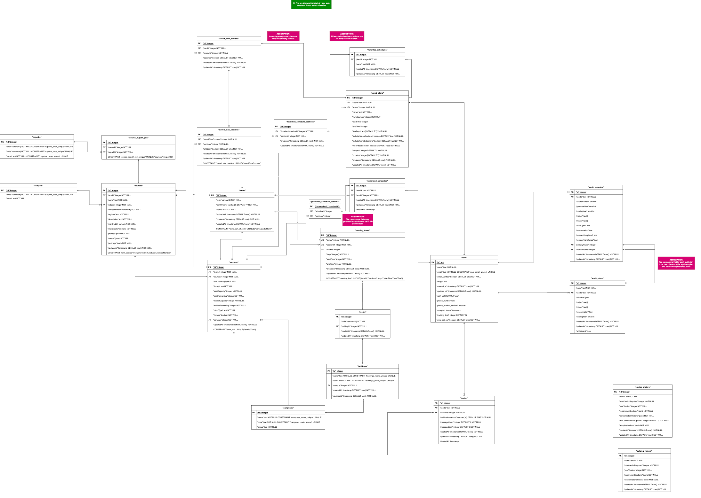


Slide 26
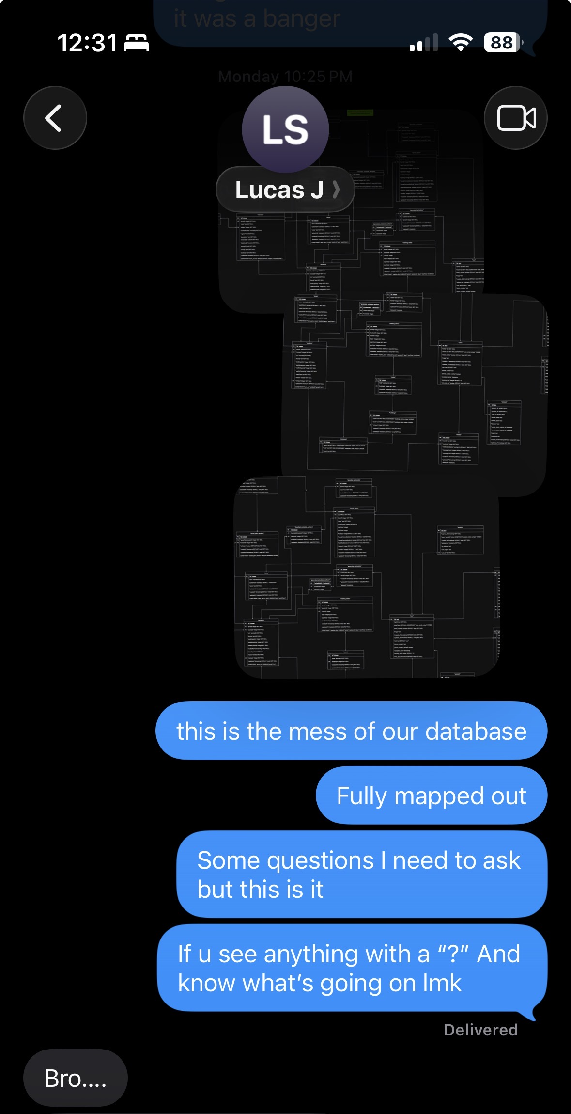

Slide 27
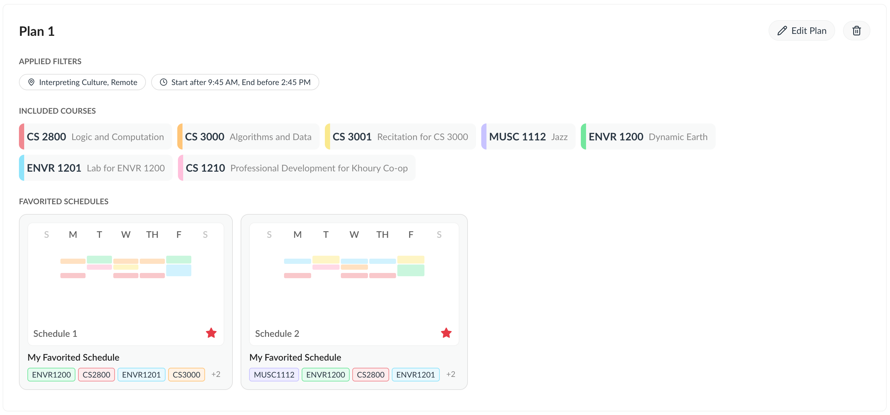
Tables Used:
saved_plans
saved_plan_courses
saved_plan_sections
favorited_schedules
favorited_schedules_sections
sections
courses
meeting_times
subjects

Slide 28
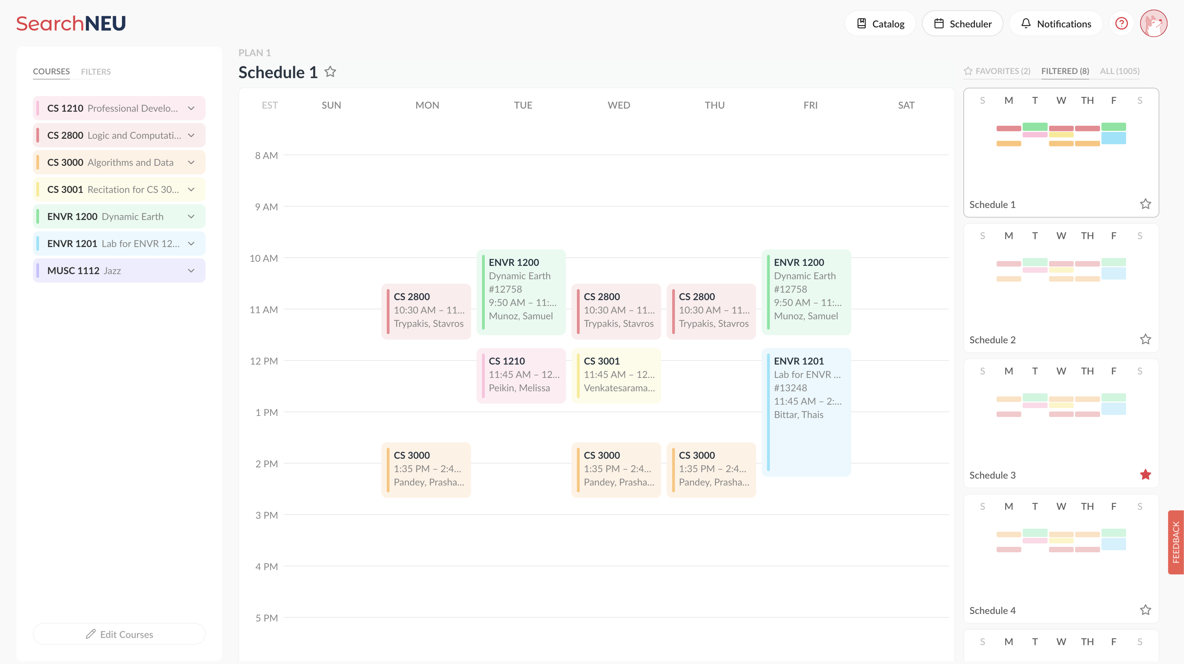
Plan's scheduler / generator essentially uses all the tables within our database. We need to pull the saved data from previous plans, create new ones, and hold all the metadata for each plan (section, building, etc.) for each user.

Slide 29
Any questions?

Slide 30
For Future Questions
Read the Docs → Evan → Lucas → Mike

