Slide 1
MATLAB Assignment
Secant, Runge-Kutta and Newton-Raphson methods: FOR and WHILE loop solutions, flowcharts and pseudocode

Slide 2
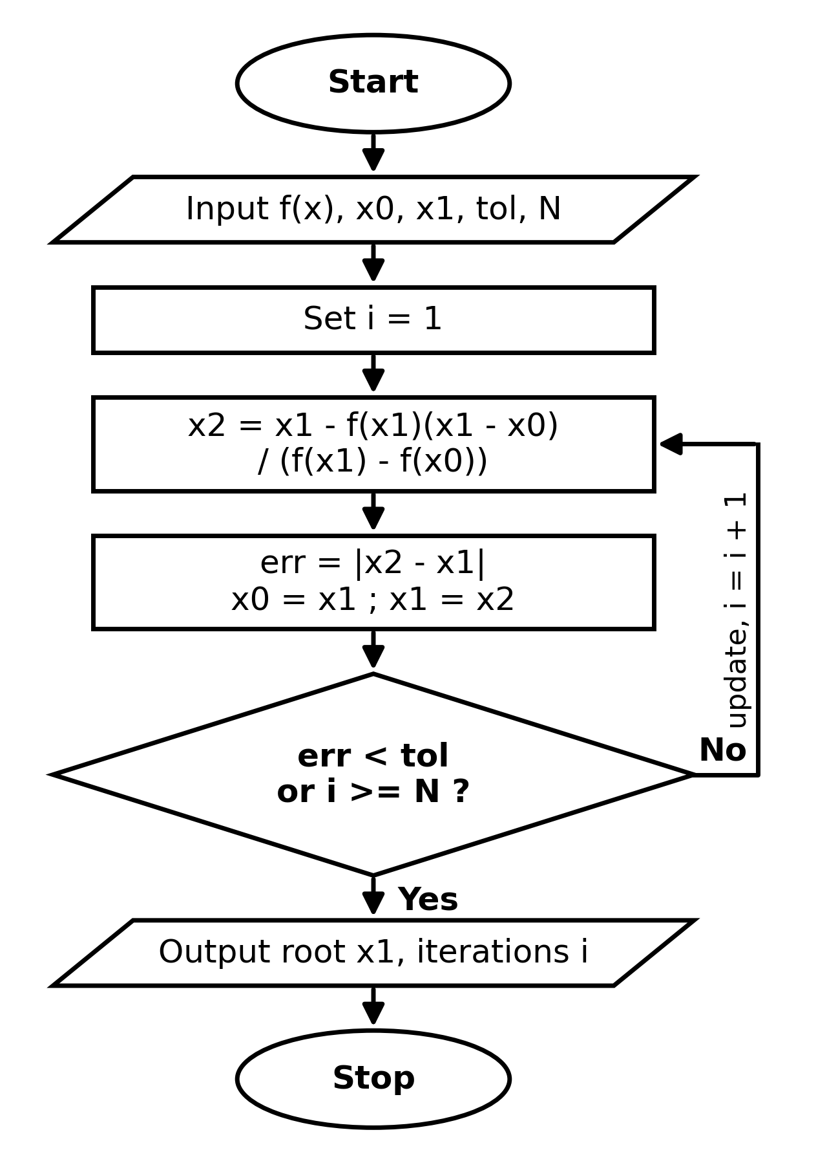
1. Secant Method
x(n+1) = x(n) - f(x(n)) [x(n) - x(n-1)] / [f(x(n)) - f(x(n-1))]
Pseudocode: FOR loop
INPUT f, x0, x1, tol, N
FOR i = 1 TO N
x2 = x1 - f(x1)(x1-x0)/(f(x1)-f(x0))
err = |x2 - x1|
x0 = x1 ; x1 = x2
IF err < tol THEN EXIT LOOP
END FOR
OUTPUT x1, i
Pseudocode: WHILE loop
INPUT f, x0, x1, tol, N
i = 0 ; err = 1
WHILE err > tol AND i < N
i = i + 1
x2 = x1 - f(x1)(x1-x0)/(f(x1)-f(x0))
err = |x2 - x1|
x0 = x1 ; x1 = x2
END WHILE
OUTPUT x1, i

Slide 3
Secant Method: Example 1
Problem: f(x) = x^3 - 2x - 5, x0 = 2, x1 = 3
MATLAB: FOR loop
MATLAB: WHILE loop
f = @(x) x^3 - 2*x - 5;
x0 = 2; x1 = 3; tol = 1e-6; N = 50;
for i = 1:N
x2 = x1 - f(x1)*(x1-x0)/(f(x1)-f(x0));
err = abs(x2 - x1);
fprintf('%d %.6f %.2e\n',i,x2,err);
x0 = x1; x1 = x2;
if err < tol, break, end
end
fprintf('Root = %.6f\n', x1);
f = @(x) x^3 - 2*x - 5;
x0 = 2; x1 = 3; tol = 1e-6; N = 50;
i = 0; err = 1;
while err > tol && i < N
i = i + 1;
x2 = x1 - f(x1)*(x1-x0)/(f(x1)-f(x0));
err = abs(x2 - x1);
fprintf('%d %.6f %.2e\n',i,x2,err);
x0 = x1; x1 = x2;
end
fprintf('Root = %.6f\n', x1);
Answer: Root x = 2.094551 (converged in 6 iterations)
Iterates: 2.058824 → 2.081264 → 2.094824 → 2.094549 → 2.094551 → 2.094551

Slide 4
Secant Method: Example 2
Problem: f(x) = e^(-x) - x, x0 = 0, x1 = 1
MATLAB: FOR loop
MATLAB: WHILE loop
f = @(x) exp(-x) - x;
x0 = 0; x1 = 1; tol = 1e-6; N = 50;
for i = 1:N
x2 = x1 - f(x1)*(x1-x0)/(f(x1)-f(x0));
err = abs(x2 - x1);
fprintf('%d %.6f %.2e\n',i,x2,err);
x0 = x1; x1 = x2;
if err < tol, break, end
end
fprintf('Root = %.6f\n', x1);
f = @(x) exp(-x) - x;
x0 = 0; x1 = 1; tol = 1e-6; N = 50;
i = 0; err = 1;
while err > tol && i < N
i = i + 1;
x2 = x1 - f(x1)*(x1-x0)/(f(x1)-f(x0));
err = abs(x2 - x1);
fprintf('%d %.6f %.2e\n',i,x2,err);
x0 = x1; x1 = x2;
end
fprintf('Root = %.6f\n', x1);
Answer: Root x = 0.567143 (converged in 5 iterations)
Iterates: 0.612700 → 0.563838 → 0.567170 → 0.567143 → 0.567143

Slide 5
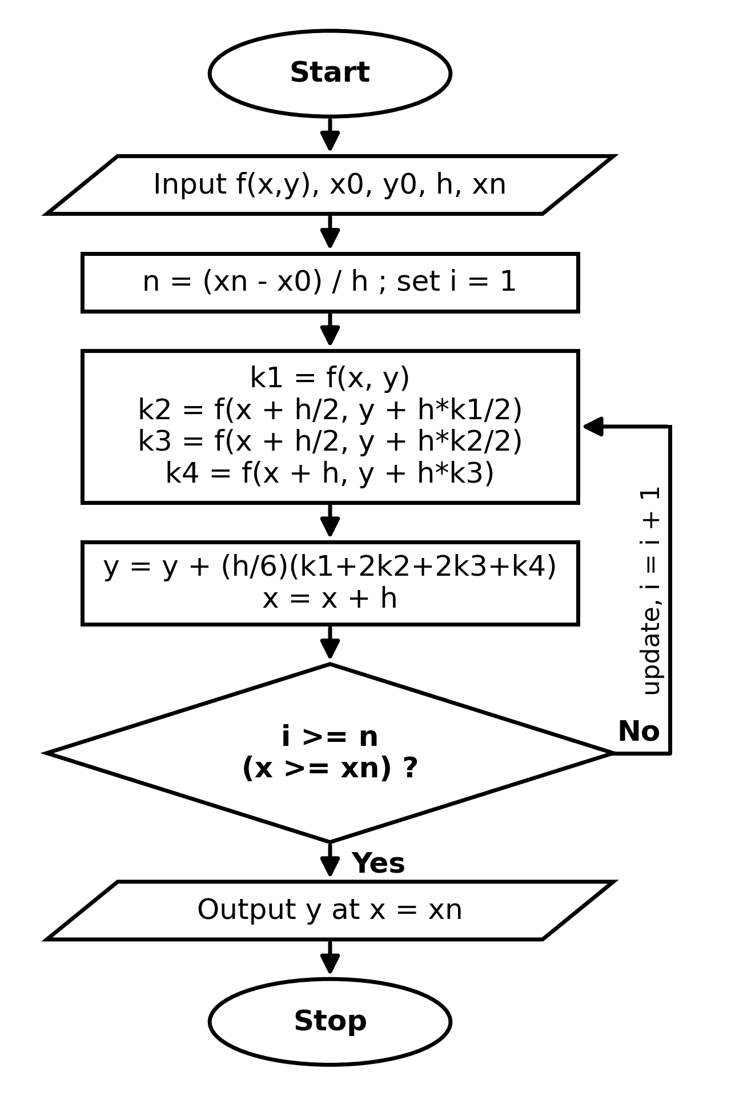
2. Runge-Kutta (4th Order) Method
y(i+1) = y(i) + (h/6)(k1 + 2k2 + 2k3 + k4)
Pseudocode: FOR loop
INPUT f, x0, y0, h, xn
n = (xn - x0)/h
FOR i = 1 TO n
k1 = f(x,y)
k2 = f(x+h/2, y+h*k1/2)
k3 = f(x+h/2, y+h*k2/2)
k4 = f(x+h, y+h*k3)
y = y + (h/6)(k1+2k2+2k3+k4)
x = x + h
END FOR
OUTPUT y
Pseudocode: WHILE loop
INPUT f, x0, y0, h, xn
WHILE x < xn
k1 = f(x,y)
k2 = f(x+h/2, y+h*k1/2)
k3 = f(x+h/2, y+h*k2/2)
k4 = f(x+h, y+h*k3)
y = y + (h/6)(k1+2k2+2k3+k4)
x = x + h
END WHILE
OUTPUT y

Slide 6
Runge-Kutta (4th Order) Method: Example 1
Problem: dy/dx = x + y, y(0) = 1, h = 0.1, find y(0.5)
MATLAB: FOR loop
MATLAB: WHILE loop
f = @(x,y) x + y;
x = 0; y = 1; h = 0.1; xn = 0.5;
n = round((xn - x)/h);
for i = 1:n
k1 = f(x, y);
k2 = f(x + h/2, y + h*k1/2);
k3 = f(x + h/2, y + h*k2/2);
k4 = f(x + h, y + h*k3);
y = y + (h/6)*(k1 + 2*k2 + 2*k3 + k4);
x = x + h;
fprintf('x = %.1f y = %.6f\n', x, y);
end
f = @(x,y) x + y;
x = 0; y = 1; h = 0.1; xn = 0.5;
while x < xn - 1e-9
k1 = f(x, y);
k2 = f(x + h/2, y + h*k1/2);
k3 = f(x + h/2, y + h*k2/2);
k4 = f(x + h, y + h*k3);
y = y + (h/6)*(k1 + 2*k2 + 2*k3 + k4);
x = x + h;
fprintf('x = %.1f y = %.6f\n', x, y);
end
Answer: y(0.5) = 1.797441 by RK4 (exact 1.797443)
Steps: x=0.1: 1.110342 x=0.2: 1.242805 x=0.3: 1.399717 x=0.4: 1.583648 x=0.5: 1.797441

Slide 7
Runge-Kutta (4th Order) Method: Example 2
Problem: dy/dx = y - x^2 + 1, y(0) = 0.5, h = 0.2, find y(1)
MATLAB: FOR loop
MATLAB: WHILE loop
f = @(x,y) y - x^2 + 1;
x = 0; y = 0.5; h = 0.2; xn = 1;
n = round((xn - x)/h);
for i = 1:n
k1 = f(x, y);
k2 = f(x + h/2, y + h*k1/2);
k3 = f(x + h/2, y + h*k2/2);
k4 = f(x + h, y + h*k3);
y = y + (h/6)*(k1 + 2*k2 + 2*k3 + k4);
x = x + h;
fprintf('x = %.1f y = %.6f\n', x, y);
end
f = @(x,y) y - x^2 + 1;
x = 0; y = 0.5; h = 0.2; xn = 1;
while x < xn - 1e-9
k1 = f(x, y);
k2 = f(x + h/2, y + h*k1/2);
k3 = f(x + h/2, y + h*k2/2);
k4 = f(x + h, y + h*k3);
y = y + (h/6)*(k1 + 2*k2 + 2*k3 + k4);
x = x + h;
fprintf('x = %.1f y = %.6f\n', x, y);
end
Answer: y(1) = 2.640823 by RK4 (exact 2.640859)
Steps: x=0.2: 0.829293 x=0.4: 1.214076 x=0.6: 1.648922 x=0.8: 2.127203 x=1.0: 2.640823

Slide 8
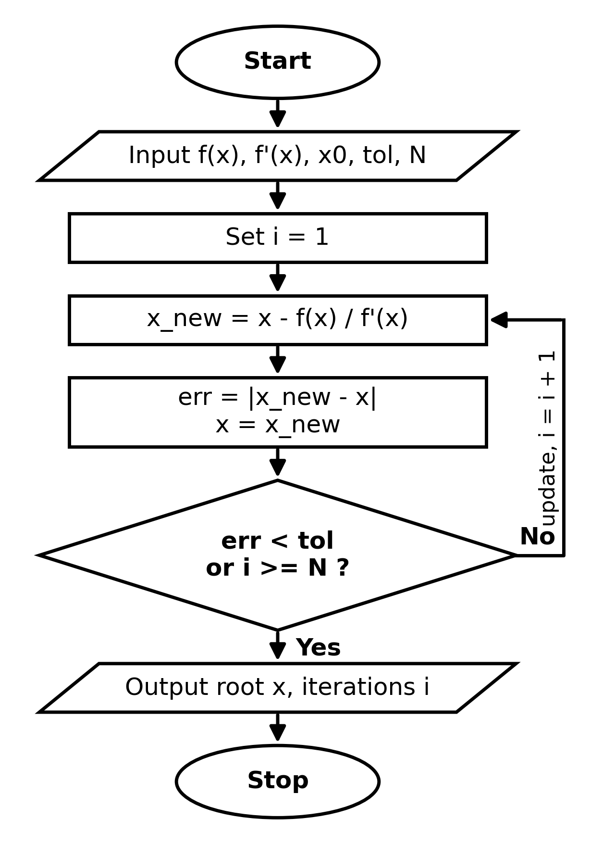
3. Newton-Raphson Method
x(n+1) = x(n) - f(x(n)) / f'(x(n))
Pseudocode: FOR loop
INPUT f, f', x0, tol, N
x = x0
FOR i = 1 TO N
x_new = x - f(x)/f'(x)
err = |x_new - x|
x = x_new
IF err < tol THEN EXIT LOOP
END FOR
OUTPUT x, i
Pseudocode: WHILE loop
INPUT f, f', x0, tol, N
x = x0 ; i = 0 ; err = 1
WHILE err > tol AND i < N
i = i + 1
x_new = x - f(x)/f'(x)
err = |x_new - x|
x = x_new
END WHILE
OUTPUT x, i

Slide 9
Newton-Raphson Method: Example 1
Problem: f(x) = x^3 - x - 2, x0 = 1.5
MATLAB: FOR loop
MATLAB: WHILE loop
f = @(x) x^3 - x - 2;
df = @(x) 3*x^2 - 1;
x = 1.5; tol = 1e-6; N = 50;
for i = 1:N
xnew = x - f(x)/df(x);
err = abs(xnew - x);
x = xnew;
fprintf('%d %.6f %.2e\n',i,x,err);
if err < tol, break, end
end
fprintf('Root = %.6f\n', x);
f = @(x) x^3 - x - 2;
df = @(x) 3*x^2 - 1;
x = 1.5; tol = 1e-6; N = 50;
i = 0; err = 1;
while err > tol && i < N
i = i + 1;
xnew = x - f(x)/df(x);
err = abs(xnew - x);
x = xnew;
fprintf('%d %.6f %.2e\n',i,x,err);
end
fprintf('Root = %.6f\n', x);
Answer: Root x = 1.521380 (converged in 3 iterations)
Iterates: 1.521380 → 1.521380

Slide 10
Newton-Raphson Method: Example 2
Problem: f(x) = cos(x) - x, x0 = 0.5
MATLAB: FOR loop
MATLAB: WHILE loop
f = @(x) cos(x) - x;
df = @(x) -sin(x) - 1;
x = 0.5; tol = 1e-6; N = 50;
for i = 1:N
xnew = x - f(x)/df(x);
err = abs(xnew - x);
x = xnew;
fprintf('%d %.6f %.2e\n',i,x,err);
if err < tol, break, end
end
fprintf('Root = %.6f\n', x);
f = @(x) cos(x) - x;
df = @(x) -sin(x) - 1;
x = 0.5; tol = 1e-6; N = 50;
i = 0; err = 1;
while err > tol && i < N
i = i + 1;
xnew = x - f(x)/df(x);
err = abs(xnew - x);
x = xnew;
fprintf('%d %.6f %.2e\n',i,x,err);
end
fprintf('Root = %.6f\n', x);
Answer: Root x = 0.739085 (converged in 4 iterations)
Iterates: 0.739142 → 0.739085 → 0.739085

