Slide 1
Sikkim Manipal University
Department of Computer Applications
CardioPredict
Heart Disease Prediction System Using Machine Learning
Submitted By
Under the Guidance of
Sandeep Kumar
Amit Kharb
MCA Student
Project Guide
MCA Final Year Project • Academic Year 2025–2026

Slide 2
Contents
01
Introduction & Problem Statement
07
Feature Importance
02
Objectives
08
Technology Stack
03
Dataset Overview
09
System Architecture
04
Methodology & Pipeline
10
Live Demo
05
Algorithm Comparison
11
Testing
06
Results & Analysis
12
Conclusion & Future Work
CardioPredict | Sandeep Kumar | MCA | Sikkim Manipal University

Slide 3
Introduction
• CVDs are the #1 cause of death globally — 17.9 million deaths/year (WHO)
• In India, CVDs account for 28% of all deaths
• Conventional diagnostics (ECG, angiography) are expensive
and unavailable in most rural healthcare centres
• ML can analyse routine clinical data to estimate heart
disease risk with accuracy comparable to specialists
Problem
No affordable screening tool exists for primary care clinics.
Most ML models from research exist only as Jupyter notebooks — no UI, no validation.
CardioPredict bridges this gap with a complete web application.
CardioPredict | Sandeep Kumar | MCA | Sikkim Manipal University

Slide 4
Objectives
1.
Analyse the Cleveland Heart Disease dataset (303 records, 13 clinical features)
2.
Train and compare 7 classification algorithms using 10-fold stratified cross-validation
3.
Build a responsive Flask web application for clinical use
4.
Implement dual-layer input validation (client-side + server-side)
5.
Store prediction history in SQLite for patient tracking
6.
Containerise with Docker for one-command deployment
7.
Achieve 28 automated test cases covering all critical paths
CardioPredict | Sandeep Kumar | MCA | Sikkim Manipal University

Slide 5
Dataset Overview
Cleveland Heart Disease Dataset — UCI Machine Learning Repository
303
13
2
80:20
Records
Features
Classes
Split
# | Feature | Description | Range
1 | age | Age in years | 29–77
2 | sex | Gender (0=F, 1=M) | 0 or 1
3 | cp | Chest pain type | 0–3
4 | trestbps | Resting blood pressure | 94–200 mm Hg
5 | chol | Serum cholesterol | 126–564 mg/dl
6 | fbs | Fasting blood sugar > 120 | 0 or 1
7 | restecg | Resting ECG results | 0–2
8 | thalach | Max heart rate achieved | 71–202 bpm
9 | exang | Exercise-induced angina | 0 or 1
10 | oldpeak | ST depression | 0–6.2
11 | slope | ST segment slope | 0–2
12 | ca | Major vessels (fluoroscopy) | 0–3
13 | thal | Thalassemia type | 0–2
CardioPredict | Sandeep Kumar | MCA | Sikkim Manipal University

Slide 6
Methodology
Data Loading
→
EDA
→
Pre- processing
→
Feature Scaling
→
Train/Test Split
→
Model Training
→
Evaluation
→
Serialise (.pkl)
Preprocessing
• Median imputation for missing values (ca, thal)
• StandardScaler normalisation (zero mean, unit variance)
• Stratified 80/20 split (242 / 61 samples)
• random_state = 42 for reproducibility
Evaluation & Tuning
• Stratified 10-fold cross-validation ensures each
fold has balanced class representation
• Metrics: Accuracy, Precision, Recall, F1-Score
• Confusion matrix + ROC-AUC curve analysis
• Hyperparameter tuning via GridSearchCV:
n_estimators=100 selected systematically
CardioPredict | Sandeep Kumar | MCA | Sikkim Manipal University

Slide 7
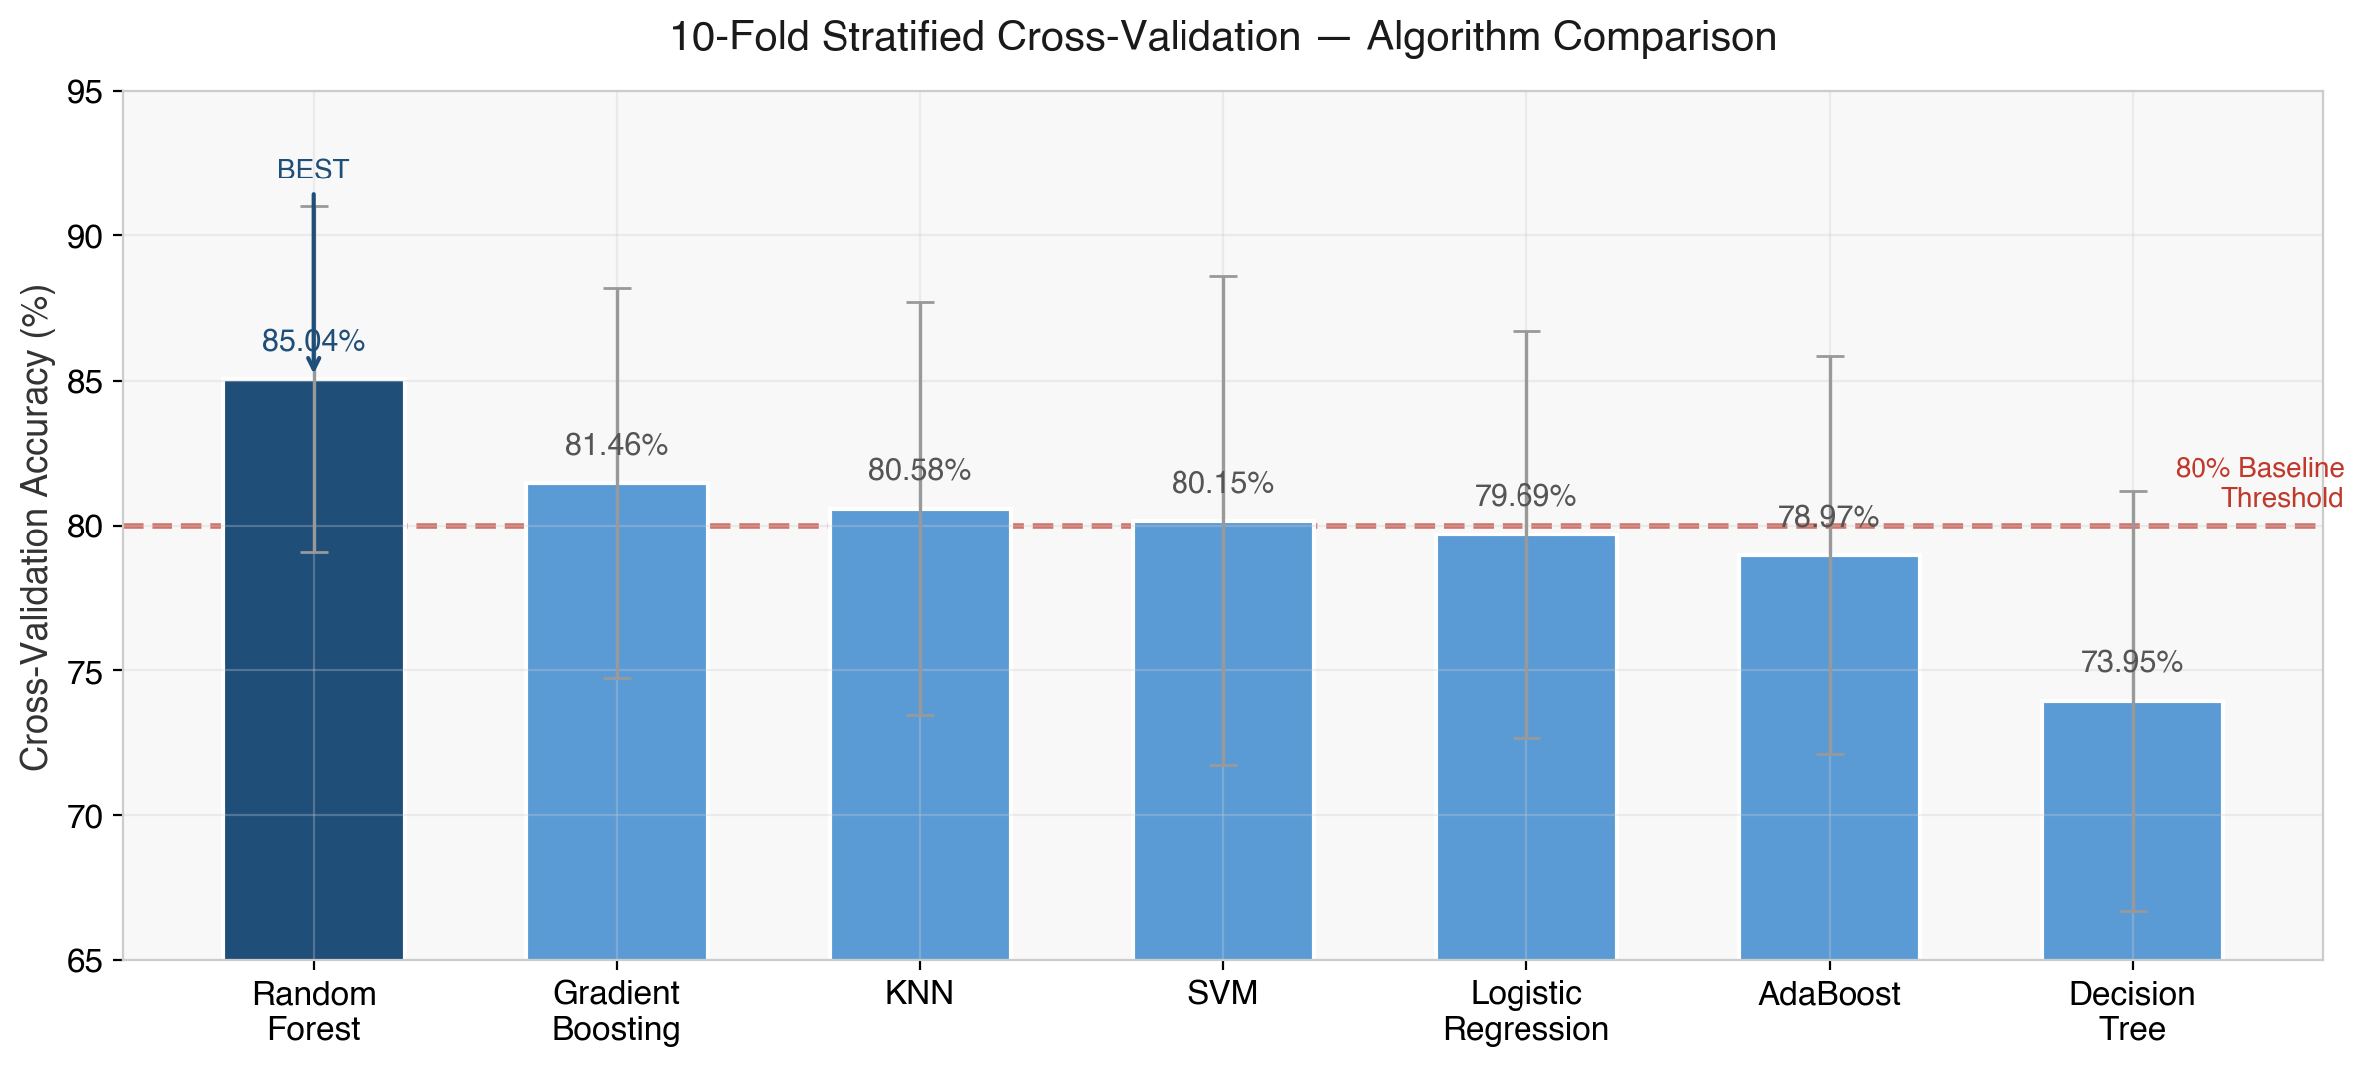
Algorithm Comparison
Red line = 80% baseline threshold. Random Forest (85.04%) — n_estimators=100 via GridSearchCV.
CardioPredict | Sandeep Kumar | MCA | Sikkim Manipal University

Slide 8
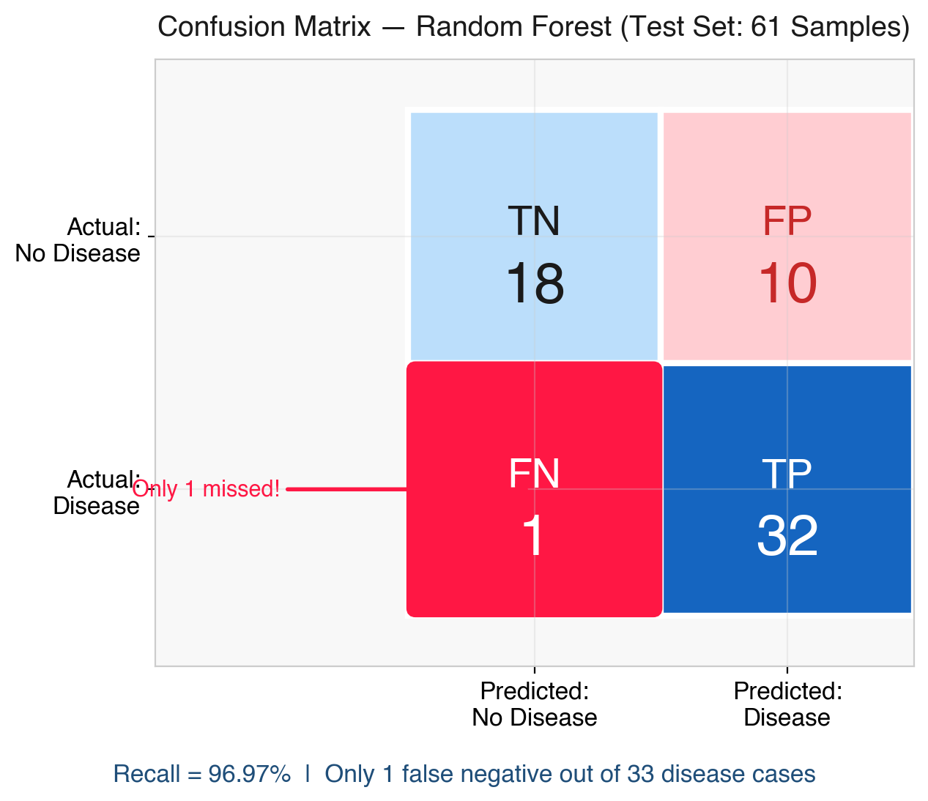
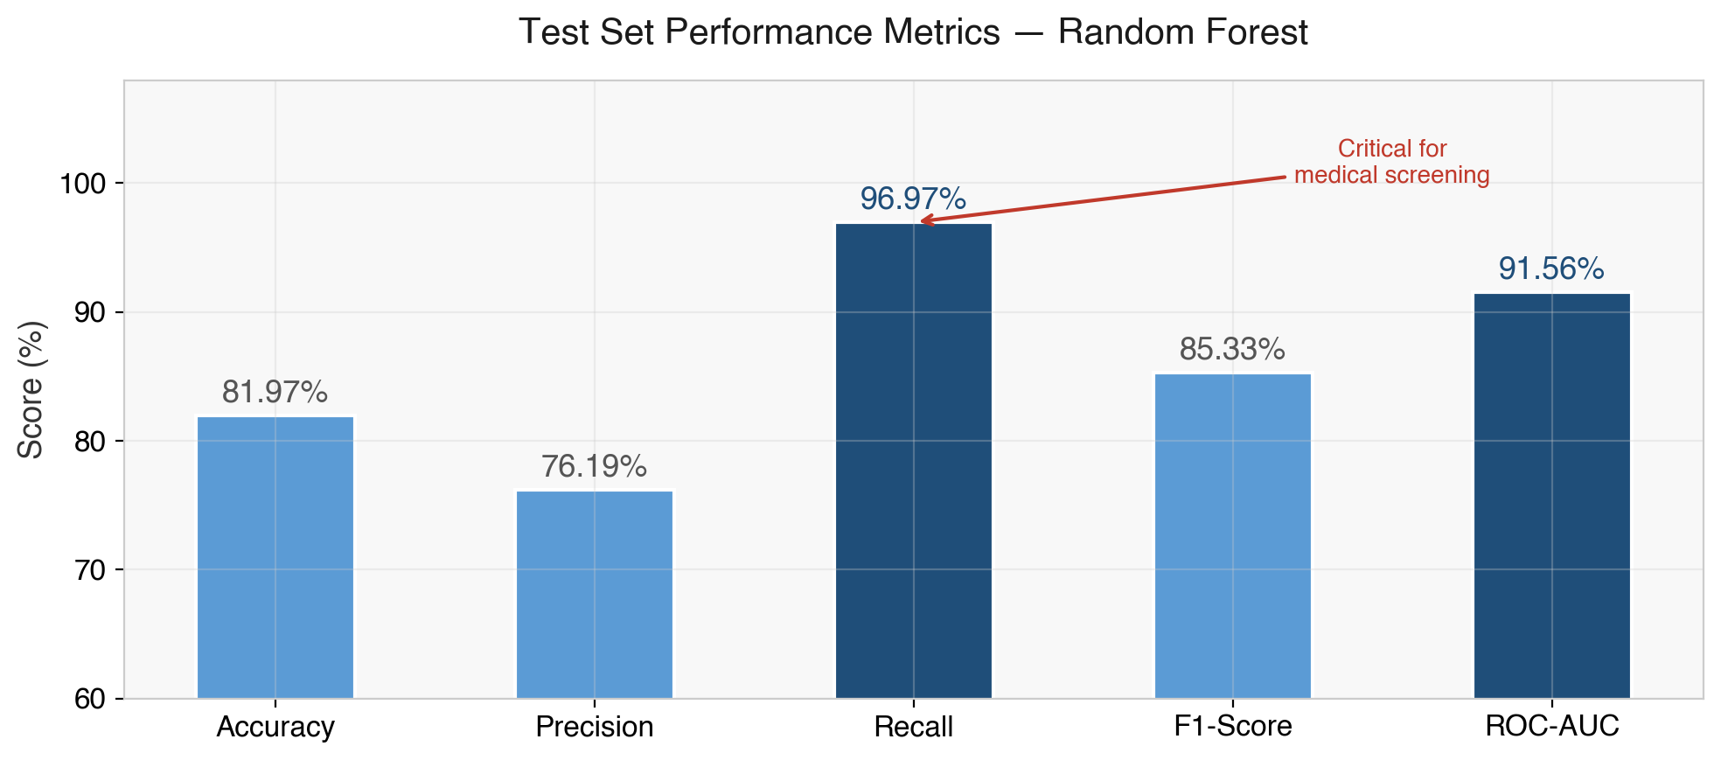
Results
Test Set Performance — Random Forest (61 samples)
Key Insight
Recall = 96.97% — Only 1 false negative out of 33 disease cases. In medical screening, a missed diagnosis is far more dangerous than a false alarm.
CardioPredict | Sandeep Kumar | MCA | Sikkim Manipal University

Slide 9
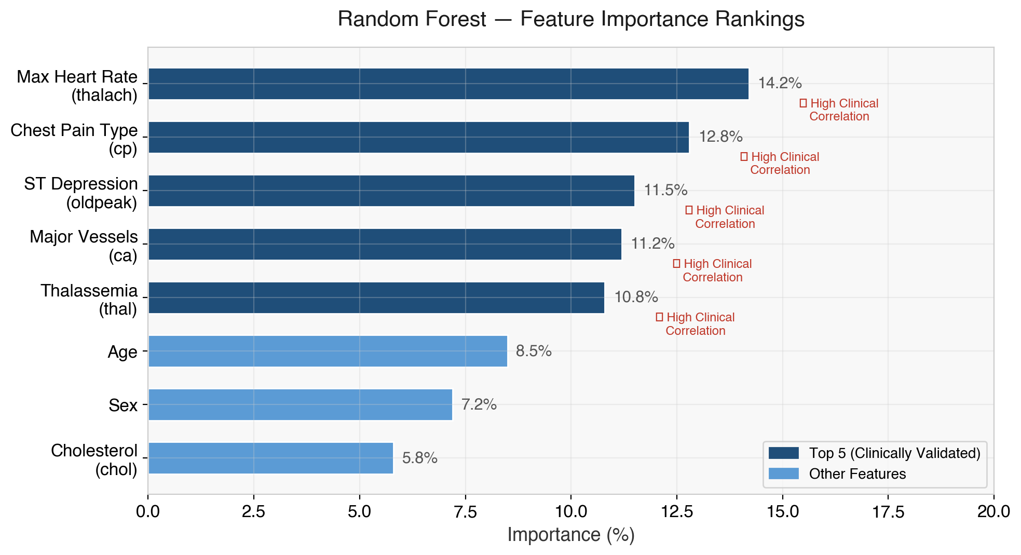
Feature Importance
Clinical Reasoning
Max Heart Rate:
Lower max HR = reduced cardiac reserve = higher risk
Chest Pain Type:
Asymptomatic (cp=3) is paradoxically the highest risk category
ST Depression:
Exercise-induced myocardial ischaemia — direct cardiac stress marker
Major Vessels (ca):
More blocked vessels = worse coronary patency
Thalassemia (thal):
Blood disorder affecting oxygen transport
CardioPredict | Sandeep Kumar | MCA | Sikkim Manipal University

Slide 10
Technology Stack
Component | Technology | Purpose
Language | Python 3.9+ | Backend, ML training, scripting
ML Libraries | scikit-learn, pandas, NumPy | Data processing and model training
Web Framework | Flask 3.0 | HTTP routing, template rendering
Frontend | HTML5, CSS3, JavaScript | User interface (no frameworks)
Database | SQLite 3 | Prediction history storage
Testing | pytest | 28 automated test cases
Containerisation | Docker + Gunicorn | Production deployment
Version Control | Git + GitHub | Source code management
CardioPredict | Sandeep Kumar | MCA | Sikkim Manipal University

Slide 11
System Architecture
Model-View-Controller (MVC) Pattern
Browser (Client)
Flask (Controller)
ML Model (Model)
SQLite (Storage)
HTML/CSS/JS User input forms localStorage prefs
Route handlers Input validation Template rendering
StandardScaler Random Forest predict_proba()
Prediction records Timestamps CRUD operations
→
→
→
Request Flow
Production Deployment
Browser → POST /predict → Flask validates
→ StandardScaler + Random Forest inference
→ SQLite saves → colour-coded result rendered
[Docker] Container — single-command deploy
[Gunicorn] WSGI server — 4 worker processes
[pip freeze] All dependencies in requirements.txt
[env] Environment variables for configuration
CardioPredict | Sandeep Kumar | MCA | Sikkim Manipal University

Slide 12
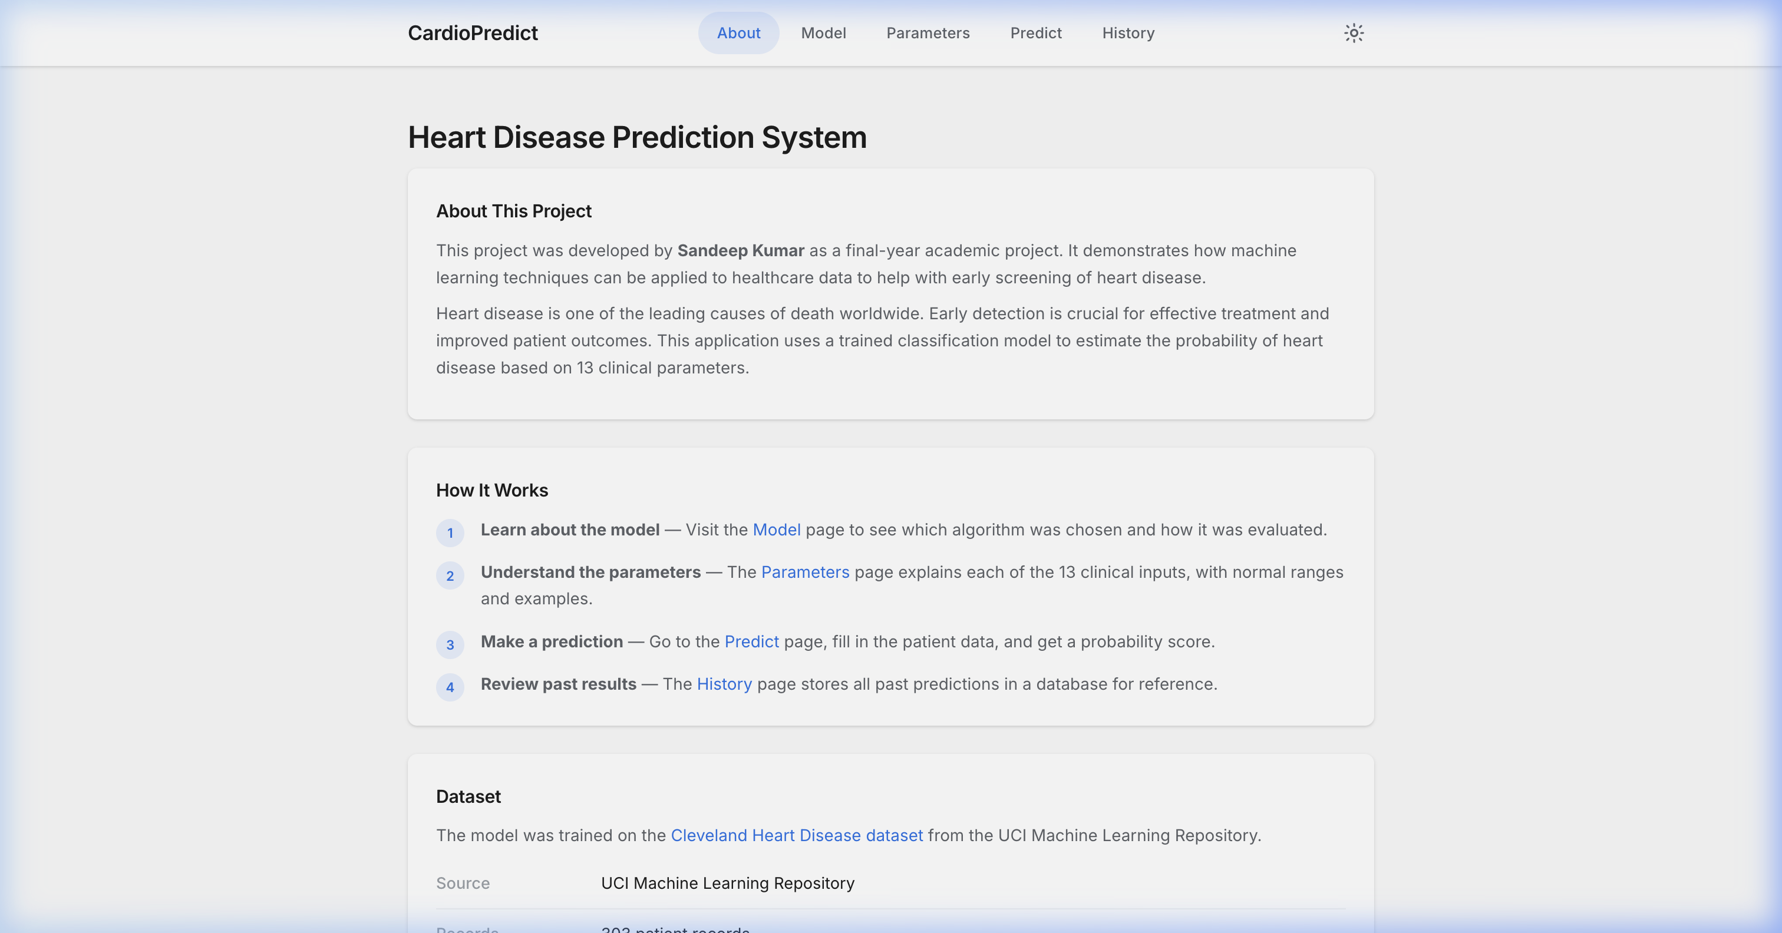
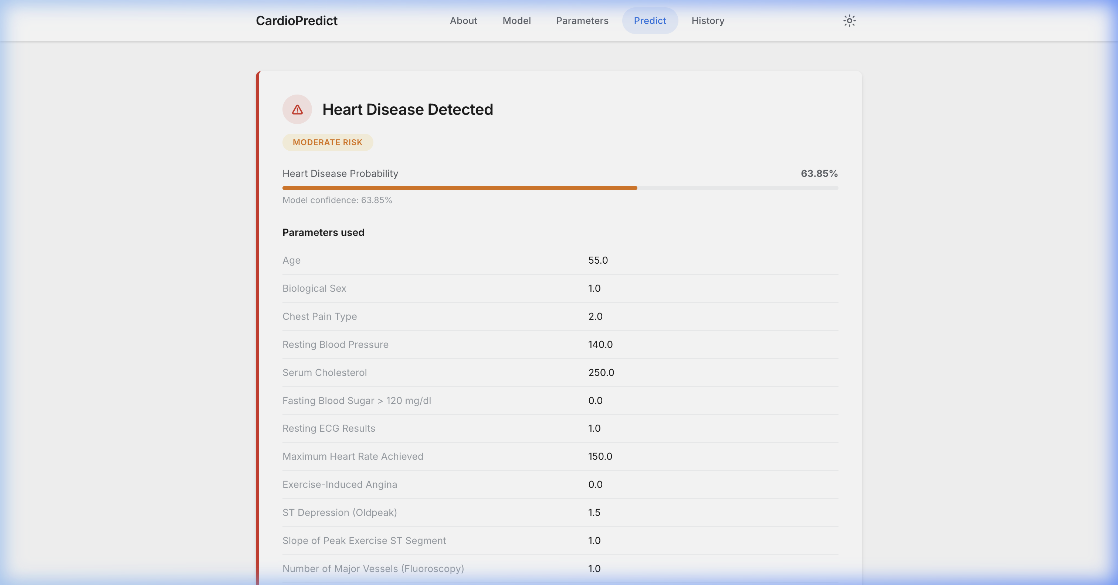
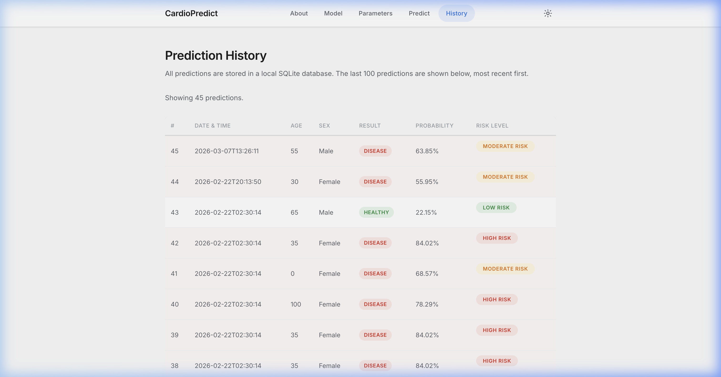
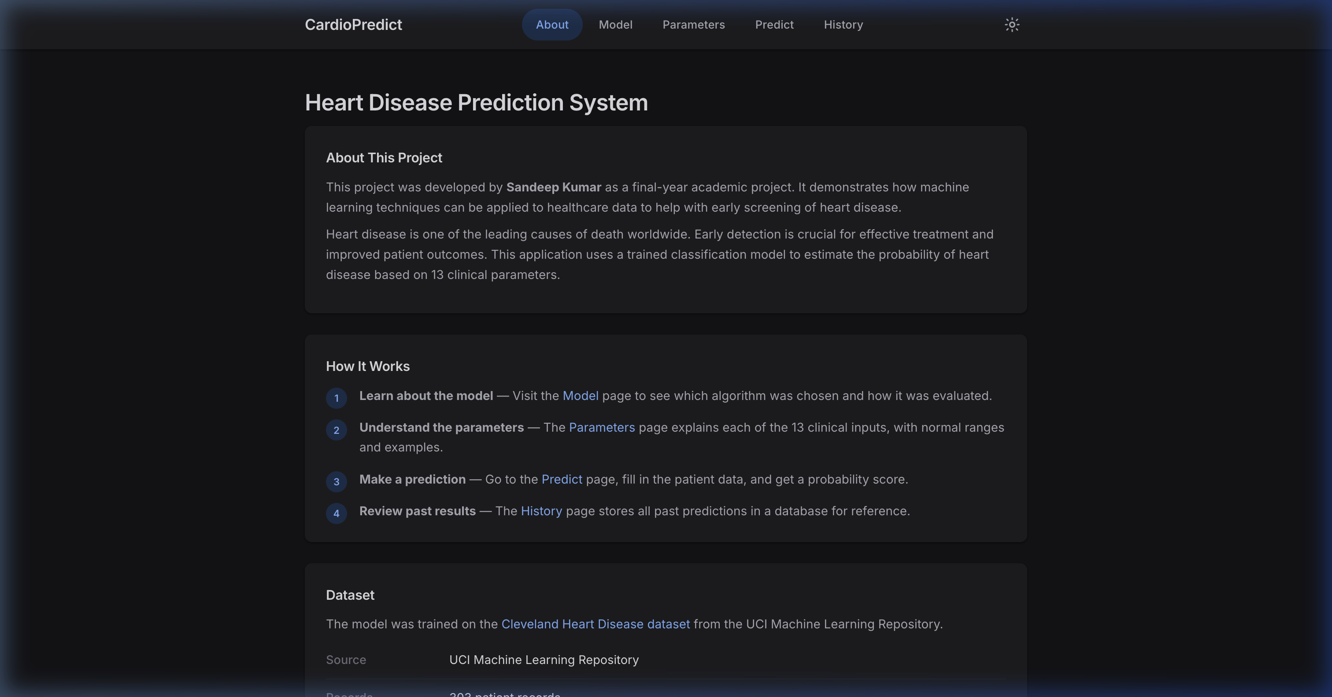
Live Demo — Application Screenshots
Home Page
Prediction Result
Prediction History
Dark Mode
CardioPredict | Sandeep Kumar | MCA | Sikkim Manipal University

Slide 13
Testing
28 automated test cases using pytest
Category | Tests | What Is Verified
Route Connectivity | 5 | All pages return HTTP 200, health API responds
Prediction Logic | 5 | Form submission, JSON API, missing field handling
Content Validation | 3 | Footer text, medical disclaimer, all 13 form fields
Edge Cases | 3 | Extreme age (100), all-zero input, 404 handling
Model Metadata | 2 | metadata.json exists, contains all required keys
Database | 2 | Predictions saved correctly, history page works
Security * | 4 | Input bounds, type validation, SQL injection prevention
Accessibility * | 4 | Dark mode toggle, responsive layout, screen reader tags
* Security & Accessibility tests highlight production-grade polish — SQL injection prevention, ARIA tags, Dark Mode.
Result: 28 passed • 0 failed • 2.34 seconds
CardioPredict | Sandeep Kumar | MCA | Sikkim Manipal University

Slide 14
Conclusion & Future Work
What Was Achieved
Random Forest — 81.97% accuracy, 96.97% recall
Full-stack Flask web application
Dark mode UI with accessibility features
SQLite prediction history with CRUD
REST API endpoint for programmatic access
Docker + Gunicorn production deployment
28 automated tests — all passing
100+ page comprehensive project report
Future Scope
Larger, multi-hospital training datasets
Deep learning models (TabNet, neural networks)
Microservice-based API architecture
User authentication with OAuth 2.0
PDF report generation for clinicians
PostgreSQL for production-scale database
Progressive Web App for mobile access
Continuous model retraining pipeline
CardioPredict | Sandeep Kumar | MCA | Sikkim Manipal University

Slide 15
Thank You
Questions & Discussion
Sandeep Kumar
Master of Computer Applications | Sikkim Manipal University
Guide: Amit Kharb | Academic Year 2025–2026
https://github.com/sandeeep-kr/HeartDiseaseProject

