Slide 1
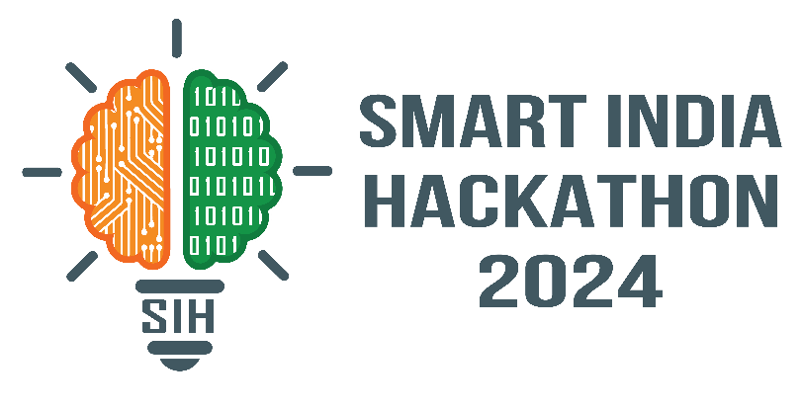
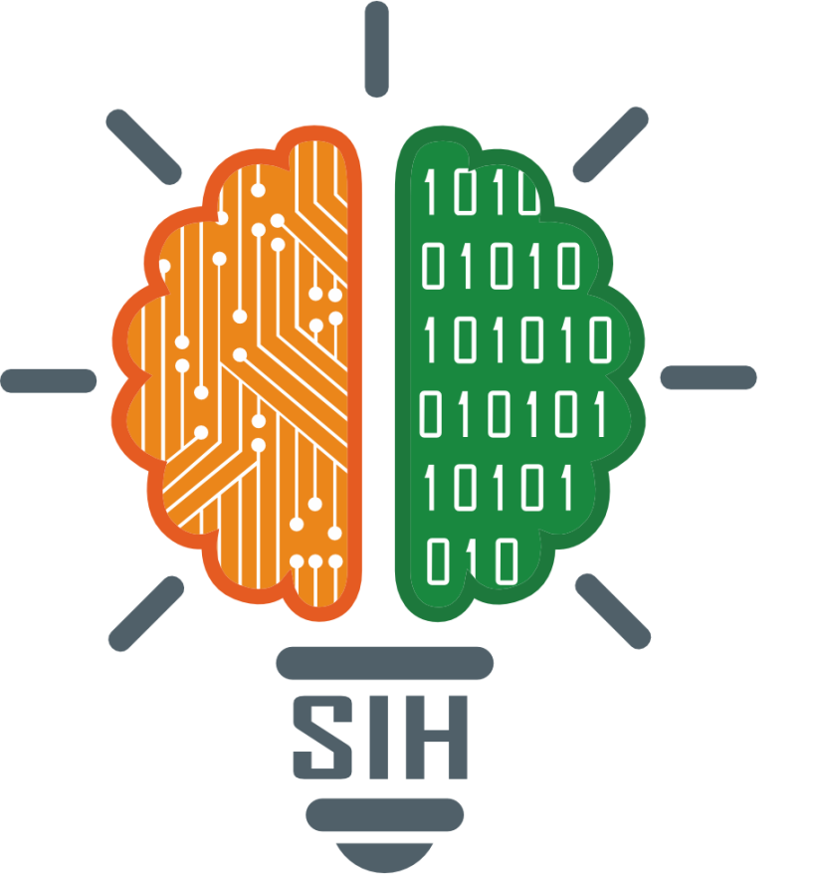
SMART INDIA HACKATHON 2024
TITLE PAGE
1604
Solution : Conversational Image Recognition Chatbot
Theme - Smart Automation
PS Category- Software
Team Name : Code Crafters

Slide 2
IDEA TITLE
Code crafters
Image Recognition Chatbot (using CNN, Transfer Learing, RNN)
Image Recognition Module :
- Utilize deep learning-based computer vision (CNN, RNN, etc.) to recognize objects in images
- Train models using ImageNet
NLP Module
- Employ NLP techniques (tokenization, entity recognition, sentiment analysis, etc.) to understand user queries
- Integrate with Image Recognition Module to generate relevant responses
Chatbot Module
- Design conversational interface using Django and JavaScript- Integrate Image Recognition and NLP Modules to generate responses
Database
- Store user queries, image recognition results, and chatbot responses
- Use database to improve chatbot's understanding and response accuracy

Slide 3
TECHNICAL APPROACH
Code Crafters
1. Image Recognition Module
- Use CNNs (ImageNet ) for object detection and recognition customer supporting bot
- After it, other NLP based multi Chatbot agents will be activated and they will started to reply it
- framework: PyTorch- Image Processing:, OpenCV
2. NLP Module
- Text Processing: NLTK for Sentiment Analysis and give customer support according uploaded image and asked quesrtions
- Text-Image Correlation: similarity metrics (cosine similarity)
3. Chatbot Module
- Frontend: React- Backend: Django, Django REST Framework
- APIs integrate image recognition and NLP modules
4. Database-
- Relational Database (SQLITE/MySQL)
- Store user queries, recognized objects, and chatbot responses
- Continuously improve accuracy through feedback loops

Slide 4
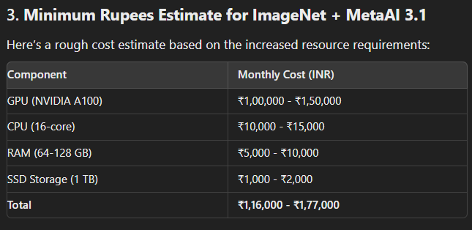
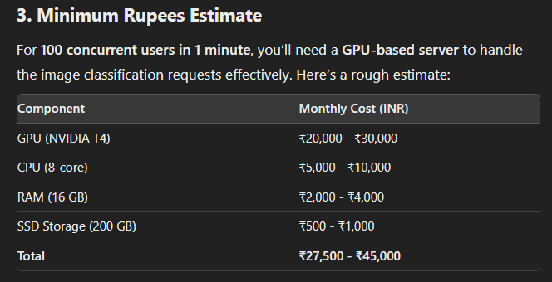
FEASIBILITY AND VIABILITY
Code Crafters
Monthy plan without our solution : ( ₹1,16,000 - ₹1,77,000)
Monthy plan with our solution : (₹27,500 - ₹45,000)
With the help of our solution we can save about 14,40,000 Rs per year appox, due to creating NLP module from scratch without fine tuning

Slide 5
IMPACT AND BENEFITS
Code crafters
Benefits for BEL :
- Streamlined Operations: Automate image processing, reduce manual intervention, and enhance workflows.
- Improved Security: Real-time threat detection, quick decision making, and enhanced surveillance.
- Enhanced Customer Support: Automated equipment diagnostics, real-time assistance, and improved customer satisfaction.
- Training and Maintenance: Visual training aid, proactive maintenance, and improved equipment reliability.
Impact on BEL Customers :
- Faster Issue Resolution: Quick diagnosis, efficient support, and reduced downtime.
- Enhanced Product Security: Product integrity, surveillance feedback, and quality assurance.
- Improved User Experience: Ease of use, 24/7 assistance, and continuous support.
- Real-Time Monitoring: Critical infrastructure monitoring, added layer of defense, and national security.
Long-Term Strategic Impact :
- Scalability: Expand applications in various sectors.
- Data-Driven Insights: Improve products, optimize support, and enhance operational efficiency.
- National Security: Bolster national security initiatives with advanced image recognition and NLP capabilities.

Slide 6
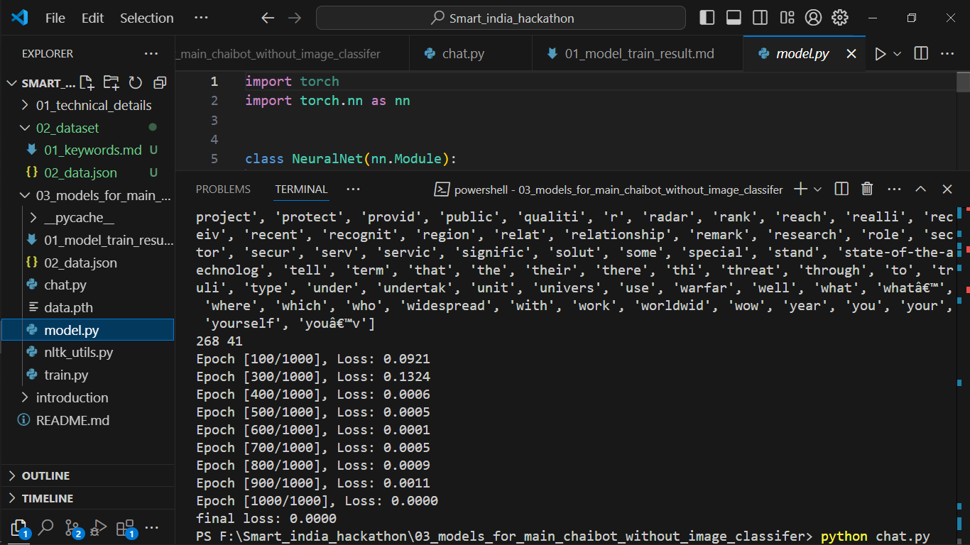
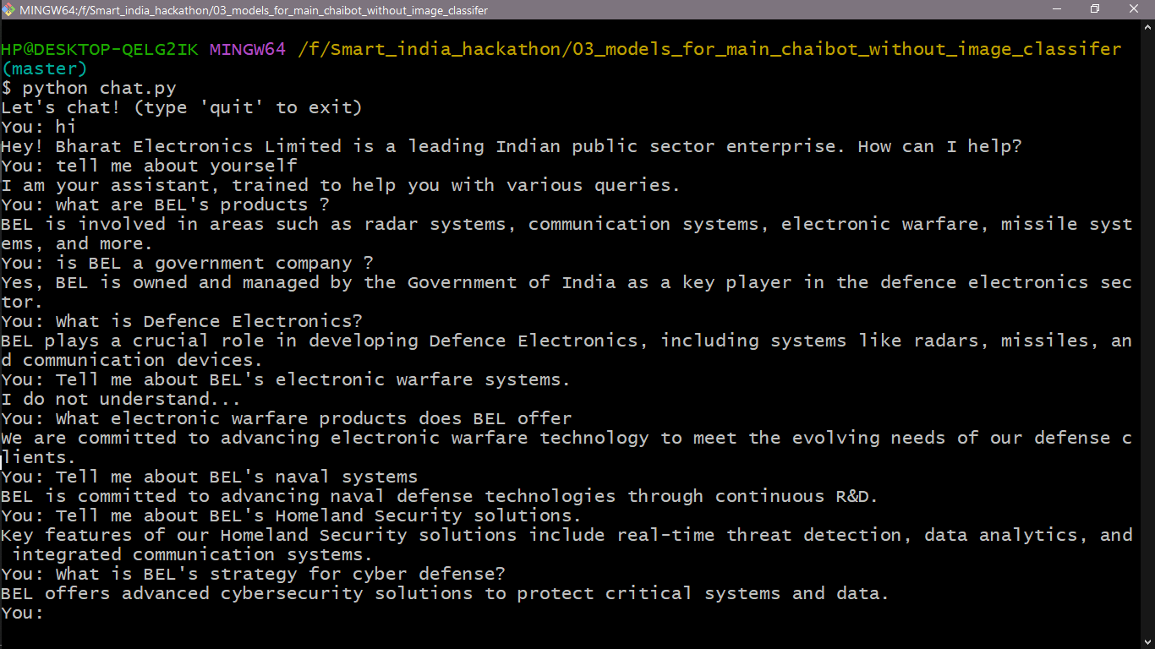
CURRENT PROGRESS & REFERENCES
Code crafters
Accuracy of our current RNN model is 99.9994% ☺
Demo of our model (currently working in GUI of this chatbot and image Classifier
References : chatgpt.com, meta.ai (for server price prediction and text of this PPT preasention thank you all 😊: : any question ?

