Slide 1
IoT-Based Leftover Food Donation Solution
-- Sandeep Prajapati

Slide 2
CONTENTS
Introduction
How It Works
Story Behind the Project
Technology Used
Features of the Website
Future Aspirations
Demo
Conclusion

Slide 3
We rise by lifting others.
-Robert Ingersoll

Slide 4
INTRODUCTION:
Brief overview of the project :
Developed an IoT-based solution to donate leftover food efficiently and effectively.

Slide 5





Steps to use iot based food donation portal
Step 1
Step 2
Step 3
Step 4
Step 5
Food Detection
Notification System (LED Light)
Assistance for Non-Mobile Users
Web Interface
Food Collection

Slide 6

How It Works
Step 1: Food Detection
Place leftover food in a designated box with an ESP8266 microcontroller and ultrasonic sensor.
If food is detected, data is sent to the server.

Slide 7
How It Works (cont.)
Step 2: Notification System
The server informs food box indicators with LED lights.
"If food is available within a 2 km range, the LED turns on; otherwise, it stays off.

Slide 8
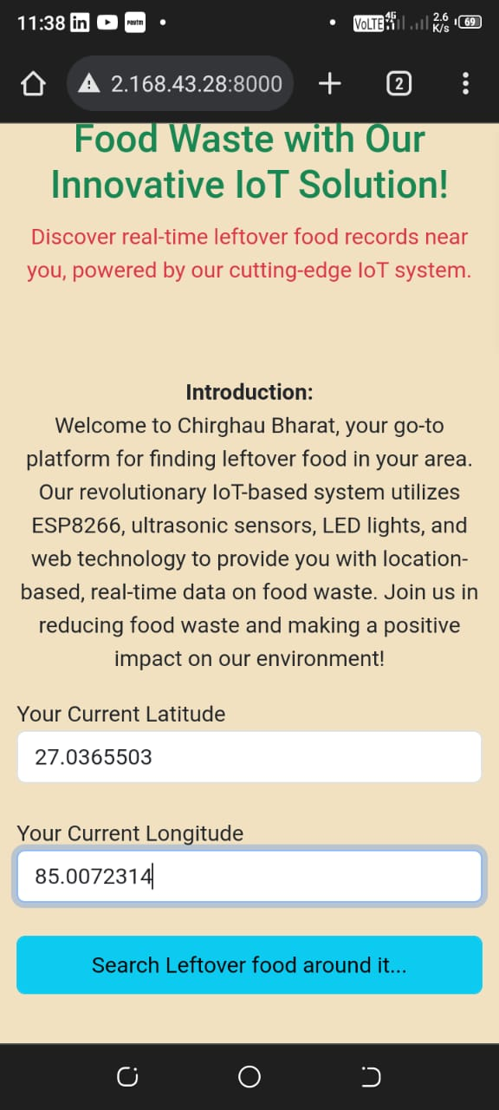
How It Works (cont.)
Step 3: Assistance for Non-Mobile Users
individuals without mobile or internet access can request help from others to check for nearby food availability within a 2 km range.

Slide 9
How It Works (cont.)
Step 4: Web Interface
A user-friendly web interface displays images, locations, landmarks, contact details, addresses, and descriptions of available food.

Slide 10
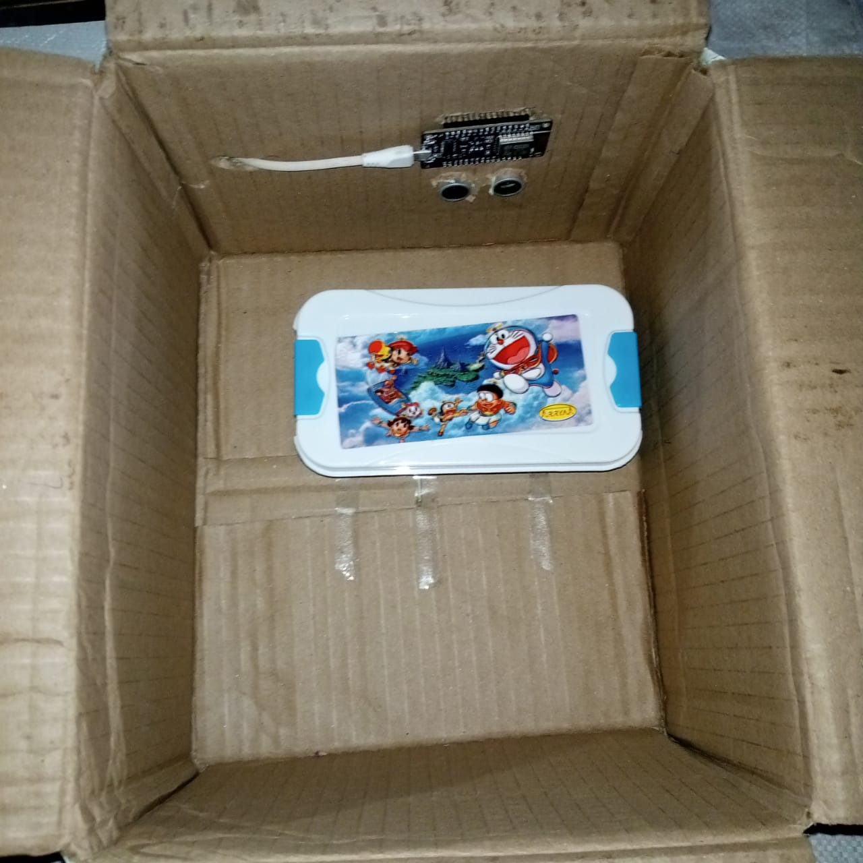
How It Works (cont.)
Step 5: Food Collection
Once food is taken from a box, the LED light turns off, and the data is automatically removed from the website.

Slide 11
Story Behind the Project
Inspired by a documentary on the global food crisis, I decided to create a solution for better food management and distribution
Approximately 800,000,000 people lack adequate food, and 300,000,000 are children kid

Slide 12
Features of the Website
Code Generation: Generate and paste a code for your food donation box.
Location-Based Search: Search for available food within a 2 km range.
User-Friendly Design: Easy and intuitive interface.
Automated Records: Records generated and maintained by IoT devices.
Embedded System Design: Integration of IoT and web technology for seamless operation.

Slide 13
Demo

Slide 14
Future Aspirations
Feeding India
Akshaya Patra Foundation
A non-profit organization that provides meals to people in need across India, with a focus on reducing hunger and malnutrition among underserved communities.
A non-profit organization that provides mid-day meals to children studying in government schools and government-aided schools, with the aim of countering malnutrition and supporting the Right to Education.

Slide 15
Conclusion
Continuously enhancing features like using loudspeakers instead of LED lights.
Integrating AI models to predict the correct amount of food to cook for events.
Committed to making a difference in food management and distribution.

Slide 16
THANK YOU
Sandeep Prajapati​
6392424180sandeep@gmail.com
+916392424180
https://x.com/mr_mark_of_ind
https://www.linkedin.com/in/sandeep-prajapati-391604218/
https://github.com/sandeeep-prajapati/

