Slide 1
PACCAR INVENTORY OPTIMIZATION
DATA-DRIVEN SOLUTION TO OPTIMIZE INVENTORY AT PACCAR PARTS
Presented By : Sandeep, Patra, Jayathi, Thao, Uyen

Slide 2
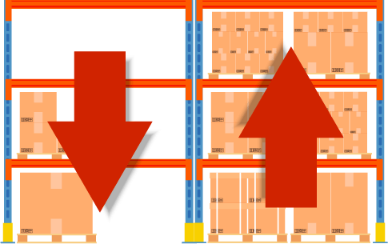

THE PROBLEMs:
Inventory Challenges
(Supplier Reliability, Lead Time, On-transit item)
Manual Review

Slide 3

THE PROBLEMs:
Supplier Reliability Lead Time
On-transit item
Manual Review

Slide 4



Parts Above Safety Stock Still Stocked Out — Due to Longer Delivery Times
Marked Safe (Above Safety Stock)
51 Days Lead Time
“
This shows the opportunity to enhance the model by layering in lead time, especially for items with slower supply recovery
”
Marked Risky (Below Safety Stock)
44 Days Lead Time

Slide 5


In-transit Inventory Contributes to Stockouts Despite Availability
“ The gap between inventory on-hand and inventory on-the- way contributed to unexpected
stockouts”
Marked Safe (Above Safety Stock)
13% order on the way
Marked Risky (Below Safety Stock)
22% order on the way

Slide 6
Late Supplier Deliveries Are a Hidden Cause of Regional Stockouts
“
The system sees available inventory, but not whether incoming supply will arrive on time
— and that’s where risk can slip through
”
Marked Safe (Above Safety Stock)
SUPPLIERS 15% delay on average
Marked Risky (Below Safety Stock)
^{SUPPLIERS} 18% delay on average

Slide 7
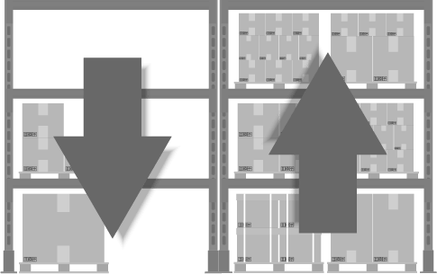
THE PROBLEMs:
Supplier Reliability Lead Time
On-transit item
Manual Review

Slide 8
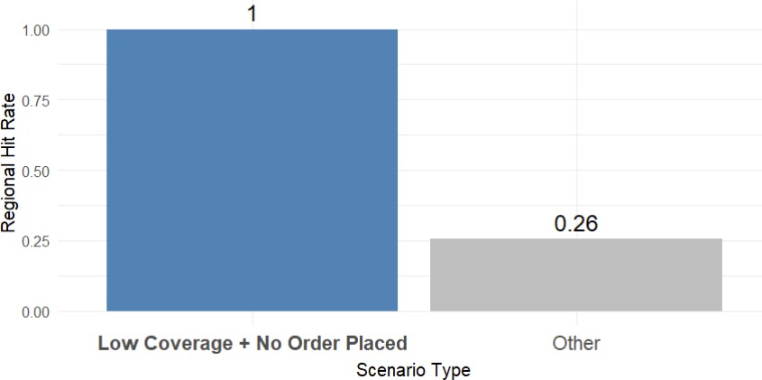
When Manual Review Didn’t Act Fast Enough…
“
If inventory is low and no order is placed, stockouts always happen.
Detecting risk earlier could give planners more time to avoid running out of stock.
”
Risk Detected, But No Action Was Taken → Stockout

Slide 9
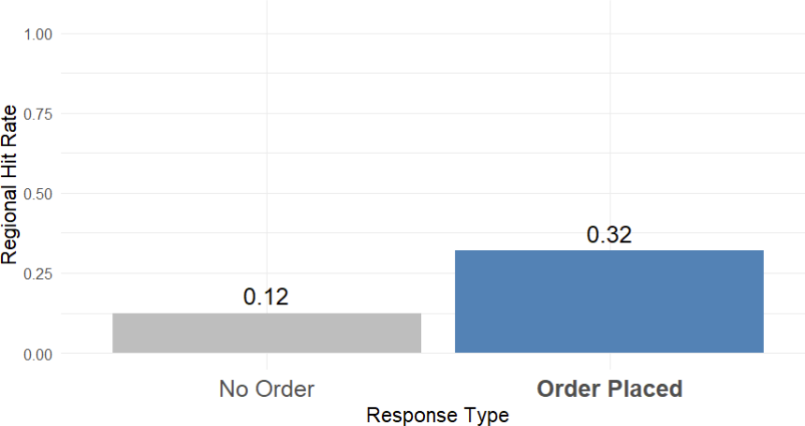
When Manual Review Didn’t Act Fast Enough…
“Even when an order is placed, it’s often too late to prevent a stockout. Earlier detection helps planners respond in time.
”
Action Was Taken, But Too Late to Avoid Stockouts

Slide 10
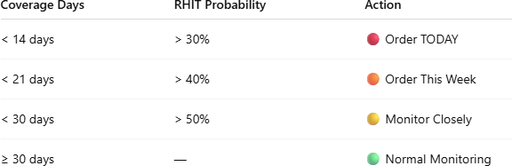

Our Solution: Predictive Model for Proactive Ordering
Model Objective
Predicts whether a RHIT will occur (rhit_label = 1)
Uses Gradient Boosting with inventory , supplier, and demand signals
Trigger action when:
Low coverage (e.g. < 14 days) + high RHIT probability
Action Threshold Table
Example:
Item: A
RHIT Probability = 55% Coverage = 12 days Supplier reliability = Low
→ Triggered:
Order TODAY

Slide 11
























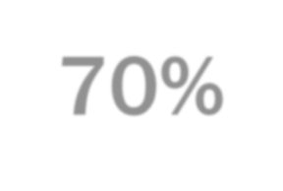

Key Results – Early Warning Performance
Baseline
67%
51%
Improvement Model
Accuracy
Accuracy of “High Risk”
and “Low Risk” Predictions
80%
Accuracy
Accuracy of “High Risk”
and “Low Risk” Predictions
▲13%
66%
Precision
Accuracy of “High Risk”
Predictions
Precision
Accuracy of “High Risk”
Predictions
▲15%
70%
Recall

Slide 12

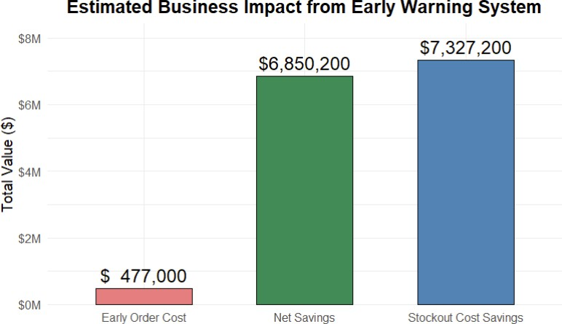

Business Value of Model with Early Warning System
What Our Model Prevented
Metric | Value
RHITs Caught Early (Recall) | 6,106 items
Est. Cost per RHIT | $1,200 (emergency freight, downtime, admin)*
→ Stockout Cost Savings | $7.33 Million*
What It Cost to Act Early
Metric | Value
False Alarms (no RHIT, but flagged) | 3,180 items
Est. Cost per Early Order | $150 (storage, shipping inefficiency, admin)*
→ Early Order Cost | $477,000*
Net saving = Stockout Cost Savings - Early Order Cost
*Cost values are estimates based on freight shipping and related expenses.
Source: PACCAR, AirFreight-Comparison

Slide 13


Recommendations for Future Development
Link live inventory, lead times, and backorders Incorporate external data (delays, tariffs, strikes)
Real-Time Adaptation
Adjust alerts based on freight cost, part value, and urgency
Avoid over-prioritizing low-value items
Cost-Aware Prioritization
Deep Learning for Smarter Forecasting
Use deep learning to identify demand and stock patterns over time, focusing on fast-moving parts.

Slide 14
Thank you for listening

