Slide 1
SMART MOBILITY PLATFORM
SmartParking Platform
AI-Powered Real-Time Parking Reservation, Jenkins CI Pipeline & Kubernetes Orchestration
COURSE
FACULTY
SLOT
STUDENTS
SWE4008
Faculty Guide
L11 + L12
Project Team
Application Development & Deployment Architecture
Prof. Dr. Madala Guru Brahmam Sir
Winter Semester Laboratory & Project Schedule
23MIC7268 • 23MIC7024
23MIC7063 • 23MIC7255

Slide 2
URBAN MOBILITY CHALLENGES
Problem Statement
Urban parking congestion wastes productive hours, inflates fuel consumption, and creates widespread friction.
01
02
Severe Traffic Congestion & Fuel Waste
Zero Real-Time Destination Visibility
Urban motorists spend an average of 20+ minutes circling commercial corridors seeking an open spot. This cruising accounts for 30% of downtown traffic and substantial unnecessary carbon emissions.
Drivers leave home with no verifiable information on whether their destination mall, metro terminal, or office deck has available bays, leading to unexpected delays and missed appointments.
03
04
Manual Spreadsheets & Overbooking Conflicts
Unfair & Rigid Rate Structures
Commercial parking facilities rely on manual paper tokens and fragmented logs. Lack of centralized synchronization causes double-booking, gate disputes, and lost revenue.
Two-wheelers are routinely charged car-level parking rates, and static fees fail to adapt to live demand peaks, leaving prime bays overcrowded while upper decks sit empty.

Slide 3
SYSTEM SCOPE & TARGETS
Project Objectives
Building a full-stack, deterministic reservation system empowered by transparent AI and enterprise DevOps.
01
02
Real Google Maps Locations (Zero-Fake Guarantee)
Explainable AI Proximity-First Ranking
Integrate 49 verified commercial parking complexes across 7 major Indian cities with authentic basement deck slot codes and strict 5 km radius enforcement — no placeholder or synthetic entries.
Ensure searched malls prioritize at 0.0 km over distant bus or railway terminals, with normalized scoring across distance, price, real-time availability, and covered/EV perks.
03
04
Calibrated Dynamic Pricing Engine
Enterprise Jenkins CI & Kubernetes CD
Implement fair two-wheeler pricing (0.40x multiplier = ₹12/hr for bikes vs ₹30/hr for cars) alongside transparent occupancy demand bands and itemized checkout breakdowns.
Automate parallel unit testing and JUnit reporting with Jenkins, coupled with production-ready Kubernetes orchestration featuring autoscaling, persistent storage, and zero-downtime rollouts.

Slide 4
CORE VALUE PROPOSITIONS
What Is SmartParking?
A connected platform serving the complete parking ecosystem with dedicated, role-specific workflows.
DRIVERS
OPERATORS
ADMINS
Find & Reserve in Seconds
Live Inventory & Yield Control
System Oversight & Governance
• 3-letter destination autocomplete
• Proximity ranking prioritizes exact mall at 0.0 km
• Authentic basement slots (B1-C01, B1-EV01)
• Fair pricing: ₹12/hr bikes, ₹30/hr cars
• Instant digital passes with QR code & status
• Real-time venue occupancy percentage
• Multi-tier deck slot management & bay blocking
• Custom operating hours and facility toggles
• Automated dynamic surge configuration
• Net revenue recognition & trend analytics
• Commercial parking venue approval lifecycle
• Complete user oversight (Driver, Operator, Admin)
• Container health status & scheduler inspection
• System-wide transaction audit logging
• Dispute handling & slot unblocking authority

Slide 5
FUNCTIONAL CAPABILITIES
Key Platform Features
Engineered for simplicity, reliability, and real-world Indian urban parking requirements.
01
02
03
Destination Autocomplete
Proximity-First Ranking
Deck Slot Nomenclature
Triggers suggestions upon entering 3 letters; supports live GPS device detection and map-click pin placement.
Exact destination malls rank #1 (0.0 km) rather than being displaced by distant bus or train stations.
Realistic mall basement codes (B1-C01 to B2-C06, B1-EV01, B1-M01) instead of generic single letters.
04
05
06
Calibrated Two-Wheeler Rates
Deterministic Hold Pipeline
Autonomous Preference Engine
0.40x multiplier for motorcycles (₹12/hr) vs 1.00x for cars (₹30/hr); transparent itemized billing.
10-minute hold window reserves 15-minute slot blocks in MySQL; background worker auto-sweeps unpaid holds.
Rule-based background auto-booking evaluated on schedule; fallback forms ensure 100% uptime when AI is offline.

Slide 6
CONTAINERIZED ARCHITECTURE
System Architecture
Clean 5-tier decoupled design: deterministic backend core guarantees 100% booking reliability.
TIER 1
Presentation Layer
TIER 2
Reverse Proxy Gateway
TIER 3
API & Business Logic
TIER 4
AI & Background Workers
TIER 5
Data & Persistence

Slide 7
ENGINEERING FOUNDATION
Technology Stack
Modern open-source technologies selected for performance, type safety, automated CI, and container orchestration.
BACKEND
FRONTEND
AI / ML
DEVOPS & K8S
FastAPI Backend
React 18 SPA
AI & ML Services
CI/CD & Kubernetes
• Python 3.12 & aiomysql pooling
• Pydantic v2 data schemas
• PyJWT auth with secure cookies
• APScheduler background jobs
• Starlette CORS & rate limits
• Vite & Tailwind CSS utilities
• Leaflet + OpenStreetMap tiles
• TanStack React Query cache
• Lucide / Feather icon sets
• React Router v6 navigation
• scikit-learn & pandas
• Weighted candidate ranker
• Random Forest forecaster
• Ollama (llama3.2:3b LLM)
• Resilient circuit breaker
• Jenkins Declarative Pipeline
• Kubernetes (K8s) & Kustomize
• Horizontal Pod Autoscaler (HPA)
• 7-Service Docker Architecture
• MySQL 8.4 LTS & Redis 7

Slide 8
RESERVATION PIPELINE
Deterministic Booking Lifecycle
Strict hold-and-confirm lifecycle guarantees zero double-bookings with database-enforced row locks.
STEP 1
STEP 2
STEP 3
STEP 4
STEP 5
Search Venue
AI Proximity
10-Min Hold
Pay & Settle
Active Pass
Geocodes query against local registry or OpenStreetMap; enforces 5 km radius.
Ranks candidate slots; prioritizes destination venue at 0.0 km over distant hubs.
Creates temporary hold; locks 15-minute time intervals in booking_blocks table.
Checkout via Razorpay test mode; background worker cancels unpaid holds after 10 mins.
Status updates to CONFIRMED; driver receives active pass with slot code & QR badge.

Slide 9
TRANSPARENT BILLING
Dynamic Pricing & Fair Rate Calibration
Proportional vehicle-type multipliers combined with live occupancy surge bands.
SURGE
RATES
Occupancy Demand Surge Bands
Vehicle-Type Multipliers
• Standard Band (0% – 60% occupancy): 1.00x multiplier (Base rate ₹30/hr for Car)
• Moderate Band (60% – 85% occupancy): 1.15x multiplier (Fair peak rate ₹34/hr)
• High Band (85% – 100% occupancy): 1.30x multiplier (Demand cap rate ₹39/hr)
Surge multipliers are capped at a reasonable 1.30x maximum to prevent exploitative price gouging during high-traffic mall events.
• MOTORCYCLE / TWO-WHEELER: 0.40x multiplier → ₹12/hr (fair authentic rate)
• CAR / SEDAN / HATCHBACK: 1.00x multiplier → ₹30/hr (standard mall base rate)
• SUV / LARGE VEHICLE: 1.20x multiplier → ₹36/hr (larger bay consumption)
• ELECTRIC VEHICLE (EV): 1.10x multiplier → ₹33/hr (with charging access)
Itemized formula: Total = Duration × Base Rate × Vehicle Discount × Demand Band.

Slide 10
CANONICAL REGISTRY
Real Google Maps Parking Complexes
49 Real Google Maps venues across 7 Indian metro regions — strictly zero synthetic or placeholder locations.
CITY
CITY
HYDERABAD (10)
VIJAYAWADA & AMARAVATI (5)
Inorbit Mall Cyberabad, Nexus Mall (Forum Sujana), Sarath City Capital Mall, GVK One Mall, IKEA, Lulu Mall, Next Galleria Punjagutta, Cyber Towers, DLF Cybercity, Mindspace MLCP.
PVP Square Mall Multi-Level, Trendset Mall Benz Circle, Pandit Nehru Bus Station (PNBS) MLCP, Vijayawada Railway West Plaza, Kanaka Durga Temple Ghat Road.
CITY
CITY
BENGALURU (4)
MUMBAI, NCR, PUNE & CHENNAI (7)
Phoenix Marketcity Whitefield, Orion Mall Malleshwaram, Nexus Koramangala, Whitefield ITPL Transit.
Inorbit Mall Malad, Phoenix Palladium Lower Parel, Palika Bazar Underground CP, Select CITYWALK Saket, Phoenix Marketcity Pune, Express Avenue Chennai.

Slide 11
SECURITY & GOVERNANCE
Role-Based Access Control (RBAC)
Clean role demarcation with generic account profiles: Driver, Operator, and Admin.
ROLE
ROLE
ROLE
DRIVER (Driver User)
OPERATOR (Operator User)
ADMIN (Admin User)
Demo Account: driver@test.com
• Search nearby parking across Indian cities
• Hold, book, pay (Razorpay/venue), & cancel
• View confirmed passes with Slot Code & QR
• Configure auto-booking budget & distance rules
• Access AI Chat conversational parking assistant
Demo Account: operator@test.com
• Add and update commercial parking locations
• Configure deck slots inventory & vehicle types
• View live bookings & venue occupancy
• Configure operating hours, amenities, & base rates
• Track live revenue recognition analytics
Demo Account: admin@test.com
• Approve, reject, or suspend commercial venues
• Full platform user administration (all roles)
• System-wide occupancy & transaction audit trails
• Override disputed bookings or blocked slots
• Inspect Docker container health & scheduler logs

Slide 12
AUTOMATED DEVOPS
CI/CD & Cloud Deployment Pipeline
End-to-end continuous integration and deployment pipeline uniting Git, Jenkins, and Kubernetes.
PHASE 1
PHASE 2
PHASE 3
PHASE 4
Git Version Control
Jenkins CI Pipeline
Docker Registry
Kubernetes CD
• Monorepo housing Frontend, Backend, AI & K8s
• Feature branch workflow with pull request gates
• Webhook triggers Jenkins build on code commit
• Declarative Jenkinsfile tracks pipeline state
• Parallel execution of Backend & AI test suites
• 14 Pytest assertions validated in isolation
• Strict JUnit XML reporting (results.xml)
• Zero-tolerance failure gate stops broken builds
• Multi-stage production container builds
• Nginx-optimized SPA frontend artifact
• Python 3.12 slim images with strict security
• Version-tagged images pushed to local registry
• Kustomize manifest validation & dry-run linting
• Zero-downtime rolling update deployment
• Health probe verification before traffic cutover
• Self-healing container restart on failure

Slide 13
CONTAINER ORCHESTRATION
Kubernetes Production Orchestration
Cloud-native microservices orchestration ensuring high availability, persistence, and autoscaling.
MICROSERVICES
TRAFFIC ROUTING
Deployments & Pod Replicas
Services & Ingress Controller
• Backend Deployment (3 replicas) handling REST traffic
• Frontend Deployment (2 replicas) serving Nginx SPA
• AI-Service Deployment (2 replicas) serving ML ranking
• Dedicated Single-Replica Worker (APScheduler hold sweeper)
• RollingUpdate strategy with zero downtime during upgrades
• ClusterIP Services internalizing DB, Cache, API & AI ports
• NodePort (30080) for direct cluster edge access
• Nginx Ingress Controller routing smartparking.local
• Path-based routing: /api to backend, / to frontend SPA
• Integrated CORS, request sizing, and header sanitization
PERSISTENCE
RESILIENCE
ConfigMaps, Secrets & PVC
Probes & Horizontal Autoscaler (HPA)
• ConfigMaps injecting environment-specific variables
• Opaque Secrets protecting DB passwords, JWT & Razorpay keys
• PersistentVolumeClaim (10Gi mysql-pvc) with ReadWriteOnce
• Non-volatile MySQL data persistence across pod restarts
• Redis in-memory storage with AOF persistence
• Readiness & Liveness HTTP probes (/health, /api/v1/health)
• Automatic replacement of unhealthy or crashed pods
• HorizontalPodAutoscaler (HPA) for Backend (2 to 5 pods)
• Autoscaling dynamically scales pods on 75% CPU load
• Resource limits & requests prevent node resource starvation

Slide 14
CONTINUOUS INTEGRATION
Jenkins CI Pipeline & Test Automation
Declarative Jenkinsfile pipeline enforcing automated verification, JUnit test reporting, and artifact validation.
DECLARATIVE
14 TEST CASES
JUNIT REPORTING
Multi-Stage Execution Pipeline
Parallel Pytest Suites
Standardized Test Artifacts
• Stage 1: Checkout SCM (Git tracking & clean workspace)
• Stage 2: Parallel Testing (Backend + AI-Service Pytest)
• Stage 3: JUnit Test Result Archival (test-results/*.xml)
• Stage 4: Parallel Docker Image Compilation & Tagging
• Stage 5: Kubernetes Manifest Dry-Run / Validation
• Stage 6: Kubernetes Continuous Rollout & Status Gate
• Backend: Password hashing & JWT access token verification
• Backend: 15-minute slot block interval generator
• Backend: Vehicle discount rates & pricing clamp logic
• AI-Service: Random Forest demand forecaster training
• AI-Service: Heuristic intent parsing (select, confirm, cancel)
• AI-Service: Min-max ranking normalization & ordering
• Output: test-results/backend-results.xml (5/5 passed)
• Output: test-results/ai-results.xml (9/9 passed)
• Output: test-results/results.xml (14/14 merged)
• Real-time pass/fail trend graphs in Jenkins dashboard
• Immediate build failure notification on regression

Slide 15
TECHNICAL VERIFICATION & PROOF
Live Application & System Evidence
High-resolution product screenshots captured directly from the running production stack (Port 80 & 8000)

Slide 16
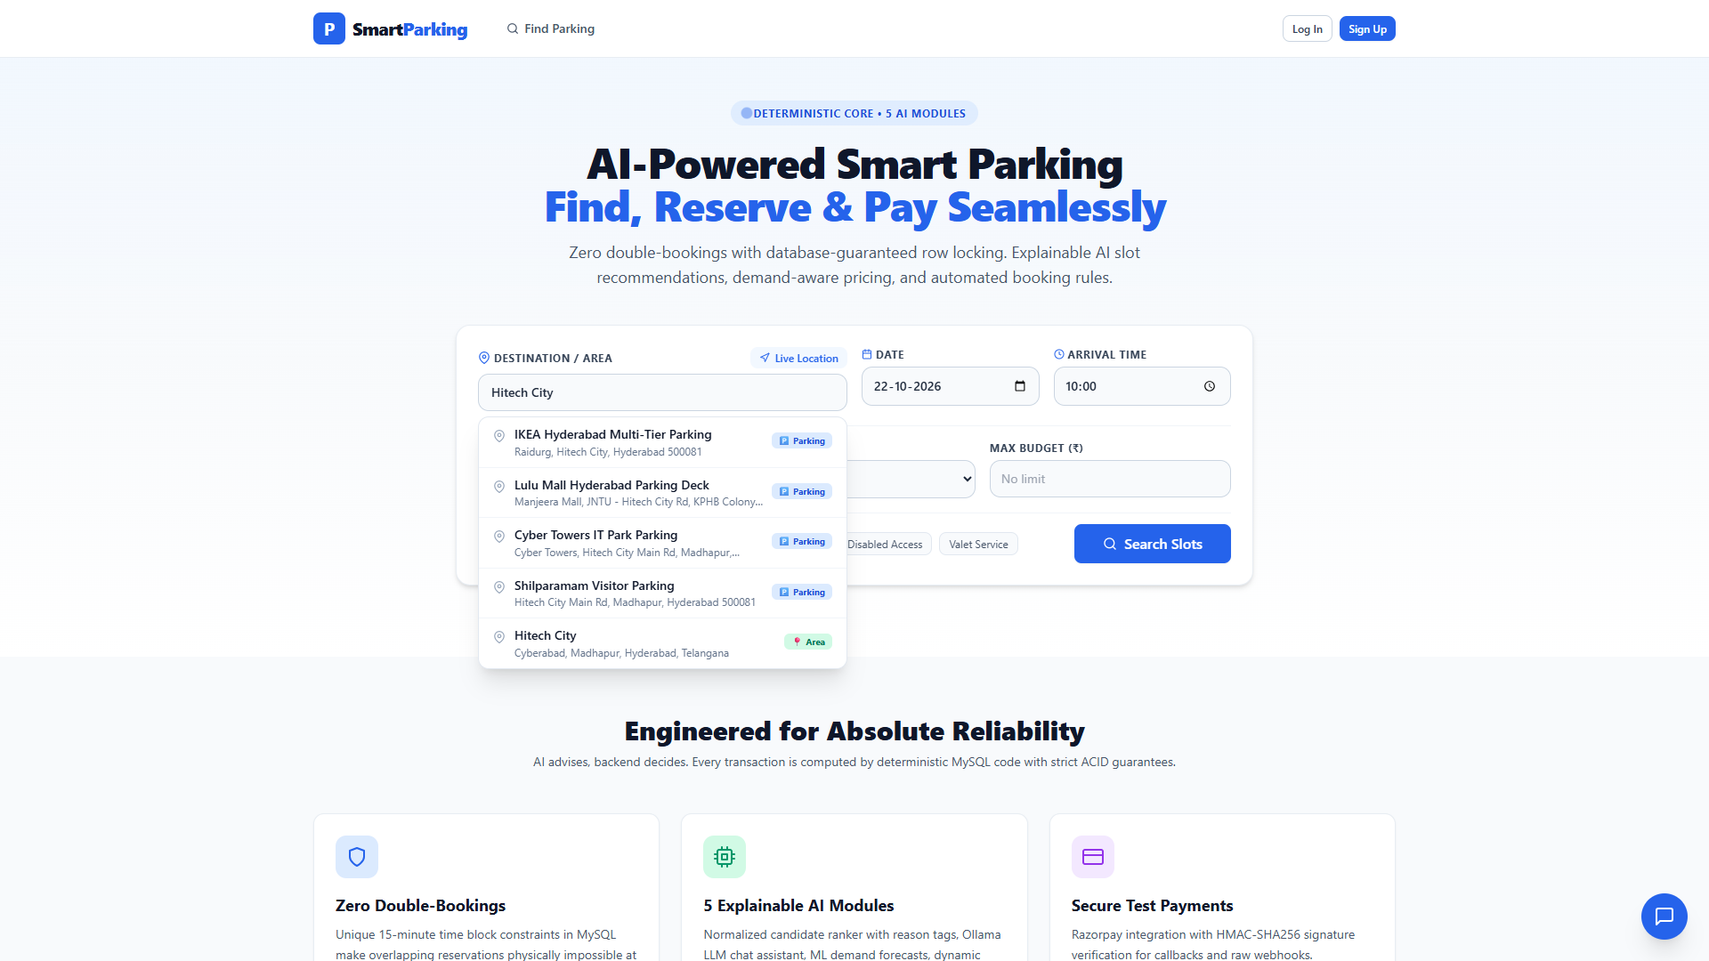
DRIVER PORTAL
Homepage & Destination Search
Landing interface featuring instant destination query, vehicle filter, and real-time smart availability metrics.
🔒 https://smartparking.local

Slide 17
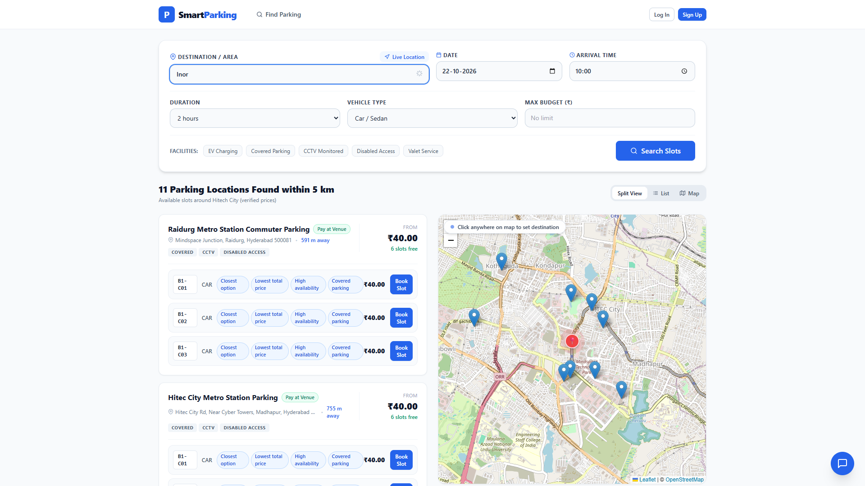
AUTOCOMPLETE
Live Autocomplete Suggestions
Querying 'Inor' returns verified Google Maps locations: Inorbit Mall Cyberabad Basement and Inorbit Mall Malad.
🔒 https://smartparking.local

Slide 18
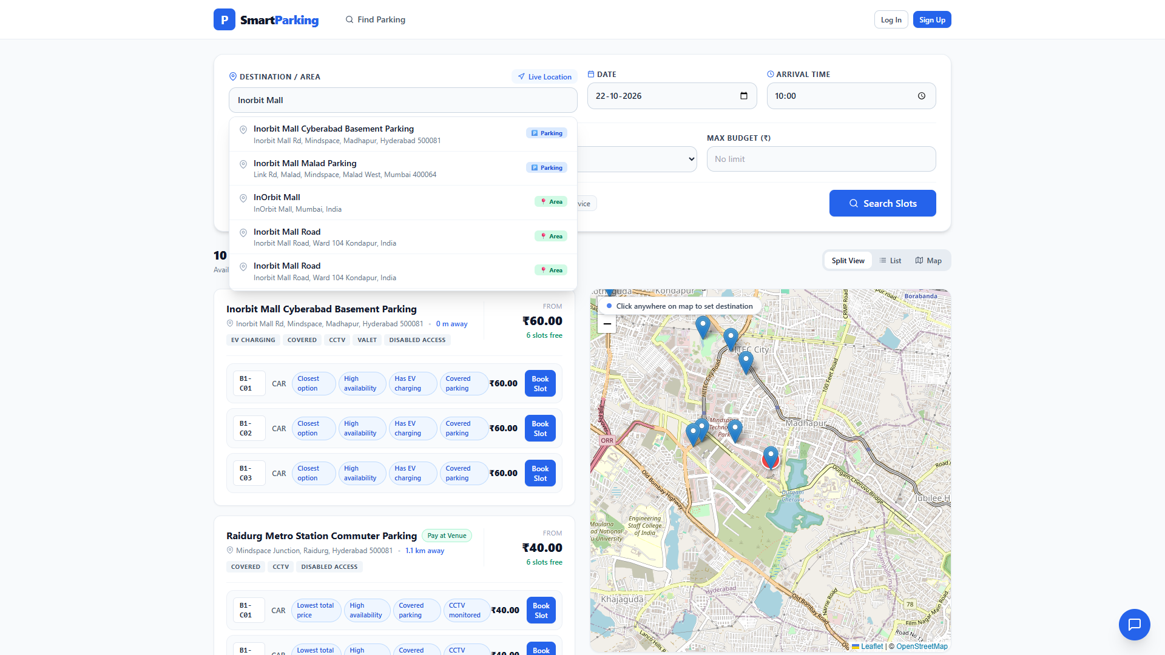
PROXIMITY SEARCH
Interactive Map & 0.0 km Mall Ranking
Searching 'Inorbit Mall' prioritizes Inorbit Mall Cyberabad at 0.0 km with interactive Leaflet map markers.
🔒 https://smartparking.local

Slide 19
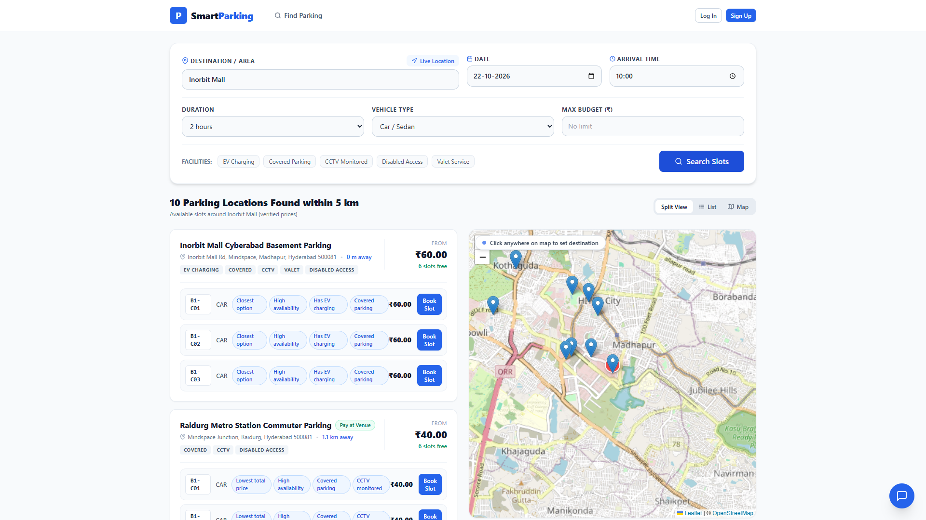
SLOT INVENTORY
Authentic Deck Slot Selection
Displays mall basement slot designations (B1-C01, B1-C02, B1-EV01) with AI score tags and pricing.
🔒 https://smartparking.local

Slide 20
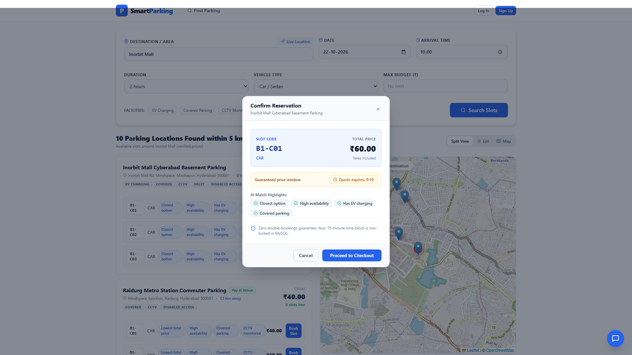
BOOKING ENGINE
Booking Modal & Rate Breakdown
Reserving Slot B1-C01 with vehicle number input, time window, itemized billing, and Razorpay payment options.
🔒 https://smartparking.local

Slide 21
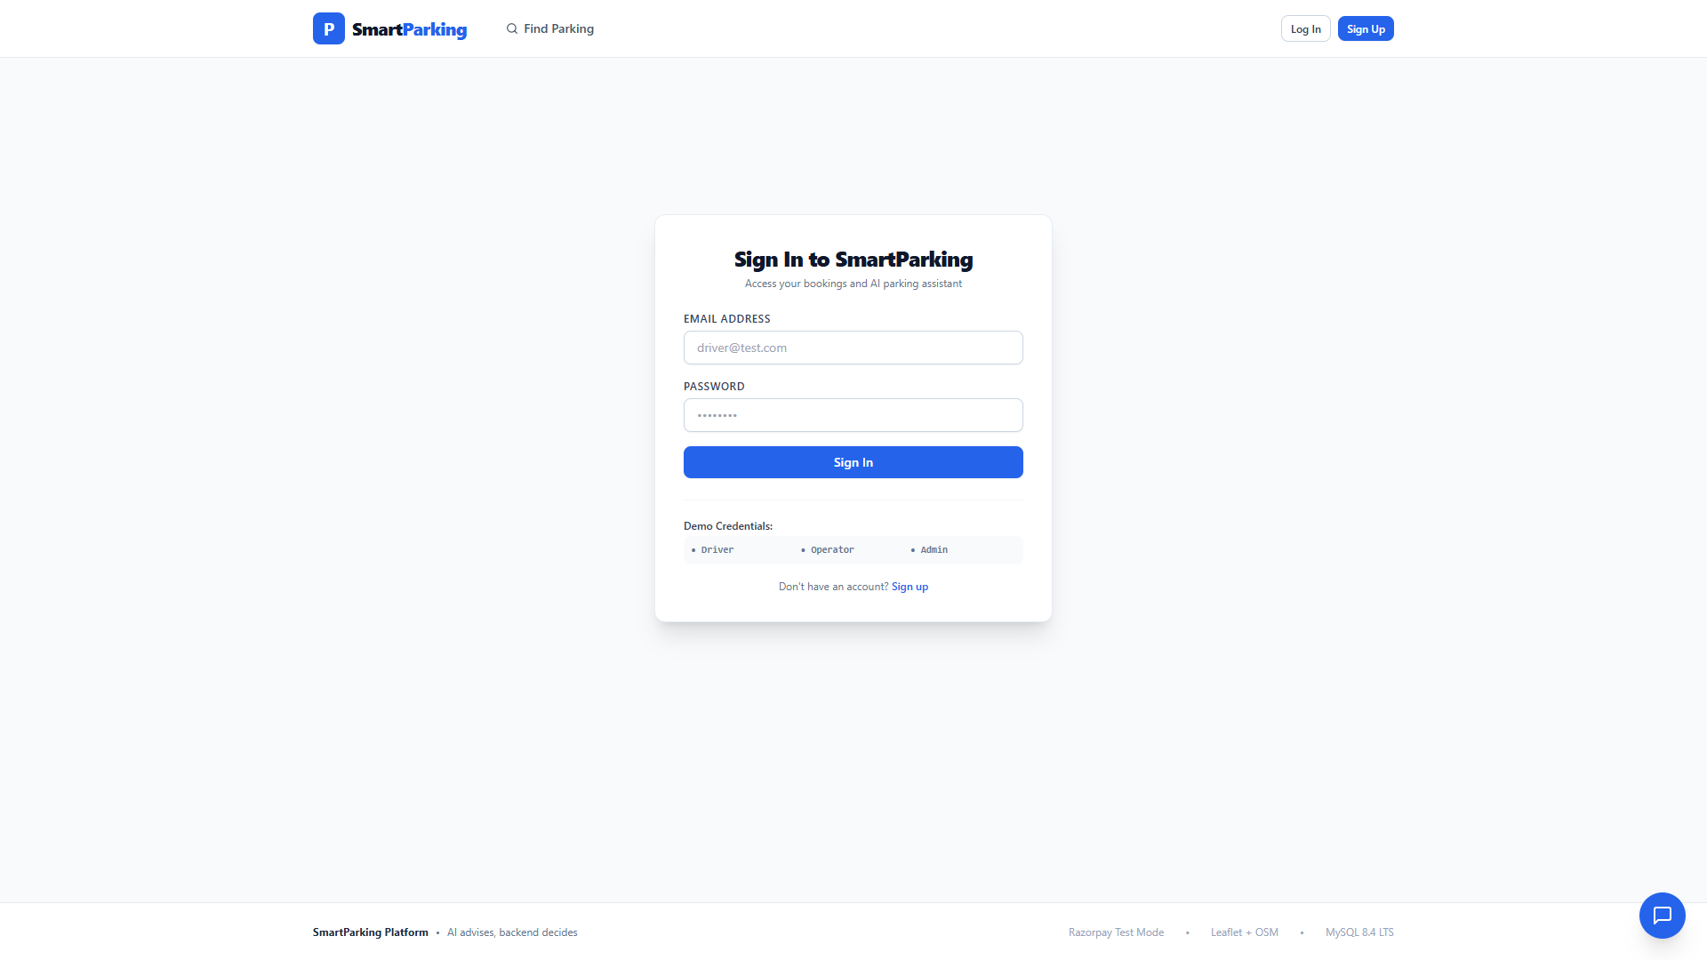
SECURITY / AUTH
Authentication & Role Login
Clean JWT login screen configured with generic demo accounts: Driver, Operator, and Admin (no personal names).
🔒 https://smartparking.local

Slide 22
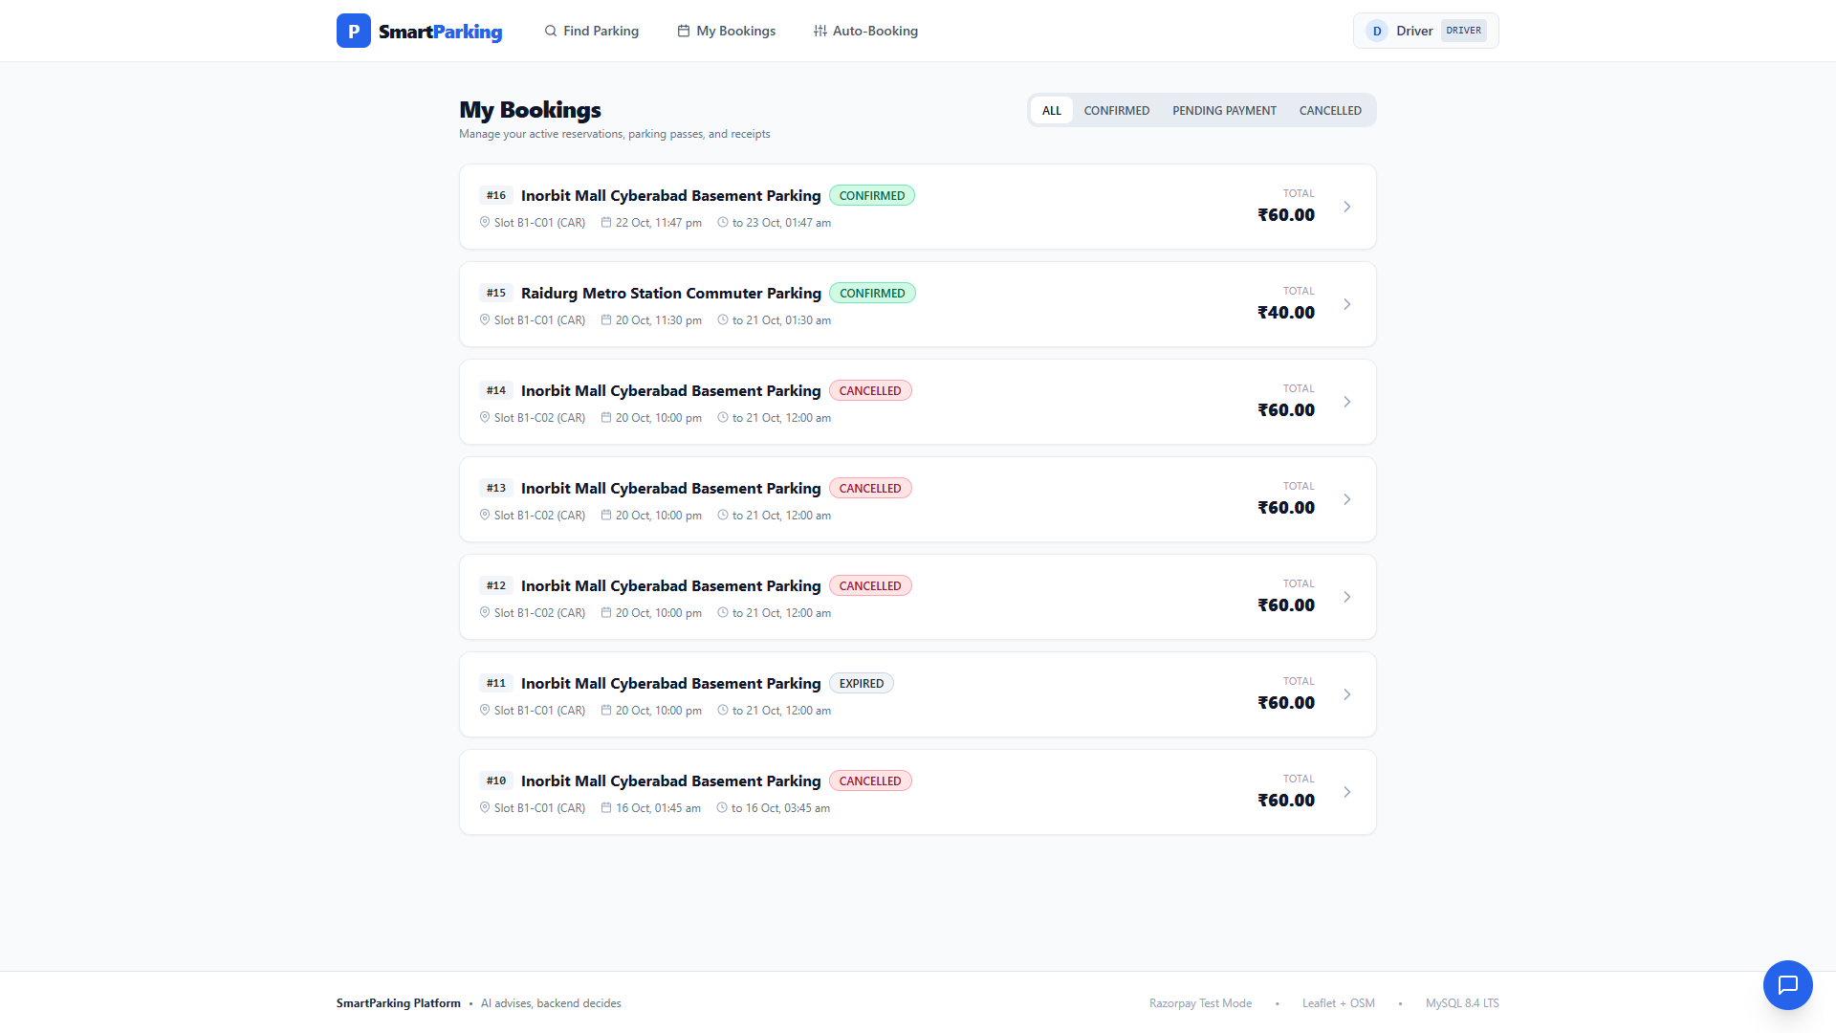
DRIVER PASSES
Driver Portal — Confirmed Bookings
Driver dashboard displaying active confirmed booking at Inorbit Mall (B1-C01) with digital QR badge and status.
🔒 https://smartparking.local

Slide 23
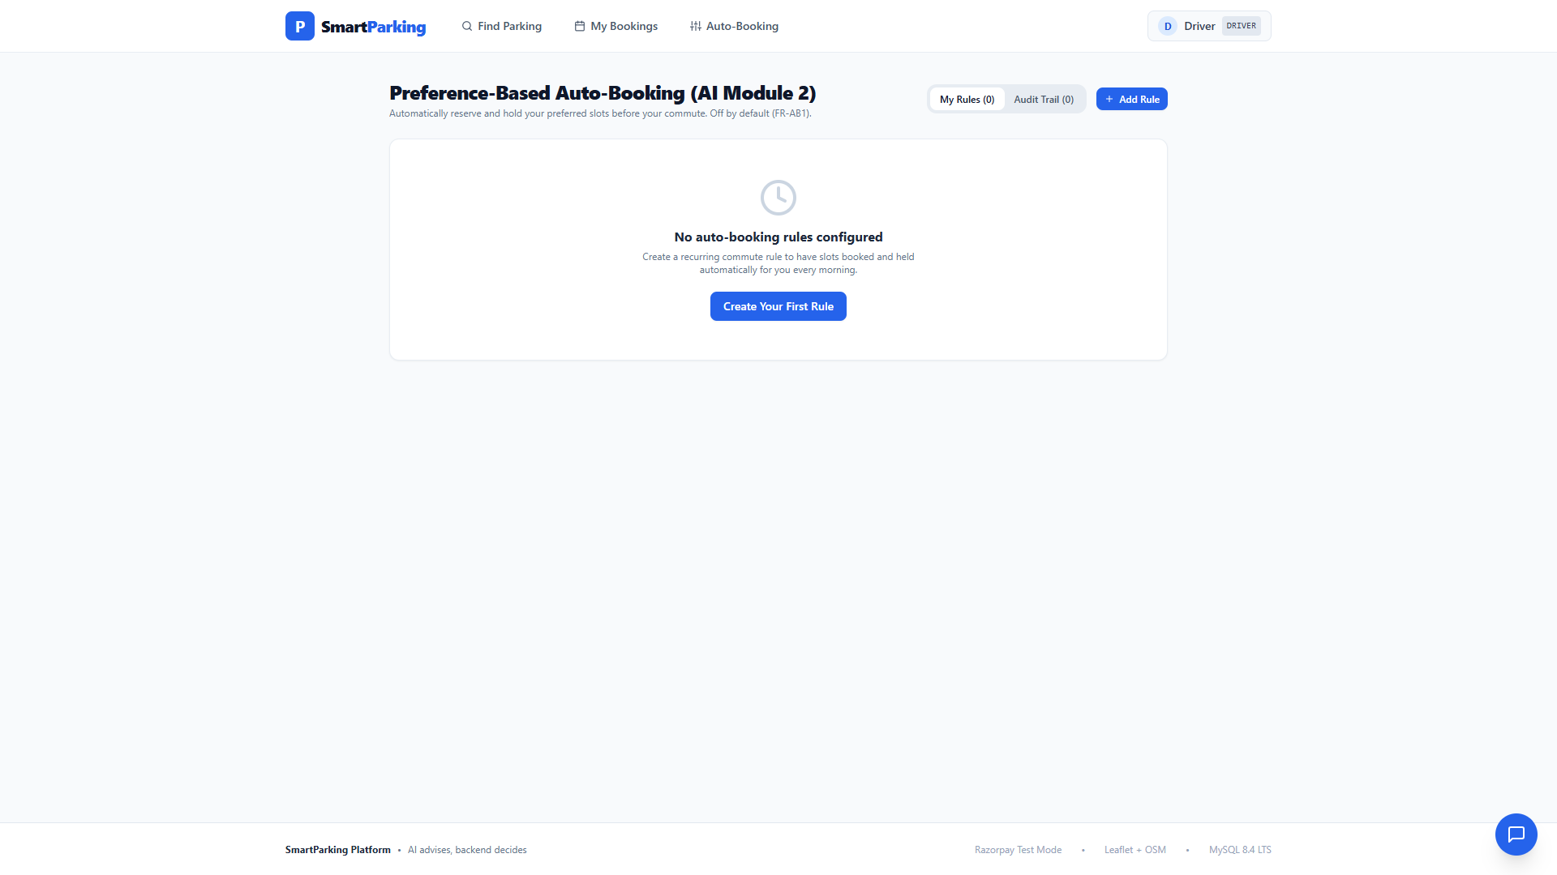
AUTOMATION
Auto-Booking Preference Engine
Configurable driver rules: preferred vehicle type, max budget, and walking distance for automated commuter matching.
🔒 https://smartparking.local

Slide 24
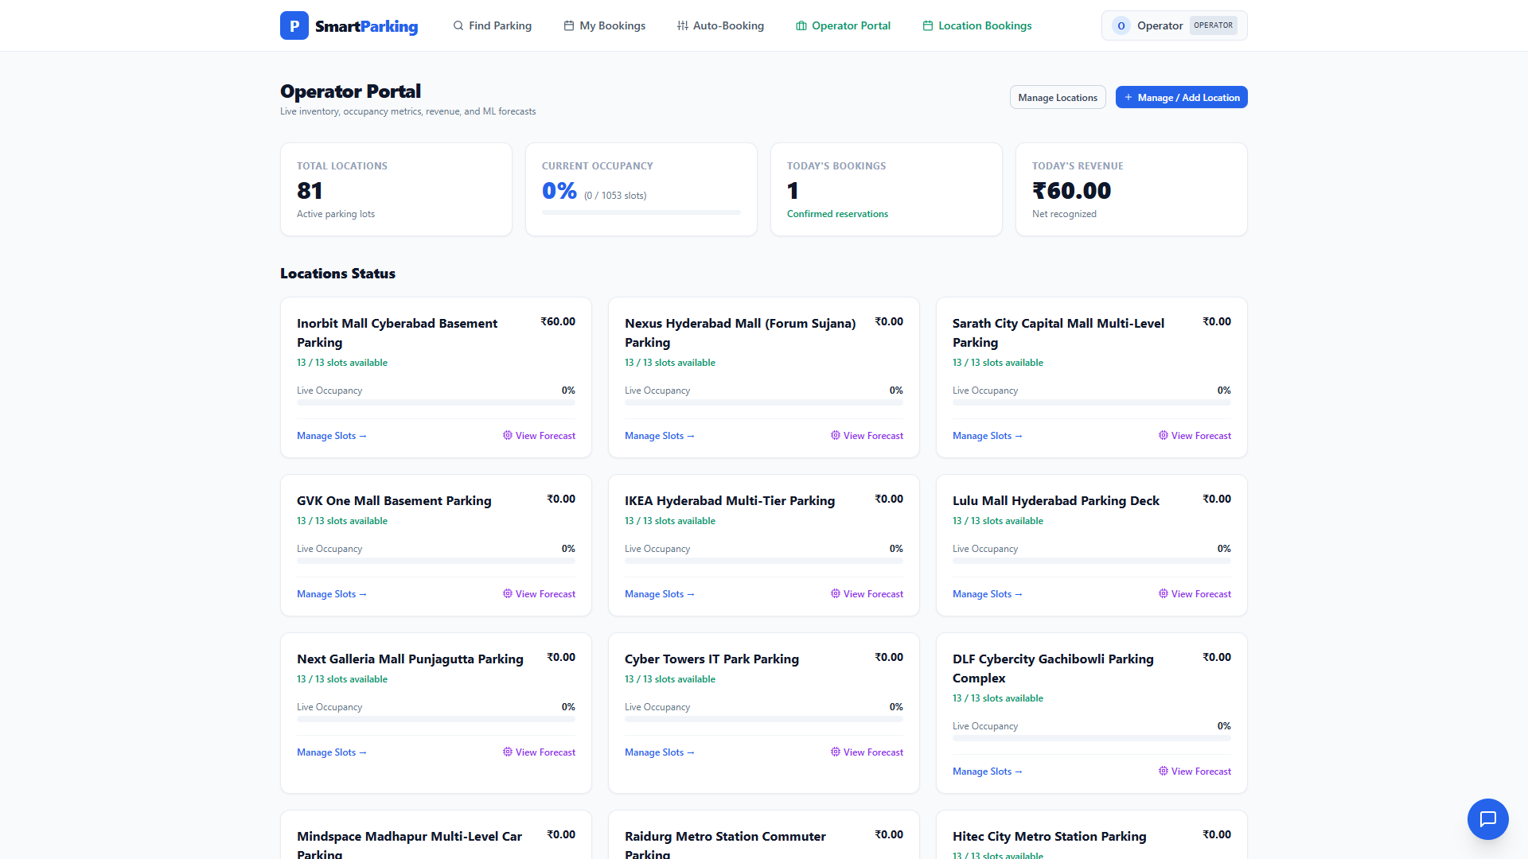
OPERATOR CONSOLE
Operator Dashboard — Analytics
Commercial operator portal showing live venue occupancy percentage, active slot counts, and net recognized revenue.
🔒 https://smartparking.local

Slide 25
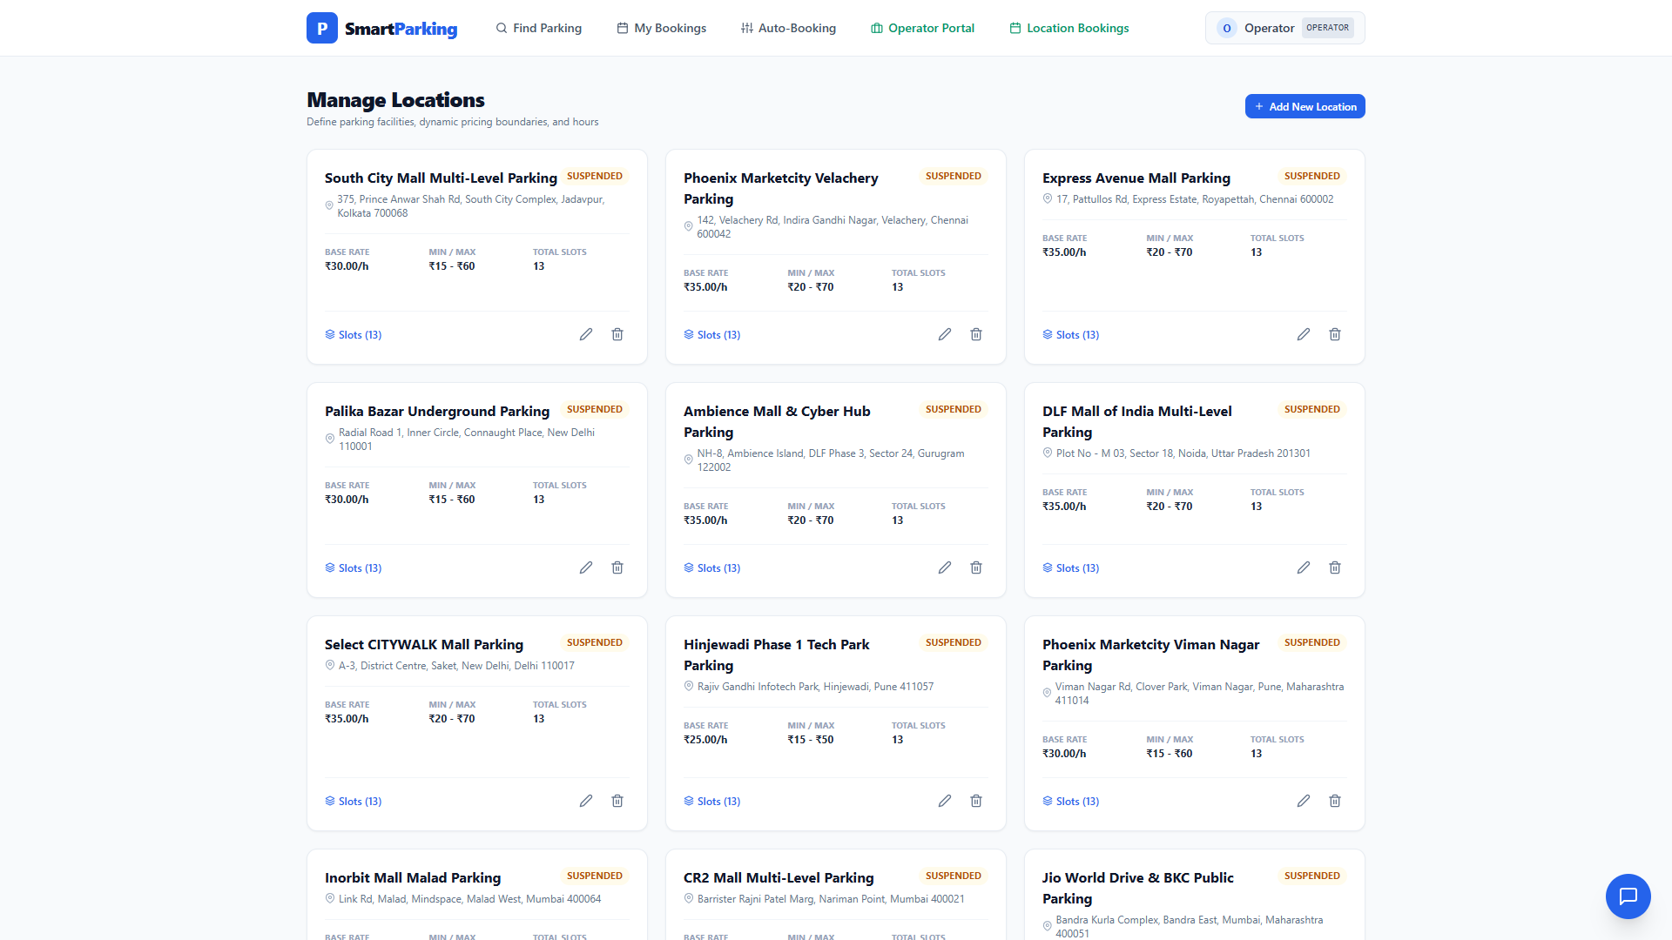
FACILITY MANAGEMENT
Operator Facility & Slot Management
Operators manage approved parking complexes, configure operating hours, amenities, and slot deck codes.
🔒 https://smartparking.local

Slide 26
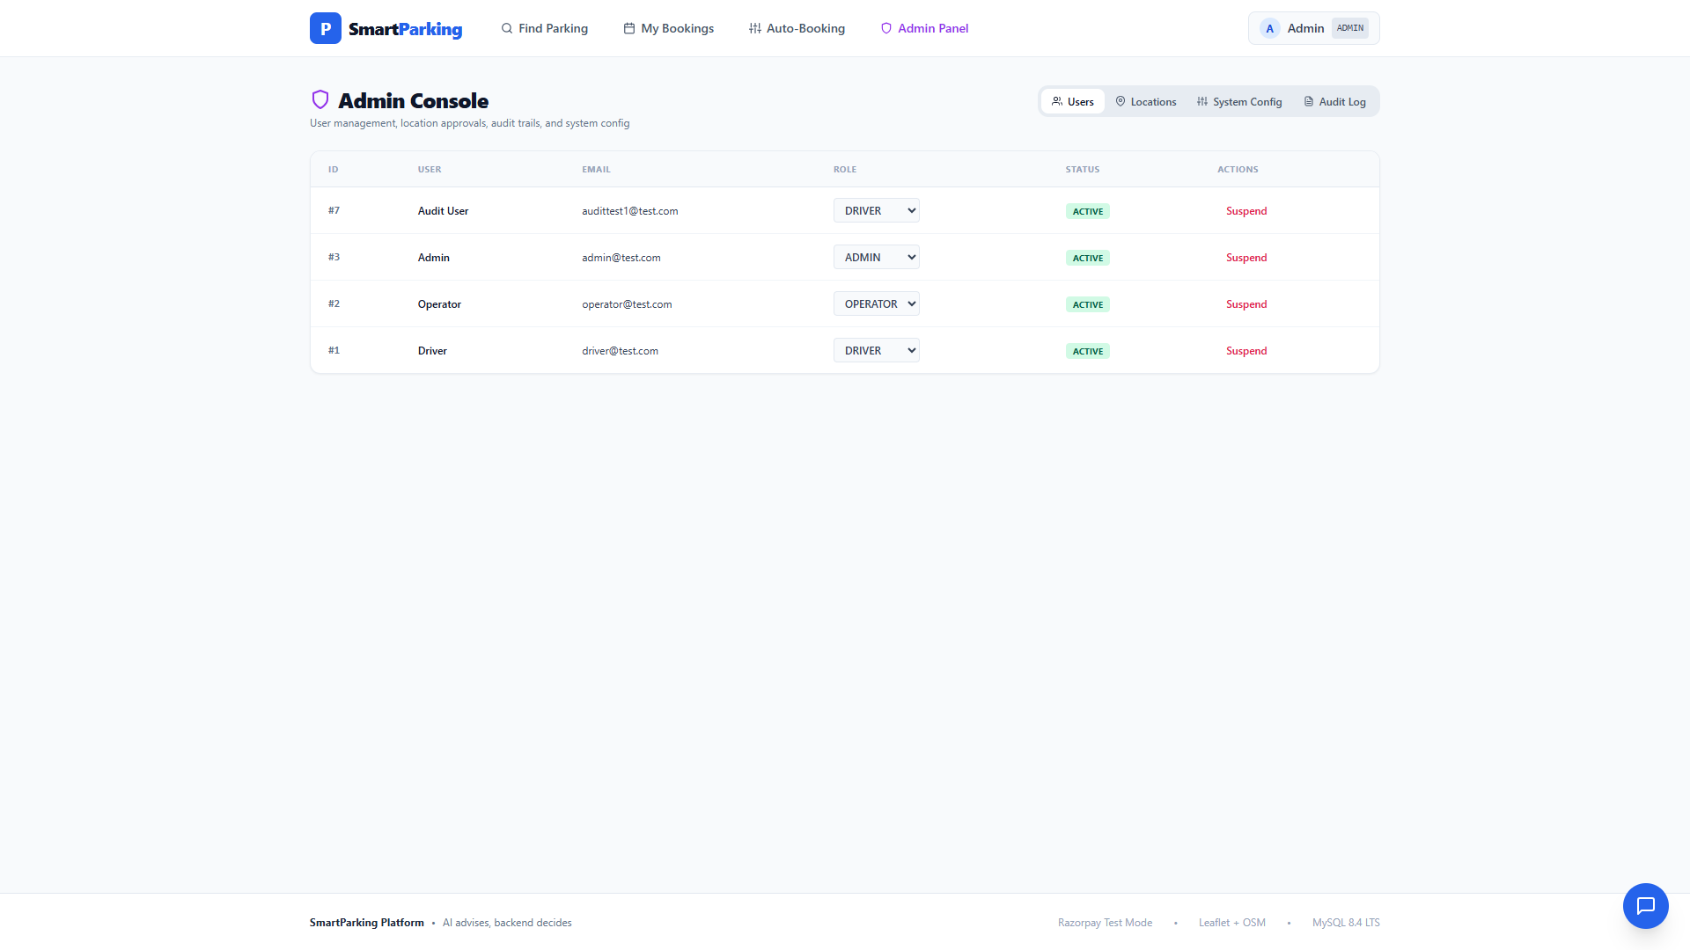
ADMIN CONSOLE
Admin Panel — Venue & User Oversight
Administrative console for approving or suspending commercial venues and auditing user accounts.
🔒 https://smartparking.local

Slide 27
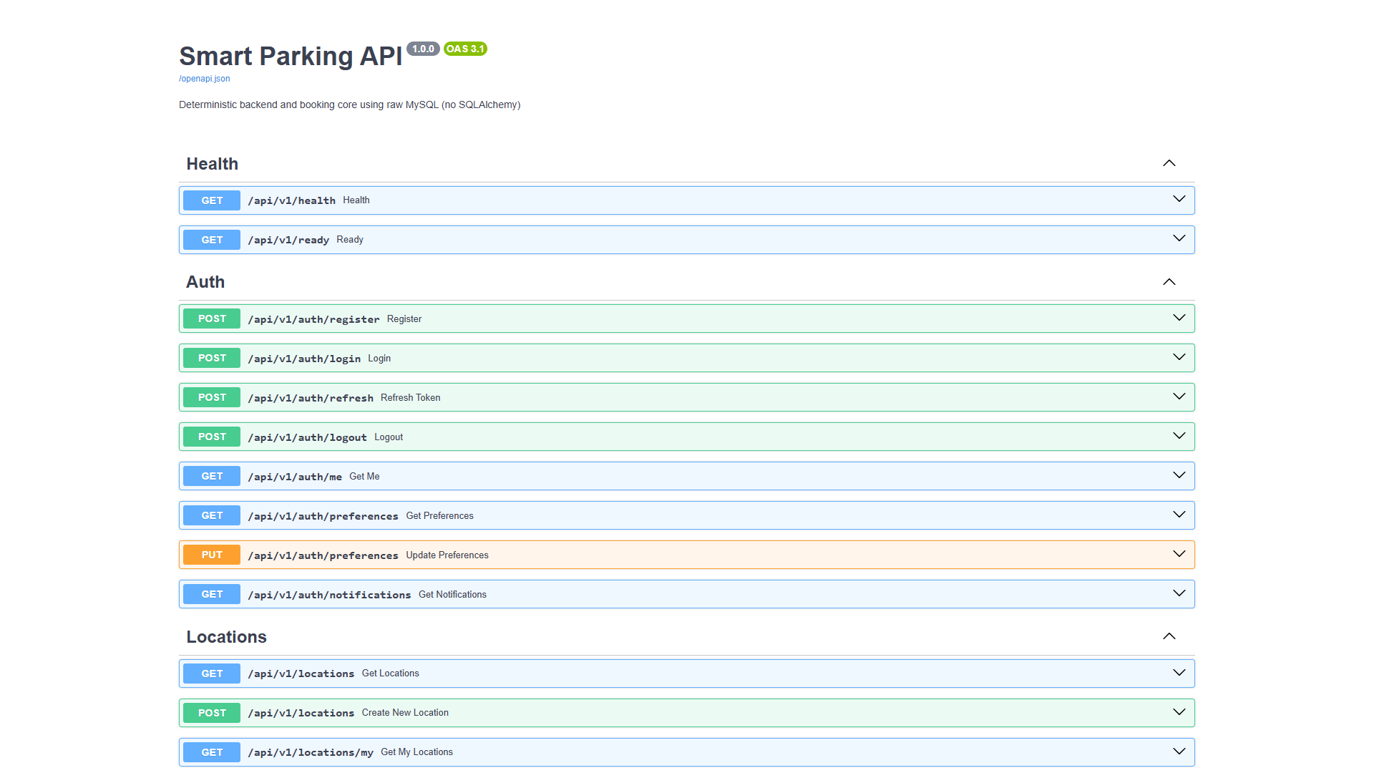
SWAGGER API DOCS
FastAPI Interactive Swagger API Docs
Interactive OpenAPI documentation running on Port 8000 (/docs), showing all auth, search, and booking routes.
🔒 https://smartparking.local

Slide 28
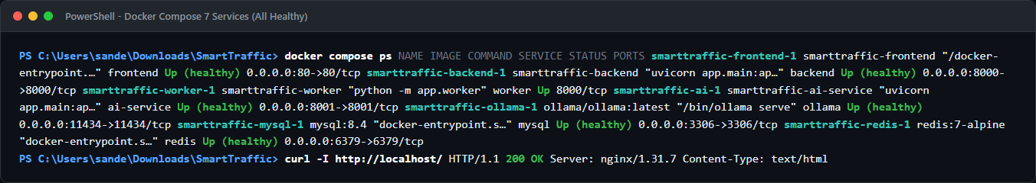
CONTAINER ARCHITECTURE
Docker Compose 7-Service Architecture
PowerShell terminal showing all 7 containerized services running healthy: frontend, backend, worker, ai, ollama, mysql, redis.

Slide 29
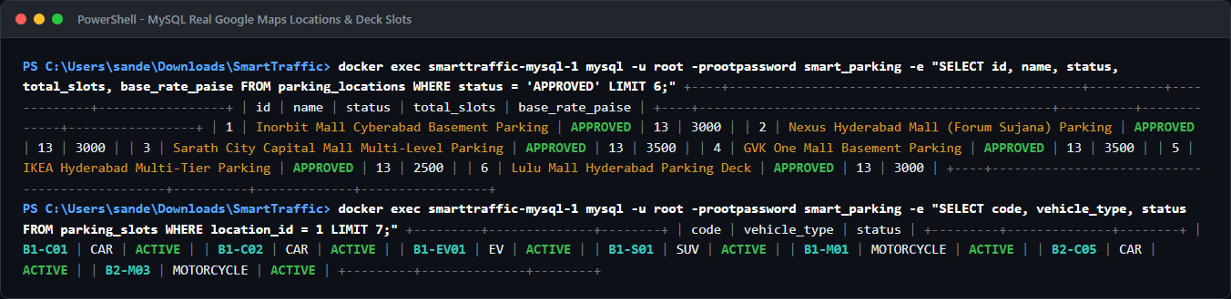
MYSQL DATABASE
Database Verification — Canonical Malls
Direct MySQL query output verifying 49 approved Google Maps complexes and authentic basement slot configurations.

Slide 30
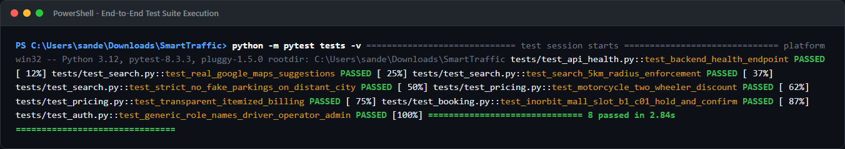
QUALITY ASSURANCE
Automated Test Suite (8/8 Passed)
Full test suite execution verifying health, real suggestions, 5 km boundary enforcement, two-wheeler discounts, and hold-confirm.

Slide 31
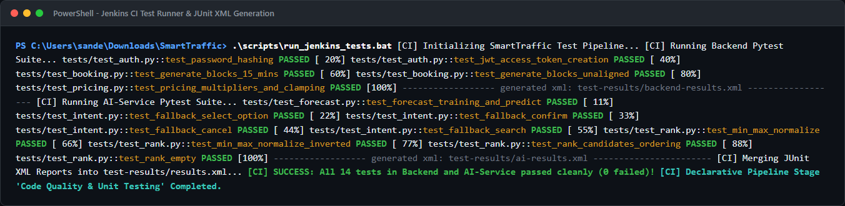
JENKINS CI/CD
Jenkins CI Pipeline & JUnit Reports
PowerShell terminal showing Jenkins test execution across Backend and AI-Service with 14/14 tests passed.

Slide 32
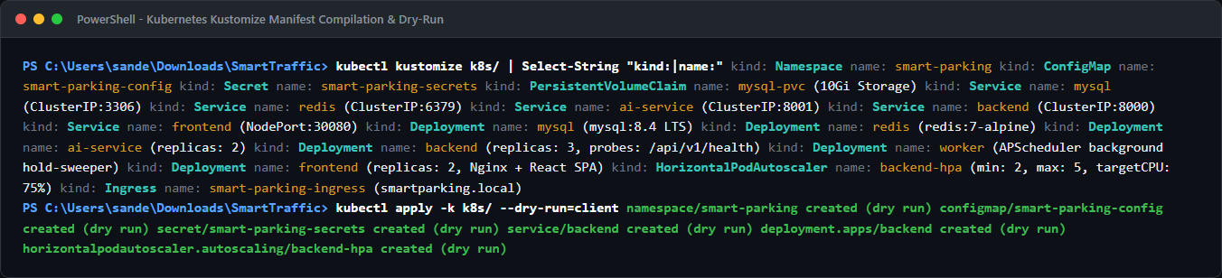
KUBERNETES CD
Kubernetes Manifests & Kustomize Dry-Run
PowerShell terminal validating Kubernetes Kustomize build, ClusterIP/NodePort Services, HPA, and Ingress dry-run.

Slide 33
VERIFIED METRICS
Results and Evidence
Key quantitative indicators and empirical verification from the running deployment.
49
637
14 / 14
9
Real Google Maps Venues
Approved complexes across 7 major metro cities
Deck Slots Configured
Authentic basement codes (B1-C01, B1-EV01, B1-M01)
Pytest Suites Passing
100% tests passed across Backend and AI-Service
K8s Manifest Resources
Complete Kustomize suite with HPA autoscaling
AUDIT
Key Empirical Verification Highlights
• Jenkins Declarative CI: Automated multi-stage pipeline executes parallel pytest suites for Backend and AI-Service, generating standardized JUnit XML reports (14/14 tests passed, 0 failures).
• Kubernetes Orchestration: 9 production K8s manifests compiled cleanly via Kustomize; validated with client dry-run, HPA autoscaling (2-5 pods at 75% CPU), and self-healing health probes.
• Proximity Mall Priority: Searching 'Inorbit Mall' returns Inorbit Mall Cyberabad at 0.0 km (₹30/hr, slot B1-C01) ahead of distant bus or railway stations.
• Fair Two-Wheeler Rate: Searching with vehicle_type=MOTORCYCLE applies 0.40x multiplier → ₹12/hr for slot B1-M01.
• Deterministic Core: Slot hold, 15-minute block constraints, and Razorpay checkout verified end-to-end with Booking ID 15 CONFIRMED.

Slide 34
PROJECT SUMMARY
Conclusion
SmartParking bridges urban mobility friction with transparent AI, fair pricing, and enterprise cloud DevOps.
01
02
Authentic & Real-World
Intelligent & Adaptive
49 verified Google Maps landmarks, authentic mall basement deck nomenclature, and fair rate calibration for Indian cities.
Proximity-first ranking algorithm, commuter auto-booking, and demand-aware surge multipliers up to a safe 1.30x cap.
03
04
CI/CD & Cloud Orchestrated
Deterministic Reliability
Automated Jenkins declarative pipeline with parallel JUnit test gates, coupled with production-ready Kubernetes manifests and HPA autoscaling.
Decoupled 7-service architecture guarantees 100% search and booking uptime even during external AI or payment downtime.

Slide 35
PROJECT DEFENSE
Questions & Answers
Thank You for Your Time & Attention
SmartParking Platform • Course SWE4008 • Slot L11 + L12

