Slide 1
RECOMMENDATION ENGINES
Prepared By….
Sandeep Singh [C0727422]
Febin Roy Edakalathur [C0723559]
Amal Das [C0724011]
Alan Salo [C0727079]
Enamol Hassan [C0728399]

Slide 2

Agenda
Introduction
Applications
Recommendation Models Types
Similarity Algorithms
Implementation using R
Implementation using Python

Slide 3
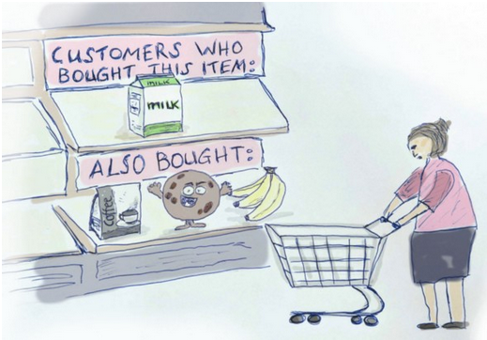
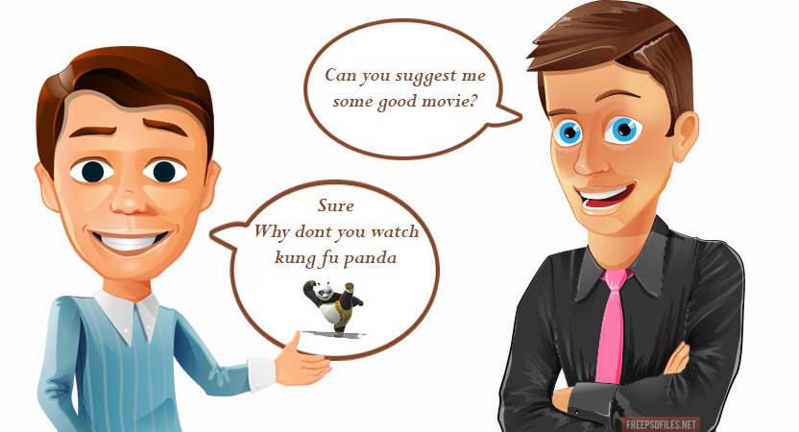
Introduction
A recommendation engine filters the data using different algorithms and recommends the most relevant items to users.
It first captures the past behavior of a customer and based on that, recommends products which the users might be likely to buy.

Slide 4


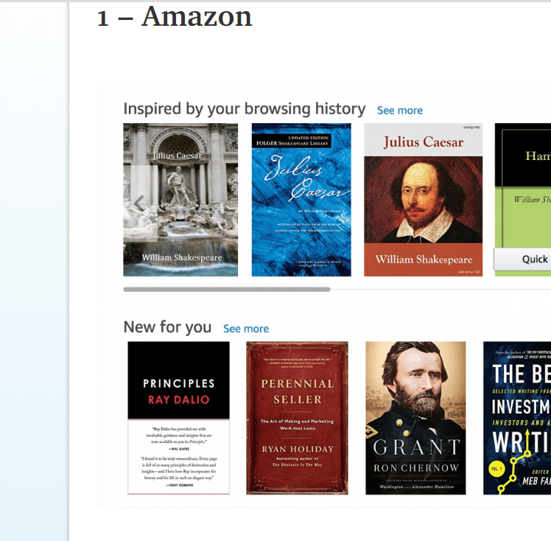
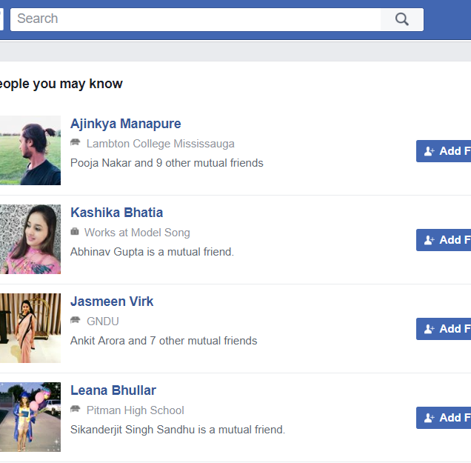
Applications
Online Shopping
Entertainment
Advertisements
Social Sites
Travel Advisor
E - Learning
Mobile Applications

Slide 5
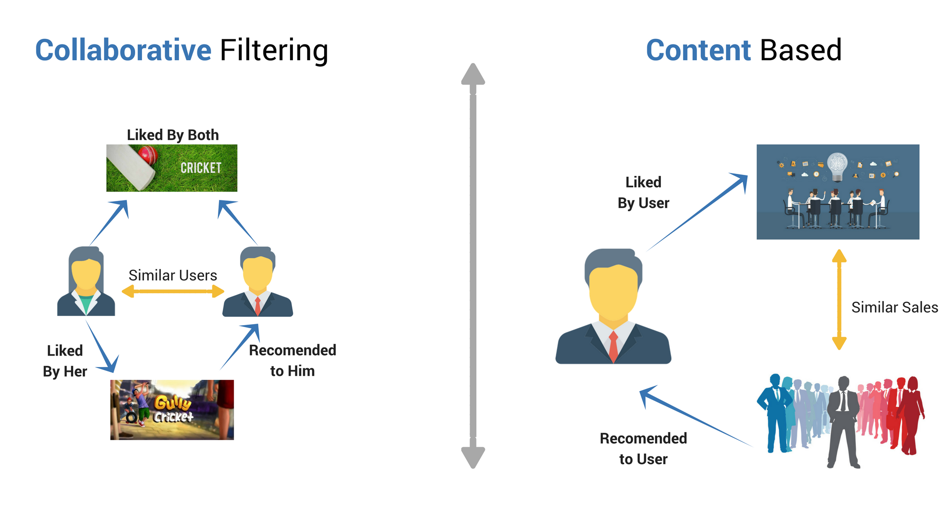
Recommendation Models Types
Content based filtering
Collaborative filtering

Slide 6
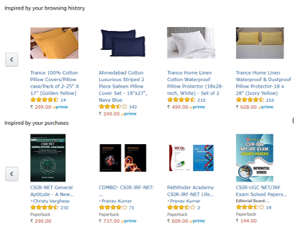
Content Based Filtering
Selects items based on the correlation between the content of the items and the user’s preferences.
Works with existing profiles of users and particular item.
Does not depend on lots of user data, so it is possible to give recommendations to even your first customer.
For instance – In adjacent pic you can see amazon’s recommender system recommends products based on viewed and purchased history.

Slide 7
Problems in Content Based Filtering
Requires manual or automatic indexing – Item feature do not capture everything.
Needs to learn what content features are important for the users, so takes time.
It assumes that user’s taste and preference remains more constant over time.
Provision of discovering something fortunate, especially while looking for something entirely unrelated is absent.

Slide 8
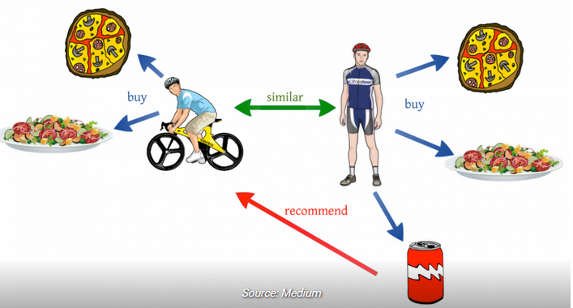
Collaborative Filtering
Collaborative Filtering is the process of filtering or evaluating items using the opinions of other people.
For each user, recommender systems recommend items based on how similar users liked the item.
Let’s say Alice and Bob have similar interests in video games. Alice recently played and enjoyed the game Legend of Zelda: Breathe of the Wild. Bob has not played this game, but because the system has learned that Alice and Bob have similar tastes, it recommends this game to Bob.

Slide 9
Similarity Algorithms
Jaccard Similarity
Cosine Similarity
Pearson Coefficient

Slide 10
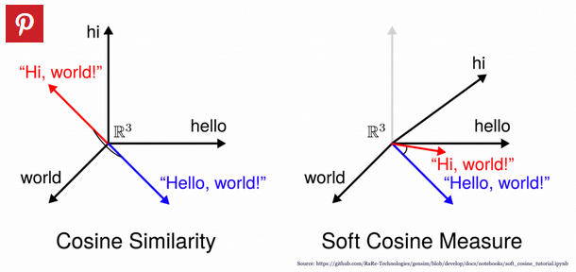
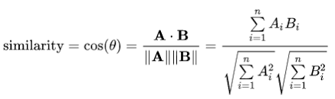
Cosine Similarity
With this, we are going to evaluate the similarity between two vectors based on the angle between them.
The smaller the angle, the more similar the two vectors are.

Slide 11
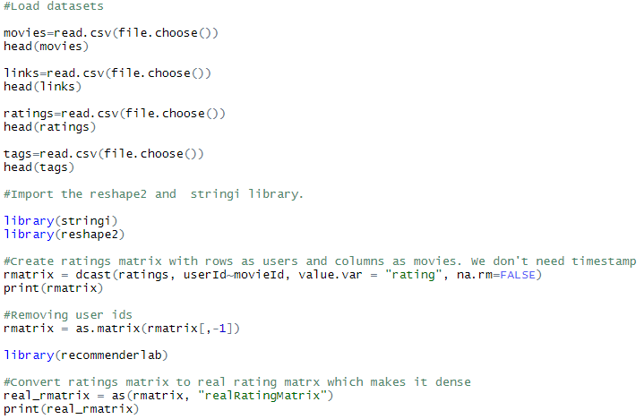
Implementation using R

Slide 12
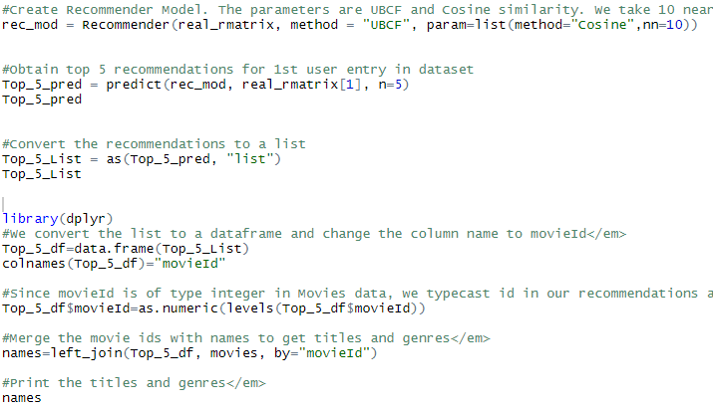

Slide 13
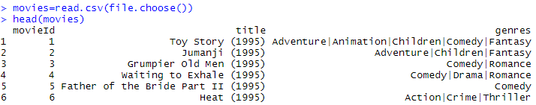
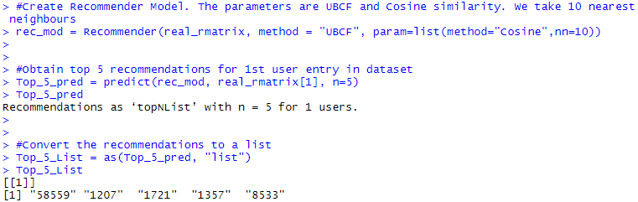
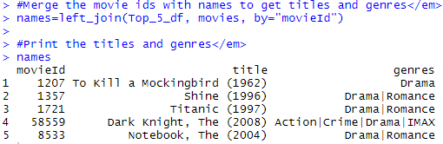
Output

Slide 14

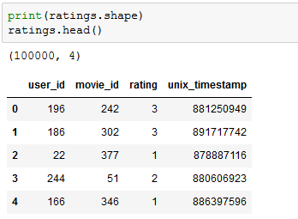
Implementation using Python

Slide 15
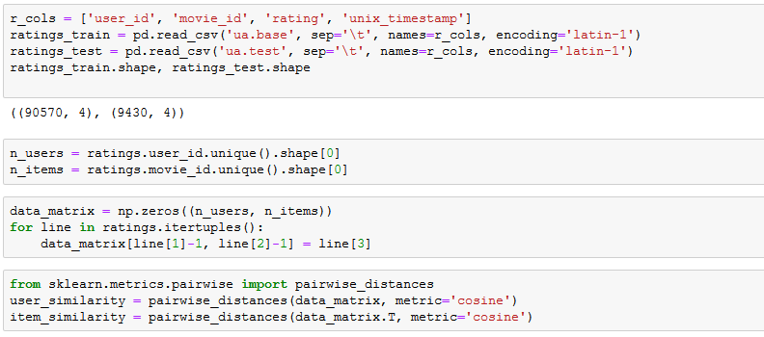
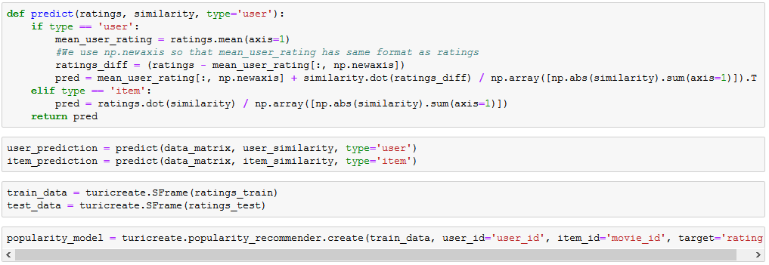

Slide 16
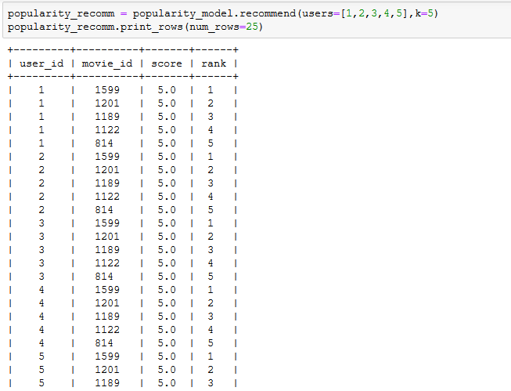
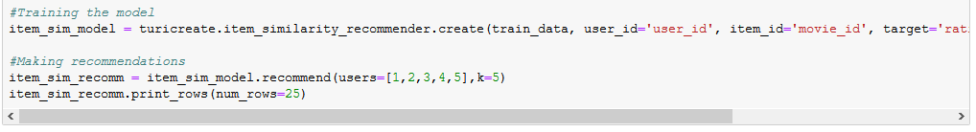

Slide 17
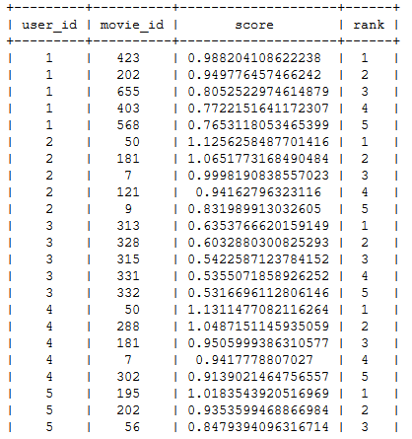
Output
You receive recommended movie_id for user_id 1,2,3,4 and 5.

Slide 18
References
https://towardsdatascience.com/how-to-build-a-recommendation-engine-quick-and-simple-aec8c71a823e
https://www.analyticsvidhya.com/blog/2018/06/comprehensive-guide-recommendation-engine-python/
https://medium.com/@mark.rethana/building-a-song-recommendation-system-using-cosine-similarity-and-euclidian-distance-748fdfc832fd
https://towardsdatascience.com/collaborative-filtering-based-recommendation-systems-exemplified-ecbffe1c20b1
https://en.wikipedia.org/wiki/Cosine_similarity
https://www.data-mania.com/blog/how-to-build-a-recommendation-engine-in-r/
https://www.analyticsvidhya.com/blog/2016/03/exploring-building-banks-recommendation-system/

