Slide 1
Logic gates Simulator using C++
Lecturer: Prajwal Pakka Sir
Saksham Neupane (THA081BCT032)
Sandeep Dhungana (THA081BCT034)
Sandesh Acharya (THA081BCT035)
Department of Computer and Electronics
Thapathali Campus
August 22, 2025

Slide 2
Motivation
Making digital logic more interactive and visual for learners.
Gaining practical experience in C++ GUI development.
Combining programming skills with educational tools to create a practical ,demonstrable project.

Slide 3
Objectives:
Develop a real-time logic gate simulator.
Implement a modular, object-oriented design for gates and circuits.
Use C++ and GUI for intuitive interaction.
Allow users to observe logic propagation visually.

Slide 4
Introduction
Logic Gate Simulator in C++ supporting AND, OR, NOT, NAND, NOR gates.
Inputs are set via GUI switches; outputs are displayed graphically in real-time.
Designed as an educational tool to understand digital logic.

Slide 5
Tech used:
C++ - Core programming language for implementing the simulator and logic operations.
Raylib – GUI/graphics library for interactive placement, wiring, and real-time visualization
Visual Studio(IDE) - For coding, debugging, and project management.
GitHub - Version control and project collaboration.

Slide 6
GATE WORKFLOW
Let’s see how the gate simulator works

Slide 7
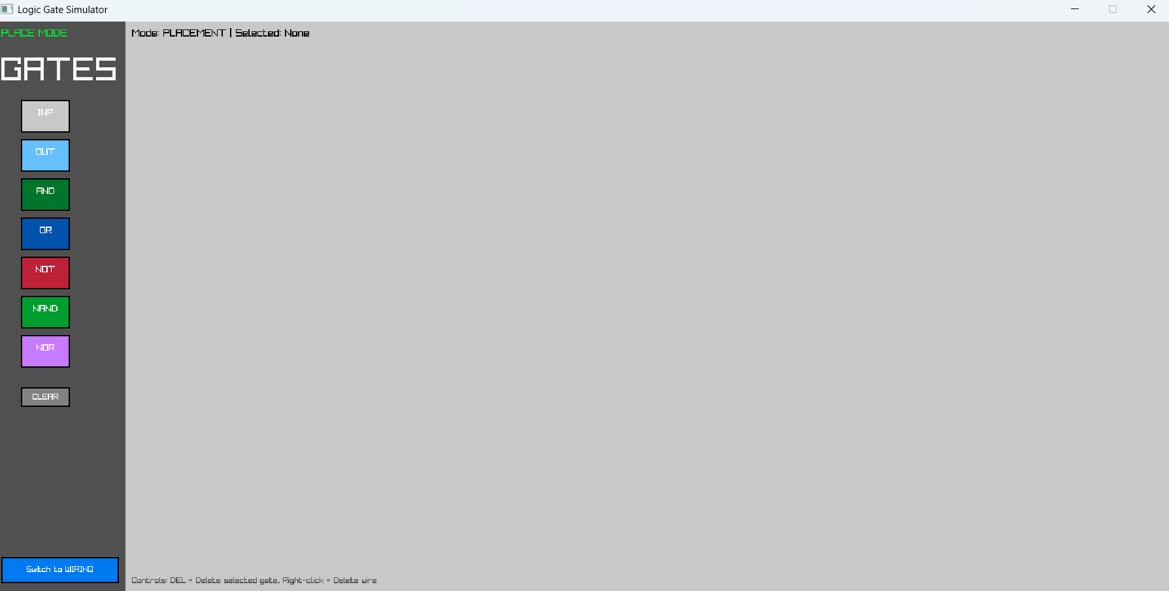

Slide 8

1.PLACEMENT MODE

Slide 9
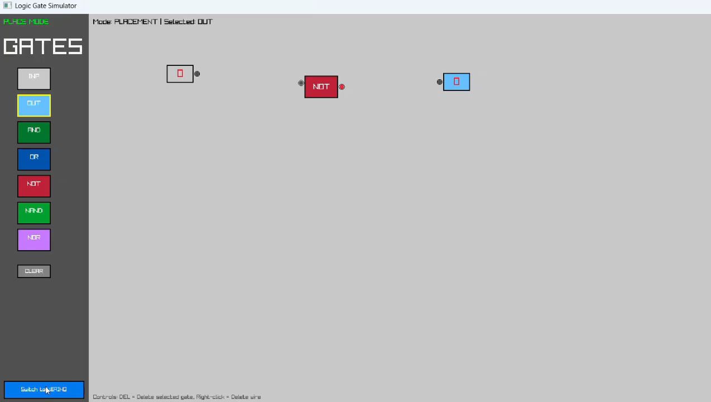
2.WIRING MODE

Slide 10
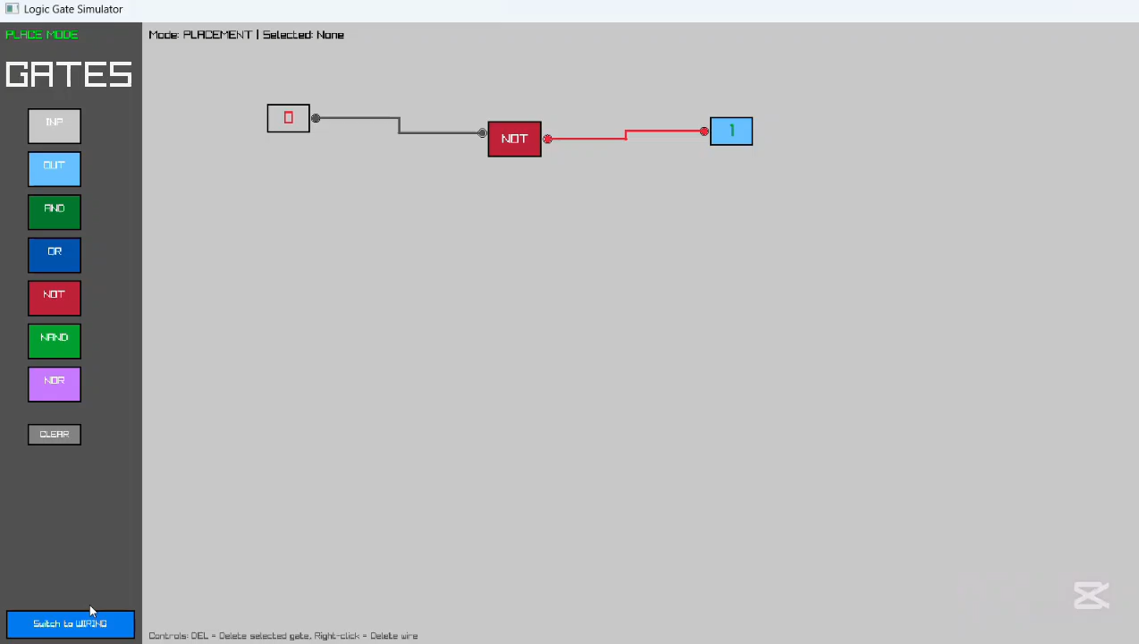
3.TOGGLING PHASE

Slide 11
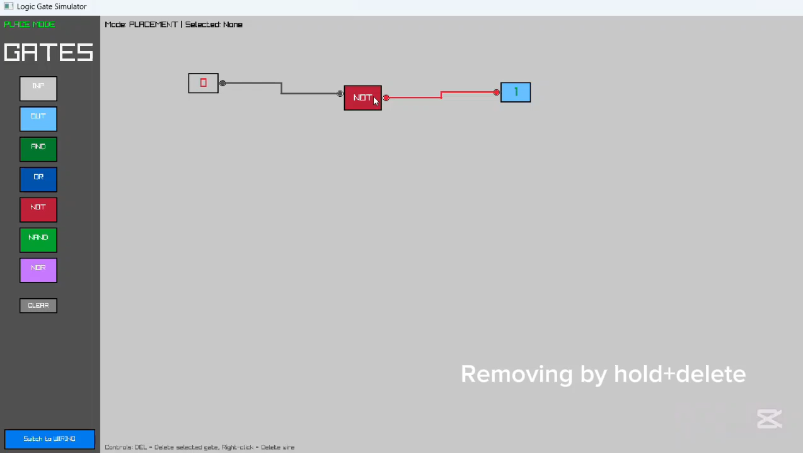
4.Removeal

Slide 12
Conclusion
Developed an interactive logic gate simulator supporting AND, OR, NOT, NAND, and NOR gates.
Achieved real-time visual feedback for input and output signals
Successfully combined C++ programming, OOP principles, and Raylib GUI to create an educational tool.
Well-structured and easy to expand with new gates or features.
Provides a practical platform for learning digital logic concepts effectively.

Slide 13
Challenges Faced
Choosing the GUI library
Remote collaboration
Designing intuitive wiring and placement
Testing for accuracy

Slide 14
Future Enhancement
Add more logic components like XOR and XNOR gates.
Extend support to sequential circuits with clocks and flip-flops.
Automatic truth table generation for any user-created circuit.
Option to load / save.
Add real-time multi-user editing for remote learning

