Slide 1
Client-Server Chat Application
Lecturer: Prajwol Pakka Sir
Saksham Neupane (THA081BCT032)
Sandeep Dhungana (THA081BCT034)
Sandesh Acharya (THA081BCT035)
Department of Computer and Electronics
Thapathali Campus
March 21, 2025

Slide 2
Motivation
Understanding the basics of client-server communication.
Gaining practical experience in socket programming.
Building a foundation in networking protocols for future projects.

Slide 3
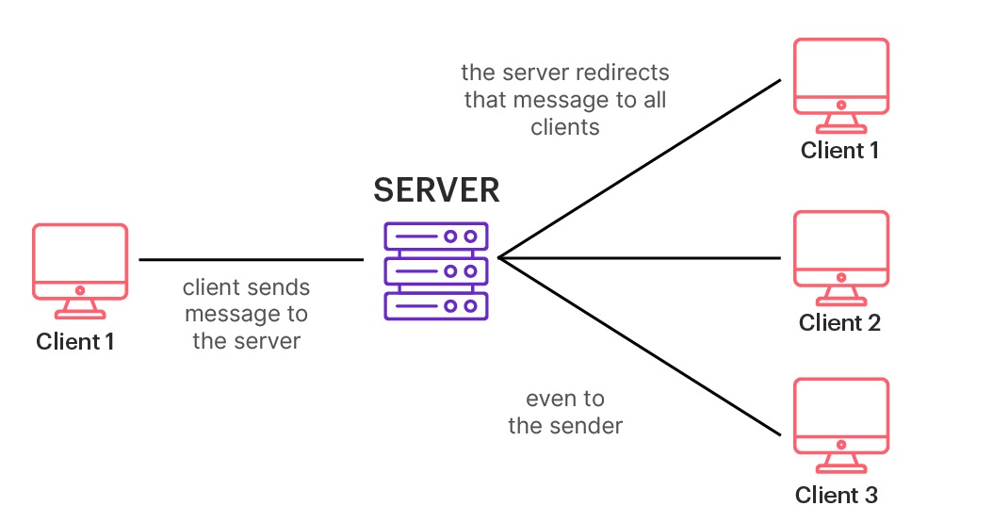
Objectives:
To develop a real-time client-server communication system.
To use socket programming in the C programming language.
Fig: Client-server chat application

Slide 4
Introduction
A project to develop a real-time chat application using c programming.
Demonstrates client-server communication using socket programming.

Slide 5
Concepts used:
Client-Server Architecture
A communication model where:
The client sends requests for services.
The server processes and responds to these requests.
2. Socket Programming
Enables real-time communication between client and server.
Uses network sockets to establish a connection.

Slide 6
Socket Programming
Socket: It is an endpoint of a 2-way communication between programs running on the network.
Socket programming is a way of connecting two node on a network to communicate with each other.

Slide 7
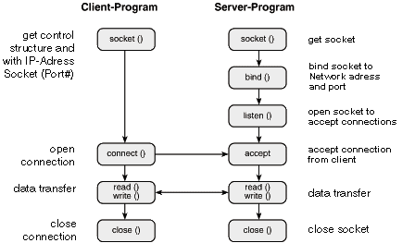
Reference :socket programing w&t

Slide 8
Socket functions:
socket() :
It creates socket.
bind() :
Bind socket to the ip address and specific port.
listen() :
Listen the incoming connections form client
connect() :
Connect to a server port.

Slide 9
accept() :
Accept new connections from new clients.
send()/recv() :
Send and receive data over stream socket.
close() :
It signals the end of communication between client-server pair
(closes the socket).

Slide 10
“Client” Socket Workflow
The client socket is created with a socket() call and then connected to a remote address with the connect() call, and then finally can retrieve data with the recv() call.

Slide 11
“Server” socket workflow
On the “Server” end of the socket, we need to also create a socket() call , but then, we need to bind() that socket to an IP and port where it can then listen() for connections, and then finally accept() a connection and then send() or recv() data to the other sockets.

Slide 12
Future Enhancement
Implement multi-device support to allow multiple users to chat simultaneously.
Add message encryption for secure communication.
Introduce a graphical user interface for a more user-friendly experience.

Slide 13
Conclusion
Simple ,efficient , and user-friendly C program design.
Supports real-time communication between client and server.
Reliable use of socket programming for smooth data transfer.
Well-structured and easy to expand with new features.
Useful for learning and practical networking projects.

Slide 14
References:
YOUTUBE :
youtube.com/NesoAcademy/socket-programing
SOCKET PROGRAMMING IN C :
geeksforgeeks.org/socket-programming

