Slide 1
MacroBase: Prioritizing Attention in Fast Data
Peter Bailis, Edward Gan, Samuel Madden, Deepak Narayanan, Kexin Rong, Sahaama Suri

Slide 2

abundant data, scarce attention

Slide 3
abundant data, scarce attention
data is increasingly too big for manual inspection

Slide 4
abundant data, scarce attention
data is increasingly too big for manual inspection Twitter, LinkedIn, Facebook, Google: log 12M+ events/s projected 40% year-over-year growth (e.g., via IoT)

Slide 5
abundant data, scarce attention
data is increasingly too big for manual inspection Twitter, LinkedIn, Facebook, Google: log 12M+ events/s projected 40% year-over-year growth (e.g., via IoT) today’s operators say:
< 6% of this data is ever accessed after ingest

Slide 6






the key to fast data
combine: classify and explain
classify
explain
how should we do it?

Slide 7

dataflow (alone) is not enough
dataflow: a substrate, not a complete solution
missing:
scalable, modular operators for prioritizing attention via classification and explanation
Notes:
Missing: A lot of work to go in building production quality data pipelines.
Actual implementation of statistical operators is not very easy.

Slide 8



macrobase: a fast data system
classify
explain
a system providing
fast, reusable, modular operators for classification and explanation prioritizing attention in fast data

Slide 9


classify
explain
key: make this combo fast
Notes:
Key Contribution: Combining a statistical operators in an end to end system which has some key optimizations.

Slide 10









MacroBase System: Prioritize Attention
Execute cascades of operators that transform, filter, aggregate the stream
dimensionality reduction,
feature extraction, data fusion,
streaming ETL
segmentation, rule evaluation, supervised + unsupervised inference
aggregation into interpretable outputs

Slide 11
MacroBase: Data points and operators
Operators
Ingestion: Stream<Point>
Transformation: Stream<Point> → Stream<Point>
Classifier: Stream<Point> → Stream<label, Point>
Explanation: Stream<label, Point> → Stream<Explanation>
Data Types
Point: (array<double> metrics, array<varchar> attributes)
Explanation: (array<varchar> attributes, stats statistics)

Slide 12
Overview
Ingestion Requires necessary stream ordering done before ingestion.
Transformation
Domain specific. User performs this without modifying later stages.
Classification
Label each point according to its input metrics.
Explanation
Return attribute value combination that is common among outlier points
But not common among inliers.

Slide 13
End-to-end optimizations
Adaptable damped reservoir Novel sampling in streaming data context.
Cardinality Imbalance Optimized way to generate explanations explanations
Amortized Maintenance Counter Similar attributes in fast data streams.

Slide 14
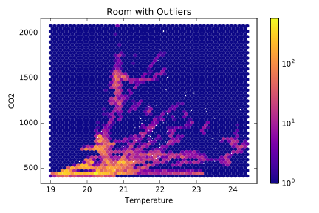
Classification
Mean μ
Default: identify unlikely data points (e.g., via density estimation)
unsupervised density based classifiers with supervised methods (thresholds, predicates)
More than k standard deviations from μ
Notes:
By default, we provide a set of unsupervised density based classifiers,
Where we seek to find data points in unlikely regions of space
this could be via density estimation or something very simple like gaussian

Slide 15
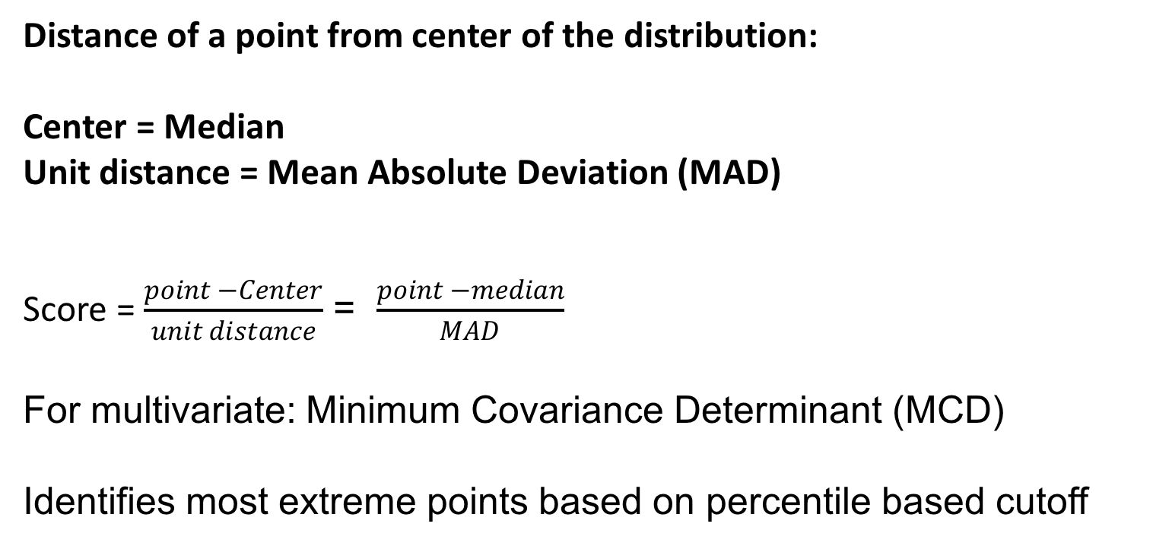
Default Classification
Distance of a point from center of the distribution:
Center = Median
Unit distance = Mean Absolute Deviation (MAD)
Score = $\frac{point −Center}{unit distance}$ = $\frac{point −median}{MAD}$
For multivariate: Minimum Covariance Determinant (MCD)
Identifies most extreme points based on percentile based cutoff

Slide 16
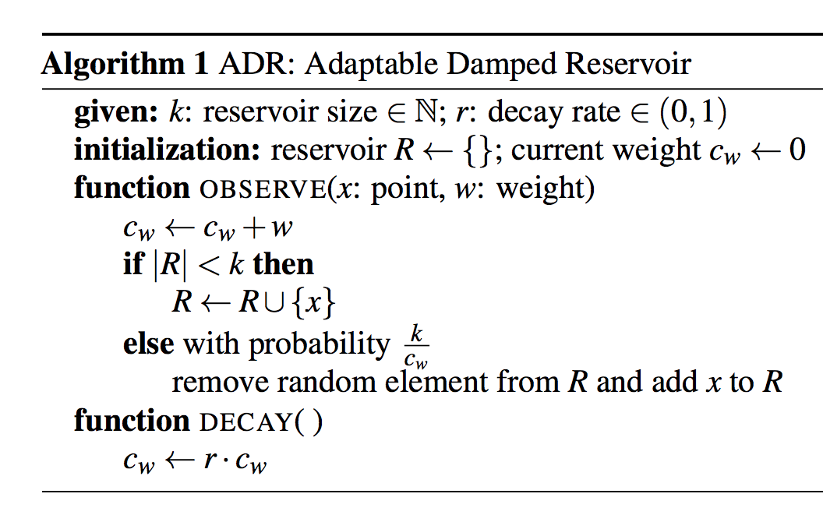
Classification: Streaming Execution
Idea: Maintain Sample of data
Traditional approach:
Reservoir Sampling: Choosing k samples from
a very large stream
Adaption of Reservoir Sampling: Adaptive Damped Reservoir (ADR)
Model retraining is done using ADR on input stream.
Outliers are maintained in ADR, which is used to periodically compute the score quantile.

Slide 17
Explanation
Explain classification results that describes attributes common to outliers but relatively uncommon to inliers. on data attributes
Errors
{iPhone7, Canada}
{iPhone7, USA}
{iPhone8, Canada}
{iPhone7, USA}
{iPhone8, Canada}
Non-Errors
{iPhone8, USA}
{iPhone7, USA}
{iPhoneX, USA}
{iPhone7, USA}
{iPhone7, USA}
{iPhone8, USA}
{iPhone7, USA}
{iPhone7, USA}
Canada may have a problem!
Notes:
Here, we want to take the filtered data from the classification stage identify what is different between the filtered and unfiltered data

Slide 18


Explanation
Explain classification results that describes attributes common to outliers but relatively uncommon to inliers.
Default: relative risk calculation based on data attributes
Relative Risk
error
non-error
P(error | canada)
P(error | not canada)
Notes:
We quantify this metric with what's known as the "risk ratio"
What this ratio computes is
how much more likely am I to be in error if I originate in canada vs not canada
And by effiiciently checking this for a number of additional attributes, we can detect whether or not certain subsets of attributes are more correlated with being in error or being classified as an outlier

Slide 19
Risk Ratio for various attributes
B
C
A D
A A
A B D C B B E B
Naive Solution ?
Optimization: Individual ratio vs Set
Optimization: Exploit Cardinality imbalance
Search for attributes in outliers (= O) with minimum risk ratio.
Compute attribute combinations over O (= C).
Filter C by risk in inliers is less than r.
Note: Inliers>> outliers
Notes:
FPGrowth: Maintains a frequency describing prefix tree of attributes.

Slide 20
Streaming Explanation
Maintain count of frequent items = Heavy hitters
Heavy hitters → Approximate risk ratio and occurrence of attributes.
Traditional Solution: Space saving algorithm with exponential decayed settings
Problem: Performance. (Update time is more. We have to update frequency for every point.)
Notes:
Heavy hitters: Given a stream of size N, and a parameter K.
Find all elements that occur at least N/K times

Slide 21
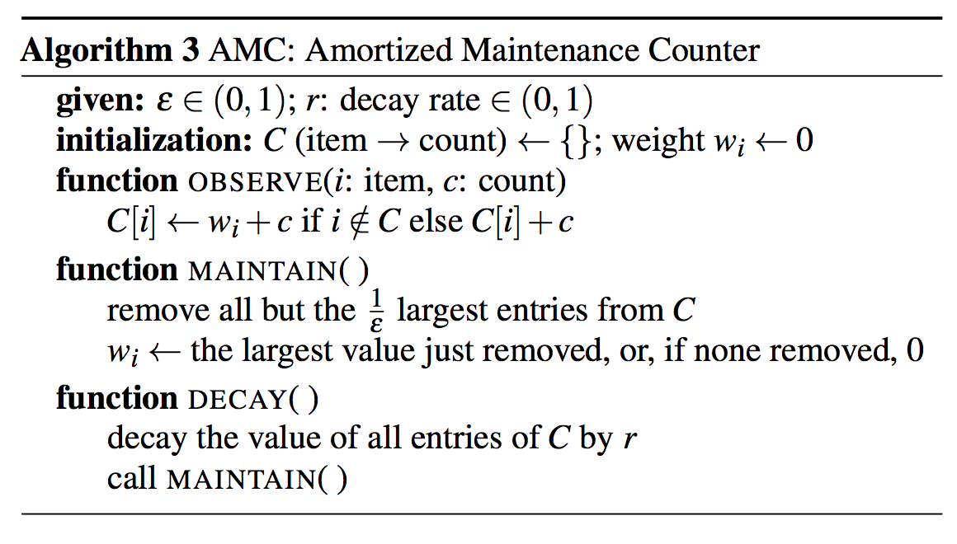
Streaming Explanation
Optimized Heavy hitters: Much larger space
Notes:
Heavy hitters: Given a stream of size N, and a parameter K.
Find all elements that occur at least N/K times
If: item I is not in set, add item item i to the set,
Else if item I is already in the set, update its count.
Updating is now a constant time.
Maintenance step is now expensive.
Traditional maintenance is called on every step.

Slide 22
Evaluation
Results: MacroBase on 4 Intel Xeon CPU with 12 cores each and 1 TB of RAM.
Default minimum occurrence/support: 0.1%
Default minimum risk: 3
Target outlier percentile: 1%
ADR and AMC sizes of 10K
Decay range of 0.01 for every 100K points.

Slide 23
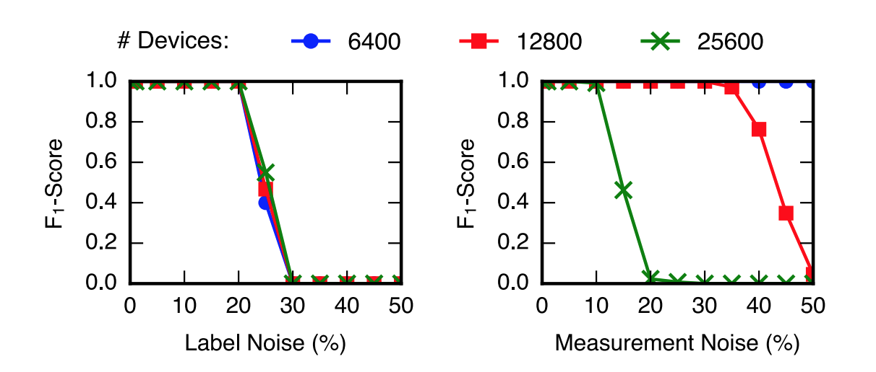
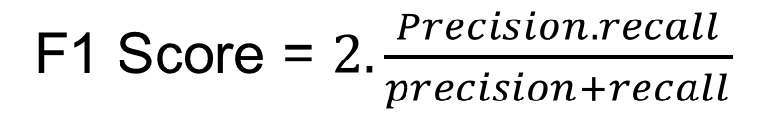
Synthetic dataset accuracy
Data from # devices.
Inlier distribution N (10,10)
Outlier distribution N (10,10)
Total Points: 1M
F1 Score = $2.\frac{Precision.recall}{precision+recall}$
label noise: Randomly assigning readings from the outlier distribution to inlying devices and vice-versa.
Measurement noise: Randomly assigning a proportion of both outlying and inlying points to a third, uniform distribution over the interval [0,80].
Notes:
Real-world dataset accuracy is also provided in a table,

Slide 24
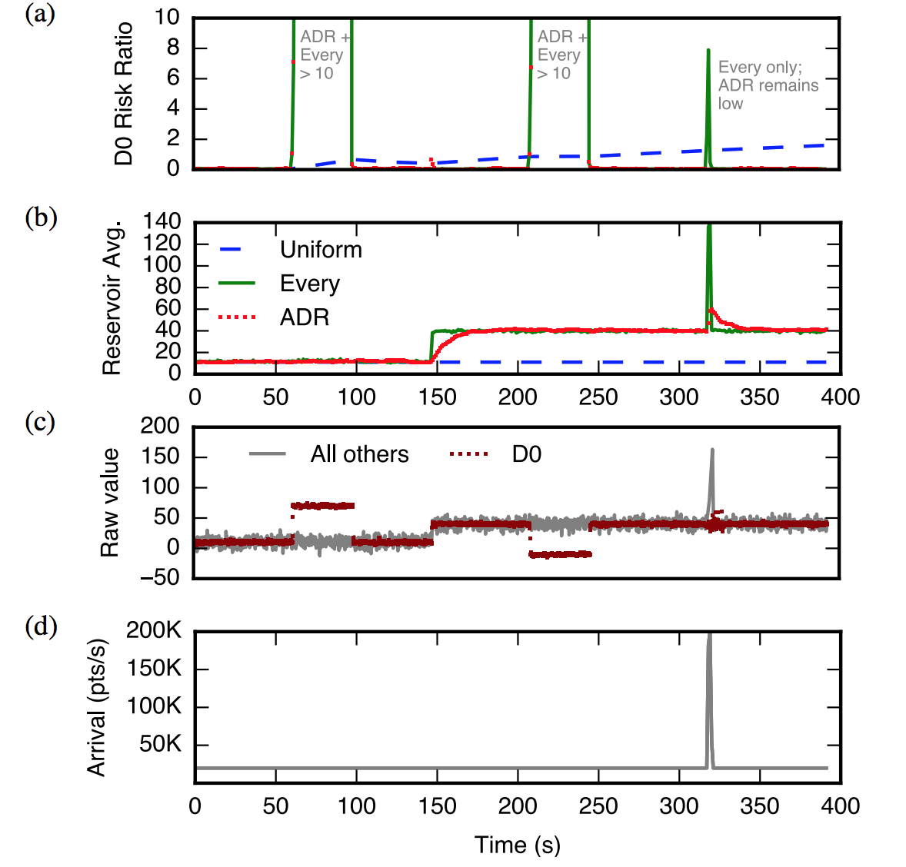
Adaptivity
Time evolving data stream representing 100 devices.
Change underlying data distribution
and Variable arriving rate
100 Devices
0-50 sec, All devices: Gaussian N(10,10)
50-100 sec, D0 : Gaussian N(70,10)
100-150 sec, D0 return to N(10,10)
150-300 sec, all devices N(40,10)
-----
Uniform: Uniform Sampling Reservoir
Every: Per-tuple exponentially decaying
ADR: Adaptive Damped Reservoir
Notes:
Every and ADR can adapt to change In the distribution
ADR is better at 325, when a spike in the arrival rate appears.

Slide 25
Other Comparisons & Results
Effect of cardinality aware explanation: 3 X improvement
Effect of AMC (Heavy hitters): 500X improvements due to extra space (space is 1000X more than space saving algorithm)
End to end runtime breakdown of time
% of time in training MAD, scoring points and generating explanation

Slide 26
Discussed Case Studies
Supervised classifier
Transformation
Notes:
2 case studies, one where a supervised classifier is used to rate score the trip quality,
And transformation on time-series data of electricity using Fourier transform.

Slide 27


Early Production Usage
“MacroBase discovered a rare issue with the CMT application and a device-specific battery problem.
Consultation and investigation with the CMT team confirmed these issues as previously unknown…”
[Bailis et al., SIGMOD 2017]

Slide 28
Conclusion

