Slide 1

CAMUNDA
Team – Sandeepani
G Kottresha 40019967
P G Sandeep 40019977
D Ashish. 40019964
K Mohan Krishna. 40019976
G Karthik 40019147
B Steven Babu 40012965

Slide 2

What is camunda
Camunda Platform is an open-source workflow and decision automation platform.

Slide 3
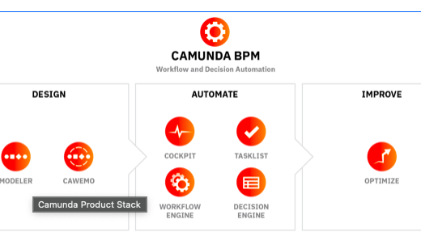
Camunda workflow

Slide 4
Users (Roles)
Admin (Cockpit)
Doctor
Laboratory Person
Patient

Slide 5
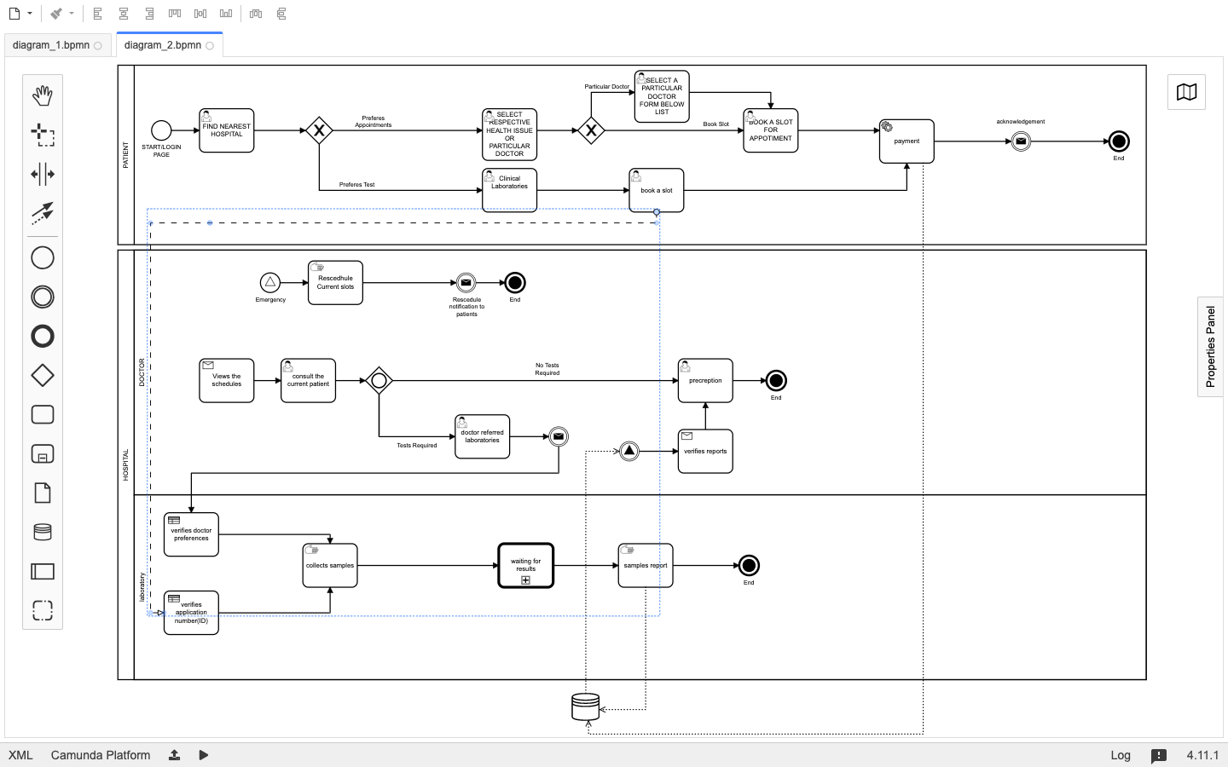
Camunda bpmn

Slide 6

Thank You

