Slide 1

PROOF OF CONCEPT
Passwordless Login for CIAM
Bringing FIDO2 Passkeys to Azure AD B2C — before the platform catches up
Identity Management Team
Personal proof-of-concept exploration — not an approved or officially committed architecture.

Slide 2






WHAT WE'LL COVER
Agenda
Why Passwords Fail
The real cost of credential-based authentication
Implementation Architecture
How it's wired into our LCS applications
FIDO2 & Passkeys 101
How passwordless authentication actually works
Live Demo
Register once, sign in anywhere
The B2C Gap
Why our current IdP can't get us there in time
Roadmap
From pilot, to production, to Entra
Our Bridge: open-passkey
An MIT-licensed library that closes the gap now
Reflects an individual proof-of-concept by the presenter — not an approved team or organizational decision.
Identity Management Team • Proof of Concept
2

Slide 3
WHY THIS MATTERS
Passwords Are Still Our Biggest Attack Surface
77%
3,000%
36%
47%
of breaches involve stolen or reused credentials
increase in AI-powered phishing attacks on corporate credentials
of people have had an account compromised by a weak or stolen password
success rate of AI spear-phishing — even against trained security staff
Passwords are a shared secret. You give it to a server, the server stores it, and now there are two places it can be stolen.
Source: industry breach & phishing research (figures to be verified before publishing).
Identity Management Team • Proof of Concept
3

Slide 4
FOUNDATIONS
What Is FIDO2? What Is a Passkey?
FIDO: Fast IDentity Online — an open industry alliance and standard built entirely on public-key cryptography.
Private Key
Lives on your device. Never leaves. Signs challenges.
FIDO2: WebAuthn (the browser API) + CTAP2 (the device protocol). The current standard — fully passwordless, works in every major browser.
mathematically linked
A passkey: is a FIDO2 “discoverable credential” — a key pair bound to one site and one account.
Public Key
Stored on the server. Can verify — but can't sign. Worthless if stolen.
The guarantee: the private key never leaves your device. Only signatures are ever sent over the network.
Identity Management Team • Proof of Concept
4

Slide 5
FIDO2 MECHANICS
How Passkeys Work: Registration
User
Browser
Authenticator
Server (RP)
Clicks "Register Passkey"
Request registration options
Challenge + RP ID + user info
navigator.credentials.create()
Verify biometric/PIN → generate key pair
Public key + credential ID
Send response → store public key
Identity Management Team • Proof of Concept
5

Slide 6
FIDO2 MECHANICS
How Passkeys Work: Authentication
User
Browser
Authenticator
Server (RP)
Clicks "Sign in with Passkey"
Request authentication options
Fresh challenge (one-time, random)
navigator.credentials.get()
Verify biometric/PIN → sign the challenge
Signed assertion
Send assertion → verify → session created
Identity Management Team • Proof of Concept
6

Slide 7







SECURITY ARCHITECTURE
Domain Binding: FIDO's Secret Weapon
github.com
Authenticator finds a matching RP ID → signs the challenge → login succeeds.
github-secure.com (phishing)
RP ID doesn't match → the authenticator refuses to sign — nothing for the user to get tricked into giving up.
Why each classic attack fails
Phishing
Credential Stuffing
DB Breach
Replay Attacks
Keylogging
Domain-bound — fake sites can't trigger it
Unique key pair per site
Only the useless public key is stored
Fresh, one-time challenge every login
Nothing is ever typed
Identity Management Team • Proof of Concept
7

Slide 8
THE TRADE-OFFS
Passkeys vs. Password vs. OTP/MFA
 | Password | + SMS OTP | + TOTP App | Passkey
Security | ★☆☆☆☆ | ★★★☆☆ | ★★★★☆ | ★★★★★
Phishing resistant | No | No (real-time relay) | No (code can be phished) | Yes — domain-bound
Safe if server breached | No | No | No | Yes — only public key stored
Avg. login time | ~20 sec | ~45 sec | ~30 sec, manual entry | ~3–4 sec
Setup effort | Easy | Medium | Hard for non-tech users | Easy — one tap
Identity Management Team • Proof of Concept
8

Slide 9
THE PAYOFF
Real-World Impact, When Others Made the Switch
6x
4x
98%
~3–4 sec
faster sign-in reported after Amazon's passkey rollout
improvement in sign-in success rate reported at Google
reduction in mobile account-takeover fraud reported at CVS Health
average passkey login, vs. ~20–45 sec for password (+ OTP)
“Tap your fingerprint” beats “type, forget, reset, retype” — for security teams and for users.
Source: vendor-reported case studies (figures to be verified before publishing).
Identity Management Team • Proof of Concept
9

Slide 10
OUR REALITY
Closing the Gap in Azure AD B2C
Why we can't just wait for the platform to catch up
Identity Management Team • Proof of Concept
10

Slide 11
THE CONSTRAINT
Why Azure AD B2C Can't Get Us There
Today: Password-First Identity
The Roadblock
B2C custom policies handle sign-up and sign-in
Azure AD B2C retires by 2030 (Microsoft guidance)
MFA is email / SMS OTP — both still phishable
Feature-frozen: no new capabilities planned
No WebAuthn / FIDO2 support today
FIDO2 / passkey support will never ship for B2C
No roadmap commitment to add it
Entra ID is the eventual destination — it supports passkeys natively. But that migration is still a multi-year journey. We need passwordless sooner than that.
Identity Management Team • Proof of Concept
11

Slide 12
THE STRATEGY
A Bridge, Not a Detour
Today
Add passkey verification as a layer in front of B2C. B2C still issues every token.
Near-Term
Roll passkey login out across the LCS + identity UIs. Harden for production scale.
Future
Migrate to Microsoft Entra ID — passkeys are native there. Retire the bridge layer.
Ship passwordless UX now — fully independent of the IdP migration timeline.
Identity Management Team • Proof of Concept
12

Slide 13




OUR BRIDGE
Why open-passkey
MIT Licensed, Open Source
No vendor lock-in, no procurement cycle — fast enough to integrate in a sprint.
Spring Integration Available
We kept full control via a custom controller — needed for multi-RP routing.
ES256 — a Mainstream Algorithm
ECDSA P-256. Broad interoperability across browsers and authenticators today.
Post-Quantum Direction in Progress
Forward-looking design, even though PQ isn't client-ready yet.
Pluggable Store Interfaces
Swapped in our own PostgresCredentialStore without forking the library.
Identity Management Team • Proof of Concept
13

Slide 14



HONEST ASSESSMENT
open-passkey: Things to Watch
Not on Maven Central
Vendored JARs in our repo — needs manual provenance review and upgrade governance.
Security-Critical Logic Is Now Ours
Verification logic lives in our app boundary — more our responsibility to harden, test, and monitor.
In-Memory Challenge Store
Fine for a POC. A multi-instance production deployment needs a distributed store (e.g. Redis).
Test Coverage Today Is Minimal
Mostly context-load checks. Real auth-path test coverage is a pre-production must-have.
PQ/Hybrid Support Is Aspirational
Gated by browser & authenticator ecosystem maturity — not a near-term win, despite the roadmap.
Balanced by design — these are the items on our production hardening backlog, not blockers to a pilot.
Identity Management Team • Proof of Concept
14

Slide 15
HOW WE BUILT IT
Solution Architecture
My Account UI
localhost:5555
Admin Console UI
localhost:4444
identity-auth library
shared Angular module — shows the sign-in method screen
Sign in with Passkey
Sign in with Password
identity-passkey-service
Spring Boot + open-passkey • :8080
Azure AD B2C Hosted Login
standard OIDC redirect
Azure AD B2C Token Endpoint
client_credentials + verified userId
JWT issued → set as the session cookie on the shared domain
Same result either path — the app sees a JWT in its cookie. Nothing downstream changes.
Identity Management Team • Proof of Concept
15

Slide 16
IMPLEMENTATION DETAIL
Registration: What Actually Happens
Browser
PasskeyController
open-passkey
PostgreSQL
POST /passkey/register/begin
registry.get(rpId) → begin()
Options + challenge returned
navigator.credentials.create()
POST /passkey/register/finish
finishRegistration() → verify
Store credential (public key, sign count)
Identity Management Team • Proof of Concept
16

Slide 17
IMPLEMENTATION DETAIL
Login + Token Handoff: What Actually Happens
Browser
PasskeyController
open-passkey
Azure AD B2C
POST /passkey/login/begin
beginAuthentication(userId?)
Challenge + options returned
navigator.credentials.get()
POST /passkey/login/finish
finishAuthentication() → verified
Token request (client_credentials, username=userId)
JWT returned → set as session cookie
Identity Management Team • Proof of Concept
17

Slide 18
IMPLEMENTATION DETAIL
Code Spotlight
Multi-RP Routing
Token Handoff After Verification
PasskeyService svc =
registry.get(rpId);
RegistrationOptions opts =
svc.beginRegistration(
userId, username);
String verifiedUserId =
result.get("userId");
TokenResponse token =
tokenService.fetchToken(
verifiedUserId);
return ResponseEntity.ok(token);
open-passkey only verifies the WebAuthn ceremony. Token issuance stays entirely in our code, calling B2C directly.
Identity Management Team • Proof of Concept
18

Slide 19

THE PAYOFF
Why This Design Scales Across LCS Apps
“Register once. Sign in anywhere.”
identity-auth library
shared across every app
My Account UI
live today
Admin Console UI
live today
Next LCS App
future — zero extra work
Capability lives in the shared library + shared service — not in each app
New LCS teams inherit passkey login automatically — zero per-app integration
B2C remains the token authority for every downstream API — nothing else changes
Identity Management Team • Proof of Concept
19

Slide 20


BEFORE PRODUCTION
Production Readiness Checklist
Identity & Security
Architecture & Scale
Observability
Security review of the passkey → token handoff
Distributed challenge store for multi-instance
Metrics for begin/finish pass-fail, by RP
Exact RP ID / origin match per environment
Timeouts/retries around the B2C token call
Alerts on auth or token failure spikes
HTTPS-only origins in production
Documented migration path to Entra-native
Correlation IDs across passkey + token calls
Account recovery & device-loss flow
Identity Management Team • Proof of Concept
20

Slide 21
SEE IT IN ACTION
Live Demo
Password Login → Register a Passkey
Sign in to My Account the normal way (via B2C). In the Personal Information panel, click Register Passkey.
1
Log Out → Sign In with Passkey
Return to My Account. This time, choose Sign in with Passkey — verified locally, no password typed.
2
Switch Apps → Same Passkey Works
Open the Admin Console — a completely different LCS app — and sign in with the same passkey. No re-registration needed.
3
Identity Management Team • Proof of Concept
21

Slide 22
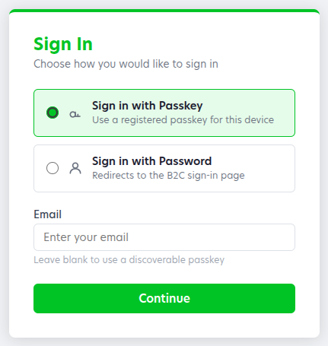
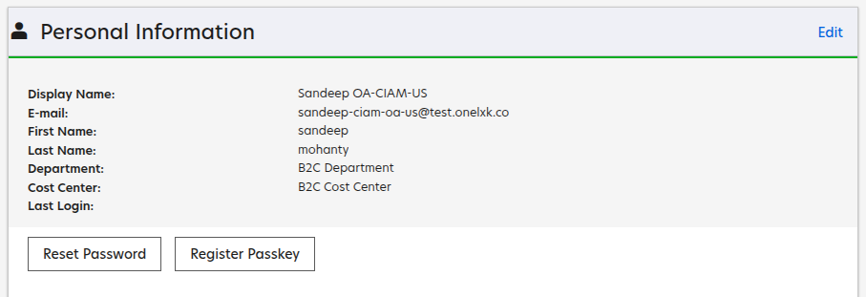
SEE IT IN ACTION
What You'll See
SIGN-IN METHOD SCREEN
MY ACCOUNT — PERSONAL INFORMATION
The new Register Passkey button — lives right next to Reset Password.
Added to the shared identity-auth library. Shown only when there's no active session.
Identity Management Team • Proof of Concept
22

Slide 23
WHAT'S NEXT
Roadmap
Pilot
Identity team apps only — My Account, Admin Console
Broaden
Roll out to remaining LCS applications
Harden
Distributed store, test depth, observability
Align with Entra
Retire the bridge once native passkeys ship
Each stage ships independently — the Entra migration timeline doesn't gate passkey rollout.
Identity Management Team • Proof of Concept
23

Slide 24
KEY TAKEAWAYS
Passkeys remove the shared secret — phishing-resistant by design.
B2C won't gain FIDO2 before it retires — we can't wait on the platform.
open-passkey + a thin custom layer closes the gap now — B2C still issues every token.
One shared library + one shared service = passkey support for every LCS app, automatically.
This is a bridge, not a fork — fully compatible with the future move to Entra.

Slide 25
Thank You
Questions & Discussion
Identity Management Team
CIAM Authentication • Proof-of-Concept Exploration

