Slide 1
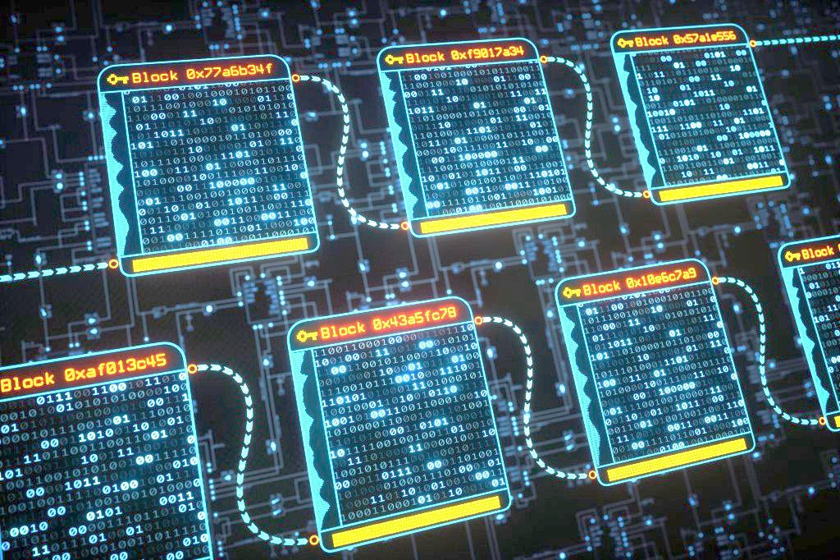
Crypto-steganographic Hybrid Blockchain Model for Network Security
Presented By:
1. Sandeep Shaw(GCECTB-R19-3022)
2.Akash Kumar Sen(GCECTB-R19-3002)
3.Surajit Bera(GCECTB-R19-3036)
4.Arijit Mukherjee(GCECTB-R19-3007)
Supervised By:
Dr. Bijoy Kumar Mondal
Assistant Professor
Department of Computer Science and Engineering
Government College of Engineering and
Ceramic Technology
Kolkata-700010

Slide 2
Content
Abstract
Introduction
Literature Survey
Proposed Method
Control Flow Diagram and Flow Chart

Slide 3
Abstract
The purpose concept of this project work is mainly focused on developing a simple but secure text messaging application that is end-to-end encrypted and provides assurance to the user by securing their data. The idea here is to address two major data security threats that usually make any regular chat application vulnerable, the former is the MITM or Man in the Middle Attack and the latter is an incident of Data Breaching. The Man in the Middle Attack is one of the most common forms of cyber attack the goal of an attack is to steal personal information, such as login credentials, account details, and credit card numbers. In order to tackle this form of cyber vulnerability, we propose to design an algorithm that could easily be used to communicate between the client and server, and even if the data is tapped by any perpetrator it will take billions of years to crack down the information and is safe against any brute force attacks.

Slide 4
The other principal motive is to store the encrypted messages in the database server so that the admin who is authorized for such a centralized database can never view the text chat between the sender and the receiver. Even in the case of a Data Breach which is a security violation, in which sensitive, protected, or confidential data is copied, transmitted, viewed, stolen, or used by an individual unauthorized to do so or in other terms are unintentional information disclosure, data leak, information leakage, and data spill, the data is still encrypted and the information can't be decoded very easily. Moreover on the server-side if any unauthorized user made an attempt to modify the data then this activity can easily be identified as the text chat between the sender and receiver is stored in a blockchain manner. Overall, this purpose idea promotes significant improvement over the existing concepts in terms of both security features and data integrity solutions related to the messaging chat application from the perspective of the client and server side.

Slide 5
Introduction
We are living in the age of computers and internet. The information on every aspects of our lives are being uploaded and transferred through internet . In a more generalized way internet is a form of computer network and as our data is uploaded and transferred through the computer networks every single minute.Our computer networks must be secured in order to prevent and survive all the third party attacks.This is the phase where the role of network security comes into action.
In this project we have proposed to build a Secure text messaging application using Cryptography and steganography together.
Later on we have also implemented Blockchain technology to store and retrieve the message data in amore secure manner.
In this project we have tried to address two major data security threats that usually make any regular chat application vulnerable, the former is the MITM or Man in the Middle Attack and the latter is an incident of Data Breaching.

Slide 6
In this section, we provide a brief literature review on recent crypto-steganography and blockchain techniques with a focus on secure data encryption, effective steganography methods, and block-chained data integrity. 1) LSB steganography is one of the most effective ways to easily embed data to create stego-object. However, this technique comes with a drawback as it is very easy to crack by just obtaining all the least significant bit [1]. 2) Symmetric encryption is a preferred choice as the encryption process is fast, used when a large amount of data is required to transfer, and resource utilization is low as compared to asymmetric key encryption [2].
Literature Survey

Slide 7
3. The weaknesses of a few nonlinear transformations in the key schedule algorithm of ciphers and it can break some reduced-round versions of AES which is its disadvantage [3][4]. In order to overcome this problem, 512 bits symmetric key of the AES algorithm can be used to increase the robustness by keeping the processing time low 4. The emergence of creating a hybrid model to store data is the feasible option that balances both data integrity by blockchain and speed by using the traditional database approach

Slide 8
Proposed Method
The idea is to build a messaging app system that provides a secure data transfer from the client to the server and stores that particular data inside the database such that the integrity of data is conserved. The methodology in which the design and analysis of the solution is proposed are:
The encrypted message is passed as input to our dynamic LSB steganography algorithms. Then the Stego-object is sent to the server via API.
At the server, the message is decoded and the encrypted message is fetched from Stego-object and stored in the database.
Storing the encrypted message in a database, a hybrid model of blockchain and traditional database is used where the current message-id stores the hash (SHA-512) of the previous message-id.
On the client-side who receives this data then loops over all the chat and the chat credentials are extracted and encoded to create a hash and simply apply AES-512 decryption by passing the hashed data and the encrypted data to obtain the message back.

Slide 9
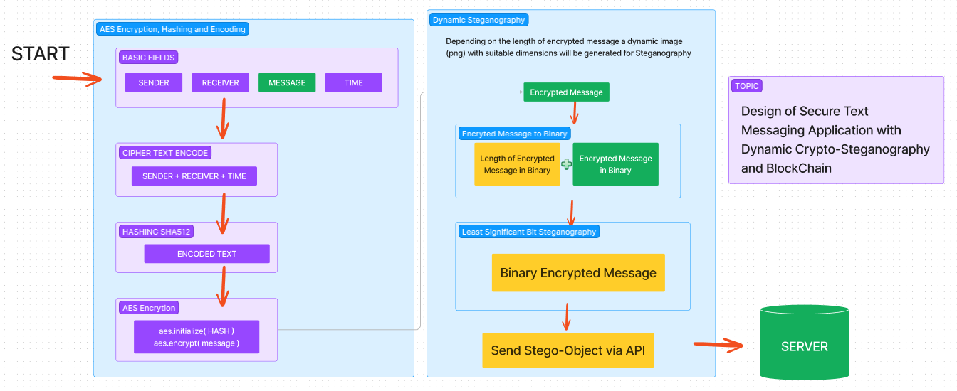
CONTROL FLOW DIAGRAM & FLOW CHART
Sender Sending Message to Receiver

Slide 10
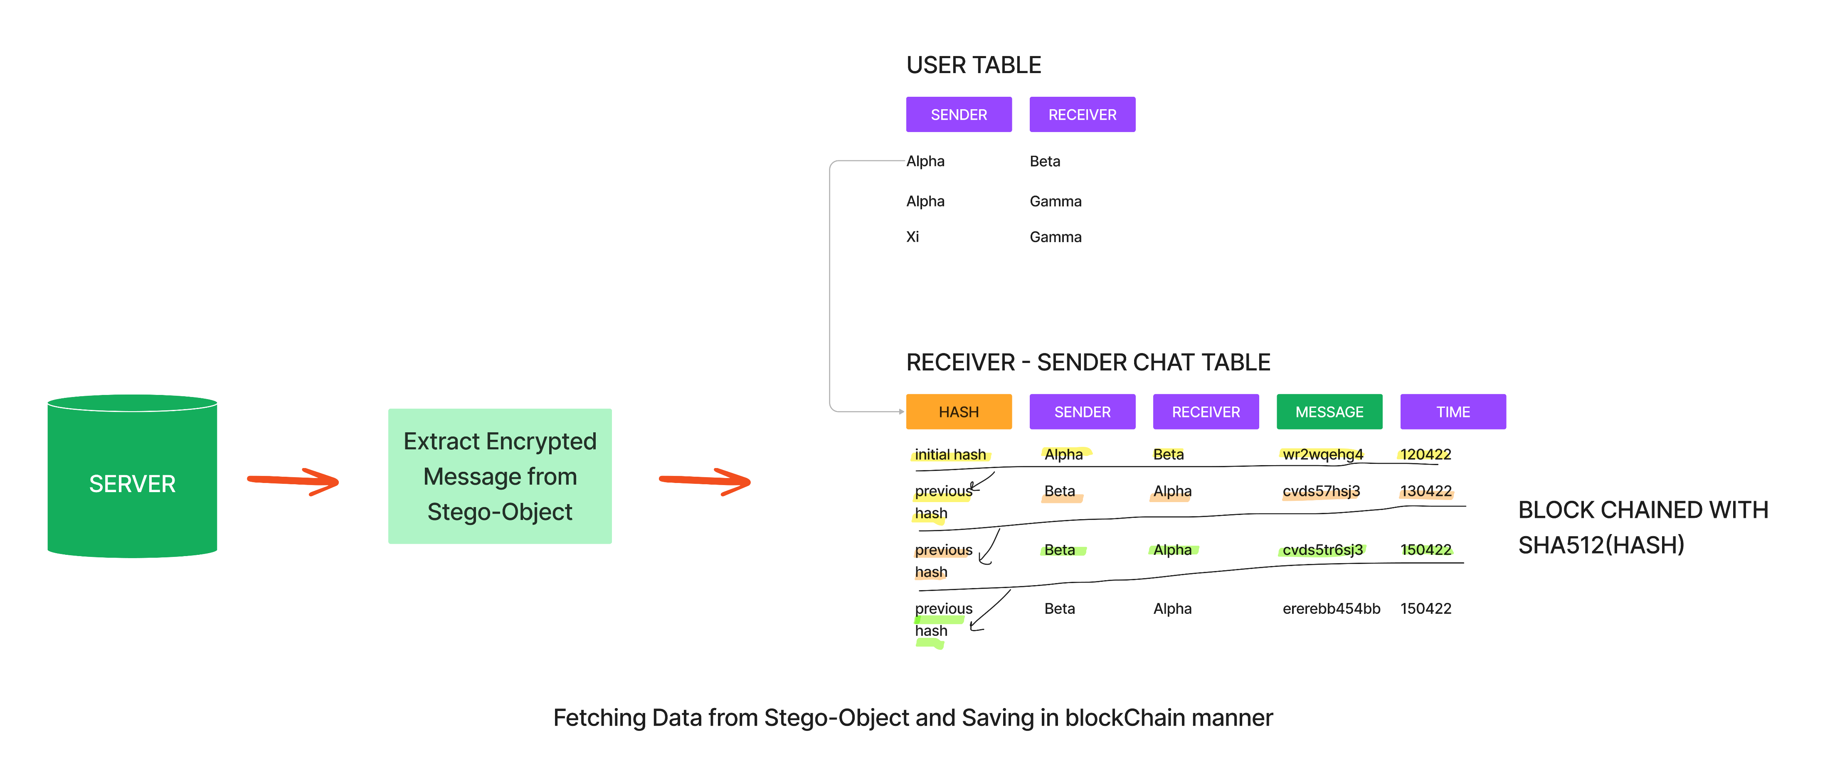

Slide 11
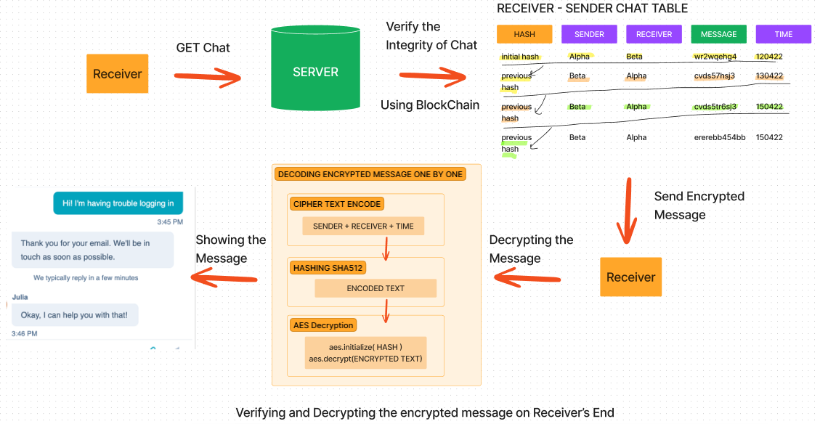

Slide 12
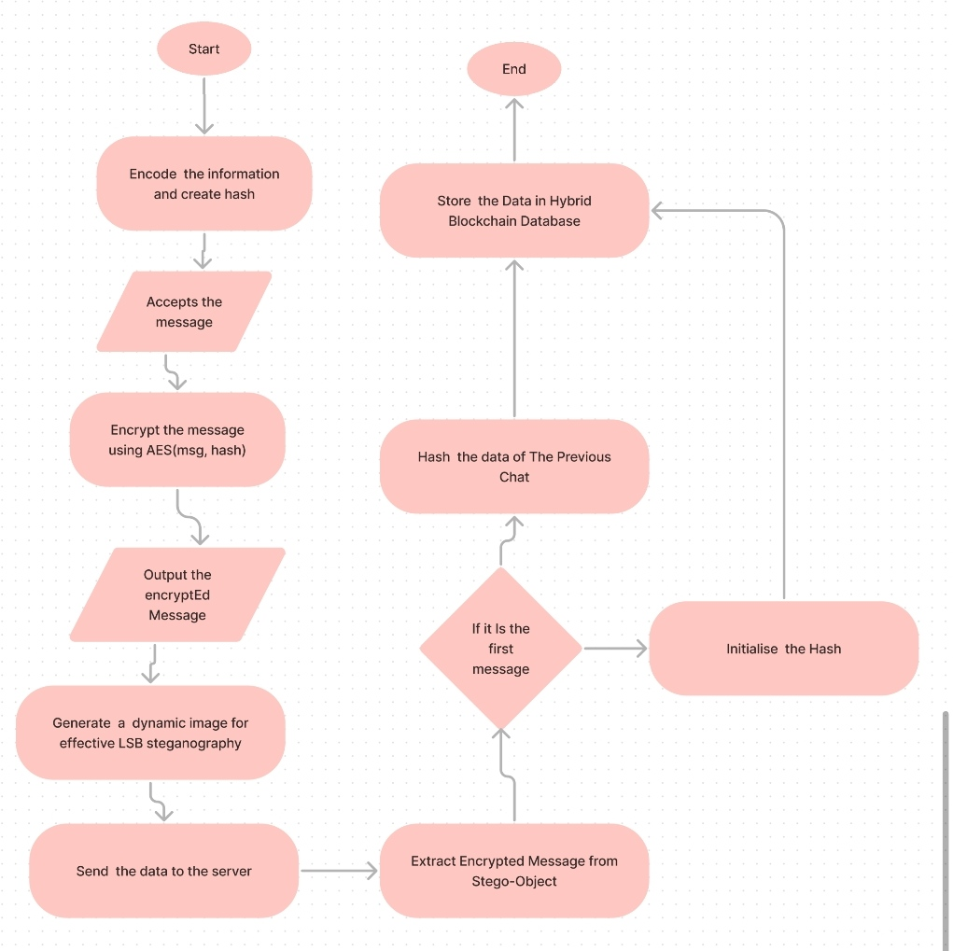

Slide 13
Thank You !

Slide 14
Algorithm of AES
Core byte substitution
Shift Rows
Mix Columns
Add a round Key

