Slide 1



Futurion
Data Analysis
UPSKILLING INDIA
Portfoliio Project Challenge
Insights On Lung Cancer
Presented By: Abotula Sai Sandeep
Date Of Submission:21/02/2025
Tools Used : MySQL And Power bi
01

Slide 2
Futurion
Instructions
UPSKILLING INDIA
📌 Problem statement
This project analyzes lung cancer data to understand the impact of various factors (such as smoking, air pollution, and age) on lung cancer diagnosis, survival, and mortality. Using SQL for data retrieval and Power BI for visualization, the goal is to provide insights that can help improve early detection and treatment strategies
📌Objective
Data Analysis & Preprocessing: Explore and clean the dataset for accurate insights.
Visualization: Create a Power BI report to visualize key metrics like lung cancer cases, lung cancer prevalence rate, and mortality rate
2
03

Slide 3
Futurion
Instructions
UPSKILLING INDIA
Dataset Overview:
Number of Records : 220632
Number of Columns : 24
Data Preprocessing: Null(None) Values:
Cancer Stage: 211,671 records had missing values. These were replaced with
"Stage 0" to represent unknown or non-cancer stages.
Treatment Type: 213,968 records had missing values. These were replaced with
"No Treatment" to indicate no treatment was recorded
2
03

Slide 4
Futurion
Home
About us
Instructions
Tasks
Contact
UPSKILLING INDIA
SQL Queries and Output
05

Slide 5
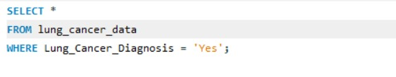
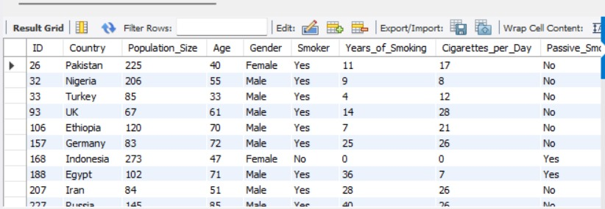
Futurion
Instructions
A) Basic Level
UPSKILLING INDIA
1. Retrieve all records for individuals diagnosed with lung cancer.
2
03

Slide 6

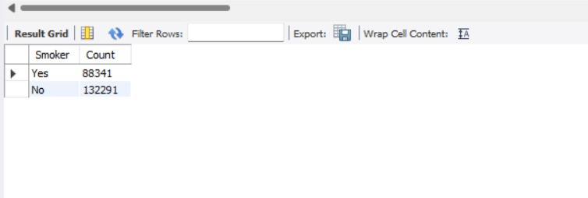
Futurion
Home
About us
Instructions
Tasks
Contact
UPSKILLING INDIA
A) Basic Level
2. Count the number of smokers and non-smokers.
05

Slide 7

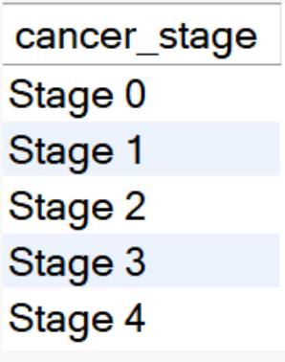
Futurion
Home
About us
Instructions
Tasks
Contact
UPSKILLING INDIA
A) Basic Level
3. List all unique cancer stages present in the dataset.
05

Slide 8
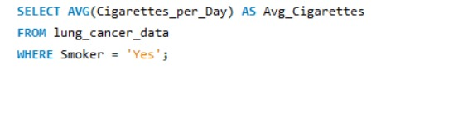
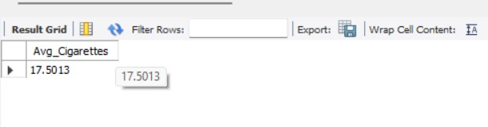
Futurion
Home
About us
Instructions
Tasks
Contact
UPSKILLING INDIA
A) Basic Level
4. Retrieve the average number of cigarettes smoked per day by
Smokers
05

Slide 9
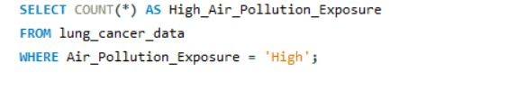
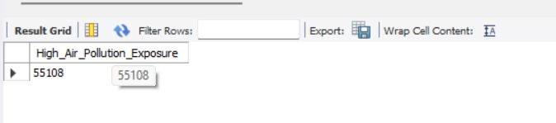
Futurion
Home
About us
Instructions
Tasks
Contact
UPSKILLING INDIA
A) Basic Level
5. Count the number of people exposed to high air pollution.
05

Slide 10
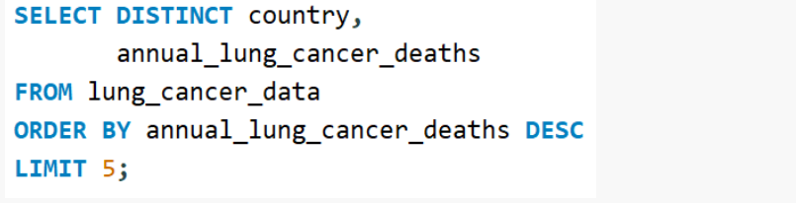
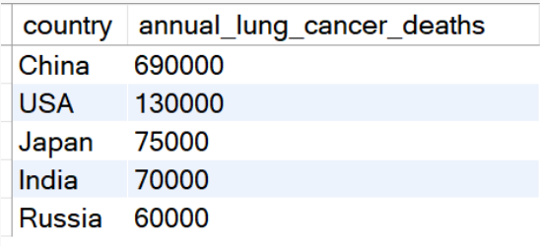
Futurion
Home
About us
Instructions
Tasks
Contact
UPSKILLING INDIA
A) Basic Level
6. Find the top 5 countries with the highest lung cancer deaths.
05

Slide 11
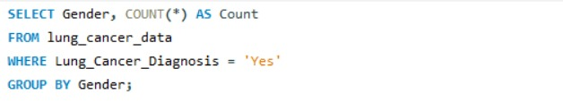
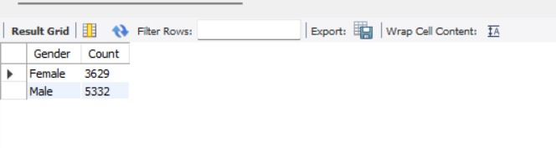
Futurion
Home
About us
Instructions
Tasks
Contact
UPSKILLING INDIA
A) Basic Level
7. Count the number of people diagnosed with lung cancer by
Gender
05

Slide 12

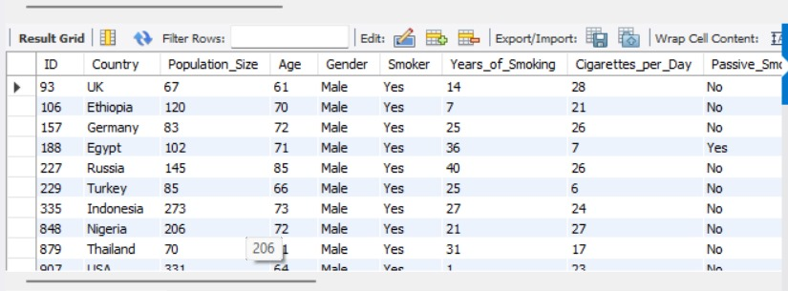
Futurion
Home
About us
Instructions
Tasks
Contact
UPSKILLING INDIA
A) Basic Level
8. Retrieve records of individuals older than 60 who are diagnosed with lung cancer
05

Slide 13
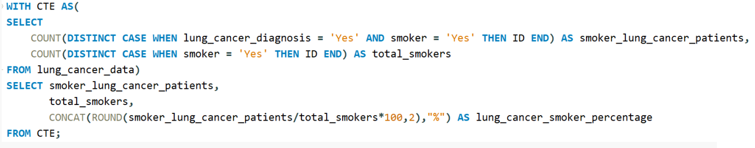
Futurion
Home
About us
Instructions
Tasks
Contact
UPSKILLING INDIA
B) Intermediate Level
1. Find the percentage of smokers who developed lung cancer.
05

Slide 14
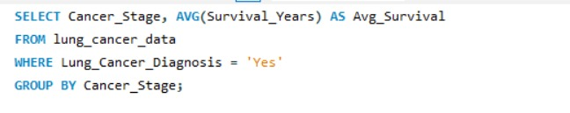
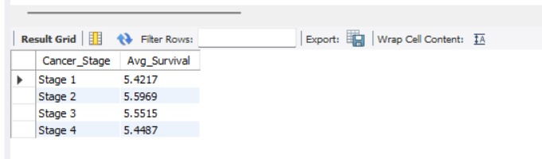
Futurion
Home
About us
Instructions
Tasks
Contact
UPSKILLING INDIA
B) Intermediate Level
2. Calculate the average survival years based on cancer stages.
05

Slide 15
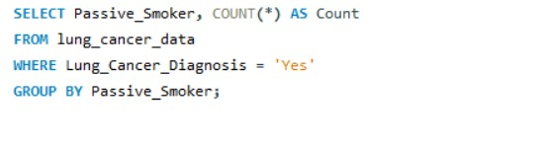
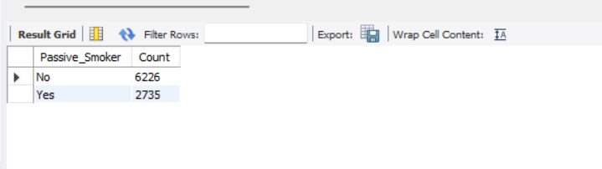
Futurion
Home
About us
Instructions
Tasks
Contact
UPSKILLING INDIA
B) Intermediate Level
3. Count the number of lung cancer patients based on passive
Smoking
05

Slide 16
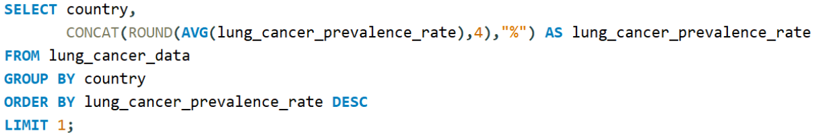

Futurion
Home
About us
Instructions
Tasks
Contact
UPSKILLING INDIA
B) Intermediate Level
4. Find the country with the highest lung cancer prevalence rate.
05

Slide 17
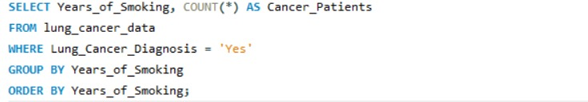
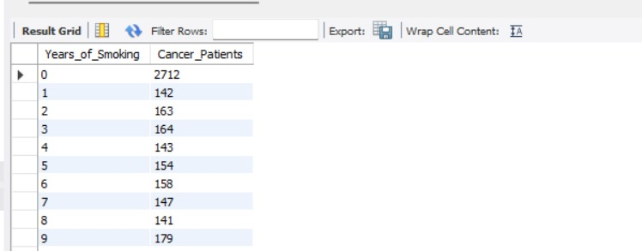
Futurion
Home
About us
Instructions
Tasks
Contact
UPSKILLING INDIA
B) Intermediate Level
5. Identify the smoking years impact on lung cancer.
05

Slide 18
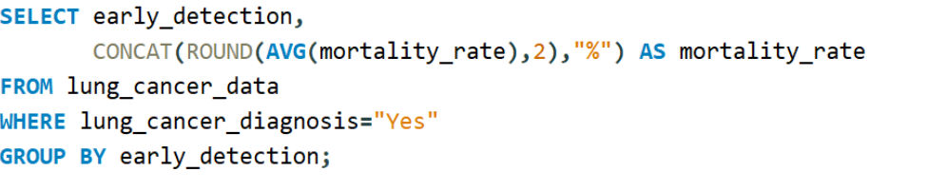
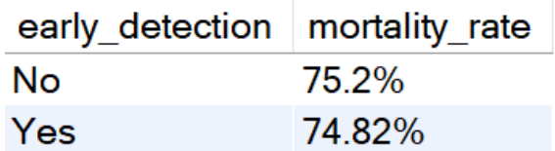
Futurion
Home
About us
Instructions
Tasks
Contact
UPSKILLING INDIA
B) Intermediate Level
6. Determine the mortality rate for patients with and without
Early detection
05

Slide 19
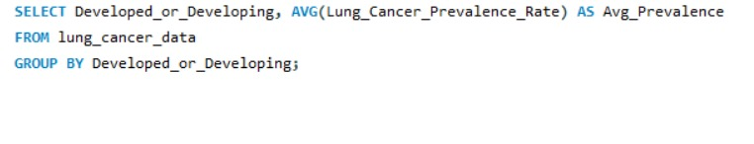
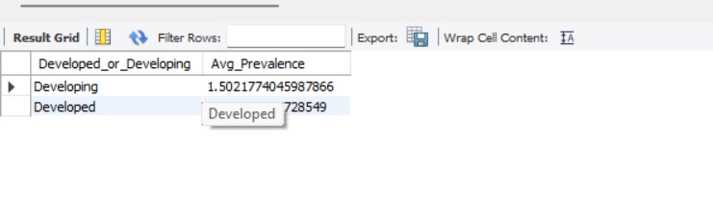
Futurion
Home
About us
Instructions
Tasks
Contact
UPSKILLING INDIA
B) Intermediate Level
7. Group the lung cancer prevalence rate by developed vs.
Developing countries
05

Slide 20
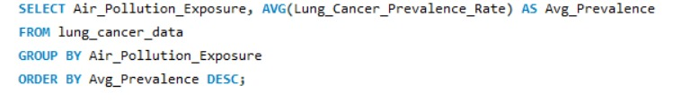
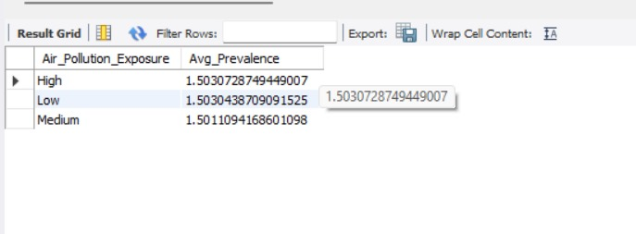
Futurion
Home
About us
Instructions
Tasks
Contact
UPSKILLING INDIA
C) Advanced Level
Identify the correlation between lung cancer prevalence and
air pollution levels
05

Slide 21
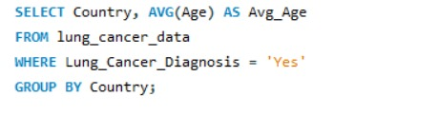
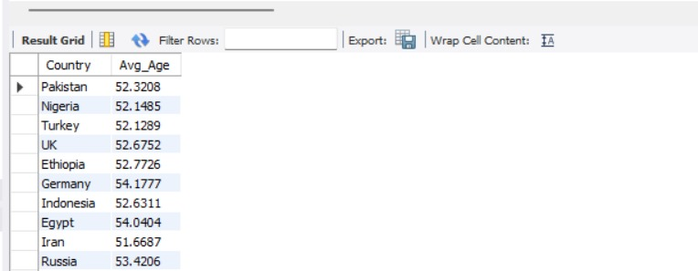
Futurion
Home
About us
Instructions
Tasks
Contact
UPSKILLING INDIA
C) Advanced Level
2. Find the average age of lung cancer patients for each Country
05

Slide 22
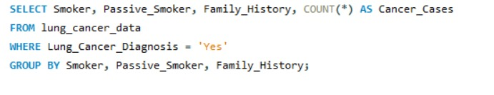
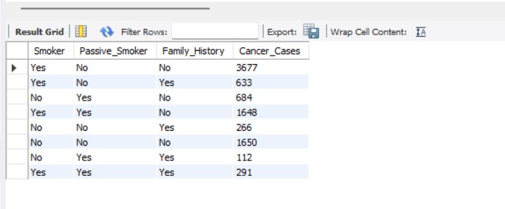
Futurion
Home
About us
Instructions
Tasks
Contact
UPSKILLING INDIA
C) Advanced Level
3. Calculate the risk factor of lung cancer by smoker status,
passive smoking, and family history.
05

Slide 23
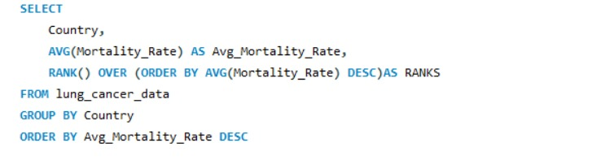
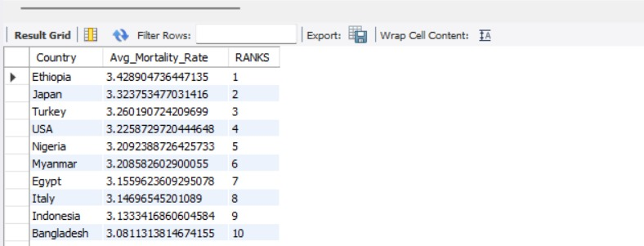
Futurion
Home
About us
Instructions
Tasks
Contact
UPSKILLING INDIA
C) Advanced Level
4. Rank countries based on their mortality rate.
05

Slide 24
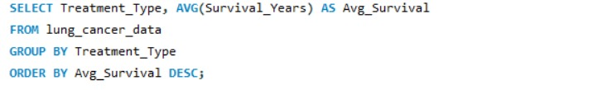
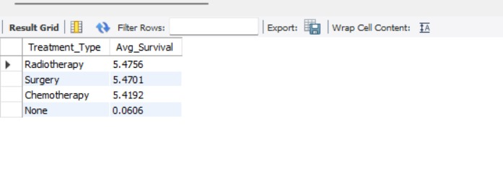
Futurion
Home
About us
Instructions
Tasks
Contact
UPSKILLING INDIA
C) Advanced Level
5. Determine if treatment type has a significant impact on
Survival years
05

Slide 25
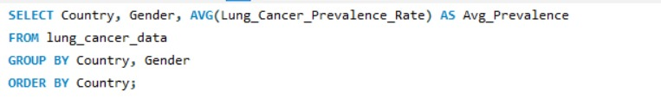
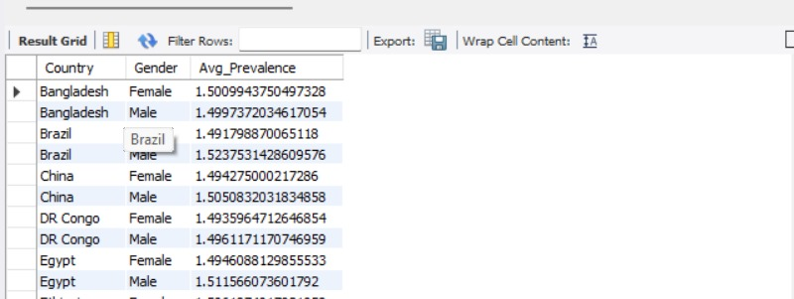
Futurion
Home
About us
Instructions
Tasks
Contact
UPSKILLING INDIA
C) Advanced Level
6. Compare lung cancer prevalence in men vs. women across Countries
05

Slide 26
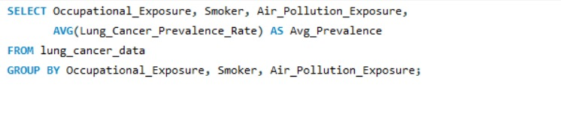
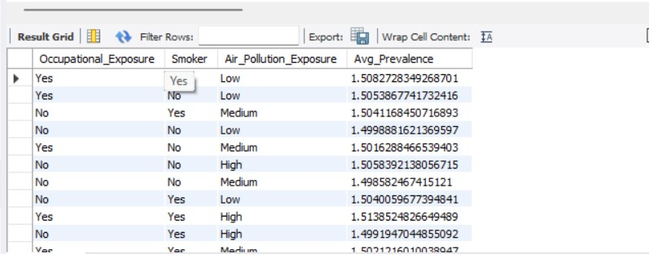
Futurion
Home
About us
Instructions
Tasks
Contact
UPSKILLING INDIA
C) Advanced Level
7. Find how occupational exposure, smoking, and air pollution collectively impact lung cancer rates.
05

Slide 27
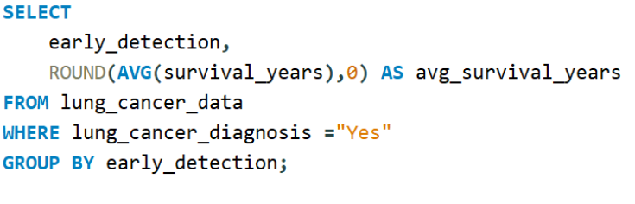
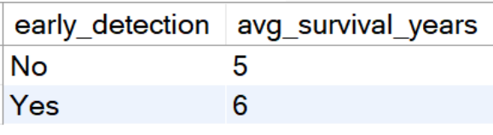
Futurion
Home
About us
Instructions
Tasks
Contact
UPSKILLING INDIA
C) Advanced Level
8. Analyze the impact of early detection on survival years.
05

Slide 28
Futurion
Home
About us
Instructions
Tasks
Contact
UPSKILLING INDIA
Data visualization & Report
05

Slide 29
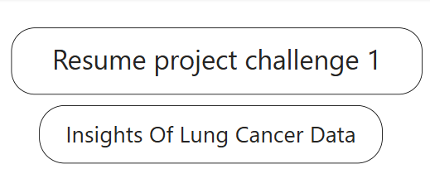
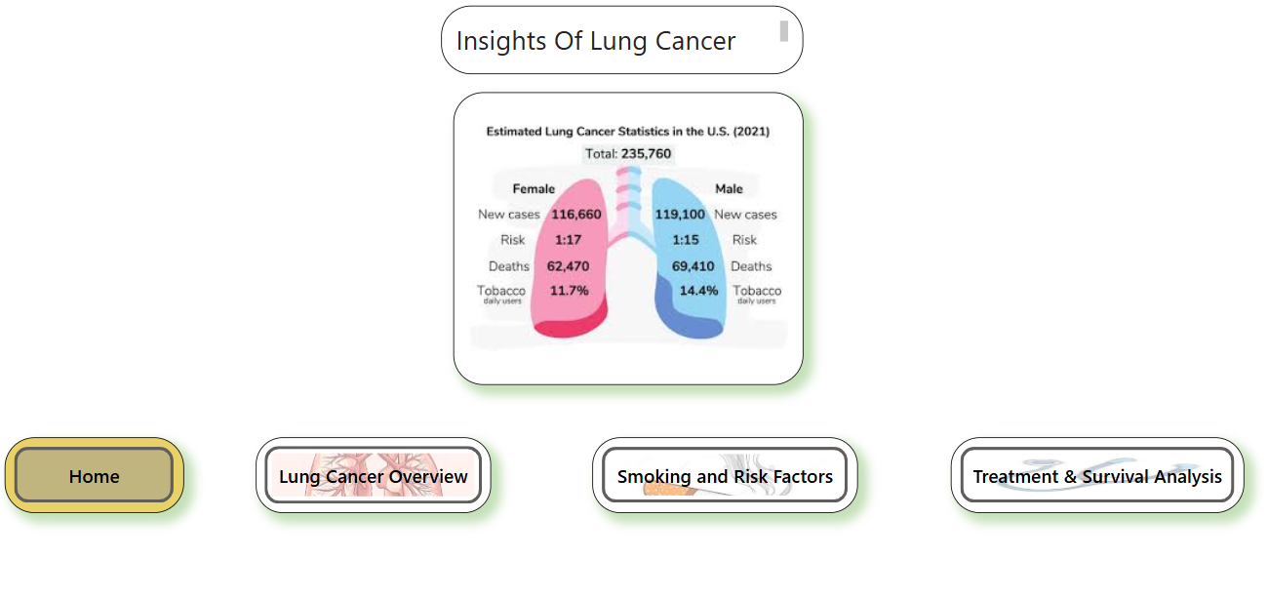
Futurion
UPSKILLING INDIA
05

Slide 30
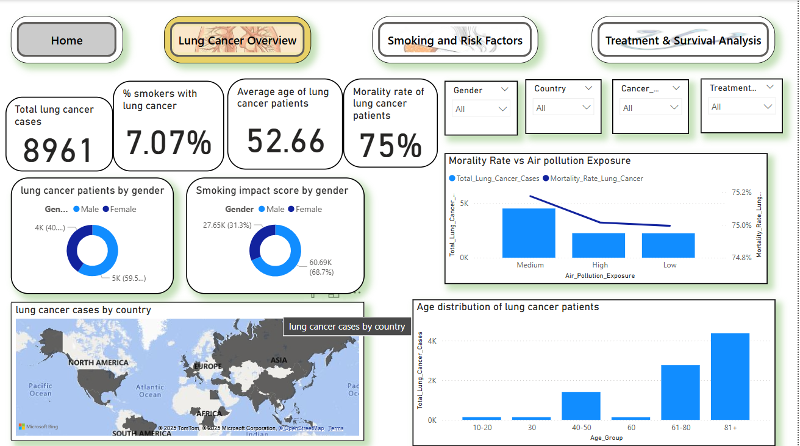
Futurion
UPSKILLING INDIA
05

Slide 31
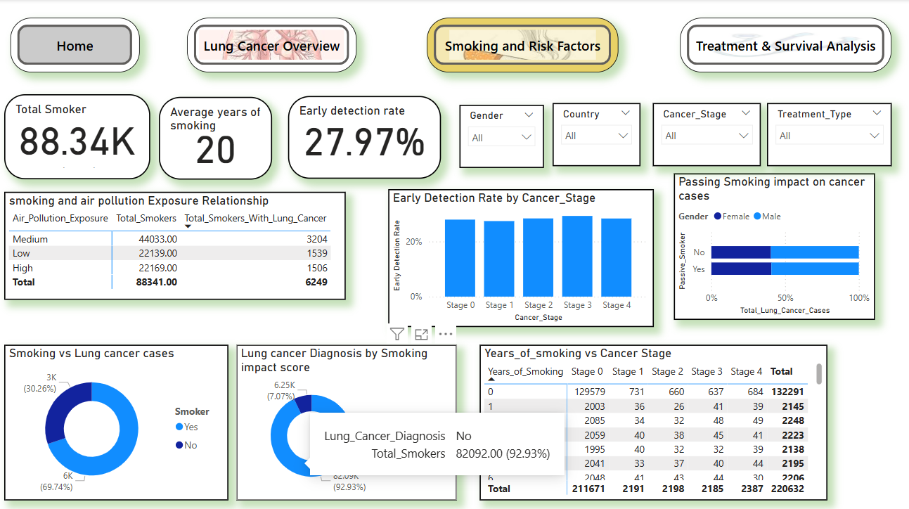
Futurion
UPSKILLING INDIA
05

Slide 32
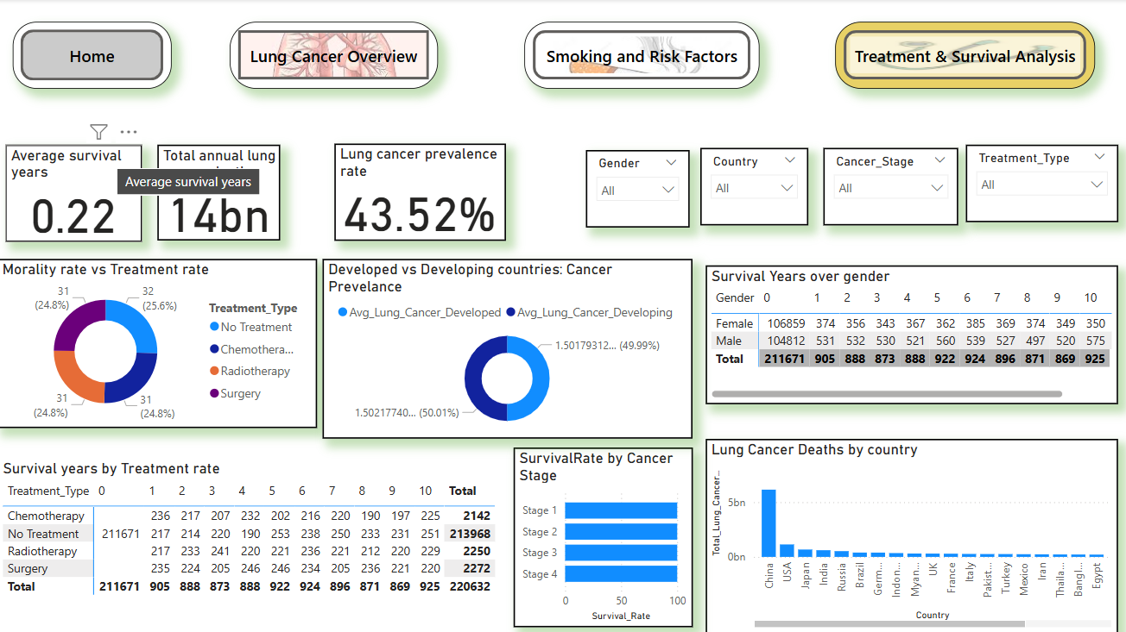
Futurion
UPSKILLING INDIA
05

Slide 33
Futurion
UPSKILLING INDIA
Key Insights:
Smoking remains the leading risk factor, with an average of 18 cigarettes smoked per day among smokers.
Interestingly 7.07% of smokers were diagnosed with lung cancer.
Lung cancer cases are significantly higher in men than in women.
China, the USA, Japan, India, and Russia report the highest annual lung cancer deaths.
Fewer lung cancer patients had exposure to secondhand smoke compared to those who didn’t.
The average age of lung cancer patients varies between 51-54 years across different countries.
05

Slide 34

Futurion
UPSKILLING INDIA
05

