Slide 1

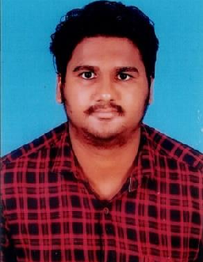



BAGATHI SANDEEP KUMAR
Education and certificates
Bachelor of Technology,
Electronics & Communication Engineering
: 2018-22
Certification:
AZ-900 Fundamental.
AZ-104 Microsoft Azure Administrator.
Analyst/Software Engineer ITransform L&D Left Shift Batch
Base Location: Mumbai
Email ID:
BAGATHI-SANDEEP.KUMAR@CAPGEMINI.COM
Mobile No: +91 9573284254
Skills
Grade:
A4
C#
Basics, OOPS, Exception Handling
,Arrays ,Collection and Generics, Delegates and Events.
Strengths
Full Stack Developer
Achievement
Completed case study on Crop Deal which is a Web based System. Crop Deal is implemented to make farmer’s life easier by advertising their crops and sell them directly to the dealer, as it neglects all The commissions’ farmers pays to sell their crops. The main objective of Crop deal is to act as bridge between farmer and the dealer by registering famer and dealer and farmer will list their crops and the dealer will able to make payment directly to farmer’s account.
Technologies used:
ANGULAR
ASP.NET CORE
Microsoft SQL Server
Understanding of RDMS concepts using SQL Server.
Practical understanding of C# and SQL concepts using
Visual Studio and SQL Server
.NET Framework
ADO.NET,ASP.NET
WITH MVC5 AND
WEB API, Entity Framework
Hands on experience in developing applications using .NET Framework, ADO.NET Core
Database
SQL
Understanding of HTML5 , CSS and Angular Cli
Tools
GIT,Swagger
UI Technology
HTML5 ,CSS &
Angular
Add On Skills
Communication Skills, Team Management
Video Link : Click
GitHub Link
Presentation Title | Author | Date © Capgemini 2017. All rights reserved | 1

