Slide 1
Dcf.Wwp.BritsBatch
WWP - Brits Batch Programs - The next generation

Slide 2
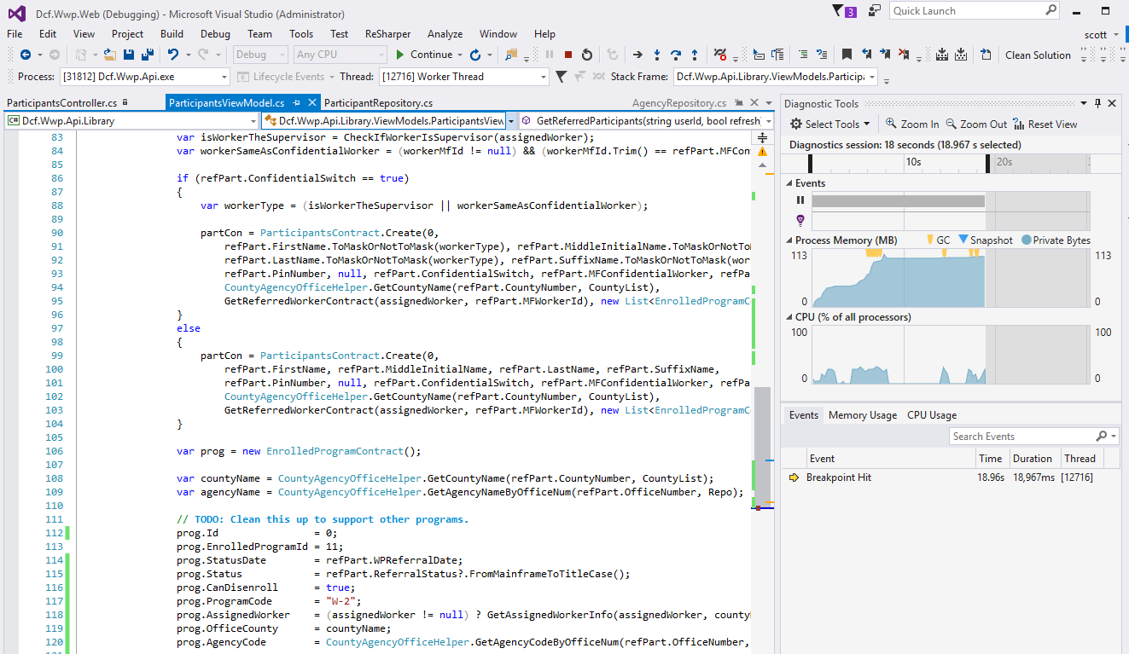
Overview
Batch jobs run under Control-M
Written as .NET wrappers (WWP ones)
Naming conventions
Output
Program structure
Creating new .Net batch jobs
(Cntl-M outside of scope of this slideshow)

Slide 3
Naming Conventions
In Cntl-M
Established by CPS
Nomenclature: JWaaaPnn
e.g. JWBWP01
in .Net
Pretty much the same
Class name is JWWWP01
Traceback Cntl-M --> .NET/.NET classes easier

Slide 4
Output
Console (for Control-M capture)
Log file (on disk for end user)
Results (on disk for end-user)
Log4net – 1 Logger and 2 appenders
ConsoleAppender
FileAppender
Custom File Exporter

Slide 5
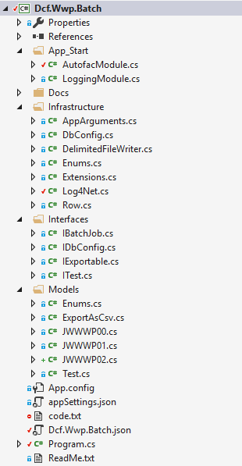
Structure
Class folders
App_Start
Infrastructure
Interfaces
Models
Root files
Program.cs
Dcf.Wwp.Batch.json config file
ReadMe.txt

Slide 6
Structure
Class folders:
App_Start
Infrastructure
Interfaces
Models
Config files:
Program.cs
Dcf.Wwp.Batch.json file
ReadMe.txt

Slide 7


Resharper Benefits
ReSharper
Navigate and search
Automated solution-wide code refactoring
Code Editing Heuristics - Hundreds of quick-fixes to solve problems automatically
Analyze code quality
Code style and formatting
DCF already licenses ReSharper Ultimate, but only installs the VS plug-in on developers’ VDIs

Slide 8




Resharper Ultimate
ReSharper Ultimate
ReSharper
ReSharper Visual Studio Plug-in
DotTrace
DotPeek
DotMemory
DotCover
DCF already licenses ReSharper Ultimate, but only installs the VS plug-in on developers’ VDIs

Slide 9
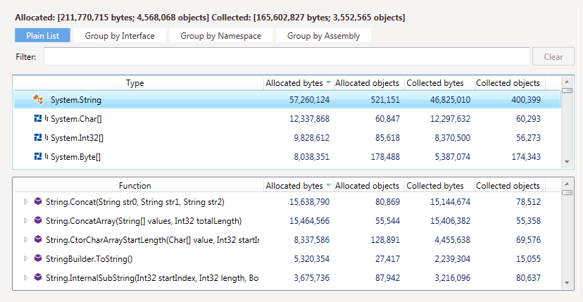
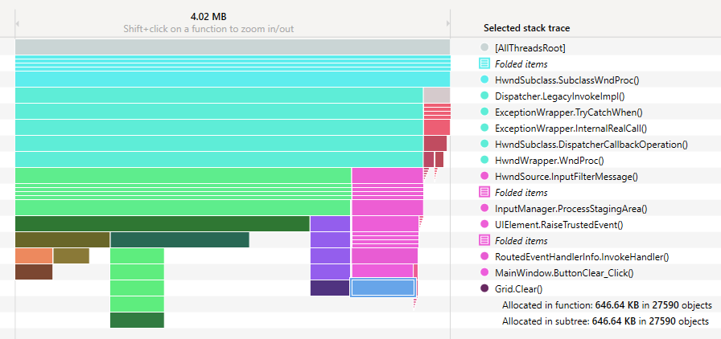
Resharper Ultimate
DotMemory
Profiles memory consumed application in real time
Auto-detects issues
Automatic inspections
Multiple views on data
DCF already licenses ReSharper Ultimate, but only installs the VS plug-in on developers’ VDIs

Slide 10
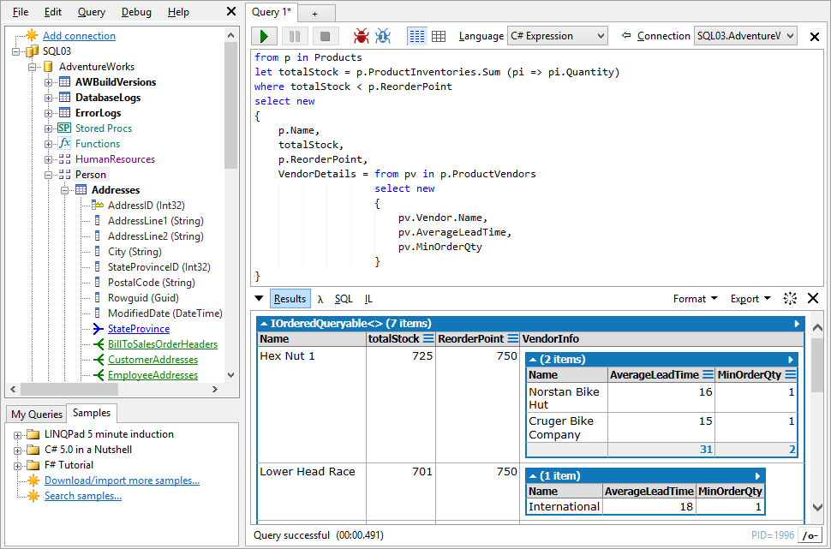
LINQPad
The Ultimate .NET Scratchpad:
Instantly test any C# snippet or program
Query databases in Linq (or SQL)
Optimize Linq queries

Slide 11
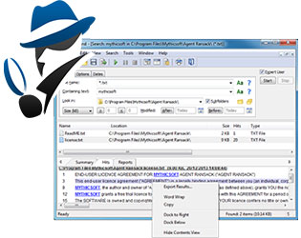
Agent Ransack/File Locator Pro Lite
The Ultimate .NET Scratchpad:
Boolean expressions
RegEx
Supports Office formats
Results preview

