Slide 1
Sandeep kumar M
Final Project
3/21/2024 Annual Review

Slide 2
PROJECT TITLE
Liver Disease Prediction Project
3/21/2024 Annual Review

Slide 3


AGENDA
PROBLEM STATEMENT
PROJECT OVERVIEW
WHO ARE THE END USERS?
YOUR SOLUTION AND ITS VALUE PROPOSITION
THE WOW IN YOUR SOLUTION
MODELLING
RESULTS
3/21/2024 Annual Review

Slide 4

PROBLEM STATEMENT
Liver disease is a significant public health concern, requiring early detection for effective intervention. Manual prediction methods are time-consuming and prone to errors. This project aims to develop an accurate and automated liver disease prediction system using machine learning and deep learning techniques.
3/21/2024 Annual Review

Slide 5

PROJECT OVERVIEW
The project involves collecting a dataset containing various patient attributes relevant to liver disease prediction, performing exploratory data analysis (EDA), preprocessing the data to handle missing values and outliers, splitting the dataset for training and testing, standardizing features, selecting and training suitable machine learning algorithms, evaluating model performance, tuning hyperparameters for optimization, testing the final model's generalization, and providing comprehensive documentation.
3/21/2024 Annual Review

Slide 6

WHO ARE THE END USERS?
The end users of this project include healthcare professionals, medical researchers, and healthcare institutions. They can utilize the predictive model to identify individuals at risk of liver disease early on, facilitating timely interventions and improving patient outcomes.
3/21/2024 Annual Review

Slide 7

YOUR SOLUTION AND ITS VALUE PROPOSITION
Our solution employs machine learning and deep learning techniques to automate the prediction of liver disease based on patient attributes. By providing an accurate and efficient prediction system, our solution enables early detection of liver disease, leading to timely medical interventions and improved healthcare outcomes. It reduces the burden on healthcare professionals and enhances resource allocation in healthcare institutions.
3/21/2024 Annual Review

Slide 8

THE WOW IN YOUR SOLUTION
The project leverages advanced machine learning and deep learning algorithms to accurately predict liver disease, which is crucial for public health. Its automated approach streamlines the prediction process, reducing time and potential errors associated with manual methods. Moreover, the project's comprehensive documentation and codebase ensure transparency and reproducibility, fostering trust and confidence in its results.
3/21/2024 Annual Review
8

Slide 9
MODELLING
The project explores various machine learning algorithms suitable for binary classification, such as Gradient Boosting and Neural Networks. These models are trained and evaluated using appropriate metrics to assess their performance in predicting liver disease.
3/21/2024 Annual Review
9

Slide 10
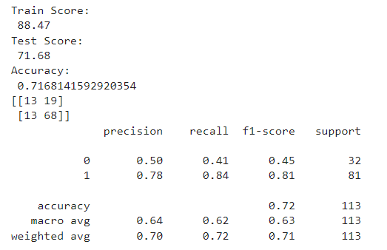
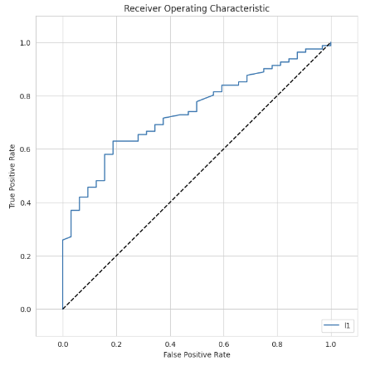
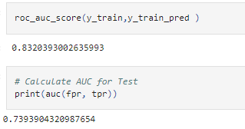
RESULTS
Model- Gradient Boosting
Demo Link
https://colab.research.google.com/drive/1jIl32kre2ZRO8zk2ibcMmTuUtp5lDSav?usp=sharing
10

Slide 11
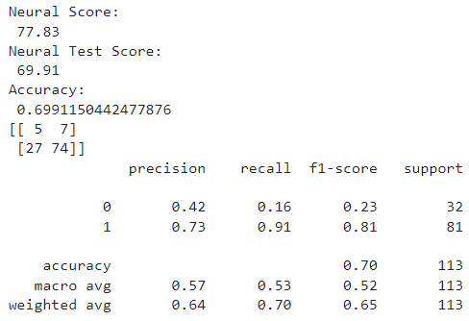
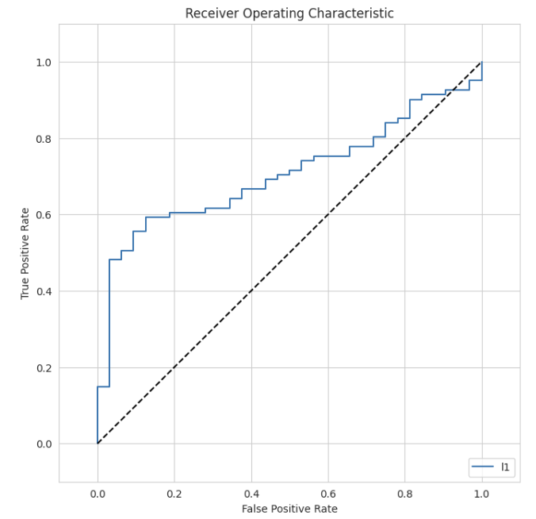
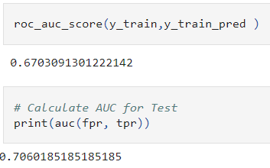
RESULTS
Model- Neural Networks
11

