Slide 1
Devops Assignment-1
Arun
Vecham Sandeep

Slide 2
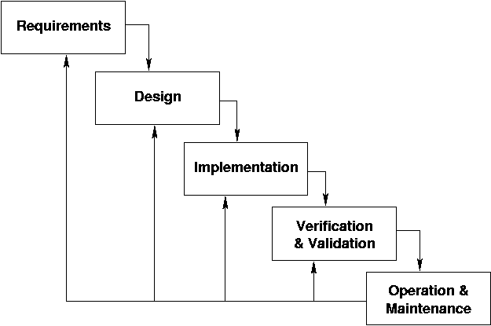
Waterfall Model

Slide 3
Waterfall model is a sequential model
Its a traditional approach(SDLC)
In this model each phase should complete before the next phase
Phases of waterfall model
Requirements, Design , Implementation, testing, Maintenance .

Slide 4
Advantages:-
Suited for smaller projects where requirements are well defined.
Easy to manage.
Simple and easy to understand & use.
Disadvantages:-
Does not allow much version.
Not suitable for complex projects.
Risk and uncertainty are high.

