Slide 1
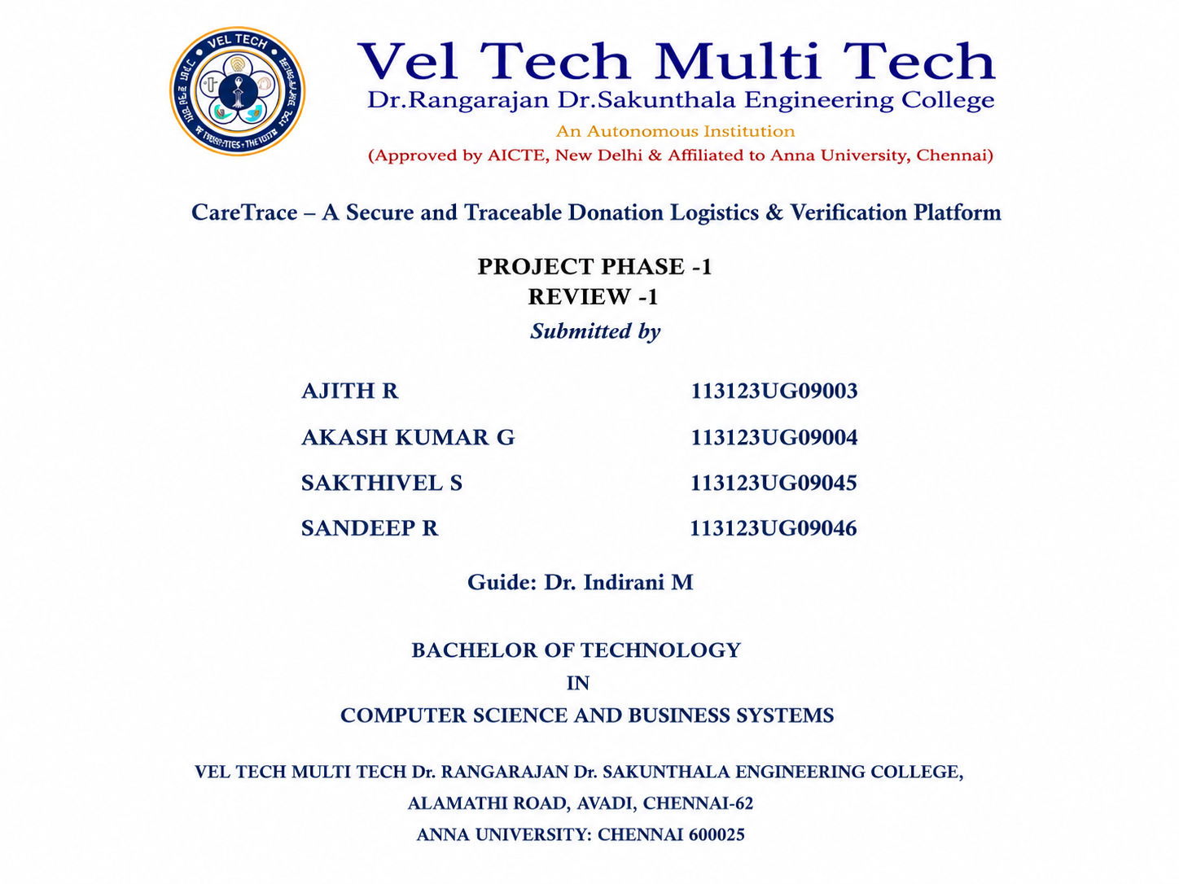

Slide 2
Abstract
Problem: Donors have no reliable way to verify whether physical donations actually reach the intended institution and are used properly.
Existing Gap: Most donation platforms focus on payments or listings, but do not track pickup, transportation, and delivery of physical goods.
Proposed Solution: CareTrace tracks each donation throughout its complete chain of custody — from verified requirements and donor matching to pickup, delivery, and confirmed handover.
Key Features: Institution verification, donation matching, QR-based Donation IDs, logistics tracking, blockchain records, and a transparency dashboard.
Goal: Close the gap between “a donation was recorded” and “a donation actually arrived and was used.”
2

Slide 3
Introduction
Donation to orphanages typically happens informally — a donor identifies a need (often assumed, not confirmed) and hands over goods directly or through an intermediary.
Donors receive little to no confirmation that a donation arrived intact, reached the right hands, or matched what the institution actually required.
Existing digital platforms solve only the payment or listing problem; none manage verified pickup, tracked transport, and confirmed handover.
CareTrace is proposed as an end-to-end donation logistics and verification platform that closes this gap — behaving like a tracked courier shipment for every physical donation.
3

Slide 4
Existing System — Literature Review
Work | Approach | Key Disadvantage
Kamza et al., 2025 (Base Paper) | Smart-contract based charity system for fund transparency | Only monetary transparency — no pickup/delivery tracking
Sameer S et al., 2025 | Comparative study of blockchain platforms | No actual end-to-end system proposed
Zhang et al., 2023 | Blockchain traceability with donor/recipient modules | Tracks only transaction records, not physical goods
Deng et al., 2022 | Blockchain + IPFS privacy protection, CP-ABE encryption | No physical tracking; encryption overhead grows with attributes
Albin T & George, 2025 | Blockchain volunteer & donation management | Custom non-public chain; no proof of delivery
Pawar et al., 2021 | Hybrid client/server blockchain tracking | Not fully decentralised; only fund transfers tracked
Alassaf & Yusoff, 2021 | Multi-point fundraising Dapp on Ethereum | Governs only fund release; needs MetaMask wallet
CareTrace – A Secure and Traceable Donation Logistics & Verification Platform
4

Slide 5
Research Gap
Across the seven reviewed works, a common limitation is that existing systems focus mainly on money and digital records rather than the physical movement of donated goods.
No pickup verification — No confirmation that goods were collected.
No transport tracking — No tracking after pickup until delivery.
No delivery confirmation — No proof of receipt by the correct institution.
Limited blockchain use — Blockchain tracks funds/metadata, not physical goods.
Centralisation gaps — Some systems still rely on central databases.
Usability barriers — Wallet-based systems may be difficult for non-technical users.
No requirement verification — Institution requests are not verified before publication.
5

Slide 6
Proposed System — Objectives
Allow verified institutions to publish genuine, authenticated requirements.
Match donor contributions (money or physical products) to published requirements.
Provide a verified pickup service with a unique Donation ID / QR for every item.
Track transport from pickup to delivery and digitally confirm receipt by staff.
Record checkpoints on a blockchain ledger so the chain of custody cannot be altered.
Detect fraud or risk signals such as repeated pickup/delivery mismatches.
CareTrace – A Secure and Traceable Donation Logistics & Verification Platform
6

Slide 7
Advantages Over Existing Systems
Our proposed system provides several improvements over existing donation platforms:
Verified Requirements — Institution requirements are verified before they are published, ensuring genuine donation needs.
Physical Chain of Custody — Each donation is assigned a unique ID/QR code and scanned during pickup and delivery.
Integrated Logistics — Pickup, transportation, and delivery tracking are built directly into the platform.
Delivery Confirmation — Donors receive delivery status and proof that the donation reached the intended institution.
Tamper-Resistant Records — Important donation checkpoints are stored on the blockchain, making records difficult to alter.
7

Slide 8
System Architecture
The system is designed using a layered architecture, where each layer performs a specific function:
Presentation Layer — Provides the user interface using React.js, dashboards, and visualizations.
Application Layer — Handles the main system operations such as institution management, donation matching, and pickup APIs using Django REST Framework.
Verification & Matching Layer — Verifies requirements, matches donations with institutions, and generates QR codes.
Blockchain Layer — Uses Solidity smart contracts to securely record donation and custody transactions.
Data Layer — Uses PostgreSQL to store user profiles, requirements, and other application data.
Deployment Layer — Uses Docker Compose for easy deployment and supports optional cloud hosting.
8

Slide 9
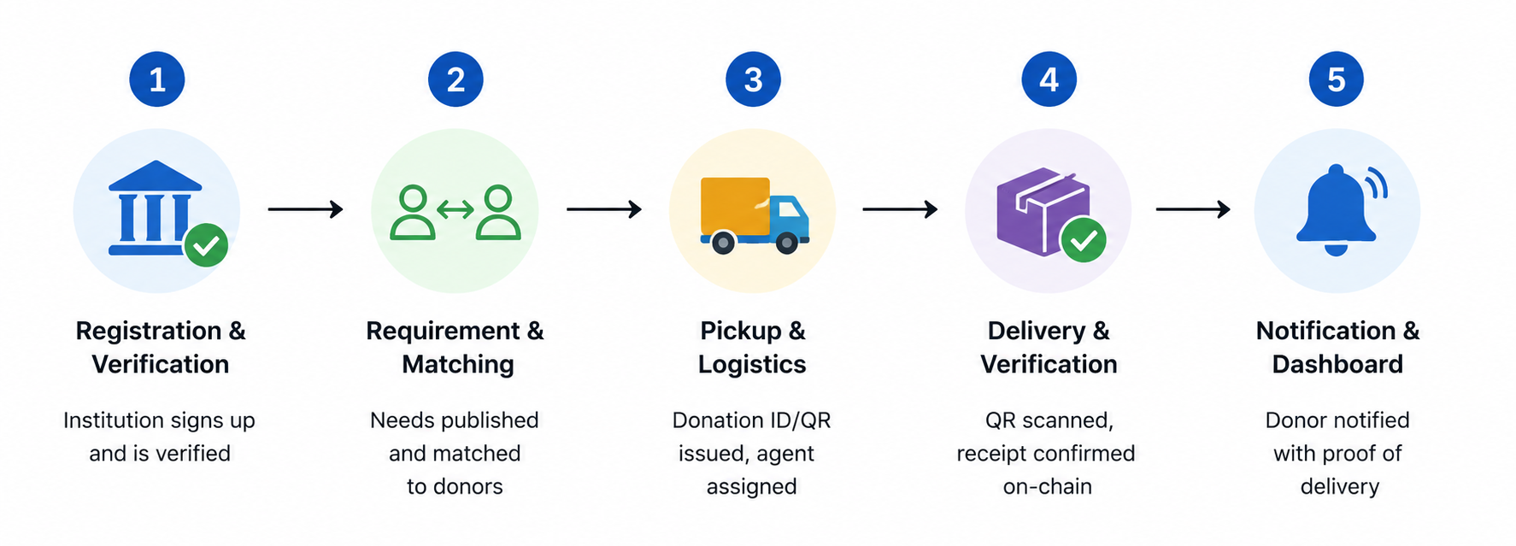
System Workflow
9

Slide 10
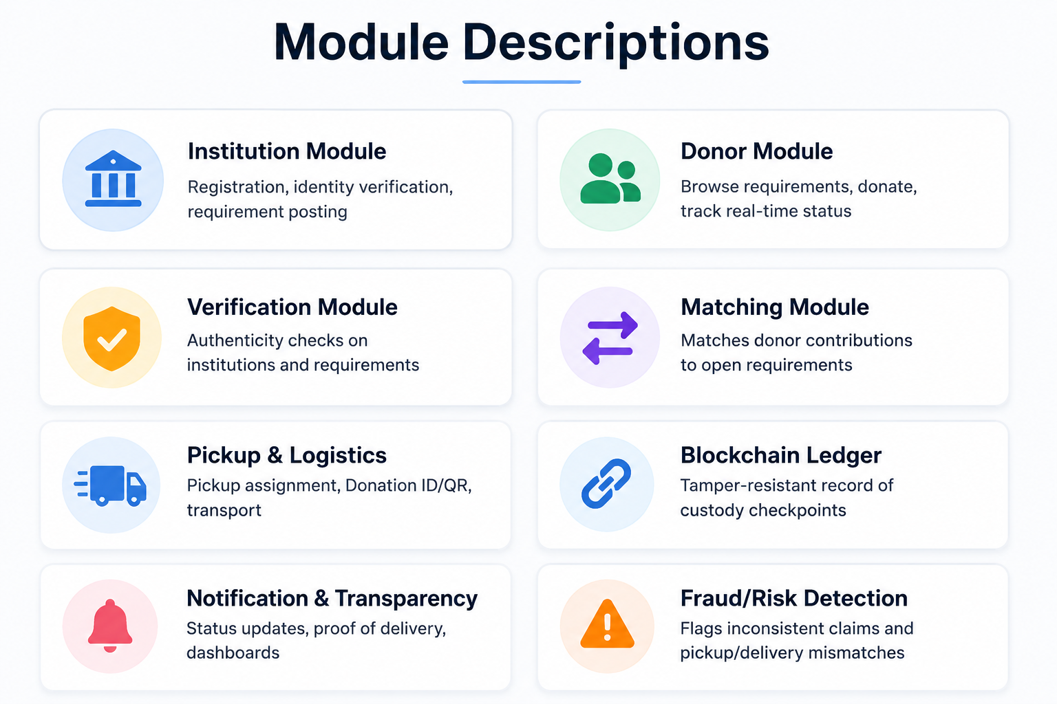

Slide 11
References
[1] D. Kamza et al., "Design and Development of Charity System Model based on Blockchain Technology," Proc. IEEE ICPCT, 2025. (Base Paper)
[2] M. Sameer S et al., "Comparative Analysis of Blockchain Platforms for Charitable Donation," Proc. IEEE ICDSBS, 2025.
[3] J. Zhang et al., "Design and Implementation of Donation Information Traceability System Based on Blockchain," 2023.
[4] L. Deng, S. Liu, H. Xu, W. Wang, W. Yang, "Blockchain-Based Charitable Donation Privacy Protection Scheme," AIoTC 2022, CEUR Vol. 3351, pp. 76-85.
[5] Albin T, S. Shiju George, "Blockchain-Based Volunteer and Donation Management System," Amal Jyothi College of Engineering, DOI: 10.5281/zenodo.15363322, 2025.
[6] P. Pawar, G. Rajukar, N. Gaikwad, A. Bute, S. Kirve, "Tracking Donations of Charitable Foundations Using Blockchain Technology," IJARCCE, Vol. 10, Issue 5, pp. 308-310, 2021.
[7] A. O. A. K. Alassaf, F. H. Yusoff, "Multi-point Fundraising and Distribution via Blockchain," IJACSA, Vol. 12, No. 7, pp. 475-486, 2021.
CareTrace – A Secure and Traceable Donation Logistics & Verification Platform
11

Slide 12
Thank You
CareTrace — Every Donation. Every Journey. Every Proof.

