Slide 1
Tours&travels

Slide 2
About
Tourism is travel for pleasure or business; also the theory and practice of touring, the business of attracting, accommodating, and entertaining tourists, and the business of operating tours.^{[2]} The World Tourism Organization defines tourism more generally, in terms which go "beyond the common perception of tourism as being limited to holiday activity only", as people "traveling to and staying in places outside their usual environment for not more than one consecutive year for leisure and not less than 24 hours, business and other purposes".^{[3]} Tourism can be domestic (within the traveller's own country) or international, and international tourism has both incoming and outgoing implications on a country's balance of payments.
Globally, international tourism receipts (the travel item in balance of payments) grew to US$1.03 trillion (€740 billion) in 2005, corresponding to an increase in real terms of 3.8% from 2010.^{[7]} International tourist arrivals surpassed the milestone of 1 billion tourists globally for the first time in 2012,^{[8]} emerging source markets such as China, Russia, and Brazil had significantly increased their spending over the previous decade.

Slide 3
Travels
Tourism in India is important for the country's economy and is growing rapidly. The World Travel and Tourism Council calculated that tourism generated ₹16.91 lakh crore (US$240 billion) or 9.2% of India's GDP in 2018 and supported 42.673 million jobs, 8.1% of its total employment.^{[1]} The sector is predicted to grow at an annual rate of 6.9% to ₹32.05 lakh crore (US$450 billion) by 2028 (9.9% of GDP).^{[2]} In October 2015, India's medical tourism sector was estimated to be worth US$3 billion, and it is projected to grow to US$7–8 billion by 2020.^{[3]} In 2014, 184,298 foreign patients travelled to India to seek medical treatment.^{[4]}
The Travel and Tourism Competitiveness Report 2019 ranked India 34th out of 140 countries overall. India improved its ranking by 6 places over the 2017 report which was the greatest improvement among the top 25% of countries ranked. The report ranks the price competitiveness of India's tourism sector 13th out of 140 countries. It mentions that India has quite good air transport infrastructure (ranked 33rd), particularly given the country's stage of development, and reasonable ground and port infrastructure (ranked 28th). The country also scores high on natural resources (ranked 14th), and cultural resources and business travel (ranked 8th).^{[9]} However, some other aspects of its tourism infrastructure remain somewhat underdeveloped.^{[10]} The nation has many hotel rooms per capita by international comparison and low ATM penetration.^{[11]} The World Tourism Organization reported that India's receipts from tourism during 2012 ranked 16th in the world, and 7th among Asian and Pacific countries.^{[12]}

Slide 4
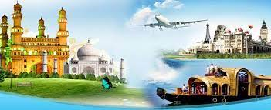

Slide 5
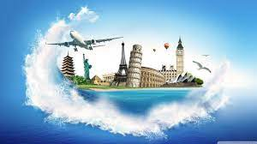
images

Slide 6
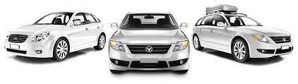
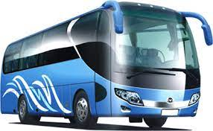
services
Buses
cars

Slide 7
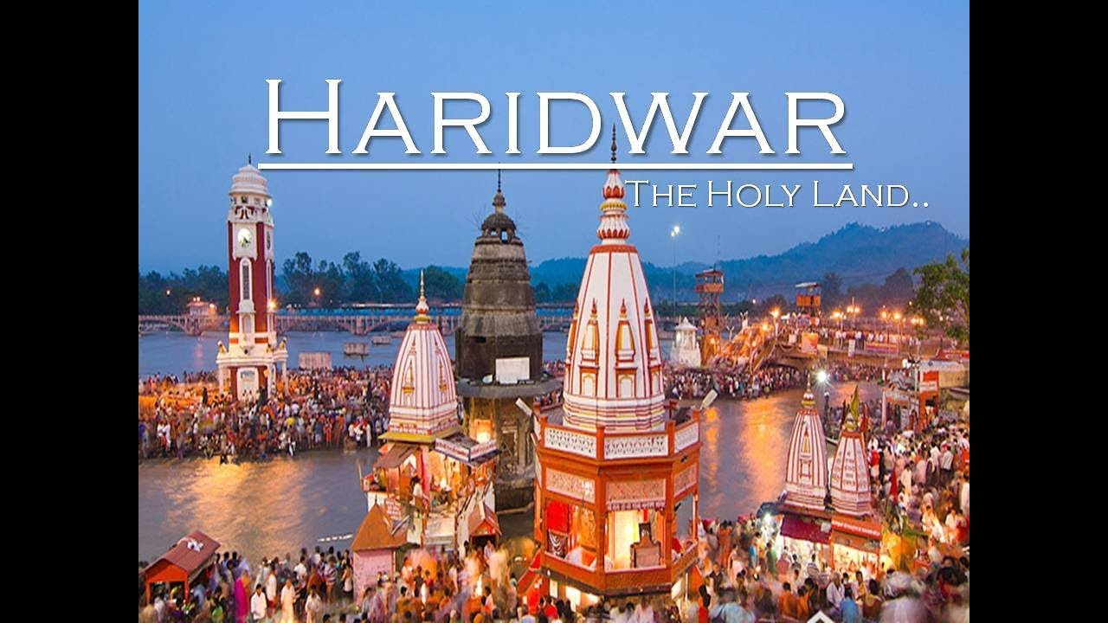

Slide 8
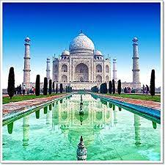
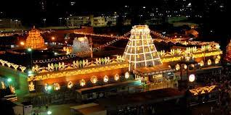
Haridwar:-The city is situated on the right bank of the Ganga river, at the foothills of the Shivalik ranges.^{[4]} Haridwar is regarded as a holy place for Hindus, hosting important religious events and serving as a gateway to several prominent places of worship. Most significant of the events is the Kumbha Mela, which is celebrated every 12 years in Haridwar. During the Haridwar Kumbh Mela, millions of pilgrims, devotees, and tourists congregate in Haridwar to perform ritualistic bathing on the banks of the river Ganges to wash away their sins to attain Moksha.
Taj mahal
Tirpuati

Slide 9
travels solgam
A Destination For The New Millennium.
A Different Light.
A More Rewarding Way To Travel.
A New Point Of View.
A New Pulse Of Dream.
A New Sky ,A New Life.
A Signature Of Excellence.
A Slogan Should Be Standalone

Slide 10
Thank you and follow link
https://sandeep20000.github.io/sandeep905/index

