Slide 1
Govern AI use at TTC, starting with CES AI Buddy
master.json: our Roslyn code graph (excerpt)
"Metadata": { "TargetFramework": "net8.0",
"Statistics": { "NodeCount": 2904,
"EdgeCount": 4196 } },
"Nodes": [ {
"Id": "class:global::BCES.Controllers
.Admin.EmpSalaryController",
"Type": "class", "Project": "CES",
"Location": {
"Path": "Controllers\Admin\
EmpSalaryController.cs",
"StartLine": 31, "EndLine": 161 } } ],
"Edges": [ {
"From": "route:/EmpSalary/CreateEmpSalary",
"Type": "routes_to",
"To": "method:...EmpSalaryController
.CreateEmpSalary(...)" } ]
“Not mature enough for AI yet” is heard everywhere. Maturity starts with seeing what actually leaves. CES AI Buddy goes first; other TTC apps repoint to the same gateway.
What we want to solve
AI Buddy answers CES developer questions from our Roslyn code graph, source code and database schema, using a hosted model. It works. What we cannot do today is show what left, or who approved it.
2,904 nodes, 4,196 edges. The graph holds structure only. The code itself is read from source and sent with the question. That is what needs governing.
What is going out?
The models are not on our enterprise framework. How safe is it?
Does any of this satisfy the acts we must follow?
Notes:
Title: govern AI use at TTC, starting with CES AI Buddy. The objection we hear is not mature enough for AI yet; maturity is built by doing the work, and the first piece is seeing what leaves. CES is the first app; other TTC apps repoint to the same gateway later. Problem. AI Buddy is our CES code assistant: Roslyn graph (master.json) plus source plus schema, answered by a hosted model. Leadership asks three questions: what is going out, how safe are models outside our enterprise framework, and does any of this satisfy the acts. The graph is structure only (no code text); source code and schema text travel in the prompt, so the prompt is the thing to govern. Graph figures are from our generated master.json.

Slide 2
Others publish principles; few can show enforcement
Who | What was found
Morgan Stanley | 98% of adviser teams adopted its internal assistant; document access rose from 20% to 80%. Self-reported.
Ontario public sector | Copilot Chat was the only approved tool, yet about 6% of GenAI use. No control stopped sensitive uploads.
Canadian banks | Published principles, training and review; little on enforcement. OSFI E-23 applies from 1 May 2027.
TTC | Microsoft Copilot is the only approved AI tool (City of Toronto generative AI guidance).
Limits we state up front
Findings rest on public, partly self-reported sources. We treat them as hypotheses to test.
Masking will not catch everything. A name buried in a paragraph can get through. We report misses.
Evidence is not compliance. Privacy assessments, contracts and legal review stay separate.
Self-hosted models may fall short on capability. We compare on the same tasks.
A ban hides the risk. A gateway contains it.
Employee
Corporate PC blocks it
Personal browser, chatbot
Invisible
Employee
Gateway inspects, masks, logs
Approved model
Governed
Each sector answers to
Canadian banks
OSFI E-23, B-13, B-10
Ontario public sector
Bill 194, Responsible Use of AI Directive, FIPPA
Federal government
TBS Directive on Automated Decision-Making, Privacy Act
City of Toronto
Generative AI Guidance, MFIPPA
Notes:
Sources: Morgan Stanley (OpenAI customer story and Morgan Stanley press release, June 2024; self-reported); Auditor General of Ontario, Use of AI (2026); OSFI Guideline E-23; Scotiabank and BMO published material; City of Toronto generative AI guidance (2025). Message: nothing here makes us compliant. It produces evidence, which most places do not have today.

Slide 3
Control egress: one gateway, a human in the loop
Apps and users
Gateway
Hosted API
Vendor cloud
AI Buddy for CES
Other developer tools
Agents
1
Classify what is sent
2
Check against policy
Canadian cloud region
Bedrock or Vertex AI
Egress control: only the gateway reaches model providers
3
Mask sensitive values
Repoint one endpoint setting. No rebuild.
4
Human in the loop for risky requests
Self-hosted model
Open-weight, on our infrastructure
5
Sign and chain a receipt
Start in log-only mode: see what leaves before enforcing anything.
Signed receipt per request: data class, decision, approver, time, payload or hash. Chained, so tampering shows. Verifiable offline.
Same need as ITSG-33 AU-9 and AU-10: audit records that cannot be altered unnoticed, and proof of who did what.
Benefits
See what leaves
Real evidence of what is sent, before any enforcement
Keep the use, stop the leak
Mask and approve instead of ban
Proof an auditor can check
Verify the receipt chain offline
Any model, same controls
Hosted, Canadian region or self-hosted
Notes:
Architecture. Apps are repointed at one endpoint; the firewall blocks direct provider access so nobody routes around it, the way payment processors were treated. The gateway classifies, checks policy, masks, waits for a person on risky requests, then writes a signed, chained receipt. Destinations: hosted API, Canadian cloud region (Bedrock or Vertex AI), self-hosted open-weight model. Claude is not offered on premises. Begin log-only. On the audit trail: ITSG-33 AU-9 (protection of audit information, with AU-9(3) cryptographic protection) and AU-10 (non-repudiation) describe the same need as the signed, chained receipts. OSFI B-13 is bank guidance; for TTC it is an external benchmark, not a requirement. Receipts give evidence of control, not compliance.

Slide 4
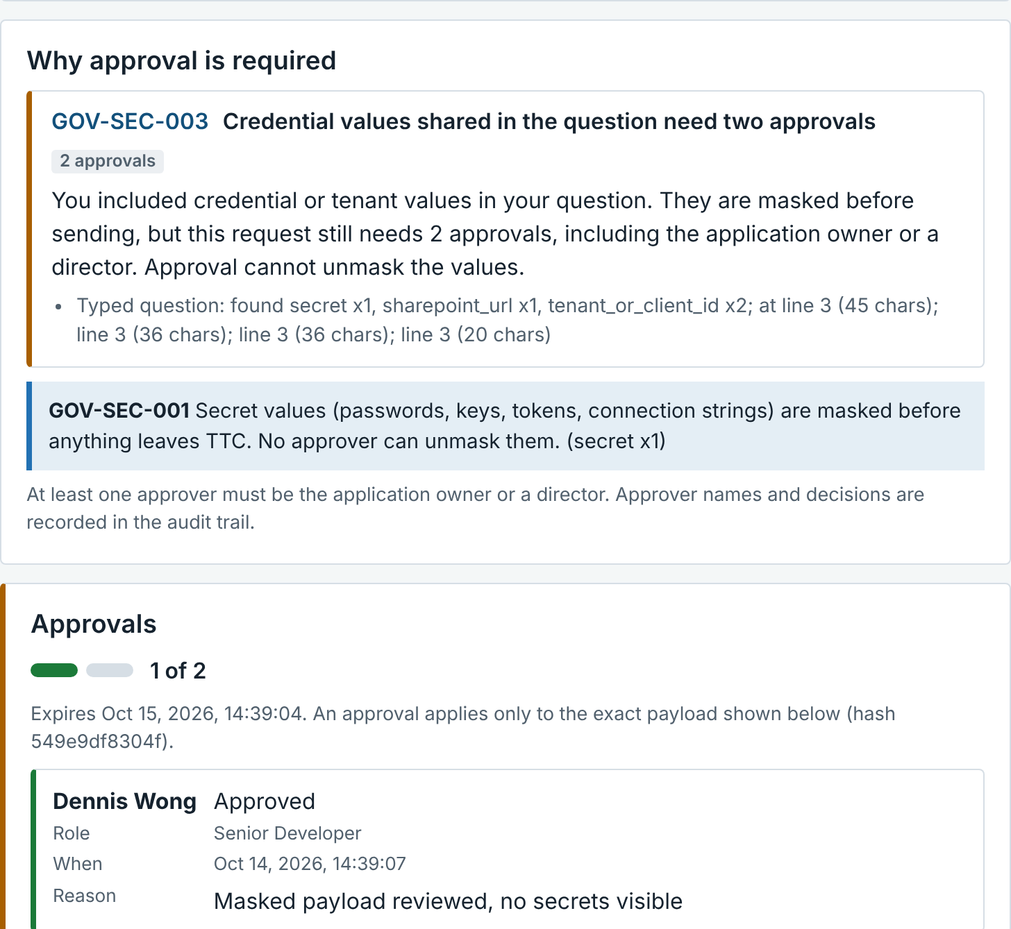
How a request flows, with a human in the loop
1
2
3
4
5
6
7
Ask
Classify
Policy
Transform
Approve
Release
Answer
Question plus code, view and schema slices
Data class C0 to C3 for every slice
30 rules: allow, mask, reduce, drop or approve
Secrets and personal data become tokens
Human in the loop: 0, 1 or 2 people. Owner or director if secrets
Sent only if the payload hash is unchanged
Values restored locally. Signed receipt
What it did with three of our test questions
The approver’s screen
Explain CES design | Allowed. Labour-rate and cost logic cut to signatures automatically. No approval.
Add SharePoint upload; tenant IDs and secret pasted | 4 values masked. 2 approvals, one from the application owner or a director.
Why does the salary grid fail to save? | Labour-rate logic: 1 approval, or send signatures only.
Test data and policies are synthetic. Credentials shown are fake.
Notes:
Flow. Every step is recorded in a signed, hash-chained audit trail. The approval is bound to the exact payload: if one character changes after approval, release is blocked. Approvers cannot unmask values. Secrets in the question (tenant ID, client secret, SharePoint URL) are masked, and still need two approvals, one from the application owner or a director. The screenshot is from the working POC with synthetic data.

Slide 5
Approve a 12-week proof of concept on real code and TTC infrastructure
Weeks 1 to 2
Weeks 3 to 6
Weeks 7 to 10
Weeks 11 to 12
Decisions requested
Set up Install the gateway on TTC infrastructure. Set the egress rule at the firewall so direct provider access is closed.
Approve a time-boxed 12-week POC
Name a sponsor and a lead architect for weekly checkpoints
Nominate reviewers from IT, security, privacy and records
Approve the egress rule at the firewall and the model options to test
Log-only baseline Route every call, enforce nothing, and report what actually leaves.
Enforce and compare Policy, masking, human-in-the-loop approval. Compare hosted, Canadian-region and self-hosted models.
At week 12 you receive
Report Evidence pack and go or no-go recommendation.
A working gateway on TTC infrastructure
A receipt chain an auditor can verify offline
Measured results across hosted, regional and self-hosted models
A go or no-go recommendation
Scope: AI Buddy for CES on the real code graph, source and schema. Legal and privacy review before any real prompt leaves TTC.
Notes:
The ask. Timeline follows the proposal: weeks 1-2 set up, 3-6 log-only baseline, 7-10 policy, masking, approval and model comparison, 11-12 review and go/no-go. Change from the earlier sandbox-only proposal: this version runs on the real CES code graph and TTC infrastructure, so legal and privacy review of data handling must precede any real prompt leaving TTC; the log-only phase keeps the first weeks non-intrusive. Success: every call routed and receipted, tampering detected, policy misses reported.

