Slide 1

Clock Synchronization
in Distributed Systems
Page
01

Slide 2

What is a
Distributed System?
  A distributed system is a collection of independent computers connected via a network.
  These systems communicate and coordinate through message passing.
  Each node can share resources like data, hardware, and software.
  Challenge: How to maintain consistency and order without a shared clock?
Page
02

Slide 3
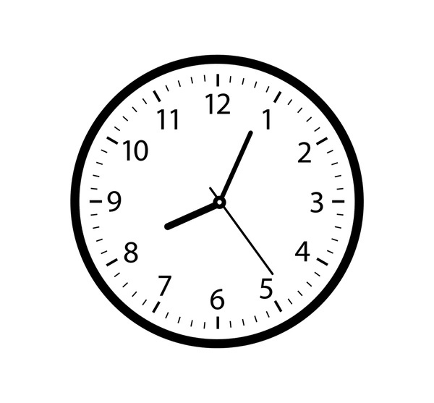
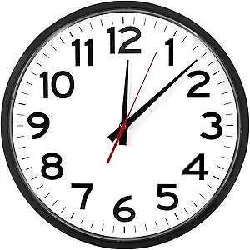
Why Synchronization is Needed
?
  In distributed systems, each node has its own local clock.
  Clocks can drift over time due to hardware differences
.
  Without synchronization:
    Inconsistent timestamps
    Incorrect event ordering
    Resource conflicts
    System failures in coordination
Page
03

Slide 4
Types of Clock Synchronization
External Clock Synchronization
Internal Clock Synchronization
  Uses an external reference clock (e.g., UTC).
  Nodes adjust their time to match this global reference.
  No external clock is used.
  Nodes synchronize with each other by exchanging time messages.
  All nodes adjust to an agreed average time.
Page
04

Slide 5
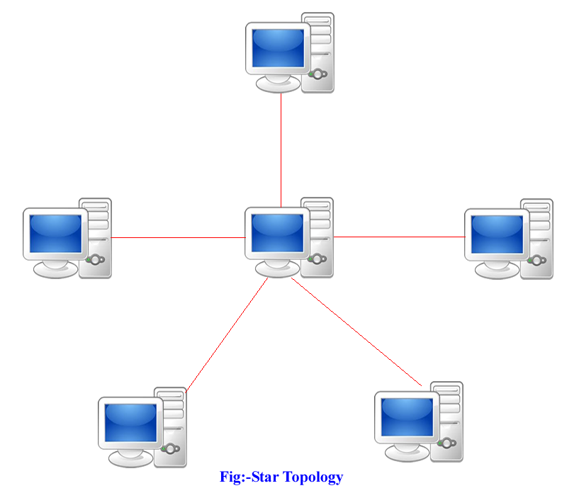
Centralized Clock Synchronization
  Uses a single time server as the reference.
  All other nodes request time from this server.
  Examples:
    Berkeley Algorithm
    Active/Passive Time Server
  Advantage:
Simple to implement.
  Disadvantage:
Single point of failure, not scalable
Page
05

Slide 6
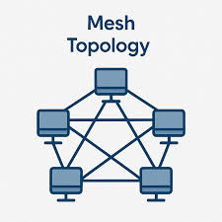
Distributed Clock Synchronization
  No central server; all nodes cooperate.
  Each node exchanges time with others and computes an average.
  Examples:
    Network Time Protocol (NTP)
    Global Averaging Algorithm
    Localized Averaging Algorithm
  Advantages: Fault-tolerant, scalable, no single point of failure.
Page
06

Slide 7
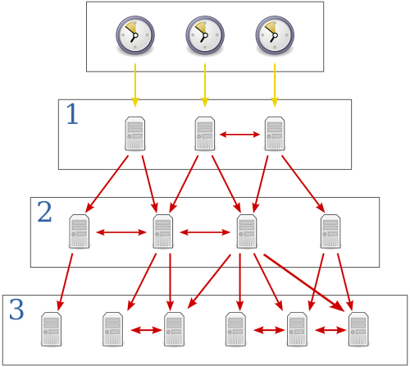
Network Time Protocol (NTP)
in Detail
  Most widely used distributed time protocol.
  Uses a hierarchy of servers (stratum levels).
  Stratum 0 = atomic clock, Stratum 1 = primary servers, etc.
  Designed to handle network delays and packet loss.
  Provides accuracy within milliseconds over the internet.
Page
07

Slide 8

Studio Shodwe
Challenges in
Clock Synchronization
  Network Delays: Variable latency affects time accuracy.
  Clock Drift: Physical clocks run at slightly different speeds.
  Fault Tolerance: Handling node failures during sync.
  Security: Preventing malicious time attacks (e.g., in blockchain).
  Scalability: Maintaining sync in large, dynamic networks.
Page
08

Slide 9

Real-World
Applications
  Financial Systems: Timestamping transactions.
  Cloud Computing: Synchronizing distributed databases.
  Blockchain: Consensus mechanisms rely on time sync.
  Telecommunications: Call logging and billing.
  IoT Networks: Coordinating sensor data collection.
Page
09

Slide 10
Thank
You.
Sandeep Gaire
Page
10

