Slide 1

MINOR PROJECT REVIEW • 2025–26
InsureClaim Vision
AI-Powered Motor Insurance Claim Estimation
PRESENTED BY
Pullareddy Sandeep
O211007
Marri Kiran Kumar
O211082
UNDER THE GUIDANCE OF
Department of Computer Science and Engineering
RGUKT-AP, Ongole Campus
Ms. B Shireesha
Assistant Professor, Department of CSE

Slide 2
Agenda
01
Problem Statement
02
Objectives
03
Existing vs Proposed System
04
System Architecture
05
Processing Pipeline
06
AI Reasoning & Pricing Engine
07
Design Diagrams
08
Implementation & Screens
09
Future Scope & Conclusion

Slide 3




The Problem with Manual Claim Inspection
Slow turnaround
A surveyor must visit, inspect and write an estimate – settlement often takes days.
MANUAL SURVEY
Days
Inconsistent estimates
Repair-or-replace calls and labour charges vary from one surveyor to another.
INSURECLAIM VISION
Seconds
High cost for small claims
Every minor dent needs the same manual effort as a major accident.
for a first, itemised estimate

Slide 4






Project Objectives
Read damage from photos
Grade every part
Price deterministically
Identify damaged parts automatically from 1–6 ordinary images.
Severity on a 1–6 scale with a REPAIR or REPLACE decision.
Part + labour + GST from fixed rate cards – never from the AI.
Decide instantly
Show the evidence
Keep a record
Auto-approve small claims, route large ones to a surveyor.
Heatmaps and overlays so auditors can verify the AI quickly.
Store every claim and export a professional PDF invoice.

Slide 5


Existing System vs Proposed System
Existing System
InsureClaim Vision
Physical inspection by a surveyor
Estimate written manually
Different results from different surveyors
Little structured visual evidence
Customer waits days for an amount
Photos uploaded from anywhere
AI identifies parts, severity and action
Same damage → same price, every time
Heatmap + overlay for every claim
Instant estimate and approval status

Slide 6
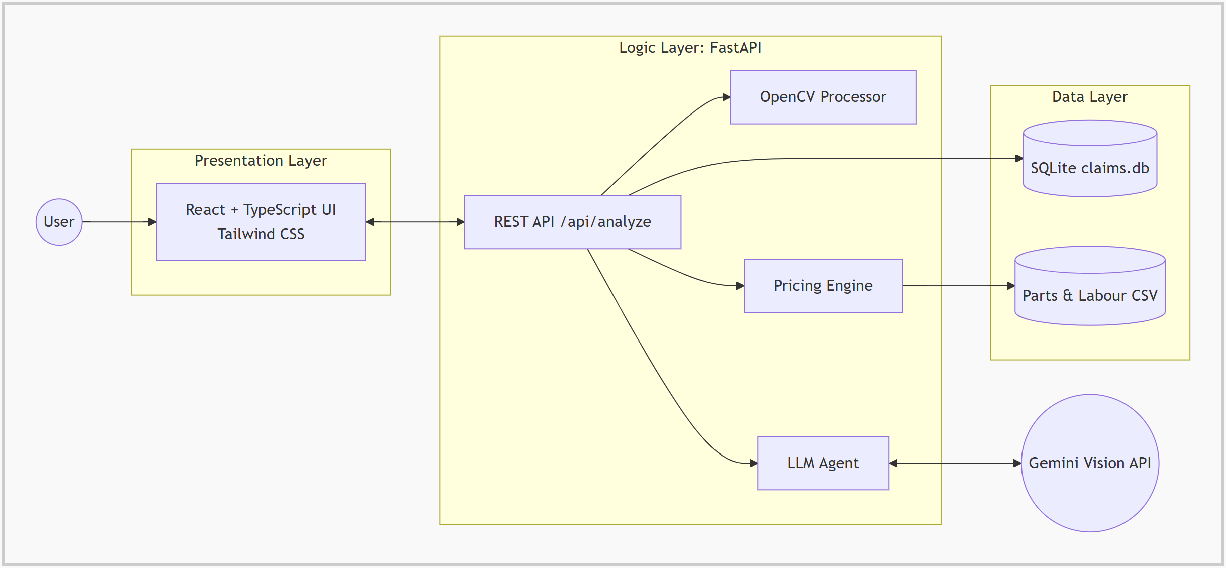
System Architecture
Presentation Layer
React 18 + TypeScript, Tailwind CSS, Vite
Logic Layer
FastAPI orchestrator, OpenCV, Gemini LLM agent, pricing engine
Data Layer
SQLite claim store, parts & labour CSV rate cards

Slide 7




How a Claim Is Processed
STEP 1
STEP 2
STEP 3
STEP 4
STEP 5
Upload
OpenCV
Gemini Vision
Pricing
Decision
1–6 photos, vehicle class, workshop & pricing mode
Normalise, enhance, find regions & point of impact
Parts, severity 1–6, REPAIR or REPLACE
Part + labour from rate cards, plus 18% GST
Auto-approve or manual review, saved & reported
Design rule: the AI only describes the damage – every rupee is calculated from fixed rate cards, so the same damage always gets the same price.

Slide 8





Perception Layer – OpenCV
Normalise
Denoise & Enhance
KEY PARAMETERS
Letterbox every image to 1024 × 768
Gaussian blur, then CLAHE on the L channel
Resolution
1024 × 768
Gaussian kernel
5 × 5
Find Damage Regions
Point of Impact
CLAHE
clip 2.0, 8×8
Canny edges → contours larger than 200 px²
Area-weighted centroid on a clock dial
Canny thresholds
50 / 150
Min region
200 px²
Quality Check
Heatmap
Brightness, contrast and blur score
Sobel gradients, JET colours, refined by AI points
Blur warning
score < 20

Slide 9


Reasoning Layer – Gemini Vision
Severity scale used by the model
STRUCTURED OUTPUT (FORMAT)
1
2
3
4
5
6
[
{
"part": "Front Bumper",
"part_key": "front_bumper",
"decision": "REPLACE",
"severity_score": 5,
"justification": "...",
"x_percentage": 50.0,
"y_percentage": 75.0
}
]
Minor
Moderate
Severe
surface scratches, tiny dings
deep scratches, dents, creases
shattered, torn, crushed
REPAIR
Can be pulled, filled and repainted
REPLACE
JSON mode • temperature 0.1 • every field re-validated and clamped in Python
Shattered, torn or structurally compromised

Slide 10

Deterministic Pricing & Approval
Part Cost
Labour
GST
Grand Total
+
+
=
OEM or aftermarket,
by vehicle class
Independent rate or
showroom midpoint
18% on the
subtotal
per claim,
itemised by part
72
parts catalogue entries
11
labour operations
4
vehicle classes
Total below Rs. 50,000
Total Rs. 50,000 or more
AUTO_APPROVE
MANUAL_REVIEW

Slide 11
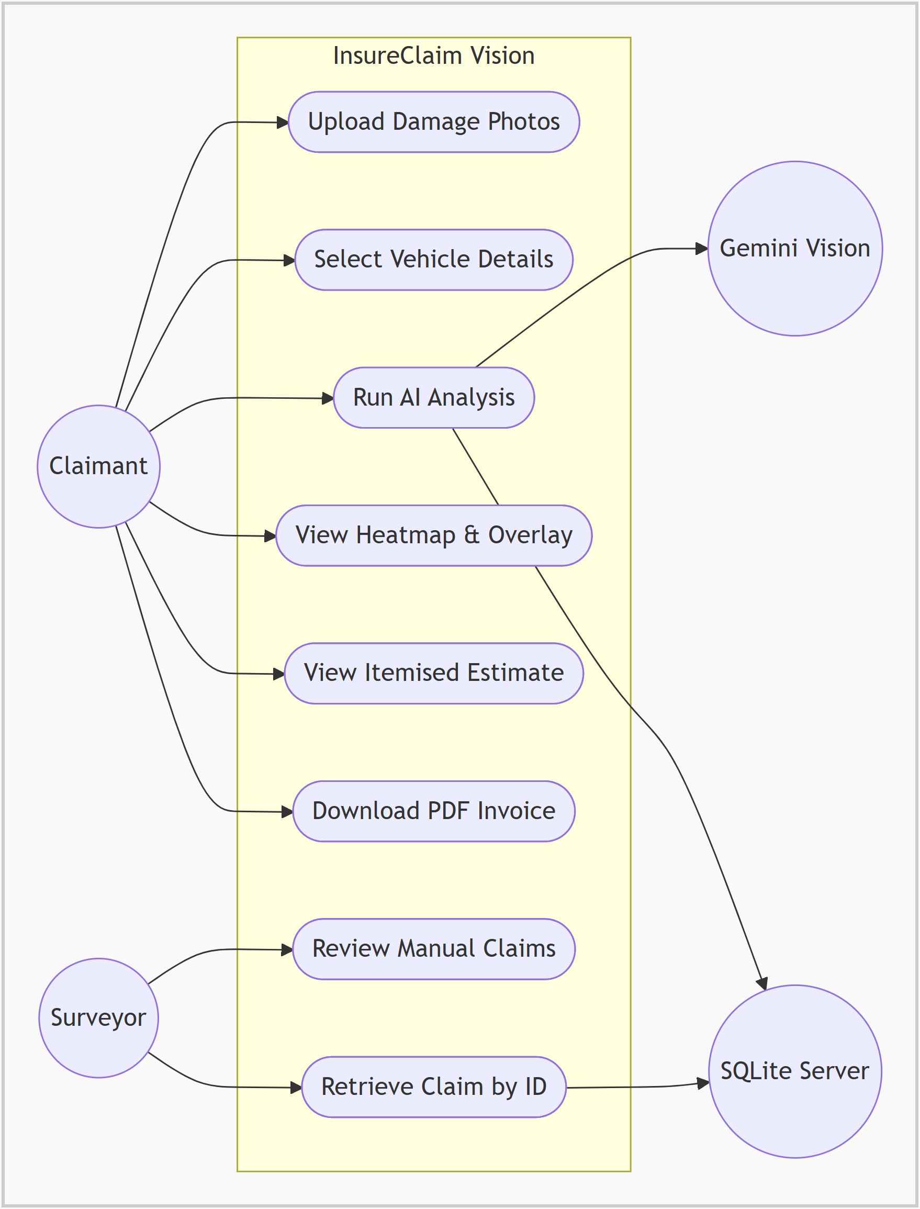
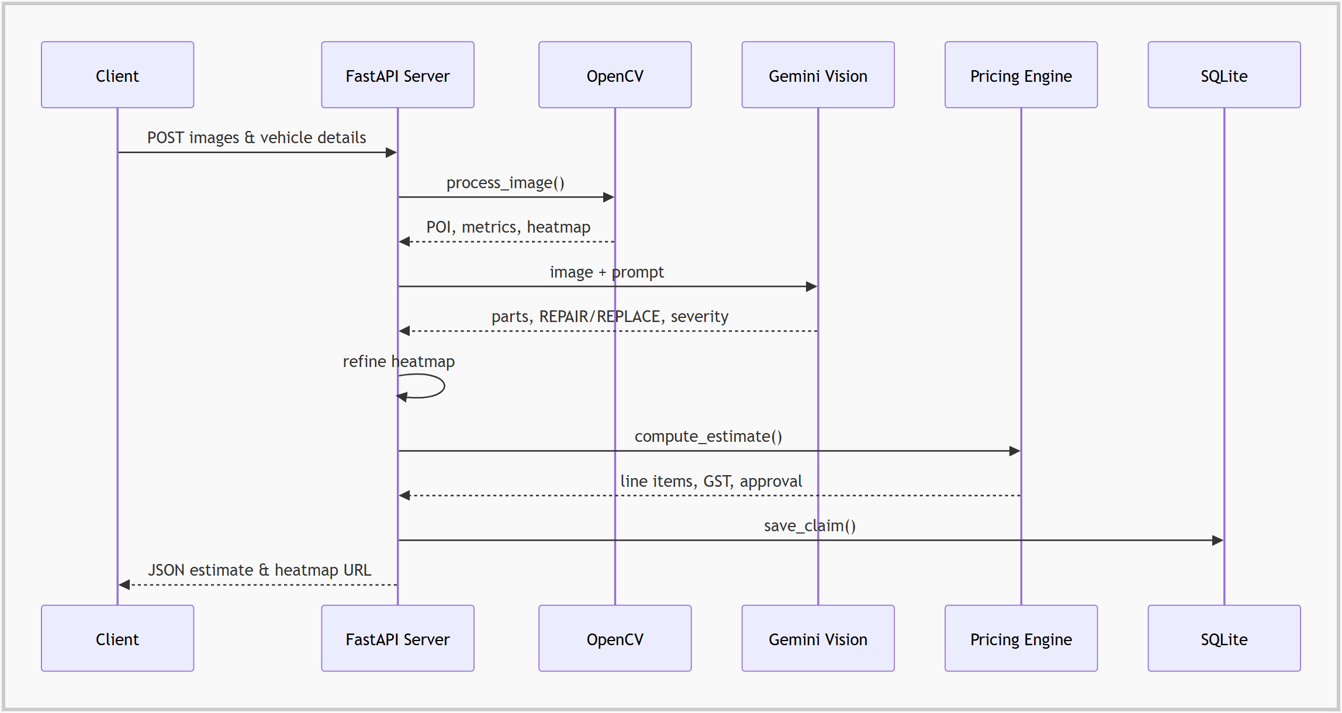
Use Case & Sequence
Use case diagram
Sequence of a claim analysis request

Slide 12
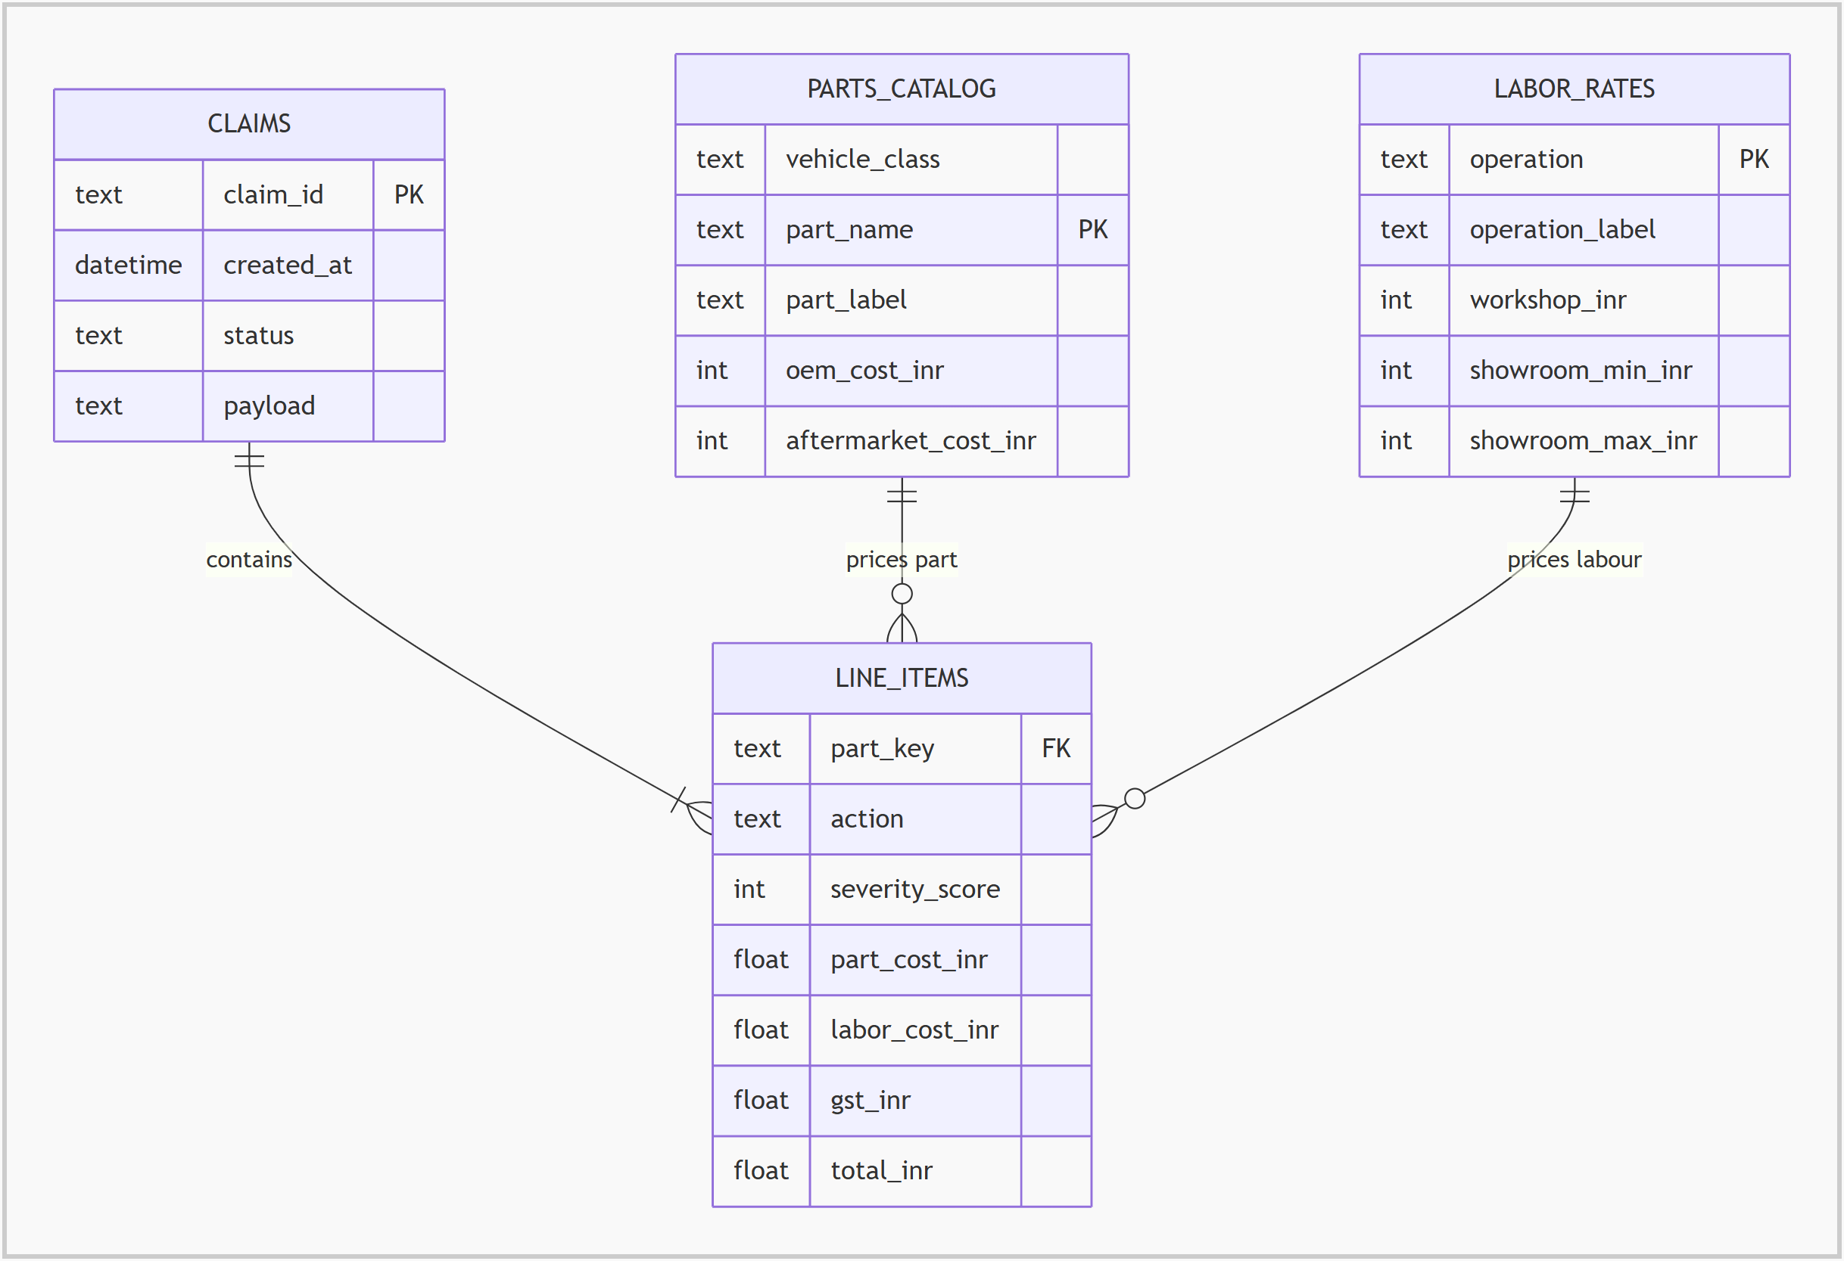
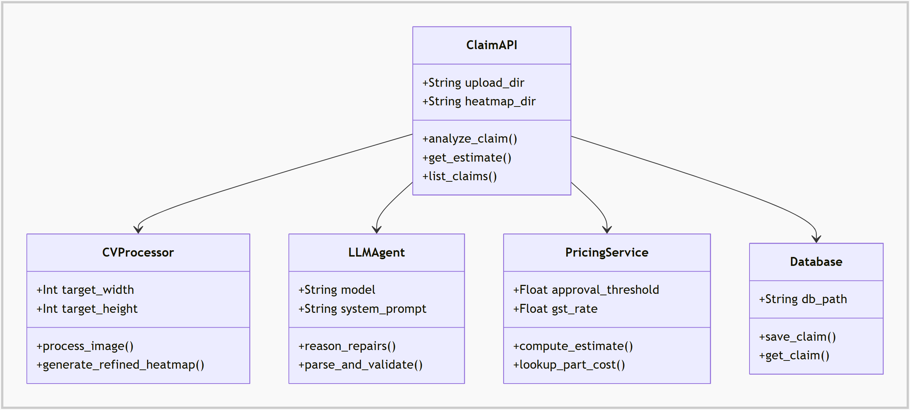
Data Model & Class Structure
Entity relationship diagram
Backend class diagram

Slide 13


Technology Stack
Frontend
Backend
AI & Vision
Data
React 18 + TypeScript
Vite & Tailwind CSS
Framer Motion
Axios, react-dropzone
jsPDF + AutoTable
Python 3
FastAPI + Uvicorn
Pydantic models
python-dotenv config
Google Gemini Vision
OpenCV
NumPy
Pillow
SQLite claim store
Pandas
Parts catalogue CSV
Labour rates CSV

Slide 14
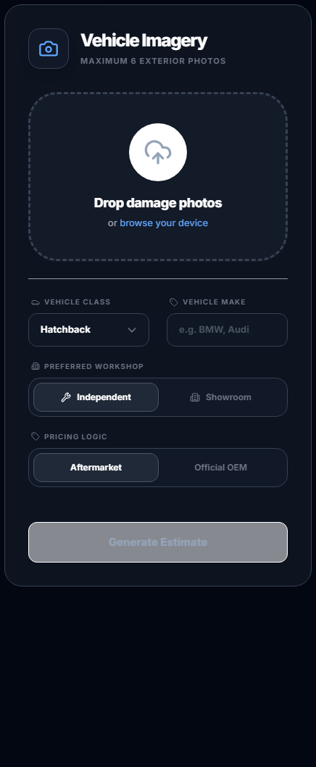




Key Features
Multi-image upload
Itemised estimate
Drag & drop up to 6 photos
Parts, labour, GST, grand total
Live pipeline tracker
Approval badge
Shows each processing stage
AUTO_APPROVE or MANUAL_REVIEW
Heatmap & overlay
PDF claim invoice
Severity-coloured damage boxes
Generated in the browser

Slide 15

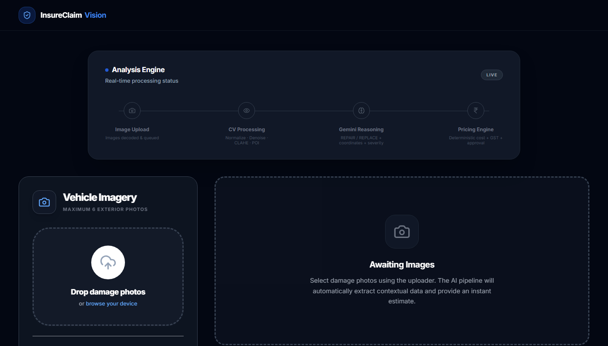
Application Screens
Landing page
Entry point with a single “Start Your Claim” action
Estimator page
Live analysis engine status and photo upload area

Slide 16






Future Enhancements
Fraud detection
Pixel-level masks
Match damage against claim history and duplicate images
Segmentation models such as SAM for exact damage areas
Multi-image fusion
Mobile app
Combine every uploaded photo, not only the primary one
On-site capture for field agents and policyholders
Live part prices
Surveyor workflow
Workshop and manufacturer APIs instead of static CSVs
Accounts, claim history and approval dashboard

Slide 17


Conclusion
Faster
Consistent
Explainable
A first, itemised claim estimate in seconds instead of days.
AI describes the damage; fixed rate cards set the price.
Heatmaps, overlays and per-part justifications for auditors.
Computer vision + multimodal AI + rule-based pricing in one maintainable platform.

Slide 18
Thank You
Questions & Discussion
Pullareddy Sandeep (O211007) • Marri Kiran Kumar (O211082)
Guide: Ms. B Shireesha, Assistant Professor | Department of CSE, RGUKT-AP Ongole Campus

