Slide 1

Date: April,2025
PROJECT TITLE : E-COMMERCE SHOPPING PLATFORM
Data Structure And Algorithms (CSL2020)
Instructor : Dr. Suchetana Chakraborty Mentor TA : Anshul Jain (M24CSA002) Group Members Ram Prakash (B23CI1031) Chirag Koted (B23PH1005) Amit Kumar (B23ME1006) Sandeep Prasad Gond (B23PH1019)

Slide 2
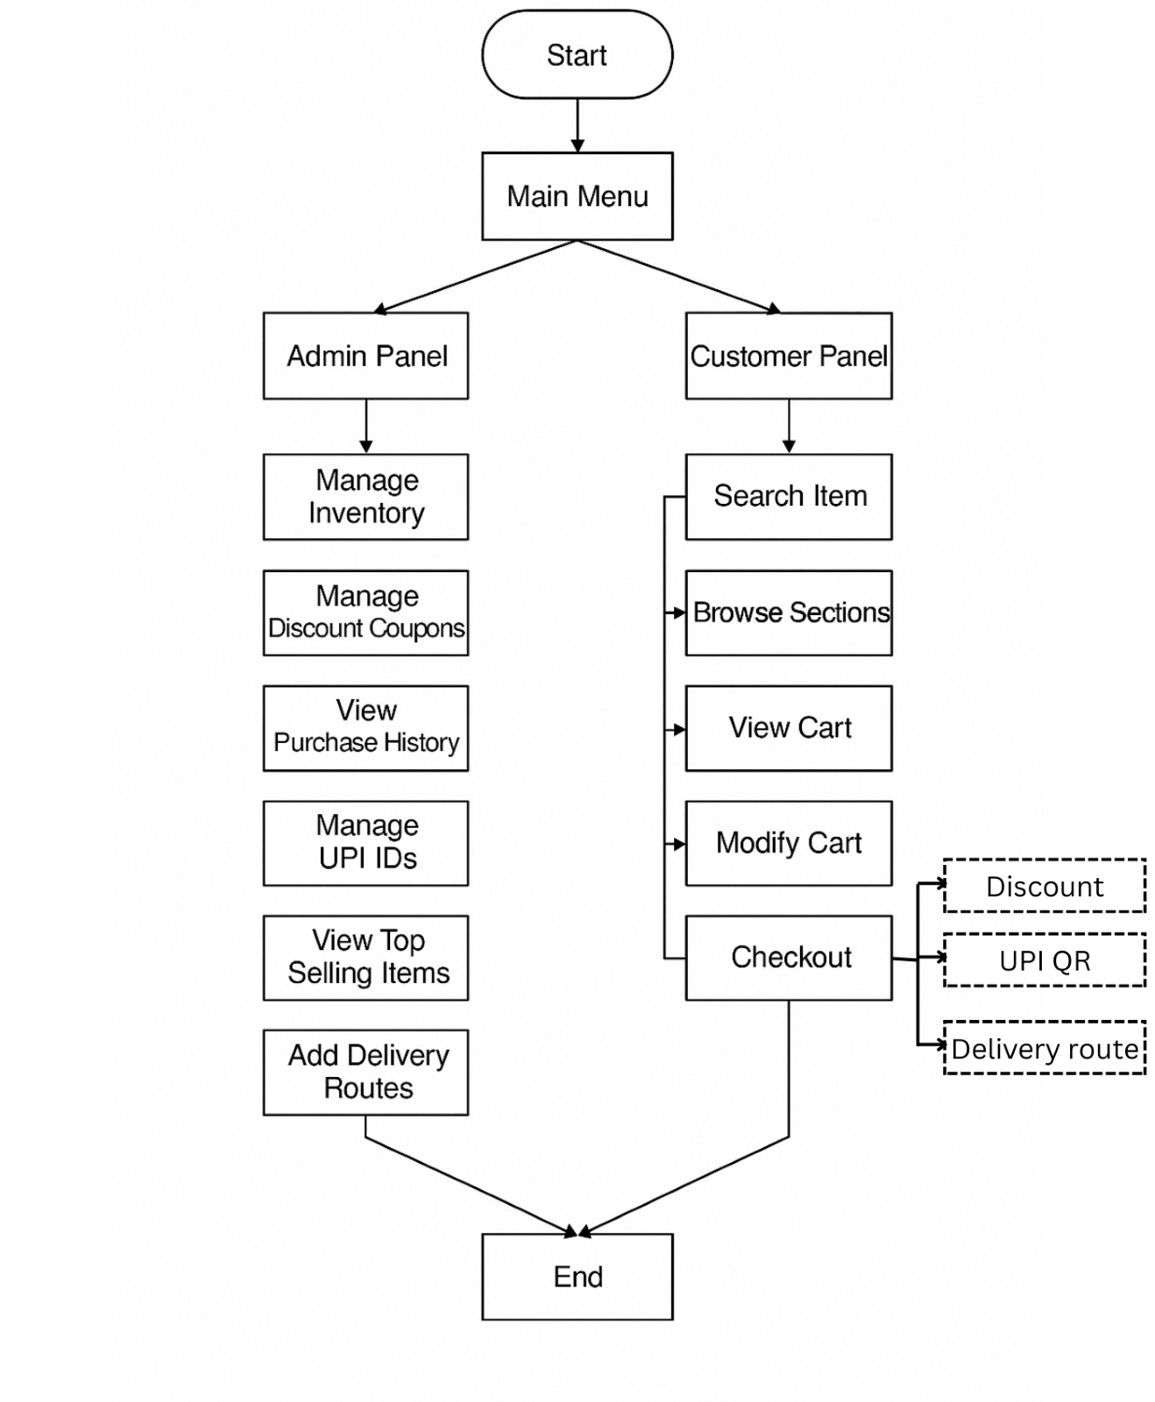
Problem Statement: DESIGN AND DEVELOP AN EFFICIENT ONLINE SHOPPING PLATFORM THAT LEVERAGES DATA STRUCTURES AND ALGORITHMS TO PROVIDE SEAMLESS PRODUCT BROWSING, INTUITIVE CART MANAGEMENT, SECURE UPI-BASED TRANSACTIONS, AND OPTIMIZED DELIVERY ROUTE PLANNING.
Domain or Use Case Mapping : This project falls under the E-Commerce domain, specifically targeting:
Paying the cart bill’s using QR system through UPI on bill itself.
To find out best possible Delivery Route.
Easy Product listing for Admin and easy search for goods according to user.
Track Top sell products.
Why a Data-Driven Solution Looks Promising:
Search optimization: With proper data structures (K-MAP && Hash Table), product search becomes lightning fast.
Graph help in finding the shortest or more efficient route between two points(Dijkstra algo).
Scalability: Good algorithm design supports scaling to thousands of users/products.

Slide 3
Why It’s an Important/Relevant Problem
E-commerce is booming: Billions of transactions happen online every year due to online purchases.
Online bill paying system through QR and finding easy route for delivery .
Real-world applications: This project mimics real-life systems like Amazon or Flipkart.
Why It’s a Challenging Problem
Requires managing multiple data entities: products, users, cart, upi, delivery routes, coupon etc.
Balancing efficiency and accuracy in searching for product and UPI transaction operations.
Implementing fast search & retrieval techniques.
Finding the best possible route for delivery.

Slide 4
CURRENT STATUS
Latest Advancements
Dynamic Pricing Models: Algorithms adjust prices in real-time based on demand fluctuations, maximizing revenue while maintaining competitive pricing.
AI-Driven Personalization: Machine learning models analyze user behavior to enhance shopping experiences, making recommendations more relevant.
Limitations of Existing Approaches
Offline billing systems often lack of QR-based digital payments (Example FNG).
Scalability Issues: Traditional data structures like arrays and linked lists struggle with large-scale product catalogs.
Security Concerns: Algorithmic approaches must balance efficiency with robust security measures to protect user data.

Slide 5
Introducing the Idea for project The idea is to design and implement E-Commerce shopping system using core data structures and algorithms. The goal is to simulate the fundamental functionalities of an online shopping platform such as:
Product listing and browsing
Search by product name or category
Shopping cart management
Checkout and bill generation
Delivery to costumer
Manage discount coupons, view purchase history, manage upi ids with defined price range.
Suggested Improvements Using DSA
The following improvements and optimizations are suggested in the implementation:
Functionality | DSA Technique Used/ other methods | Why It's Effective
Inventory | AVL tree | Fast balance search/update
Product search (by name) | K-MP algorithms | Efficient search
Payment | QR code generation (other) | Cashless transaction
Cart management | Hash Map | Linear search
Route | Dijkstra | Finding the shortest path
Top selling product | Min Heap | Cart recommendation
Discount | Hash Map | Apply discount dynamically during checkout.

Slide 6
GitHub Repository
Repo : https://github.com/sandeep33999/Shopping_management
Highlight Results
Delivery Routes (Graph + Dijkstra) : Admin can define route system finds shortest path on checkout.
Discount Coupons (Hash Map) : Admin-generated codes, applied by customers.
QR Payment (UPI Simulation) : Auto-generates QR with total bill and timeout(10 sec).
Persistent Storage : Inventory, user’s data, carts, bills, purchase history stored in files.
Complaint System : Customers can leave feedback or complaints for specific items.
Cost-Benefit Trade-Off
Algorithms | Time complexity | Space complexity
Dijkstra Algo | O((V+E) log V) | O(V)
K-MP Algo | O(m + n) | O(m)
AVL Tree | O(log n) | O(n)
Min – Max Heap | O(1) {find}, O(log n) {update} | O(n)
Hash Map | O(1) | O(n)

Slide 7
Conclusion
Key Findings and Learnings
Efficient data structure usage can significantly enhance the performance of basic operations like search, quantities of goods, and recommendation in an E-Commerce platform.
Hash tables and AVL trees drastically increase the speed of compilation .
Linked lists and Graphs proved to be flexible for dynamic operations like cart management and order queues.
The project strengthened understanding of both theoretical DSA concepts and their real-world application in system design.
Scope for Future Extension
Database Integration: Use SQL or NoSQL databases for real-time product and order persistence.
GUI or Web Interface: Add a frontend using HTML/CSS/React to enhance user interaction.
AI-based Recommendations: Integrate ML models for personalized product suggestions.

Slide 8
Summary of Innovation
This project demonstrates how core data structures and algorithms can be effectively applied to simulate key functionalities of a modern E-Commerce platform. Without relying on heavy frameworks or databases, we used smart structuring of data to achieve fast, scalable, and interactive shopping behavior in lightweight environment—highlighting the strength of algorithm-first thinking.
Acknowledgement
I would like to thank:
My course instructors and mentors, who provided foundational knowledge of data structures and problem-solving techniques.
ANSHUL JAIN ( Mentor) for discussions and suggestions that helped refine this project.
Resources Used
GeeksforGeeks – Reference for DSA concepts and algorithms. ii.
TutorialsPoint – For understanding basic E-Commerce flow modelling.
GitHub Docs – For hosting and managing project repositories.

Slide 9


