Slide 1
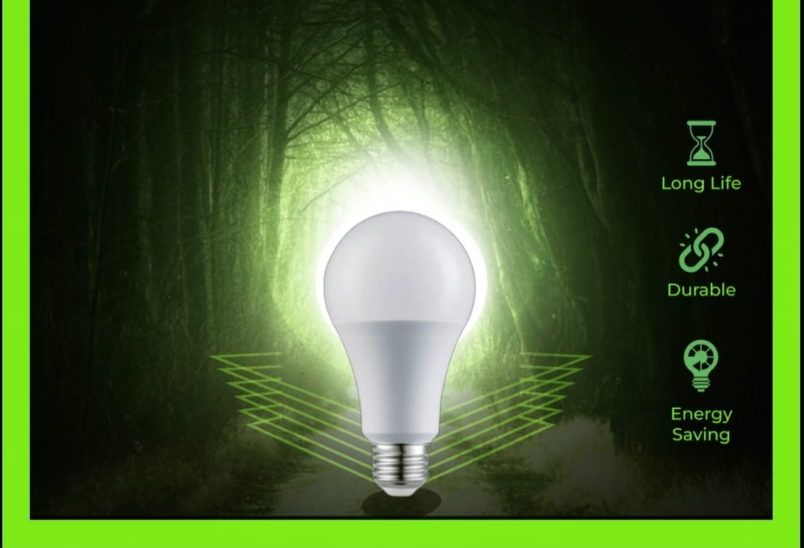




MOTION OBJECT DETECTING INVERTER BULB

Slide 2



CONTENTS
Introduction about MODI bulb
Need of innovation
Technology used in bulb
Working of bulb
Key features
Advantages over traditional bulb
Marketing potential
Applications
conclusion

Slide 3
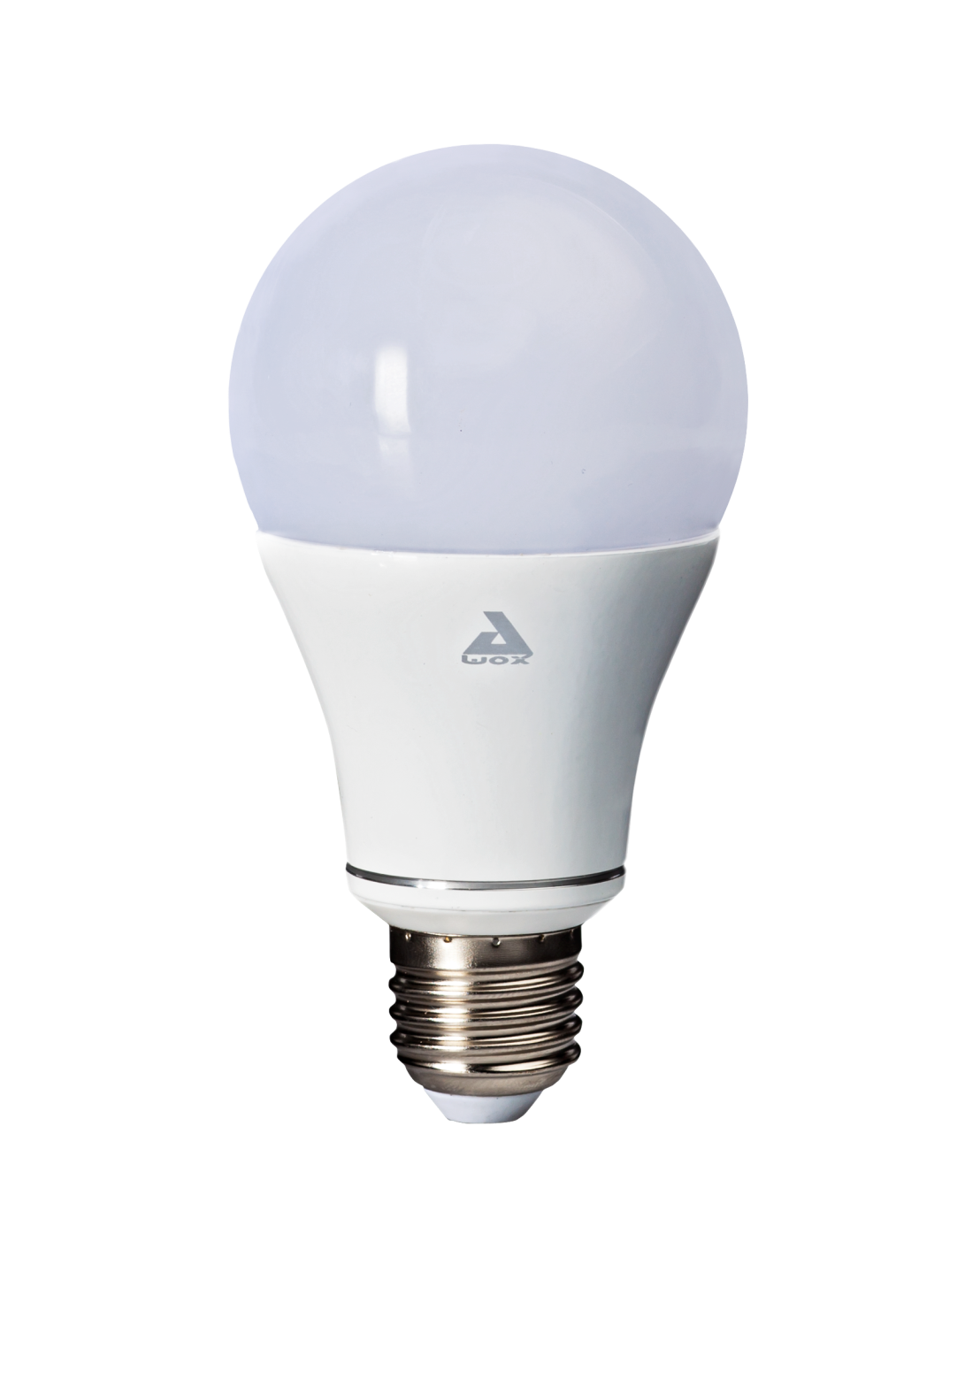


INTRODUCTION
MODI:-Motion Object Detecting Inverter Bulb
Dual Functionality:-The combined bulb integrates both charging
and motion detection features into a single device
Low Heat Emission:-LED bulbs emit very little heat compared to
traditional bulbs, making them safer and more suitable for use in
enclosed fixtures.
Long Lifespan:-Known for their longevity, LED bulbs have an extended operational life, reducing the frequency of replacements and contributing to lower maintenance costs.

Slide 4
04
03
Adaptive Lighting Solutions
05
Smart Integration
Interconnectivity
Need of innovation
02
06
Energy Efficiency
Durability and Longevity
01
07
Enhanced Sensitivity
Integration of New Technologies

Slide 5





Technology used in bulb
Energy-Efficient LED Technology
Motion sensor bulbs commonly utilize LED technology for efficient and instant lighting when activated.
Passive Infrared Sensors
Commonly employed for motion detection, PIR sensors detect changes in infrared radiation, triggering the bulb when motion is sensed..
Smart Inverting Mechanism
Innovative mechanisms within the bulb that can dynamically adjust the direction of light output, controlled by the integrated electronics.
Light Detection Sensors
Some motion sensor bulbs incorporate light sensors to avoid activation during daylight hours, enhancing energy efficiency..
Mechanical Components
Inverting bulbs may include specific mechanical components responsible for altering the orientation of the light source, providing the desired inverting effect.

Slide 6
Working of MODI bulb
Inverting Sensor Bulb:-Detection Mechanism of The inverting sensor detects changes in light levels or motion.
Triggering Action:- When a change is detected, the sensor activates a mechanism to invert the bulb state, turning it on if it was off and vice versa.
Motion Detection:- Uses infrared or other technologies to sense movement within its range.
Activation:- When motion is detected, the sensor triggers the bulb to turn on.
Time Delay:- Often includes a time delay to keep the bulb on for a specific duration after the last motion is detected.

Slide 7

Key Features
Efficient Charging
Easy Installation
Equipped with a built-in charging port, it allows users to conveniently charge their devices directly from the bulb.
Designed for hassle-free installation, making it accessible for users without specialized technical knowledge.
Smart Energy Management
Sleek Design
The bulb intelligently switches off when no motion is detected, conserving energy and contributing to lower electricity bills.
Blends seamlessly with standard bulb fixtures, maintaining an aesthetic appeal while providing modern features.
Cost-Effective
Motion Detection
Combining two essential features in one device reduces the need for additional gadgets, making it a cost-effective
solution for consumers.
Automatically activates the light when motion is sensed, enhancing security and energy efficiency.

Slide 8
Advantages over traditional bulb
Motion sensors ensurelights are activated only in the presence of motion, preventing unnecessary energy wastage
01
Energy Conservation
02
Automatically turning on lights in response to motion enhances security, deterring potential intruders.
Security Enhancement:
Reduced usage leads to longer bulb life, resulting in fewer replacements and lower maintenance costs..
03
Extended Lifespan
04
Eliminates the need for manual switching, especially useful in areas with sporadic occupancy.
Convenience
Lower energy consumption translates to reduced electricity bills, offering long-term cost savings..
05
Cost Savings

Slide 9
Marking potential
Retail Partnerships:- Partner with retailers to display and promote the bulbs effectively. Consider in-store
demonstrations or exclusive bundles to attract attention
Customer Reviews and Testimonials:- Share positive reviews and testimonials from early adopters to build trust
And credibility among potential customers.
Educational Content:- Create content that educates consumers about the benefits and installation process of inverting
and motion sensor bulbs. This could include blog posts, video tutorials, or infographics
Applications
Home Security
Smart Home Automation
Outdoor Pathway Lighting
Energy-efficient Offices
Business and Commercial Spaces
Emergency Lighting

Slide 10


Conclusion
In conclusion, inverting and motion sensing bulbs represent a significant leap in lighting technology, offering unparalleled convenience, energy efficiency, and security. These innovative bulbs find versatile applications in homes and commercial spaces, providing automatic illumination precisely when and
where it is needed. With features like adaptability in orientation and integration with smart home systems, these bulbs not only contribute to cost savings but also align with the growing demand for intelligent and sustainable lighting solutions. As technology continues to advance, inverting and motion sensing bulbs stand at the forefront of creating smarter, safer, and more energy-conscious environments

Slide 11
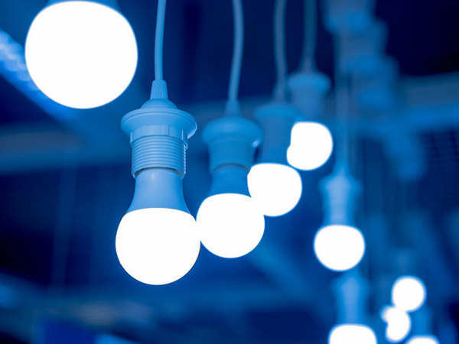

Thank you
CHANGE NEEDS WHEN ITS NEEDED
Instagram
@INNOVATIVE_ELECTRONICS_MKVSR
Contact :
9606799579
Email : innovativeeletronics@gmail.com

