Slide 1
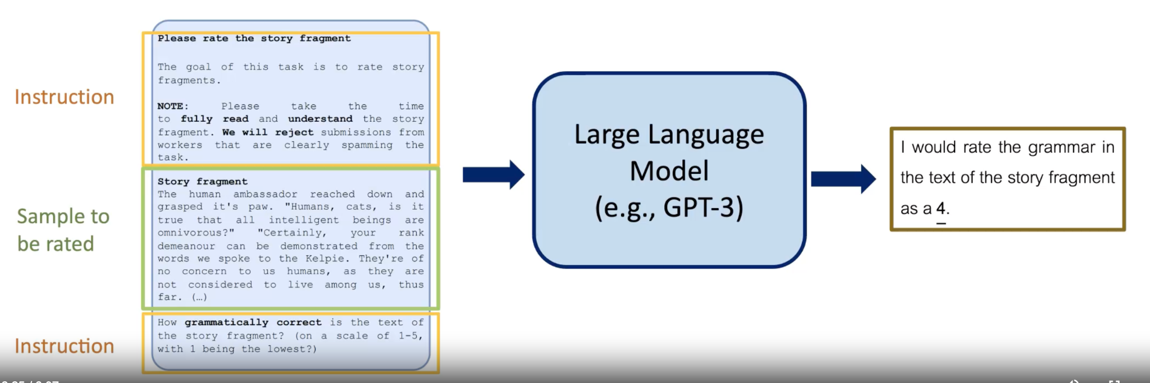
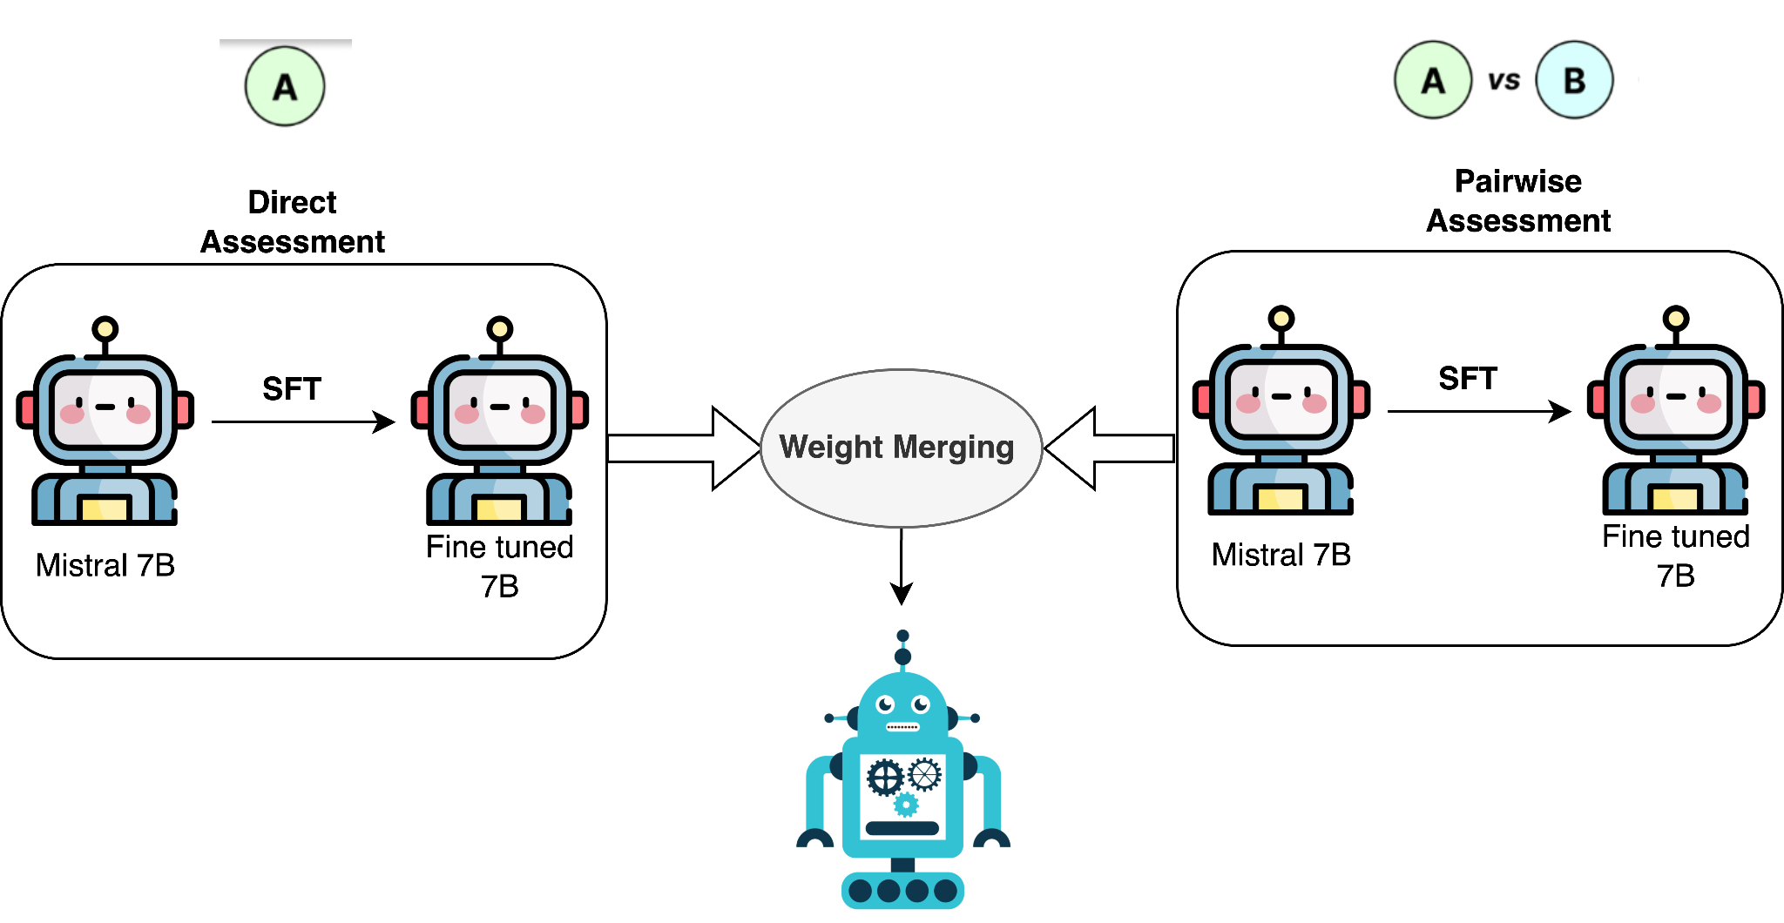
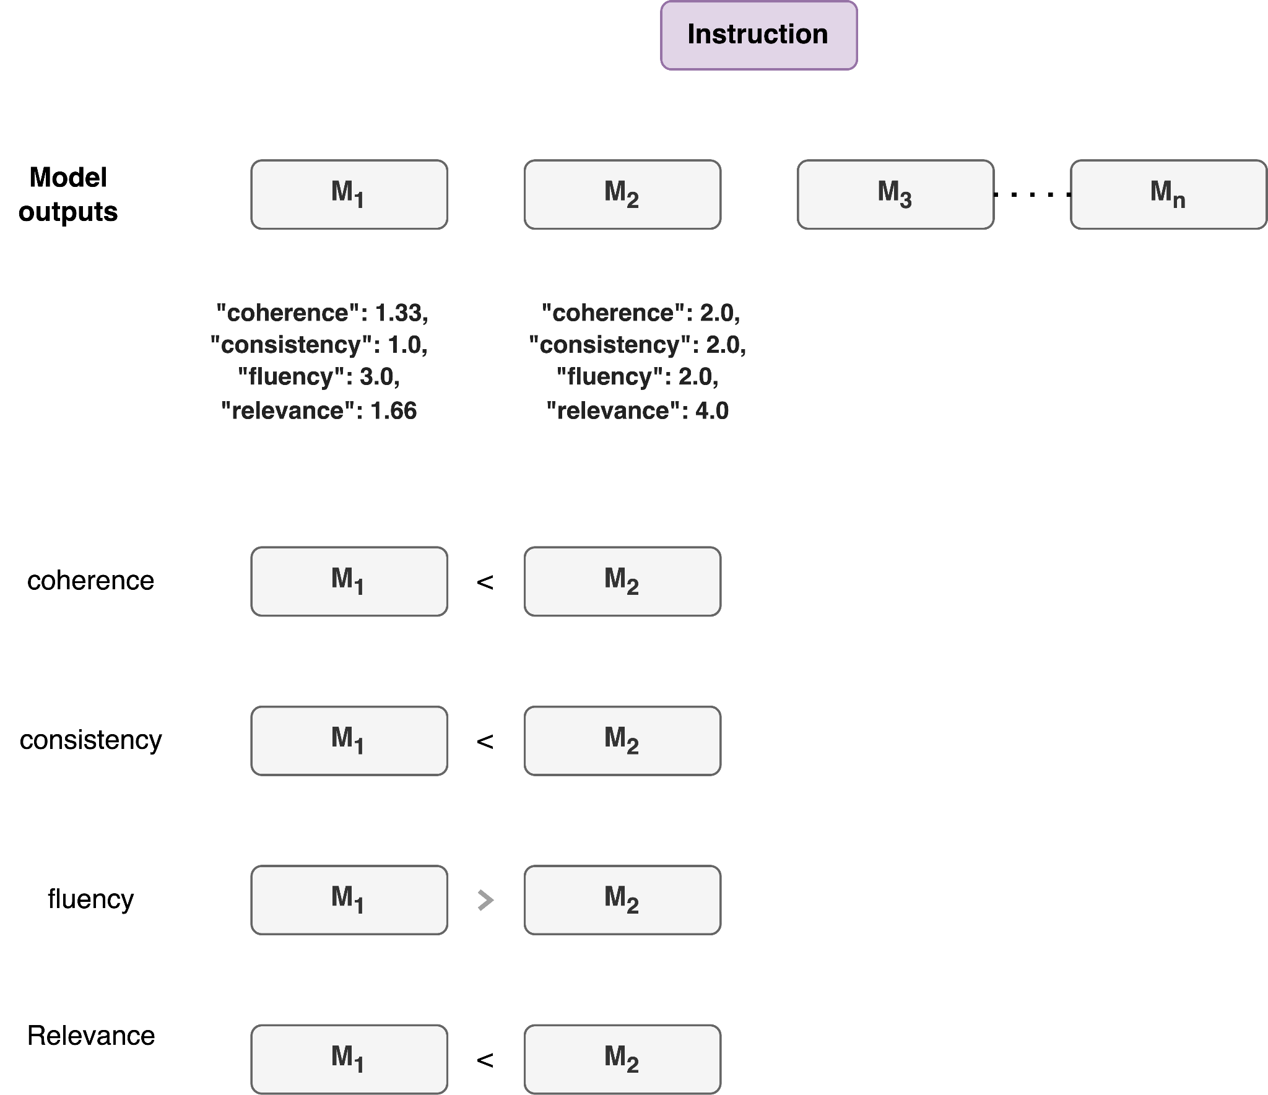
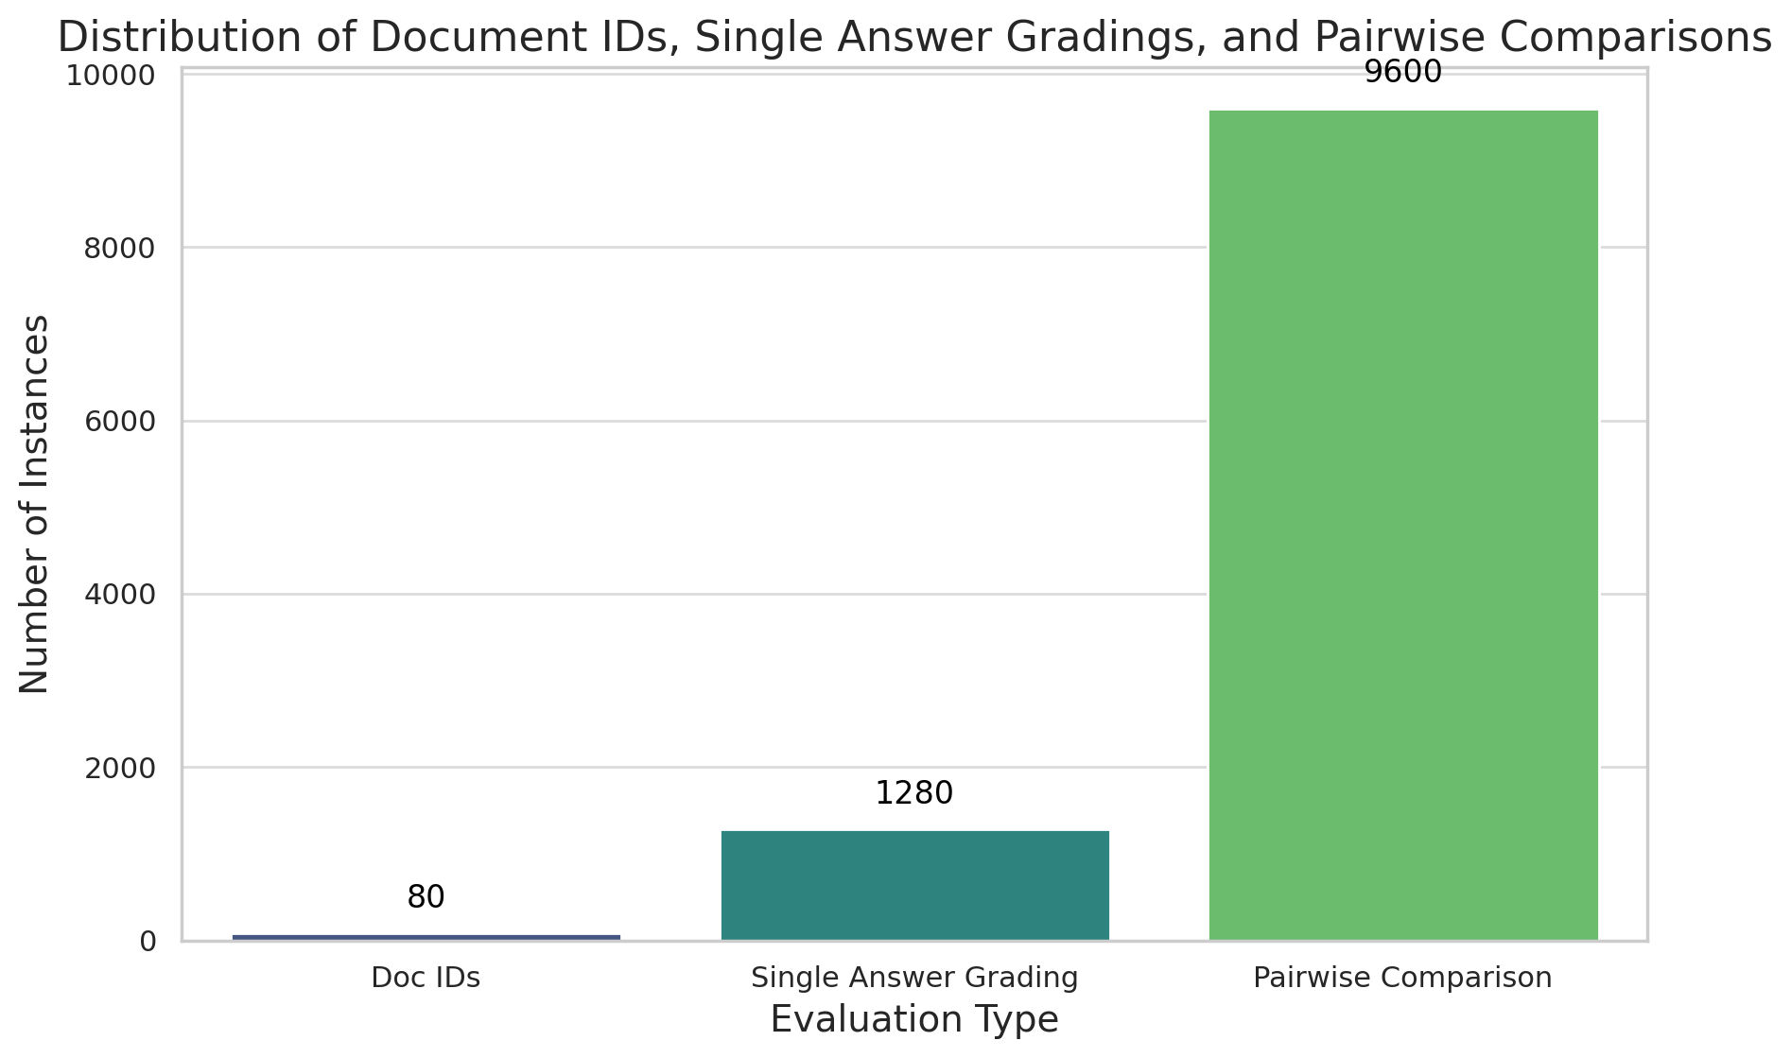
OFLMEval: An Open Source Language Model
with Better Finegrained Human Alignment
RFEST
2024
Problem Definition and Motivation
Human evaluation is costly, time consuming and is hard to reproduce.
Existing works (GPTEval, GPTScore, etc) use GPT-4 as an evaluators but challenges:-
Data Exposure
Transparency
Unpredictable API changes
controllability, and affordability
Aim: To build a strong Open source Language model for fine-grained evaluation of language models
Dataset
Methodology
SummEval is a benchmark that compares different evaluation methods or summarization.
It gives human ratings for four aspects of each summary: fluency, coherence, consistency and relevance.
It is built on the CNN/DailyMail dataset (Hermann et al., 2015)
Experimental Results
Fluency | Pearson | Spearman | Kendall
GPT-4 | 0.5924 | 0.5058 | 0.4554
Llama 70B | 0.5812 | 0.4823 | 0.4346
Llama3-8b | 0.2581 | 0.2217 | 0.2052
Llama3-8b (CoT) | 0.2474 | 0.2294 | 0.2123
Mistral 7b | 0.4067 | 0.3614 | 0.341
Mistral 7b (IFT) | 0.4239 | 0.3712 | 0.3761
Mistral 7b (IFT) + WM | 0.4451 | 0.3872 | 0.3892
Relevance
GPT-4 | 0.5882 | 0.5636 | 0.4529
Llama 70B | 0.509 | 0.4736 | 0.4168
Llama3-8b | 0.3638 | 0.3441 | 0.3003
Mistral 7b | 0.3935 | 0.3647 | 0.3192
Mistral 7b (IFT) | 0.4123 | 0.3711 | 0.3201
Mistral 7b (IFT) + WM | 0.4311 | 0.3812 | 0.333
Consistency
GPT-4 | 0.5906 | 0.5007 | 0.4199
Llama 70B | 0.6806 | 0.5949 | 0.5693
Llama3-8b | 0.5147 | 0.4361 | 0.4167
Llama3-8b (CoT) | 0.5061 | 0.4229 | 0.4019
Mistral 7b | 0.4306 | 0.4207 | 0.4046
Mistral 7b (IFT) | 0.4531 | 0.4421 | 0.4547
Mistral 7b (IFT) + WM | 0.4628 | 0.4512 | 04581
Coherence
GPT-4 | 0.5851 | 0.5711 | 0.4626
Llama 70B | 0.5777 | 0.5723 | 0.4985
Llama3-8b | 0.3518 | 0.3435 | 0.296
Llama3-8b (CoT) | 0.3089 | 0.3065 | 0.2647
Mistral 7b | 0.367 | 0.3665 | 0.3131
Mistral 7b (IFT) | 0.388 | 0.3711 | 0.3201
Mistral 7b IFT + WM | 0.376 | 0.3861 | 0.3411
Contact information: Sandeep Kumar | Team: Natural Language Intelligence

