Slide 1
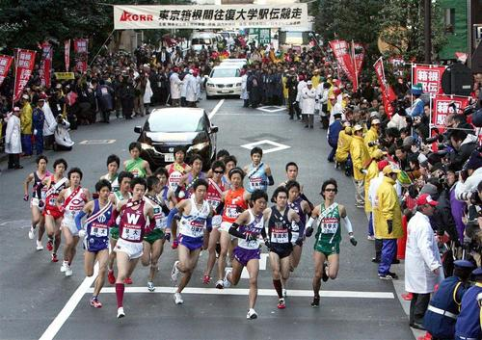
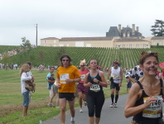

Ekiden Relay Running in Bangalore
Celebrating 60 years of the diplomatic relations between INDIA and JAPAN
We Japanese Chamber of Commerce and Industry Bangalore
(JCCIB) and Bangalore Japanese Association (BJA) is
planning to taking place “Ekiden” jointly Indian and Japanese
in Bangalore to celebrate 60 yeas of the diplomatic relations.

Slide 2
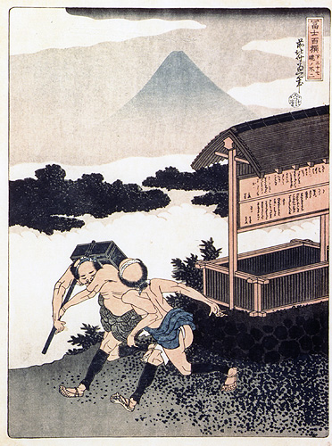
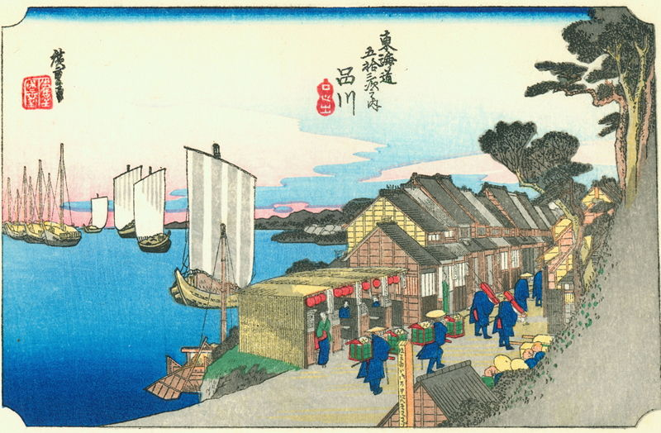
What is “Ekiden”?
・Ekiden is a term referring to a long-distance
relay running race, typically on roads.
・The Japanese term originally referred to a
post-horse or stagecoach which transmitted
communication by stages.
・As written in Japanese, Ekiden combines the
characters for "station" (Eki) and "transmit"
(Den).
・Communication and transportation
system in which stations were posted
at intervals along the road.
In the race, each runner on a team runs
the distance from one "station" to the next,
and then hands off a Tasuki, to the next
runner.

Slide 3
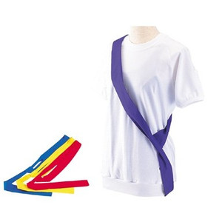
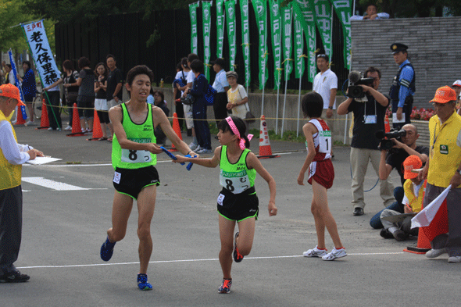
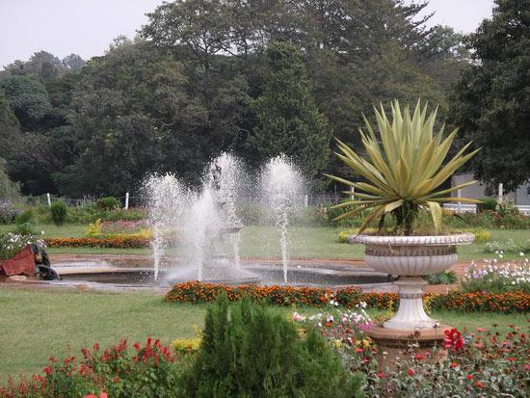
What is “Tasuki”?
Tasuki is a sort of sash that is used to hold
up the sleeves of “Kimono”.
For the purpose of smoothly running, we use
Tasuki instead of the Baton in Ekiden.
Why we want to hold “Ekiden” for celebrating 60 yeas of the diplomatic relations?
・Handing Tasuki to the next runner = Symbol
of the Team work.
・Flexibility in setting course = We can set the
course showing off Healthiness, Comfortableness
and Greatness of Bangalore to Japan.
･Different from the marathon race, we can
see very often the runner from behind to the
top, because of the difference in each
runner’s running ability.=Exciting

Slide 4
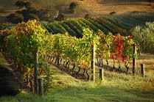
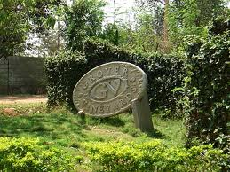
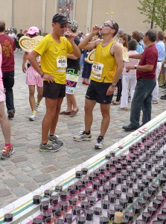
Running Course Selection
We want to show off good points of
Bangalore to Japan by the setting
course beautiful or grate place in
Bangalore.
-Course Images we are seeking-
＜Venue＞
Running inside or beside the famous
Bangalore company to show off
greatness and beauty of Bangalore.
1.Running rural landscape nearby the winery of
Grover and reach the finish line in the winery.
Toast wines and realize again the beautiful
nature and tasty wine of the Bangalore each
other.
ワイナリー写真

Slide 5
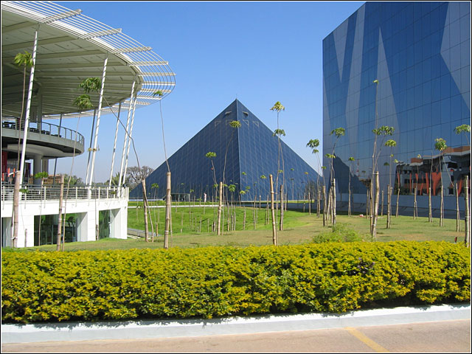

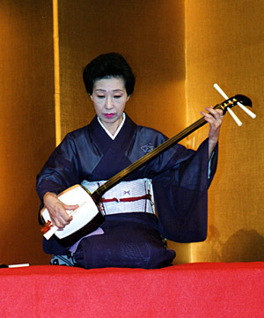
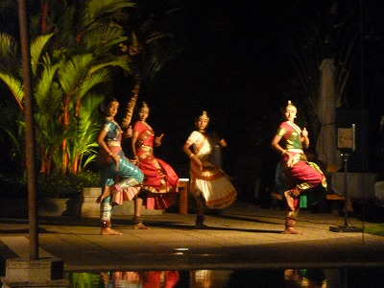
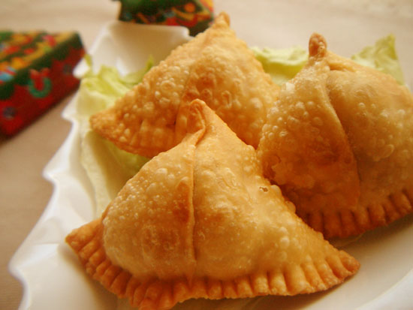
2. Running inside the premises of typical
Indian company like Infosys or Wipro to
realize again the greatness of the
Bangalore.
<Others>
1.Prepare Japanese and Indian
snacks in the relay point or goal
to exchange the food culture.
2.Prepare Indian wines and toast between Indian and Japanese.
3.Introducing each culture like dance/music at the goal point.

Slide 6
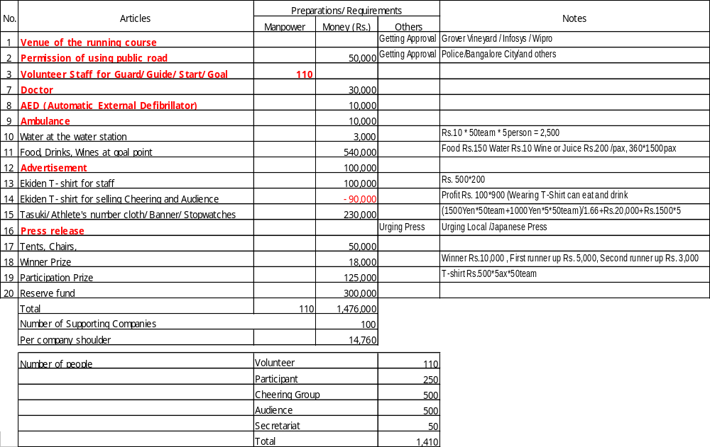
Expected Things to Prepare for Ekiden Running

