Slide 1

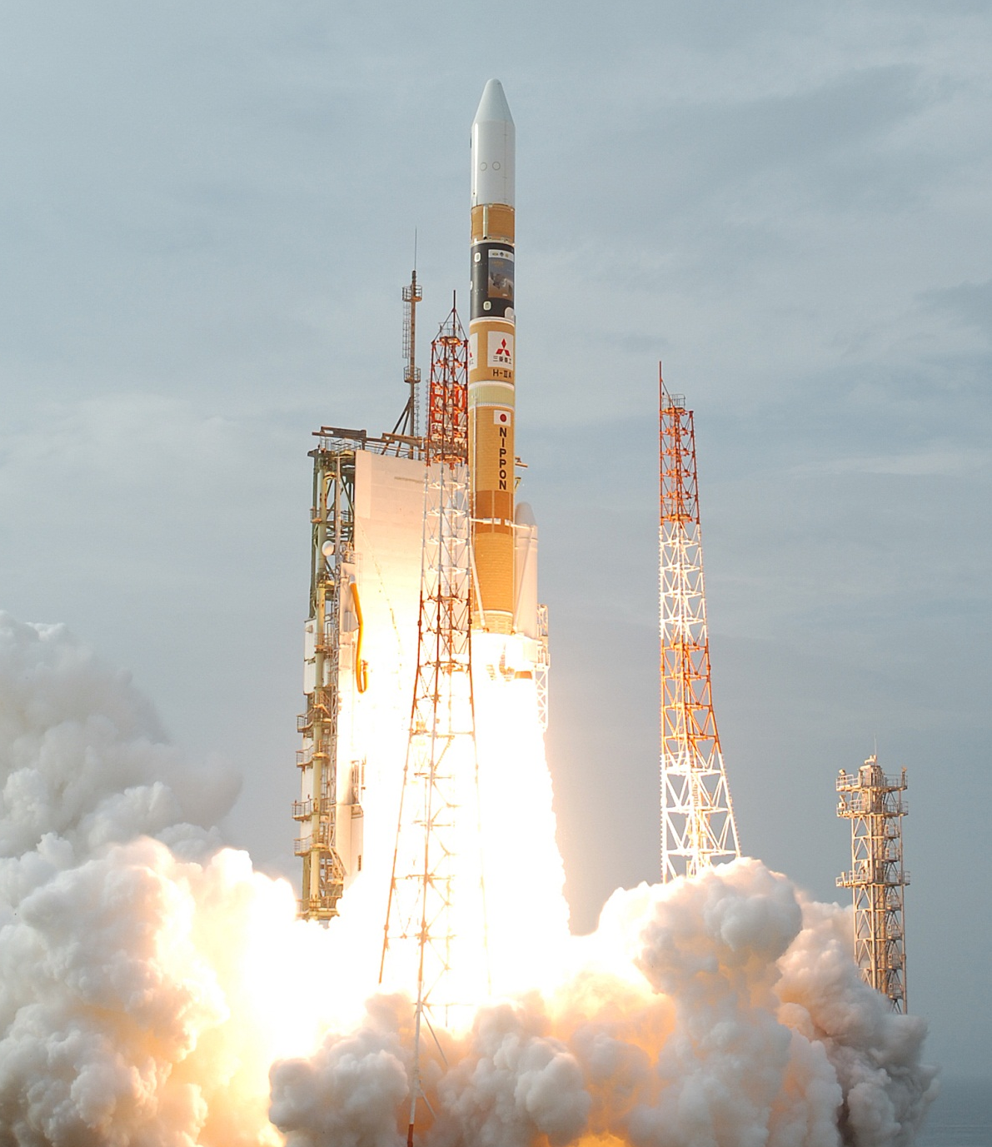




STUDY IN ENGLISH AT JAPANESE UNIVERSITIES
JAPAN EDUCATION FAIR 2012
Saturday, September 1, 2012 10:00 am – 5:00 pm
Vivanta by Taj (Trinity Hall), M.G. Road, Bangalore
1. Program: Individual consultation at each university’s booth, Presentation on universities, Indo Japan Networking Symposium
2. Guest and Host:
Chief Guest: Prof. K. VijayRaghavan, F.R.S Director, NCBS
Host: Prof. Masashi Haneda, Vice President, UT
3. Participating Universities:
Tohoku Univ., Univ. of Tsukuba, Nagoya Univ., Osaka Univ., Kyushu Univ., Meiji Univ., Waseda Univ., Doshisha Univ., Ritsumeikan Univ., and the Univ. of Tokyo (Keio, Kyoto Sophia and other universities will display brochures)
4. Registration
(This event is free, but pre-registration required):
Please register at G30 website: www.uni.international.mext.go.jp/
5. Further enquiries: shivanigk0@gmail.com
(The University of Tokyo India Office)
Supported by:
Photograph provided by Mitsubishi Heavy Industries India Pvt. Ltd.
Host:
Photo by Central Japan Railway Company

