Slide 1

2015年2月度インフラ委員会
インドのインフラ整備の概要について
2015年2月11日
JETRO様バンガロール事務所にて

Slide 2
2月度ゲストスピーカー
Pricewaterhouse Coopers
尻引 様
平川 様
Ashish Chandra 様

Slide 3
インフラストラクチャーへの民間投資状況
–
…new power generation capacity
% of total MW added during first 2 years of 12th plan
Private capacity ~45% during 11th plan
~60%
…airport passenger traffic
% of total passenger traffic handled by airports operated by private operator during FY14
~57%
Cargo movement by private ports & terminals….
As % of total cargo handled
~45%
Roads (National highways)…
PPP projects as % of total (km) in last 5 years
~97%
5

Slide 4
インフラ投資額は増えてきているが、経済発展のためには さらなる大規模投資が必要
–
Increasing trend in Investment as % of GDP during 11th plan
However, slowdown in investments during 12th plan
New government growth agenda focused on manufacturing and infrastructure
Total Infra Spend
29%
36%
Private investments
Source: The High Level Committee on Financing Infrastructure, PwC Analysis
9

Slide 5
ビジネス環境の緩和・インフラ整備に注力する
–
Emphasis on Ease of Doing Business
Intent to boost manufacturing
Fast tracking clearances and approvals
Rail, road projects cleared for outstanding issues
Easing infrastructure financing
Flexibility to extend tenure
High priority programs
Industrial corridors
Smart Cities
Railway reforms
Solar energy projects
FDI in construction
製造業の活性化
承認、クリアランス取得プロセスの加速
インフラプロジェクトのファイナンス課題の解決
注力するプログラム
10

Slide 6
2012-2017年のインフラ計画では、 1兆USD規模の投資を必要としている
–
Major & non-major ports capacity addition of over 1000 MT
Upgradation of 30 functional airports
Addition of new airports such as
Navi Mumbai Airport
Goa Airport
Kannur Airport
88 GW
30 GW
95 MMTPA
Capacity Additions
14 mn Rolling stock requirement
4000 km new lines
Western & Eastern DFC
7600 km of Doubling
Electrification of 6500 km line
Energy (35%)
Transport (33%)
Source: Planning Commission – Twelfth Five Year Plan (2012-2017), Published in 2013
Slow pace of growth - 70% of the required investment achieved during 2012-13
Pace of investment growth is expected to ramp up rapidly FY 15 onwards
* Planning Commission – Annual Report 2013-14
11

Slide 7
インフラ整備に関する問題点
–
Factors resulting in project stress (based on a sample of 95 stressed National Highway projects)
Land acquisition and project clearances have caused severe delays in the past
Several projects have achieved permits & clearances in the recent past. Approval processes under review
Project readiness can vary widely across different States
Choice of Sectors / States to pursue key to optimal use of time and effort
Source: Credit Rationale by Independent credit rating agencies, Primary interactions, PwC Analysis
Typical issues
用地買収
環境問題・森林伐採
インド国鉄からの高架化の認可
住民の移住・施設の移設
採石場等からの許可など
13

Slide 8
工業化推進の柱
産業回廊
スマートシティ
道路整備
港湾整備
空港整備
電力供給

Slide 9
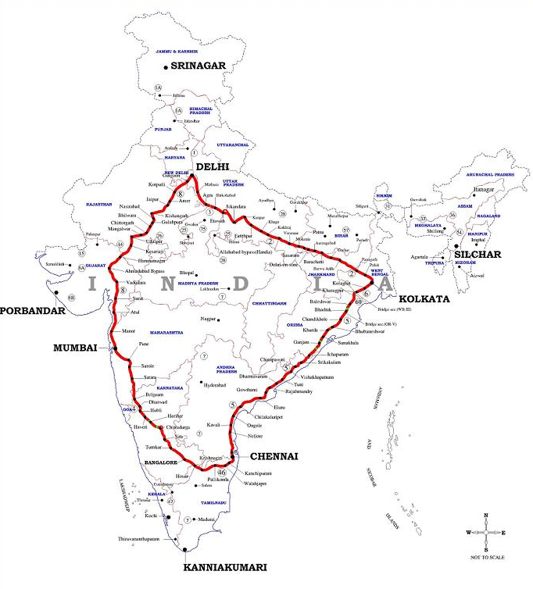
Corridor development to play an important in achieving the Manufacturing Vision for the Country
産業回廊
DIPP’s Vision
National Manufacturing Plan
Make in India
Increase manufacturing share from 16% to 25% of GDP
Target 15% annual growth over med-term
100 million additional jobs by 2022
Skill Development among rural migrant and urban poor
Increase domestic value addition by increasing technology penetration
Enhance global competitiveness through policy support
Ensure sustainability of growth
Facilitate investment, foster innovation, enhance skill development, protect intellectual property, and build best-in-class manufacturing infrastructure.
Amritsar- Delhi-Kolkata Industrial Corridor
Delhi-Mumbai Industrial Corridor
Bengaluru-Mumbai Economic Corridor
Chennai-Bengaluru Industrial Corridor
4つの産業回廊が計画されている

Slide 10
CBIC(Chennai Bengaluru Industrial Corridor) における重点産業開発地域
産業回廊
Comprehensive Master Plan for each Node
Industry Enablers and Factors of Production
Economic and Financial Feasibility of Nodes
Investment Environment Improvement
Krishnapatnam, Andhra Pradesh
Tumakuru
3
2
1
Ponneri,
Tamil Nadu

Slide 11
スマートシティ構想
Smart Cities* platform is being used to accelerate Urbanisation
–
都市エリア
Naya Raipur
AP capital
Varanasi
SEZ開発
Lavassa
Lodha
Wave City
Mahindra World
Airports/Large Hospitals
Industrial Corridors
CBIC
BMEC
VCIC
DMIC
Mumbai / Delhi / Bangalore
①
②
③
Mumbai Surveillance | Ahmedabad Metro | Hyderabad ITS | Delhi GIS
20

Slide 12
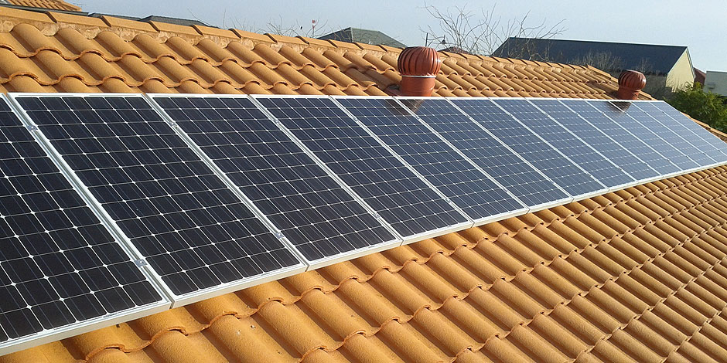
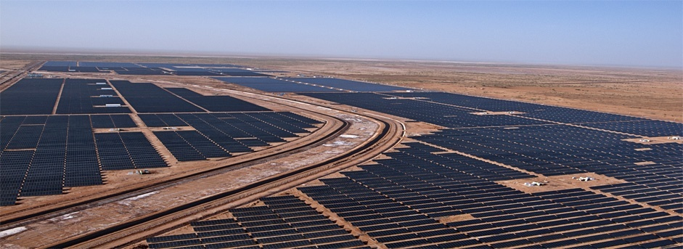
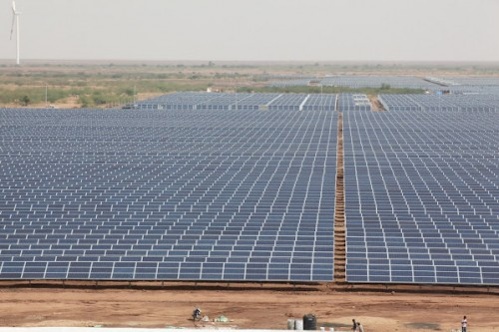
Scaling up solar energy – 100GW aimed by FY 20
再生エネルギープロジェクト
–
25
28
18
22
7
Category 1. Rooftop Projects
(< 1 MW per project)
Category 2. Large scale Grid connected (1 MW – 500 MW project)
Category 3. Ultra Mega Power Projects (>500 MW)
40,000 MW
40,000 MW
20,000 MW
Projects under both Net Metering and Gross Metering
SECI has already identified several cities and developers have been selected
Solar parks set up in Charanka (Gujarat, 500 MW) and Bhadla (Rajasthan, 3000 MW)
Other solar parks planned in more than 5 states.
Projects planned in Sambhar (Rajasthan)- 4000 MW,Kharaghoda (Gujarat)- 4000 MW, Kargil and Leh- 7000 MW
Focus on utilising wastelands
High level of project readiness. But, competition is also intense
27

Slide 13
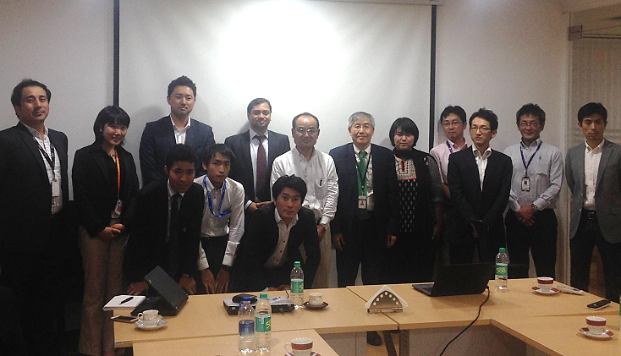
当日、ご出席いただきました皆様

Slide 14
ありがとうございました

