Slide 1
Decision Tree

Slide 2
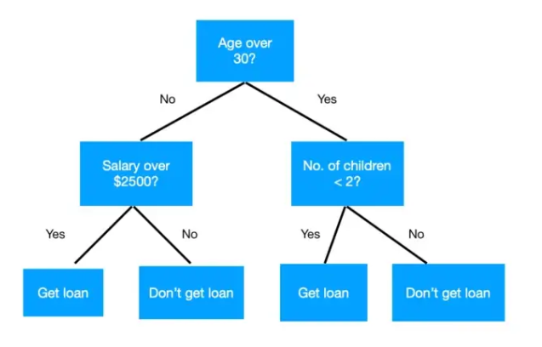
What is a Decision Tree?
Decision tree as the name suggests it is a flow like a tree structure that works on the principle of conditions. It is efficient and has strong algorithms used for predictive analysis. It has mainly attributes that include internal nodes, branches and a terminal node.
It is used for both classifications as well as regression. It is often termed as “CART” that means Classification and Regression Tree. Tree algorithms are always preferred due to stability and reliability.
It’s similar to the Tree Data Structure, which has a root, and multiple other types of nodes (parent, child, and leaf).
In the following example, we’ve to approve a loan on the basis of the age, salary, and no. of children the person has. We ask a conditional question at each node and make splits accordingly, till we reach a decision at the leaf node (i.e get loan/don’t get loan).

Slide 3
Advantages
They have high interpretability, which makes them the go-to algorithm for real-world business applications. They can be explained as a series of questions/ if-else statements.
The time required to make predictions is very less. It’s just the evaluation of a particular set of conditions for a given data point.
No missing value imputation is required as the algorithm adapts accordingly.
Disadvantages
They are unstable. A small change in data can lead to a vastly different decision tree.
They are often relatively inaccurate and prone to overfitting. This can be rectified by replacing a single decision tree with a random forest of decision trees.

Slide 4
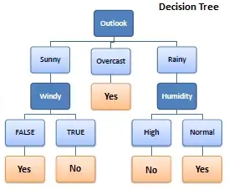
Let’s try to build intuition by using an example. We’ll take a very popular one, where we have to decide whether we can play golf (target) on a particular day or not, based on the given weather conditions (predictors).

Slide 5

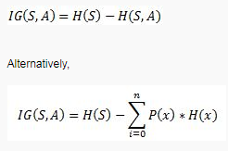

Entropy
In machine learning, entropy is a measure of the randomness in the information being processed. The higher the entropy, the harder it is to draw any conclusions from that information.
Information Gain
Information gain can be defined as the amount of information gained about a random variable or signal from observing another random variable. It can be considered as the difference between the entropy of parent node and weighted average entropy of child nodes.
Gini Impurity
Gini impurity is a measure of how often a randomly chosen element from the set would be incorrectly labeled if it was randomly labeled according to the distribution of labels in the subset.

Slide 6
Here There are for independent variables to determine the dependent variable. The independent variables are Outlook, Temperature, Humidity, and Wind. The dependent variable is whether to play football or not.
As the first step, we have to find the parent node for our decision tree. For that follow the steps:
Find the entropy of the class variable.
E(S) = -[(9/14)log(9/14) + (5/14)log(5/14)] = 0.9 4

Slide 7
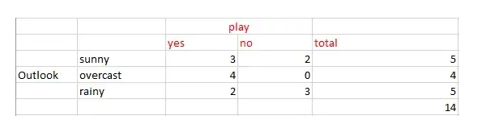
note: Here typically we will take log to base 2.Here total there are 14 yes/no. Out of which 9 yes and 5 no.Based on it we calculated probability above.
From the above data for outlook we can arrive at the following table easily
Now we have to calculate average weighted entropy. ie, we have found the total of weights of each feature multiplied by probabilities.
E(S, outlook) = (5/14)*E(3,2) + (4/14)*E(4,0) + (5/14)*E(2,3) = (5/14)(-(3/5)log(3/5)-(2/5)log(2/5))+ (4/14)(0) + (5/14)((2/5)log(2/5)-(3/5)log(3/5)) = 0.693

Slide 8
The next step is to find the information gain. It is the difference between parent entropy and average weighted entropy we found above.
IG(S, outlook) = 0.94 - 0.693 = 0.247
Similarly find Information gain for Temperature, Humidity, and Windy.
IG(S, Temperature) = 0.940 - 0.911 = 0.029
IG(S, Humidity) = 0.940 - 0.788 = 0.152
IG(S, Windy) = 0.940 - 0.8932 = 0.048
Now select the feature having the largest entropy gain. Here it is Outlook. So it forms the first node(root node) of our decision tree.

Slide 9
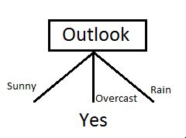
Now our data look as follows
Since overcast contains only examples of class ‘Yes’ we can set it as yes. That means If outlook is overcast football will be played. Now our decision tree looks as follows.

Slide 10
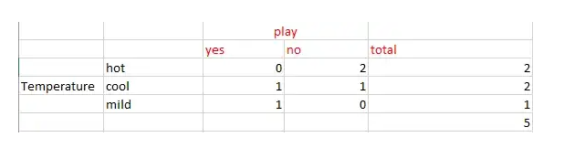
The next step is to find the next node in our decision tree. Now we will find one under sunny. We have to determine which of the following Temperature, Humidity or Wind has higher information gain.
Calculate parent entropy E(sunny)
E(sunny) = (-(3/5)log(3/5)-(2/5)log(2/5)) = 0.971.
Now Calculate the information gain of Temperature. IG(sunny, Temperature)

Slide 11
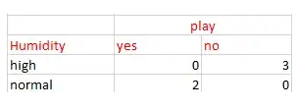
E(sunny, Temperature) = (2/5)*E(0,2) + (2/5)*E(1,1) + (1/5)*E(1,0)=2/5=0.4
Now calculate information gain.
IG(sunny, Temperature) = 0.971–0.4 =0.571
Similarly we get
IG(sunny, Humidity) = 0.971
IG(sunny, Windy) = 0.020
Here IG(sunny, Humidity) is the largest value. So Humidity is the node that comes under sunny.
For humidity from the above table, we can say that play will occur if humidity is normal and will not occur if it is high. Similarly, find the nodes under rainy.
Note: A branch with entropy more than 0 needs further splitting.

Slide 12
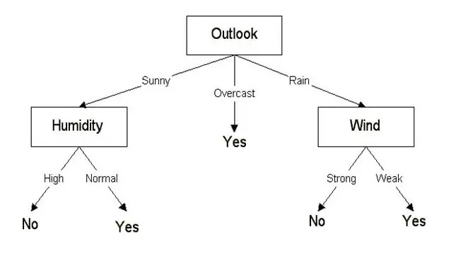
Finally, our decision tree will look as below:

Slide 13
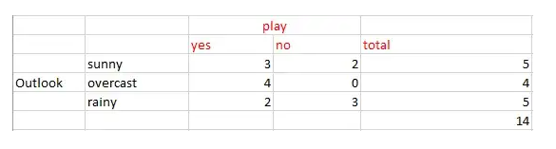
Classification using CART algorithm
Classification using CART is similar to it. But instead of entropy, we use Gini impurity.
So as the first step we will find the root node of our decision tree. For that Calculate the Gini index of the class variable
Gini(S) = 1 - [(9/14)² + (5/14)²] = 0.4591
As the next step, we will calculate the Gini gain. For that first, we will find the average weighted Gini impurity of Outlook, Temperature, Humidity, and Windy.
First, consider case of Outlook
Gini(S, outlook) = (5/14)gini(3,2) + (4/14)*gini(4,0)+ (5/14)*gini(2,3) = (5/14)(1 - (3/5)² - (2/5)²) + (4/14)*0 + (5/14)(1 - (2/5)² - (3/5)²)= 0.171+0+0.171 = 0.342
Gini gain (S, outlook) = 0.459 - 0.342 = 0.117
Gini gain(S, Temperature) = 0.459 - 0.4405 = 0.0185
Gini gain(S, Humidity) = 0.459 - 0.3674 = 0.0916
Gini gain(S, windy) = 0.459 - 0.4286 = 0.0304
Choose one that has a higher Gini gain. Gini gain is higher for outlook. So we can choose it as our root node.

Slide 14
train = pd.read_csv('/kaggle/input/bank-loan2/madfhantr.csv')
train.isnull().sum()
train.dropna(inplace=True)
NOTE: The decision tree does not support categorical data as features.
# I selected few of the columns from the dataset for this tutorial
train = train[['Gender','Married','Education','Self_Employed','Credit_History','Loan_Status']]
train['Gender']=train['Gender'].replace(to_replace='Male',value='1')
train['Gender']=train['Gender'].replace(to_replace='Female',value='0')
train['Married']=train['Married'].replace(to_replace='Yes',value='1')
train['Married']=train['Married'].replace(to_replace='No',value='0')
train['Self_Employed']=train['Self_Employed'].replace(to_replace='No',value='0')
train['Self_Employed']=train['Self_Employed'].replace(to_replace='Yes',value='1')
train['Education']=train['Education'].replace(to_replace='Graduate',value='1')
train['Education']=train['Education'].replace(to_replace='Not Graduate',value='0')

Slide 15
X = train.drop(columns=['Loan_Status'])
y = train.Loan_Status
from sklearn.model_selection import train_test_split
X_train,X_test,y_train,y_test = train_test_split(X,y,test_size=0.3,random_state=42)
from sklearn.tree import DecisionTreeClassifier
from sklearn import tree
clf = tree.DecisionTreeClassifier(max_depth=3)
clf.fit(X_train,y_train)

Slide 16
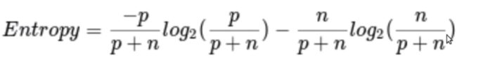

Before we visualize the tree, let us do some calculations and find out the root node by using Entropy.
Calculation 1: Find the Entropy of the total dataset
p = no of positive cases(Loan_Status accepted)
n = number of negative cases(Loan_Status not accepted)
In the data set, we have
p = 332 , n=148, p+n=480

Slide 17
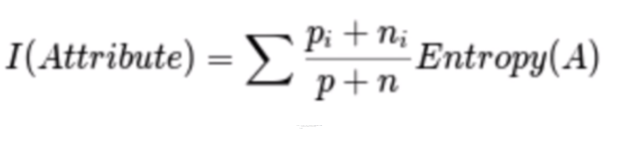
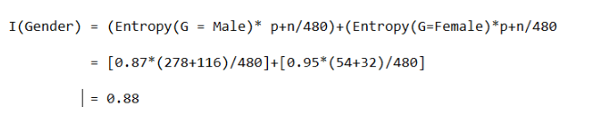
Calculation 2: Now find the Entropy and gain for every column
1) Gender Column
There are two types in this male(1) and female(0)
Condition 1: Male
data-set with all male’s in it and then,
p = 278, n=116 , p+n=489
Entropy(G=Male) = 0.87
Condition 2: Female
data-set with all female’s in it and then,
p = 54 , n = 32 , p+n = 86
Entropy(G=Female) = 0.95
Average Information in Gender column is

Slide 18
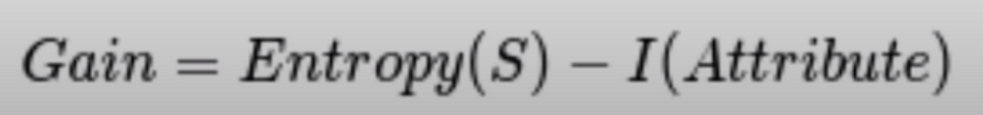
Gain(Gender) = E(s) — I(Gender)
Gain = 0.89–0.88
Gain = 0.001

Slide 19
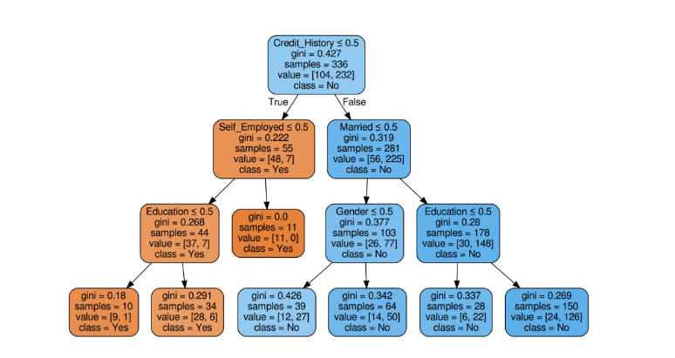

Slide 20

2) Married Column
Condition 1: Married = Yes(1)
In this split the whole data-set with Married status yes
p = 227 , n = 84 , p+n = 311
E(Married = Yes) = 0.84
Condition 2: Married = No(0)
In this split the whole data-set with Married status no
p = 105 , n = 64 , p+n = 169
E(Married = No) = 0.957
Average Information in Married column is
Gain = 0.89–0.88 = 0.001

Slide 21
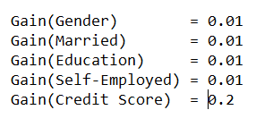
3) Education Column
4) Self-Employed Column
5) Credit Score Column
Compare all the Gain values

Slide 22
import graphviz
dot_data = tree.export_graphviz(clf, out_file=None,
feature_names=['Gender','Married','Education','Self_Employed','Credit_History'],
class_names=['Yes','No'],filled=True,
rounded=True,
special_characters=True)
graph = graphviz.Source(dot_data)
graph.render("Gini")
graph
clf.score(X_test,y_test)
#output = 0.7986111111111112

