Slide 1
Random Forest

Slide 2
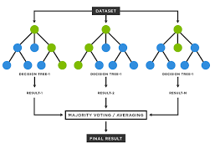
Random forest is a Supervised Machine Learning Algorithm that is used widely in Classification and Regression problems. It builds decision trees on different samples and takes their majority vote for classification and average in case of regression.

Slide 3
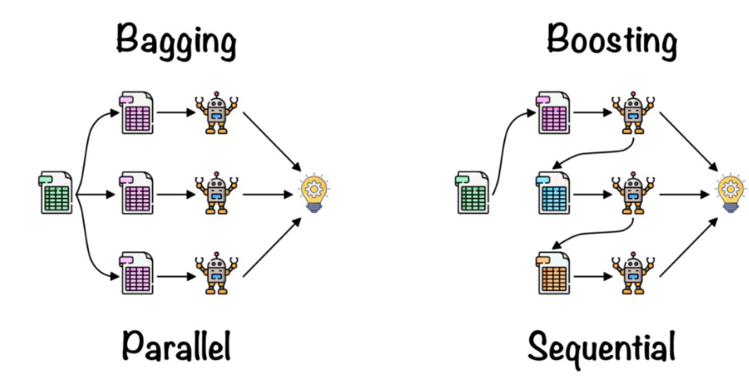
1. Bagging– It creates a different training subset from sample training data with replacement & the final output is based on majority voting. For example, Random Forest.
2. Boosting– It combines weak learners into strong learners by creating sequential models such that the final model has the highest accuracy. For example, ADA BOOST, XG BOOST

Slide 4
Bagging
Bagging, also known as Bootstrap Aggregation is the ensemble technique used by random forest. Bagging chooses a random sample from the data set. Hence each model is generated from the samples (Bootstrap Samples) provided by the Original Data with replacement known as row sampling. This step of row sampling with replacement is called bootstrap. Now each model is trained independently which generates results. The final output is based on majority voting after combining the results of all models. This step which involves combining all the results and generating output based on majority voting is known as aggregation.
Steps involved in random forest algorithm:
Step 1: In Random forest n number of random records are taken from the data set having k number of records.
Step 2: Individual decision trees are constructed for each sample.
Step 3: Each decision tree will generate an output.
Step 4: Final output is considered based on Majority Voting or Averaging for Classification and regression respectively.

Slide 5
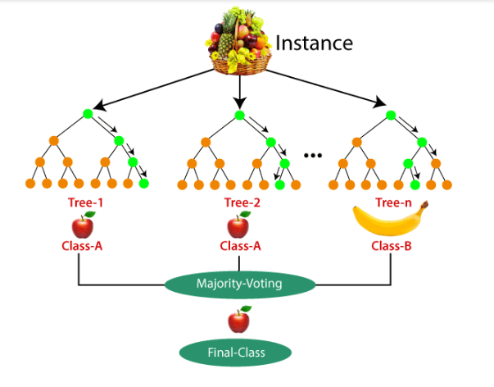
Important Features of Random Forest
1. Diversity- Not all attributes/variables/features are considered while making an individual tree, each tree is different.
2. Parallelization-Each tree is created independently out of different data and attributes. This means that we can make full use of the CPU to build random forests.
3. Train-Test split- In a random forest we don’t have to segregate the data for train and test as there will always be 30% of the data which is not seen by the decision tree.
4. Stability- Stability arises because the result is based on majority voting/ averaging.

Slide 6
Difference Between Decision Tree & Random Forest
Random forest is a collection of decision trees; still, there are a lot of differences in their behavior.
Decision trees | Random Forest
1. Decision trees normally suffer from the problem of overfitting if it’s allowed to grow without any control. | 1. Random forests are created from subsets of data and the final output is based on average or majority ranking and hence the problem of overfitting is taken care of.
2. A single decision tree is faster in computation. | 2. It is comparatively slower.
3. When a data set with features is taken as input by a decision tree it will formulate some set of rules to do prediction. | 3. Random forest randomly selects observations, builds a decision tree and the average result is taken.

Slide 7
Important Hyperparameters
Hyperparameters are used in random forests to either enhance the performance and predictive power of models or to make the model faster.
Following hyperparameters increases the predictive power:
1. n_estimators– number of trees the algorithm builds before averaging the predictions.
2. max_features– maximum number of features random forest considers splitting a node.
3. mini_sample_leaf– determines the minimum number of leaves required to split an internal node.
Following hyperparameters increases the speed:
1. n_jobs– it tells the engine how many processors it is allowed to use. If the value is 1, it can use only one processor but if the value is -1 there is no limit.
2. random_state– controls randomness of the sample. The model will always produce the same results if it has a definite value of random state and if it has been given the same hyperparameters and the same training data.
3. oob_score – OOB means out of the bag. It is a random forest cross-validation method. In this one-third of the sample is not used to train the data instead used to evaluate its performance. These samples are called out of bag samples.

Slide 8
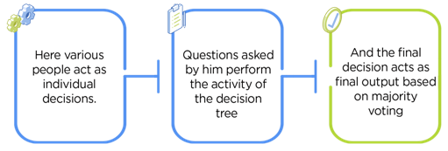

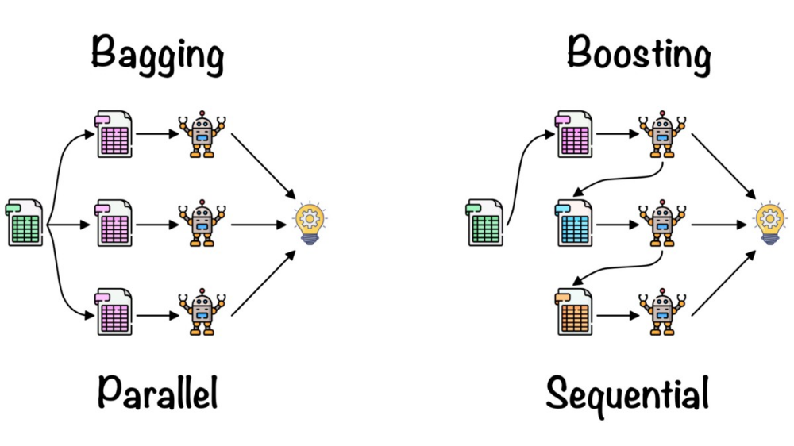
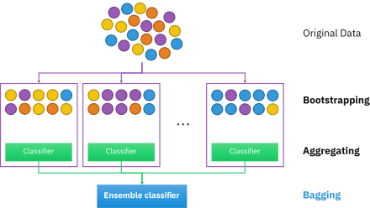
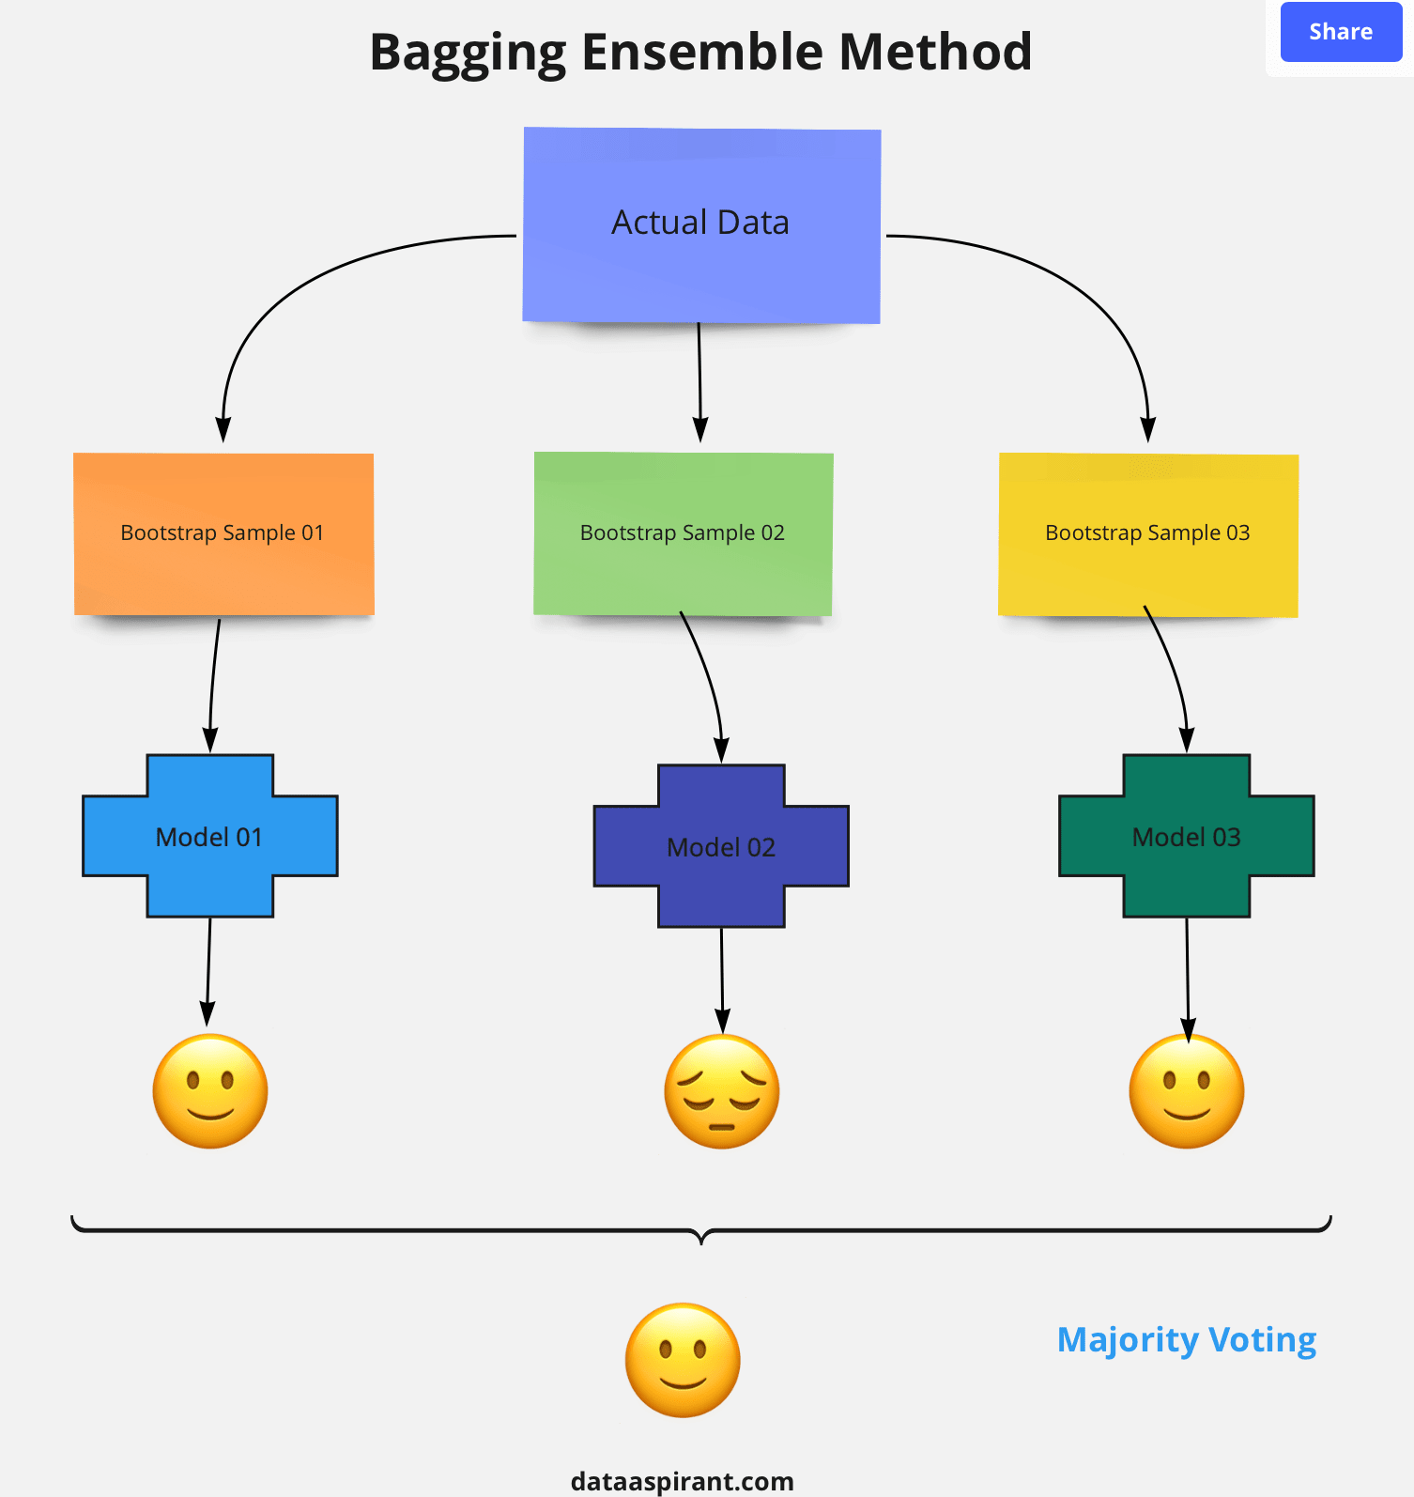
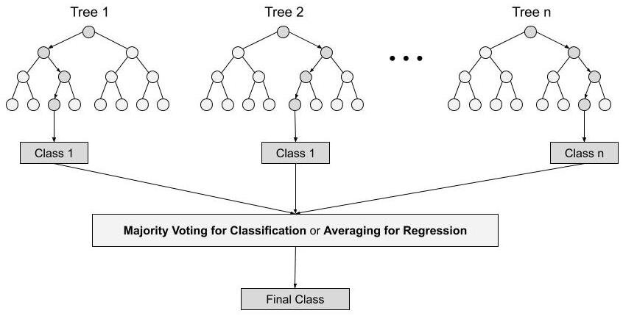
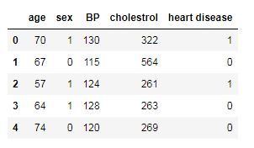
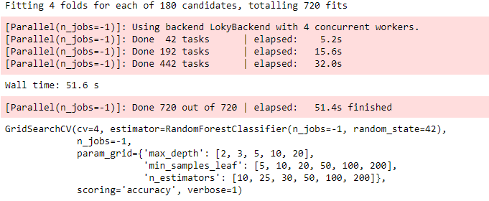
from sklearn.ensemble import RandomForestClassifier
classifier_rf = RandomForestClassifier(random_state=42, n_jobs=-1, max_depth=5,
n_estimators=100, oob_score=True)
feature_imp = pd.Series(classifer.feature_importances_,index=X.columns).sort_values(ascending=False)
feature_imp

Slide 9
Advantages of random forest
It can perform both regression and classification tasks.
A random forest produces good predictions that can be understood easily.
It can handle large datasets efficiently.
The random forest algorithm provides a higher level of accuracy in predicting outcomes over the decision tree algorithm.
Disadvantages of random forest
When using a random forest, more resources are required for computation.
It consumes more time compared to a decision tree algorithm.

Slide 10
Boosting Techniques

Slide 11
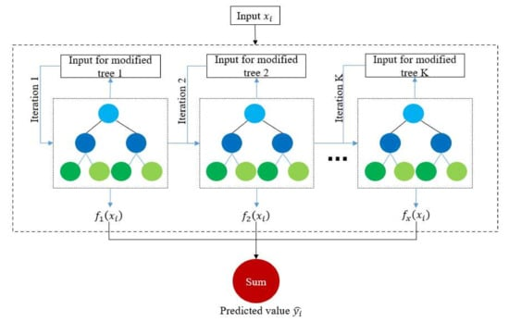
XGBoosting – Extreme Gradient Boosting
Ada Boost
Gradient Boost
from xgboost import XGBClassifier
xgbcl = XGBClassifier()
xgbcl.fit(X_train,y_train)

Slide 12
Pickling
Picknm = output_file+”_new_pickling”
saveObject = (xgbcl,X_columns_list,test_data_df)
with open(picknm,”wb”) as f:
pickle.dump(saveObject,f)
Loaded_model = pickle.load(open(ouput_file+”_new_pickling”,”rb”)

Slide 13
Naïve Bayes Classifier

Slide 14

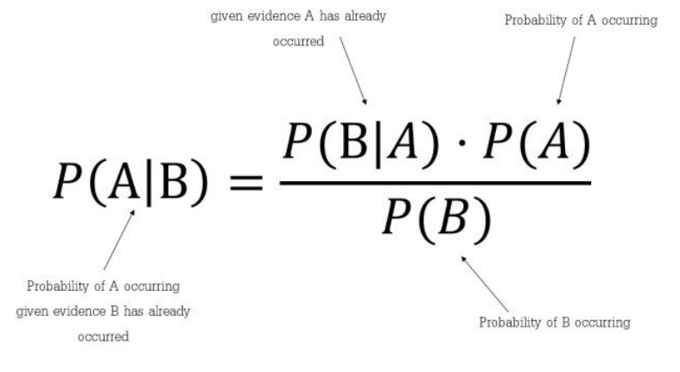
Used to predict the probability that the value of the output variable will fall in an interval for a given set of values of input or predictor variables
• Assigns each observation to the most likely class, given its predictor values
• Uses the conditional probability of P(y / x) for making prediction
Methodology
Assign a test observation with predictor vector x0 to the class j for which
is the largest
Which tells us: how often A happens given that B happens, written P(A|B) also called posterior probability, When we know: how often B happens given that A happens, written P(B|A) and how likely A is on its own, written P(A) and how likely B is on its own, written P(B).

Slide 15
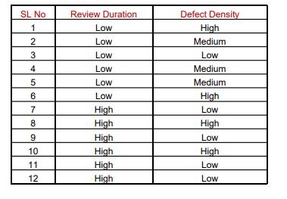
Example : The data on code review duration and defect density obtained for 10 code reviews are given below. Predict the defect density for review duration = Low using Naïve Bayes classifier?
Predict y given x = Low
P(y = Low / x = Low)
= Number of cases when both x & y are Low / Number of cases x is Low = 1/6 = 0.17
P(y = Medium / x = Low)
= Number of cases both x is Low and y is Medium / Number of cases x is Low = 3/6 = 0.50
P(y = High / x = Low)
= Number of cases both x is Low and y is Medium / Number of cases x is Low = 2/6 = 0.33

Slide 16
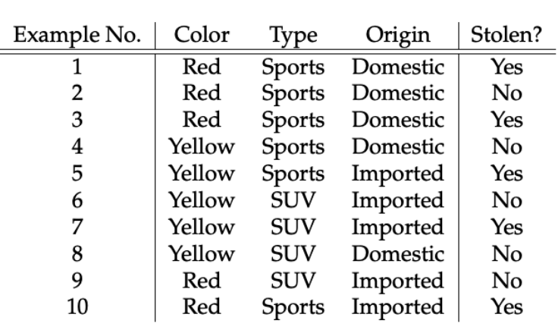
Concerning our dataset, the concept of assumptions made by the algorithm can be understood as:
We assume that no pair of features are dependent. For example, the color being ‘Red’ has nothing to do with the Type or the Origin of the car. Hence, the features are assumed to be Independent.
Secondly, each feature is given the same influence(or importance). For example, knowing the only Color and Type alone can’t predict the outcome perfectly. So none of the attributes are irrelevant and assumed to be contributing Equally to the outcome.

Slide 17
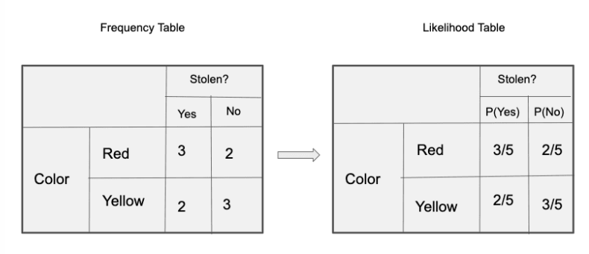
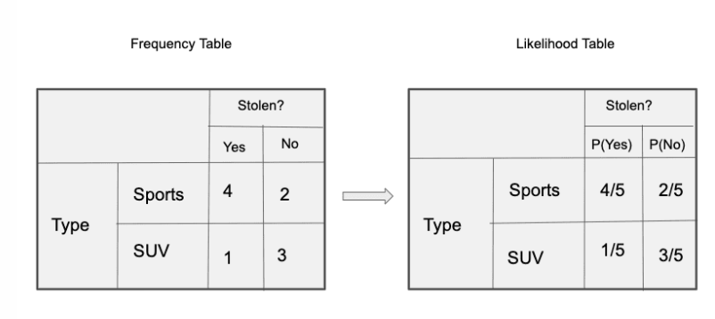

Slide 18
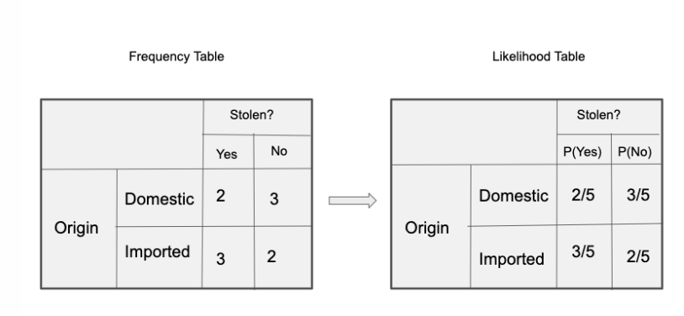
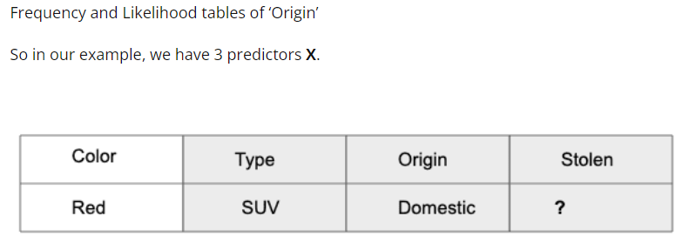

Slide 19
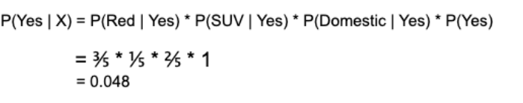

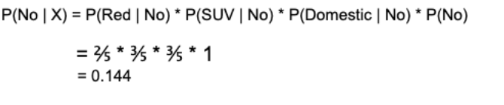
As per the equations discussed above, we can calculate the posterior probability P(Yes | X) as :
Since 0.144 > 0.048, Which means given the features RED SUV and Domestic, our example gets classified as ’NO’ the car is not stolen.

Slide 20
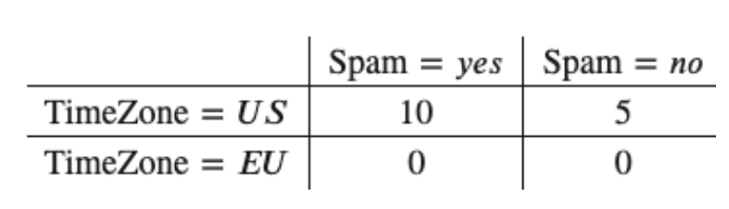
One of the disadvantages of Naïve-Bayes is that if you have no occurrences of a class label and a certain attribute value together then the frequency-based probability estimate will be zero. And this will get a zero when all the probabilities are multiplied.
An approach to overcome this ‘zero-frequency problem’ in a Bayesian environment is to add one to the count for every attribute value-class combination when an attribute value doesn’t occur with every class value.
For example, say your training data looked like this:

Slide 21
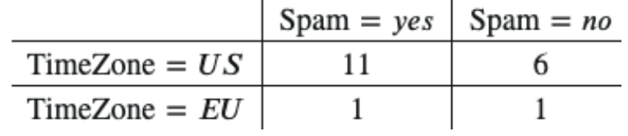
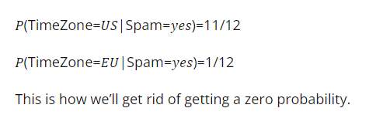
𝑃(TimeZone=𝑈𝑆|Spam=𝑦𝑒𝑠)=10/10=1
𝑃(TimeZone=𝐸𝑈|Spam=𝑦𝑒𝑠)=0/10=0
Then you should add one to every value in this table when you’re using it to calculate probabilities:

Slide 22
P(y = Low / x = Low)
= Number of cases when both x & y are Low / Number of cases x is Low = 1/6 = 0.17P(y = Medium / x = Low)
= Number of cases both x is Low and y is Medium / Number of cases x is Low = 3/6 = 0.50P(y = High / x = Low)
= Number of cases both x is Low and y is Medium / Number of cases x is Low = 2/6 = 0.33
Used to develop models when the output or response variable y is categorical
Develop a model to predict the iris plant class (1: Iris-setosa, 2: Irisversicolor & 3: Iris-virginica) based on sepal length, sepal width, petal length andpetal width using Naïve Bayes classifier. The data is given in Iris_data.csv file.
Validate the model with Iris_test.csv data?
import pandas as mypd
from sklearn.naive_bayes import GaussianNB
mydata = mypd.read_csv("Data/Iris_data.csv")
x = mydata.values[:, 0:4]
y = mydata.values[:, 4]

Slide 23
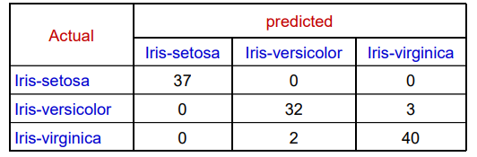
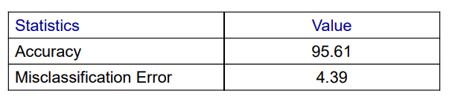
mymodel = GaussianNB()
mymodel.fit(x, y)
pred = mymodel.predict(x)
mytable = mypd.crosstab(y, pred)
mytable

Slide 24
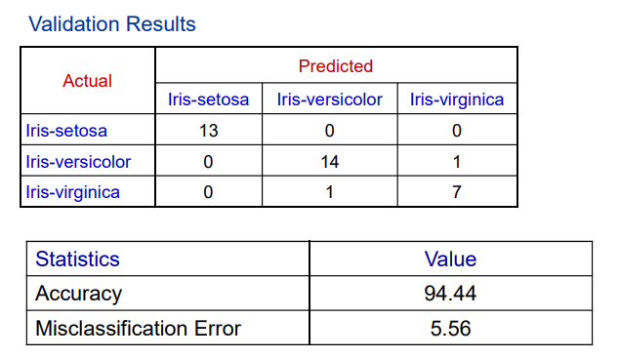
Validating the model on test data
mytestdata = mypd.read_csv("Data/Iris_test.csv")
x_test = test[["sepal_length", "sepal_width", "petal_length", "petal_width"]]
y_test = test.Species
mymodel.score(x_test, y_test)
pred_test = mymodel.predict(test_x)
mytesttable = mypd.crosstab(test_y, pred_test)
mytesttable

Slide 25
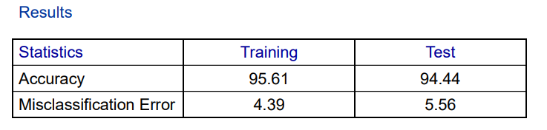

Slide 26
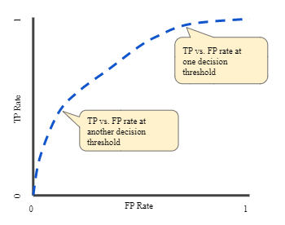


Classification: ROC Curve and AUC
ROC curve
An ROC curve (receiver operating characteristic curve) is a graph showing the performance of a classification model at all classification thresholds. This curve plots two parameters:
True Positive Rate
False Positive Rate
True Positive Rate (TPR) is a synonym for recall and is therefore defined as follows:
False Positive Rate (FPR) is defined as follows:
An ROC curve plots TPR vs. FPR at different classification thresholds. Lowering the classification threshold classifies more items as positive, thus increasing both False Positives and True Positives. The following figure shows a typical ROC curve.

Slide 27
ROC stands for Receiver Operating Characteristic curve. This is a graph that shows the performance of a machine learning model on a classification problem by plotting the true positive rate and the false positive rate. AUC stands for Area Under the Curve. It is used to measure the entire area under the ROC curve.
The ROC curve plots the true positive rate and the false positive rate at different classification thresholds, whereas the AUC shows an aggregate measure of the performance of a machine learning model across all the possible classification thresholds. You can learn more about the AUC and ROC curve in machine learning from here.

Slide 28
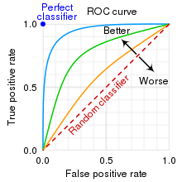
AUC - ROC Curve
In classification, there are many different evaluation metrics. The most popular is accuracy, which measures how often the model is correct. This is a great metric because it is easy to understand and getting the most correct guesses is often desired. There are some cases where you might consider using another evaluation metric.
Another common metric is AUC, area under the receiver operating characteristic (ROC) curve. The Reciever operating characteristic curve plots the true positive (TP) rate versus the false positive (FP) rate at different classification thresholds. The thresholds are different probability cutoffs that separate the two classes in binary classification. It uses probability to tell us how well a model separates the classes.

Slide 29
Imbalanced Data
Suppose we have an imbalanced data set where the majority of our data is of one value. We can obtain high accuracy for the model by predicting the majority class.
import numpy as np
from sklearn.metrics import accuracy_score, confusion_matrix, roc_auc_score, roc_curve
n = 10000
ratio = .95
n_0 = int((1-ratio) * n)
n_1 = int(ratio * n)
y = np.array([0] * n_0 + [1] * n_1)
# below are the probabilities obtained from a hypothetical model that always predicts the majority class
# probability of predicting class 1 is going to be 100%
y_proba = np.array([1]*n)
y_pred = y_proba > .5
print(f'accuracy score: {accuracy_score(y, y_pred)}')
cf_mat = confusion_matrix(y, y_pred)
print('Confusion matrix')
print(cf_mat)
print(f'class 0 accuracy: {cf_mat[0][0]/n_0}')
print(f'class 1 accuracy: {cf_mat[1][1]/n_1}')

Slide 30
Although we obtain a very high accuracy, the model provided no information about the data so it's not useful. We accurately predict class 1 100% of the time while inaccurately predict class 0 0% of the time. At the expense of accuracy, it might be better to have a model that can somewhat separate the two classes.
# below are the probabilities obtained from a hypothetical model that doesn't always predict the mode
y_proba_2 = np.array(
np.random.uniform(0, .7, n_0).tolist() +
np.random.uniform(.3, 1, n_1).tolist()
)
y_pred_2 = y_proba_2 > .5
print(f'accuracy score: {accuracy_score(y, y_pred_2)}')
cf_mat = confusion_matrix(y, y_pred_2)
print('Confusion matrix')
print(cf_mat)
print(f'class 0 accuracy: {cf_mat[0][0]/n_0}')
print(f'class 1 accuracy: {cf_mat[1][1]/n_1}')

Slide 31
For the second set of predictions, we do not have as high of an accuracy score as the first but the accuracy for each class is more balanced. Using accuracy as an evaluation metric we would rate the first model higher than the second even though it doesn't tell us anything about the data.
In cases like this, using another evaluation metric like AUC would be preferred.
import matplotlib.pyplot as plt
def plot_roc_curve(true_y, y_prob):
"""
plots the roc curve based of the probabilities
"""
fpr, tpr, thresholds = roc_curve(true_y, y_prob)
plt.plot(fpr, tpr)
plt.xlabel('False Positive Rate')
plt.ylabel('True Positive Rate')

Slide 32
Example
Model 1:
plot_roc_curve(y, y_proba)
print(f'model 1 AUC score: {roc_auc_score(y, y_proba)}')
Model 2:
plot_roc_curve(y, y_proba_2) print(f'model 2 AUC score: {roc_auc_score(y, y_proba_2)}')
An AUC score of around .5 would mean that the model is unable to make a distinction between the two classes and the curve would look like a line with a slope of 1. An AUC score closer to 1 means that the model has the ability to separate the two classes and the curve would come closer to the top left corner of the graph.

Slide 33
Probabilities
Because AUC is a metric that utilizes probabilities of the class predictions, we can be more confident in a model that has a higher AUC score than one with a lower score even if they have similar accuracies.
In the data below, we have two sets of probabilites from hypothetical models. The first has probabilities that are not as "confident" when predicting the two classes (the probabilities are close to .5). The second has probabilities that are more "confident" when predicting the two classes (the probabilities are close to the extremes of 0 or 1).
Example

Slide 34
import numpy as np
n = 10000
y = np.array([0] * n + [1] * n)
#
y_prob_1 = np.array(
np.random.uniform(.25, .5, n//2).tolist() +
np.random.uniform(.3, .7, n).tolist() +
np.random.uniform(.5, .75, n//2).tolist()
)
y_prob_2 = np.array(
np.random.uniform(0, .4, n//2).tolist() +
np.random.uniform(.3, .7, n).tolist() +
np.random.uniform(.6, 1, n//2).tolist()
)
print(f'model 1 accuracy score: {accuracy_score(y, y_prob_1>.5)}')
print(f'model 2 accuracy score: {accuracy_score(y, y_prob_2>.5)}')
print(f'model 1 AUC score: {roc_auc_score(y, y_prob_1)}')
print(f'model 2 AUC score: {roc_auc_score(y, y_prob_2)}')

Slide 35
Plot model 1:
plot_roc_curve(y, y_prob_1)
Plot model 2:
fpr, tpr, thresholds = roc_curve(y, y_prob_2) plt.plot(fpr, tpr)
Even though the accuracies for the two models are similar, the model with the higher AUC score will be more reliable because it takes into account the predicted probability. It is more likely to give you higher accuracy when predicting future data.

