Slide 1
KNN Algorithm

Slide 2
K NEAREST NEIGHBOR
Introduction to K-Nearest Neighbor (KNN)
KNN is a non-parametric supervised learning technique in which we try to classify the data point to a given category with the help of training set. In simple words, it captures information of all training cases and classifies new cases based on a similarity.
Predictions are made for a new instance (x) by searching through the entire training set for the K most similar cases (neighbors) and summarizing the output variable for those K cases. In classification this is the mode (or most common) class value.

Slide 3
How KNN algorithm works
Suppose we have height, weight and T-shirt size of some customers and we need to predict the T-shirt size of a new customer given only height and weight information we have. Data including height, weight and T-shirt size information is shown below -
Height (in cms) | Weight (in kgs) | T Shirt Size
158 | 58 | M
158 | 59 | M
158 | 63 | M
160 | 59 | M
160 | 60 | M
163 | 60 | M
163 | 61 | M
160 | 64 | L
163 | 64 | L
165 | 61 | L
165 | 62 | L
165 | 65 | L
168 | 62 | L
168 | 63 | L
168 | 66 | L
170 | 63 | L
170 | 64 | L
170 | 68 | L

Slide 4
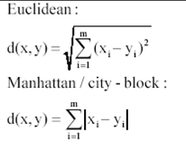
Step 1 : Calculate Similarity based on distance function
There are many distance functions but Euclidean is the most commonly used measure. It is mainly used when data is continuous. Manhattan distance is also very common for continuous variables.
The idea to use distance measure is to find the distance (similarity) between new sample and training cases and then finds the k-closest customers to new customer in terms of height and weight.
New customer has height 161cm and weight 61kg.
Euclidean distance between first observation and new observation is as follows -
=SQRT((161-158)^2+(61-58)^2)

Slide 5
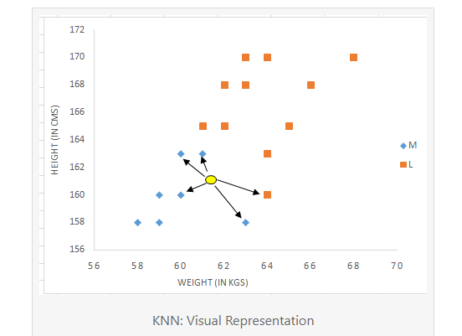
Similarly, we will calculate distance of all the training cases with new case and calculates the rank in terms of distance. The smallest distance value will be ranked 1 and considered as nearest neighbor.
Step 2 : Find K-Nearest Neighbors
Let k be 5. Then the algorithm searches for the 5 customers closest to new data, i.e. most similar to new data in terms of attributes, and see what categories those 5 customers were in. If 4 of them had ‘Medium T shirt sizes’ and 1 had ‘Large T shirt size’ then your best guess for Monica is ‘Medium T shirt. See the calculation shown in the snapshot below -
In the graph below, binary dependent variable (T-shirt size) is displayed in blue and orange color. 'Medium T-shirt size' is in blue color and 'Large T-shirt size' in orange color. New customer information is exhibited in yellow circle. Four blue highlighted data points and one orange highlighted data point are close to yellow circle. so the prediction for the new case is blue highlighted data point which is Medium T-shirt size.

Slide 6
Why KNN is non-parametric?
Non-parametric means not making any assumptions on the underlying data distribution. Non-parametric methods do not have fixed numbers of parameters in the model. Similarly in KNN, model parameters actually grows with the training data set - you can imagine each training case as a "parameter" in the model.
KNN vs. K-mean
Many people get confused between these two statistical techniques- K-mean and K-nearest neighbor. See some of the difference below -
K-mean is an unsupervised learning technique (no dependent variable) whereas KNN is a supervised learning algorithm (dependent variable exists)
K-mean is a clustering technique which tries to split data points into K-clusters such that the points in each cluster tend to be near each other whereas K-nearest neighbor tries to determine the classification of a point, combines the classification of the K nearest points

Slide 7
Can KNN be used for regression?
Yes, K-nearest neighbor can be used for regression. In other words, K-nearest neighbor algorithm can be applied when dependent variable is continuous. In this case, the predicted value is the average of the values of its k nearest neighbors.
Pros and Cons of KNN Pros Easy to understand
No assumptions about data
Can be applied to both classification and regression
Works easily on multi-class problems
Memory Intensive / Computationally expensive
Sensitive to scale of data
Not work well on rare event (skewed) target variable
Struggle when high number of independent variables

Slide 8
How to handle categorical variables in KNN?
Create dummy variables out of a categorical variable and include them instead of original categorical variable. Unlike regression, create k dummies instead of (k-1). For example, a categorical variable named "Department" has 5 unique levels / categories. So we will create 5 dummy variables. Each dummy variable has 1 against its department and else 0.
How to find best K value?
Cross-validation is a smart way to find out the optimal K value. It estimates the validation error rate by holding out a subset of the training set from the model building process.

