Slide 1


Technology Trends & Analysis Presentation
Sandeepan Mukherjee
Academics in Web and Data Science| Budding Data Scientist
Report built in March 2021

Slide 2




OUTLINE
Executive Summary
Introduction
Methodology
Results
Visualization – Charts
Dashboard
Discussion
Findings & Implications
Conclusion
Appendix

Slide 3

EXECUTIVE SUMMARY
This report was based on a survey conducted by Stack Overflow, a popular website for developers across the world, and this report shows trends in programming languages and databases
It also reflects the findings which are:
1. Demographics survey
2. Technological gap in countries
3. Gender gap in the developer job market

Slide 4

INTRODUCTION
About: What are the trends in programming development?
Purpose:
What are skill requirements for future?
What are the top programming languages in demand?
What are the top database skills in demand?
What are the popular IDEs?
Audience: IT professionals and Human Resources

Slide 5

METHODOLOGY
Data Collection Sources
Stack Overflow Developer 2019 Survey
GitHub Job Postings
Data Exploration, Cleaning and Normalizing:
Removing duplicates and outliers that could misinterpret the salaries
Normalizing the salaries to year, considering amounts in US Dollars
Data Visualization: Using Python libraries and Cognos BI
Presentation

Slide 6
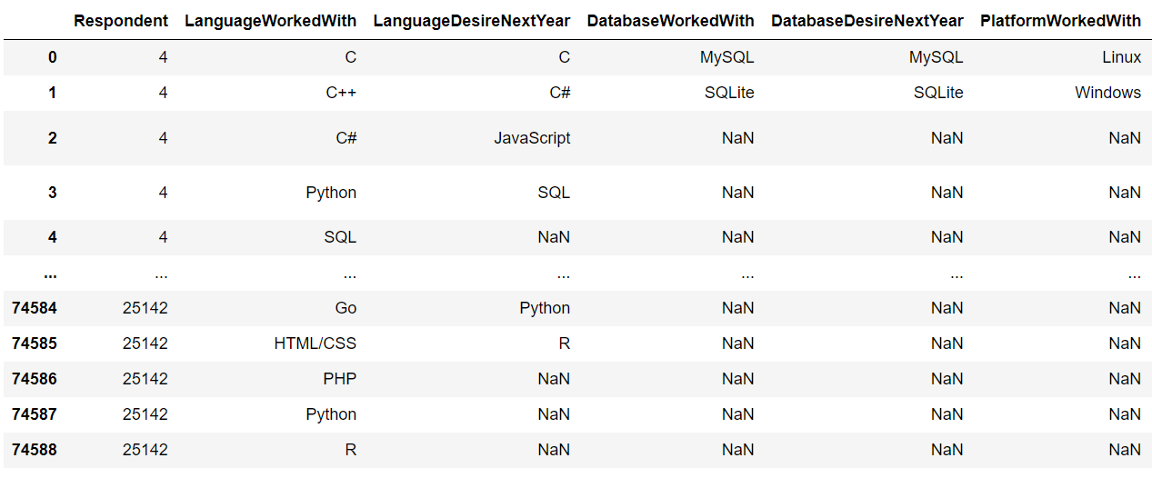
RESULTS
Results are based on this dataframe below:

Slide 7
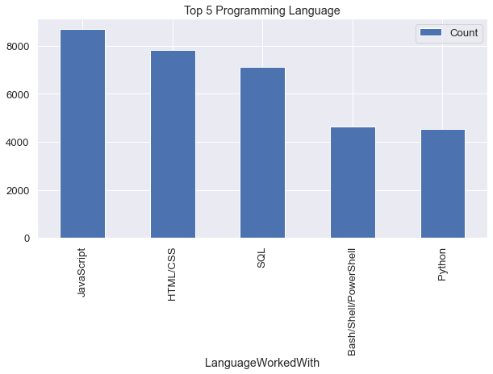
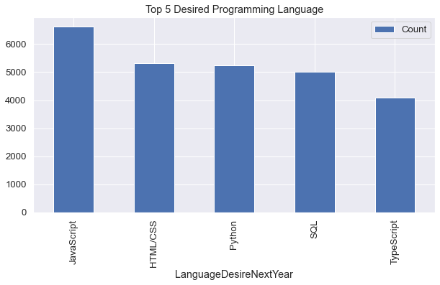
PROGRAMMING LANGUAGE TRENDS
Current Year
Next Year

Slide 8
PROGRAMMING LANGUAGE TRENDS - FINDINGS & IMPLICATIONS
Findings
JavaScript, HTML/CSS, SQL are top programming skills this year
Python and Typescript are becoming popular among techies next year
PowerShell/Bash edged are no more in priority.
Implications
Web development with Javascript and HTML/CSS are still highly in demand and popular.
With rising of Big Data technology the organization still requires SQL.
Typescript might replace Javascript and with AI and ML in rising demand, Python is best choice.

Slide 9
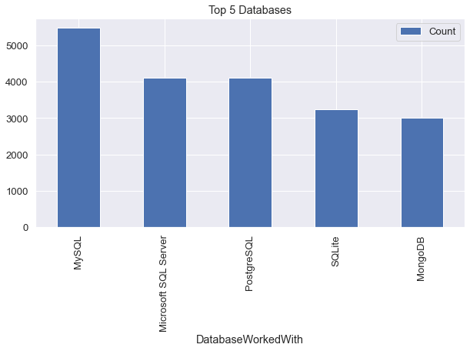
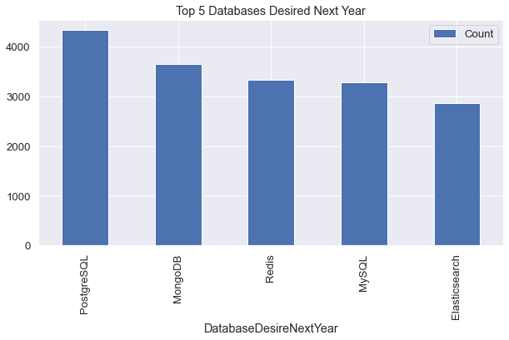
DATABASE TRENDS
Current Year
Next Year

Slide 10
DATABASE TRENDS - FINDINGS & IMPLICATIONS
Findings
MySQL and Microsoft SQL are most popular databases
MongoDB and PostgredSql are upcoming favorites and are popular with growing desire among developers
New hot desire in the market is Elasticsearch.
Implications
Open-source databases are preferred by the organizations.
NoSQL databases will make an impact in the job market
Redis supports abstract data types
Pre-tuned search to website, app, or ecommerce store

Slide 11

DASHBOARD
IBM COGNOS LINK DASHBOARD
https://eu-de.dataplatform.cloud.ibm.com/dashboards/d3d109a0-4436-4076-bf66-21bd39efb72b/view/032ae22107e2188968cddce407982c057530265ab3bb855583d77b495a312097f06d1193c879495bdf165035a5bf105ecd

Slide 12
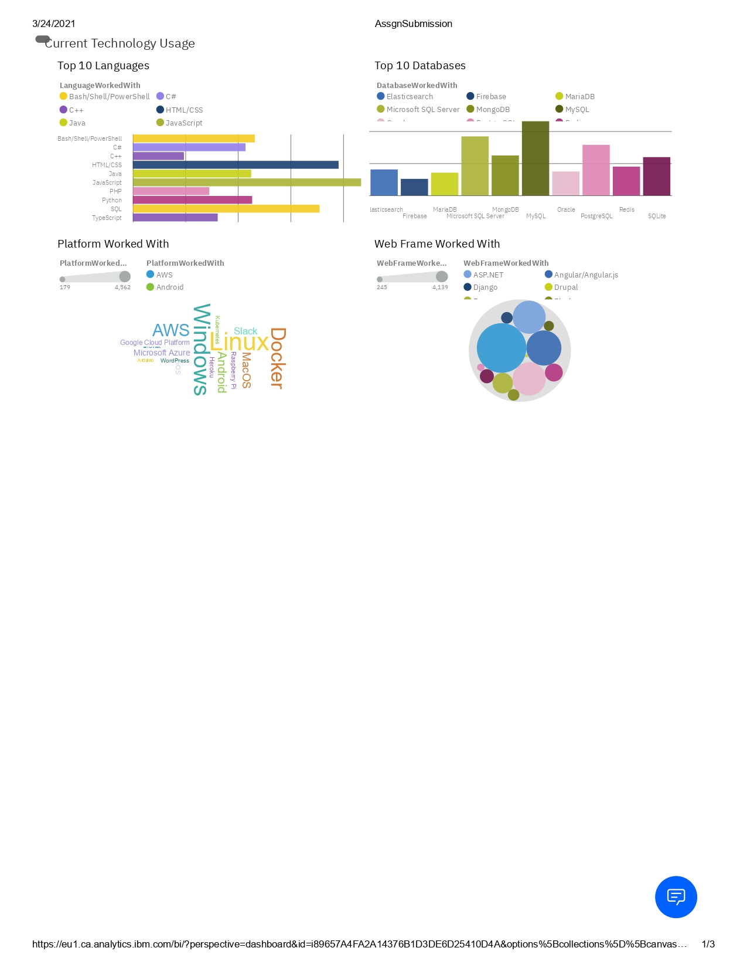
CURRENT TECHNOLOGY USAGE DASHBOARD

Slide 13
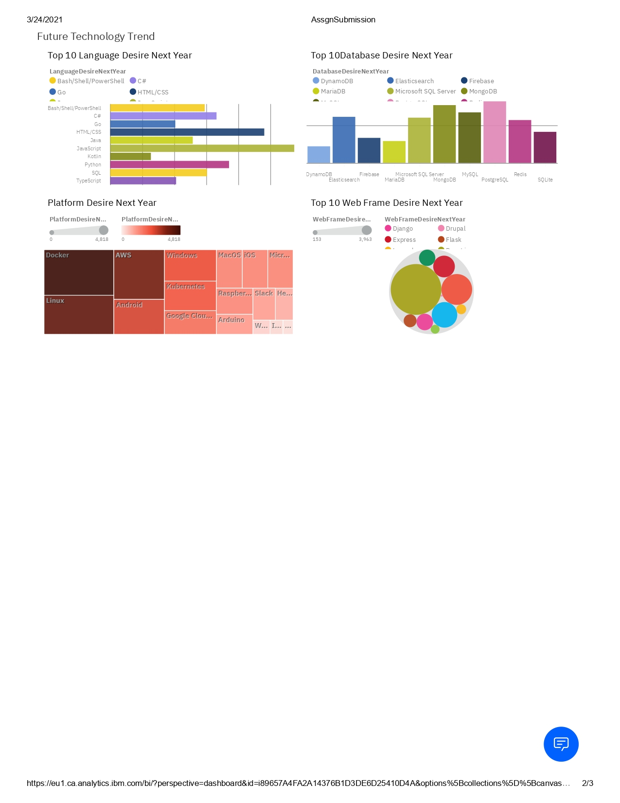
FUTURE TECHNOLOGY TREND DASHBOARD

Slide 14
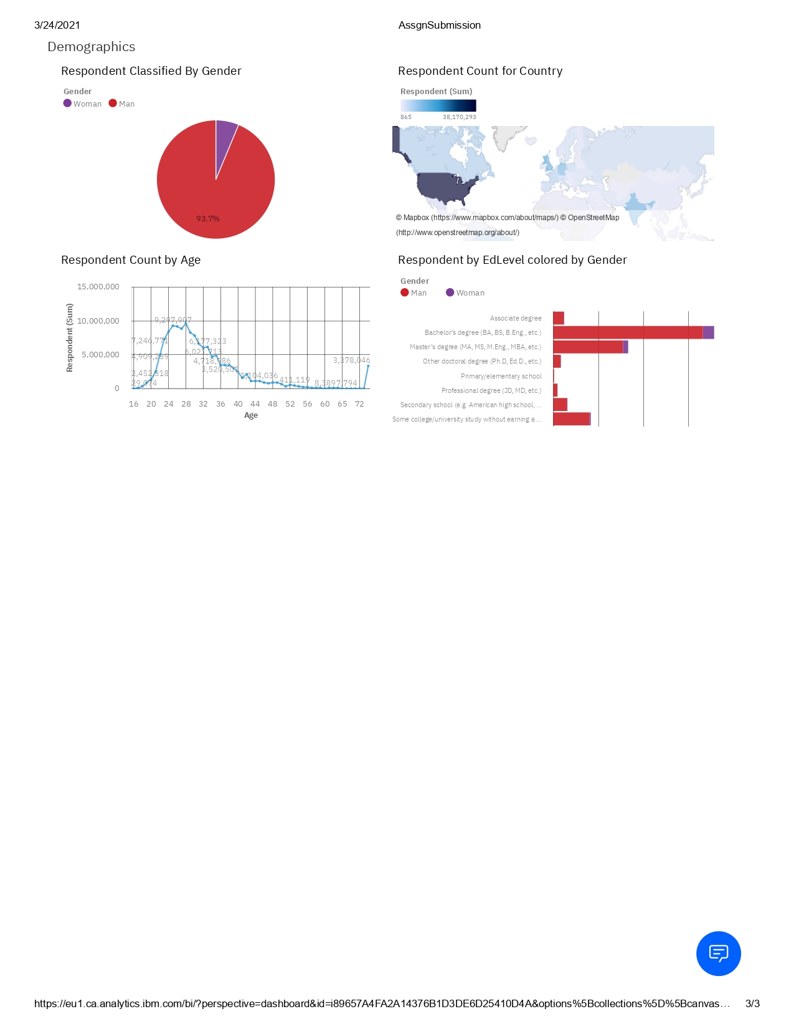
DEMOGRAPHICS DASHBOARD

Slide 15
DISCUSSION
What are technology Trends now and for the future?
What are new training and reskilling of employees required?
What can be done to increase women on the developer’s job market?
What can be done to bridge divide of technological gaps in countries which are lagging behind?
How to eliminate age and education discrimination in employment?

Slide 16
OVERALL FINDINGS & IMPLICATIONS
Findings
Fast changing technology every year
Concentration on several countries like USA and India
Gap in gender, age and educational levels.
Implications
Companies need to adapt to fast changes to keep motivation and performance
Need to spread technology out to lagging countries
Chose wisely the changes to be made
Faster app deployments and cloud services are the future

Slide 17

CONCLUSION
Comparing actual languages and desire languages can help companies chose better products
Understanding overall feelings can help professionals learn better tools
High demand for women as companies search to reduce gap
Future analysis to compare salaries of different current knowledge
In future, incorporate Machine Learning to predict trends and salaries

Slide 18

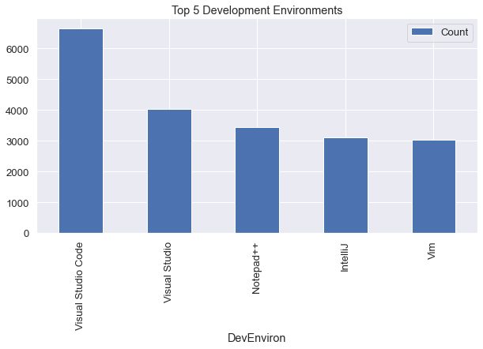
APPENDIX

Slide 19
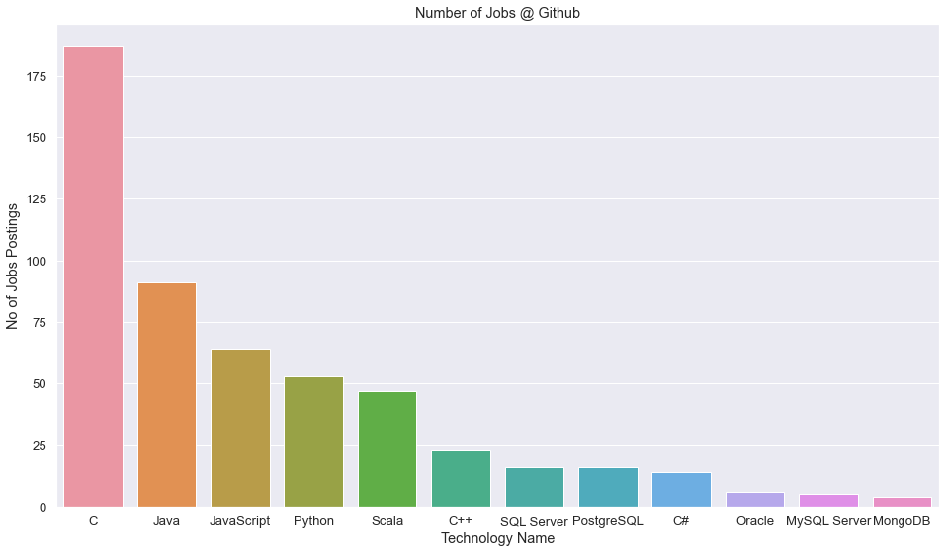
GITHUB JOB POSTINGS

Slide 20
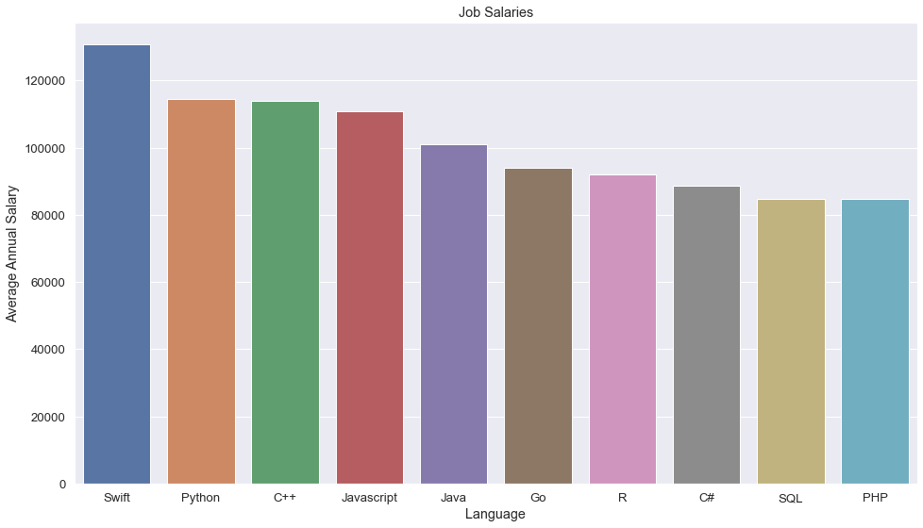
POPULAR LANGUAGES BY SALARY

