Slide 1
Crime Rate, Income, and Popular Vote
Notes:
Richard

Slide 2

Meet our Team: TSHaRK
Tara Gray
Sandeep Mehta
Haylye Plaster
Richard Yarbough
Katherine Huynh
Notes:
Richard

Slide 3
Objective
What we sought to find was the relationship between state salary, crime rates, and election outcomes over the tenure through 2000 to 2016. We reviewed state by state median salary over the tenure, violent crime rates within those states, and the Presidential election outcomes by state.
What we believe we will see in our findings is that based upon the state by state median salary and popular votes in the Presidential election, solely looking at the data from the 2000 election all the way through to the 2016 Presidential election, that these factors could possibly be affected by the states violent crime rates.
Notes:
Richard

Slide 4
Hypothesis
If a state tends to have a high crime rate, then they are less likely to have a higher state median salary and in the Presidential elections they are more likely to vote Republican.
What motivated us to explore this data: We wanted to see if we could find any correlations between the state median salary and popular votes for a particular party/candidate and crime rates. We believe these factors would possibly be influenced by a state’s violent crime rate.
Notes:
Richard

Slide 5
Seeking Data Sets
First Data set: Violent Crime Rates by State
- Over the 2001 to 2016 time period, what was the violent crime rates by state? Is there a pattern that occurred, which states increased, and which states decreased in violent crime over the years? What is the crime per capita by state?
- Sourced from Kaggle
Second Data set: Median Salary by State
- Over the 2000 to 2016 time period, what was the median salary of these states? What was the trend that occurred? What could possibly be the cause of this?
- Sourced from Kaggle
Third Data set: State Presidential Voting Outcome
- What was the overall popular vote by these 10 States in each presidential election, beginning with the 2000 Presidential election through the most recent 2016 presidential election….
- Sourced from uselectionatlas.org, cross checked with Secretary of State websites
Notes:
Haylye

Slide 6
Data Sources/Cleanup
Original Crime data had variables we were not focused on in regards to “violent crime” (ex: petty theft)
Election data showed too many factors with regards to all political parties that were options in the election, the specific names of the candidates, the percentage of the popular vote, number of early votes per state, etc.
We had to clean this data up to show just the main political parties, total popular votes per state, etc.
For median salary, we had to compress the data to show the average amount made by the population for each year from 2000 - 2016
Election Data 2000.csv
Election Data 2004.csv
Election Data 2008.csv
Election Data 2012.csv
Election Data 2016.csv
US_Median_Salary - Backup.csv
US_Median_Salary.csv
crime_data.csv
crime_out.csv
crime_sum.csv
salary_out.csv
Notes:
Katherine

Slide 7

Analysis: Review of Election Data
Compared each of the columns for the parties, did a “if” and “else if” to determine which political parties each state voted for.
Analyzed each state’s popular vote outcome.
Election.ipynb
Notes:
Haylye

Slide 8

Analysis: Review of Median Income
Analyzed the median income from 2000 to 2017 per state, note that the numbers we chose are adjusted for inflation (in 2017 dollars). This is to avoid falsely showing a positive trend.
Median Salary by State in relation to Crime Rate per Capita: Maine, Vermont, New Hampshire, North Dakota, Utah / Alaska, New Mexico, Nevada, South Carolina, Tennessee. See Graph
median.ipynb
Notes:
Haylye

Slide 9

Analysis: Review of Crime Data
Analyzed the violent crime rates (per population) by state from the year 2001 to 2016
Top 5/Bottom 5: Findings) – Lowest Crime Rate to Highest Crime Rate % per capita: Maine .119, Vermont .126, New Hampshire .175, North Dakota .193, Utah .227 / Alaska .644, New Mexico .652, Nevada .654, South Carolina .671, Tennessee .676
crime.ipynb
Notes:
Haylye

Slide 10
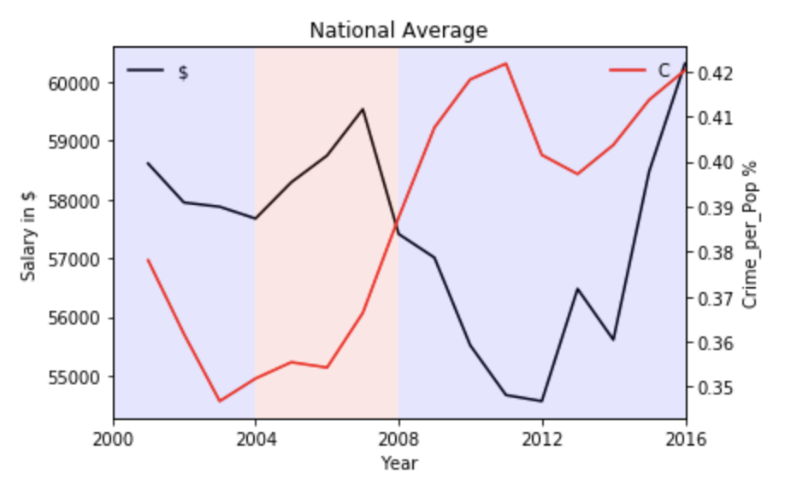
Analysis: Putting it all Together
We chose 5 states that had the highest violent crime rates, 5 states that had the lowest violent crime rates. (Maine, Vermont, New Hampshire, North Dakota, Utah / Alaska, New Mexico, Nevada, South Carolina, Tennessee. See Graph )
We determined if there is a correlation between a state populations median salary and popular vote in the Presidential elections, then that would tell us if the state had a higher or lower crime rate.
Notes:
Katherine

Slide 11
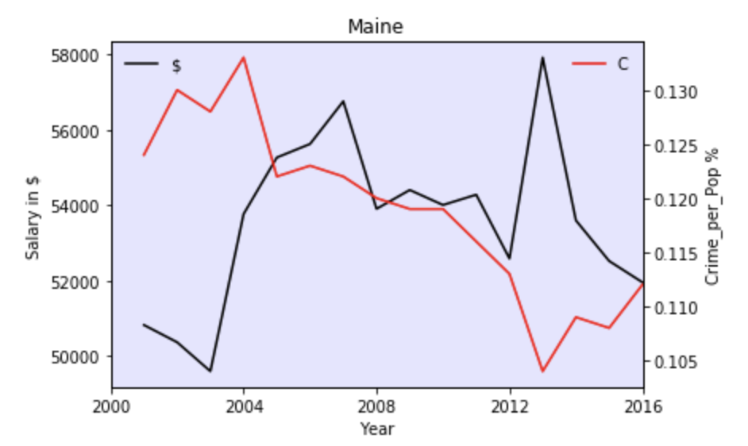
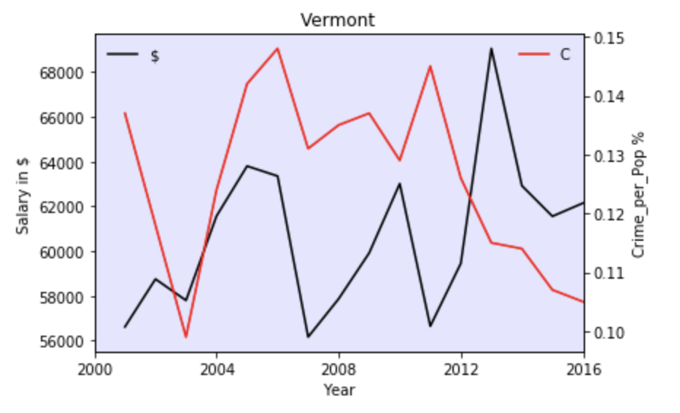
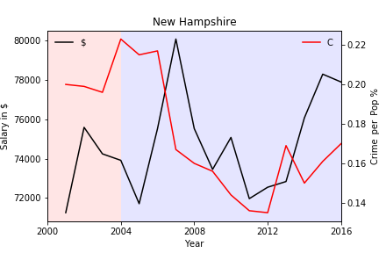
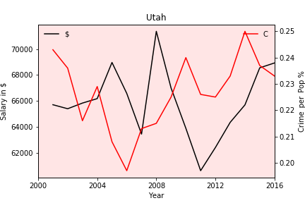
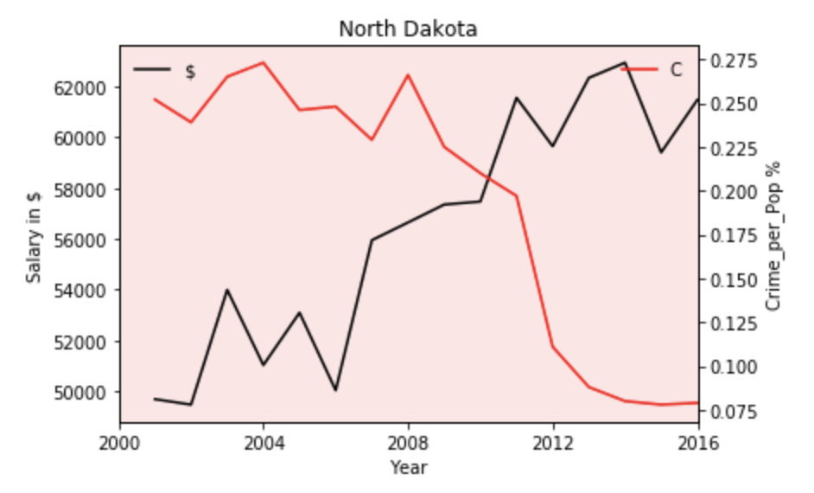
Lowest 5 States for Crime
Notes:
Tara

Slide 12
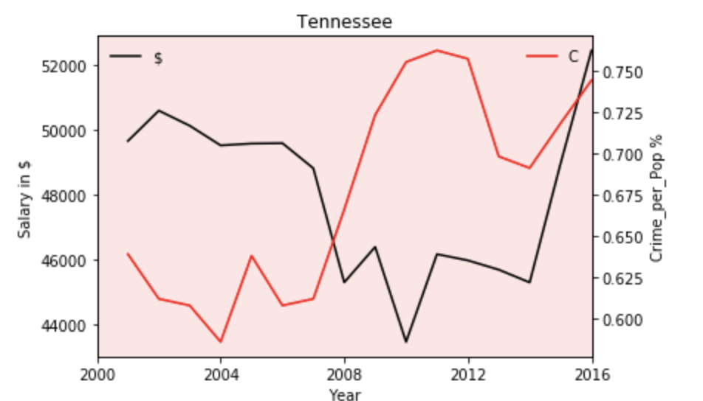
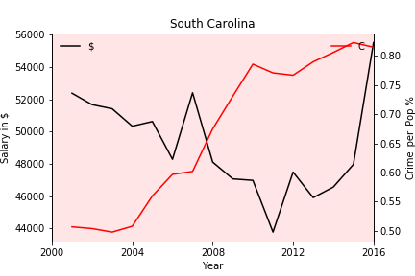
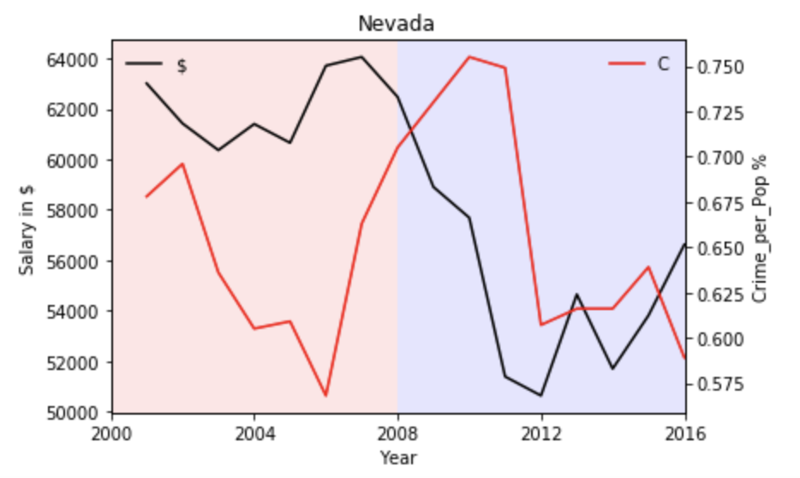
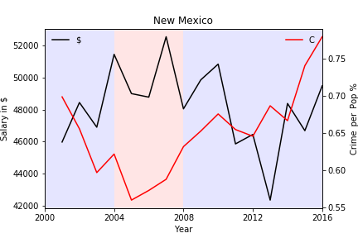
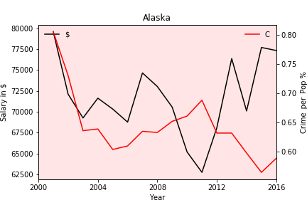
Highest 5 States for Crime
Notes:
Tara

Slide 13
Conclusion
What do our results tell us?
In extreme cases, the more consistently republican the state the more crime per capita
Nevada: uniquely during the Recession years median income dropped as well as their crime rate.
The Recession in 2008 negatively affected each state we looked at except North Dakota which seemed to have a positive response to the Recession in terms of median salary and crime rates
What are the implications of our findings?
In extreme cases, when the median salary decreased, crime increased especially in the states with the highest crime rates.
What do we still want to know?/What information would we still need?
Percentages of political party by violent crime per capita
Find the change in economy and change in crime overtime, is there a correlation over time (25-45 years)?
Notes:
first bullet: Haylye
Second: Tara
Third: Tara

Slide 14
Challenges & Learnings
What should we begin with - Objective or Data source?
How do we present the data (Chart Visualization)?
How do we keep everyone in the team busy?
Other learnings
Notes:
Sandeep

