Slide 1
SPH Assignment
Data Pipeline for YouTube Analytics using AWS services & Lakehouse implementation
---------------------------------------------------------
Sai Sandeep Chandragiri

Slide 2
Solution Overview
Followed the medallion architecture where segregated the ETL pipeline with different layers like,
Raw Layer – Extracting the data from Google YouTube Data API using AWS lambda Function and storing in S3.
Curated Layer – Reading the data from output of Raw Layer in S3 and perform data cleansing and data quality checks and write the data back to S3 in delta format.
Consumption Layer – Reading the data from output of Curated layer in S3 and add the business logic on deriving dimension and fact tables and write the data back to S3 in delta format.
Implemented Lakehouse framework with the help of DeltaLake to extends Parquet data files with a file-based transaction log for ACID transactions and scalable metadata handling.

Slide 3
Tech Stack For Data Pipeline
AWS services used for the Data Pipeline solution –
AWS Lambda
AWS S3
AWS Glue Jobs
AWS Crawler
AWS Data Catalog
AWS Athena
AWS Step Function
AWS Event Bridge
Programming Language and Data Wrangler Libraries used are,
Python
PySpark
SQL
Google YouTube Data API

Slide 4
Non Functional Requirements
Scalability
Based on the load of data extracted from the source we can make our data pipeline to scale efficiently by using auto scaling within AWS Glue on setting up the configuration min and max workers. In this way we can leverage more parallelism and increase the performance.
Security
As we store the data in S3 Bucket, We can make use of encryption at rest with the help of AWS KMS key and we can attain security in access related configuration with the help of IAM roles.
Performance
As we opted to perform transformations of the data using Apache Spark which by default leverage parallelism concept and in memory computation help to speed up the transformations on the large datasets. And with the spark configuration we can tweak them to increase the performance based on the data.
Availability
As we are using serverless application like Lambda, Glue and S3 for storage gives more availability standpoint from AWS and by maintain retry mechanisms and custom health check scaling options help to draw more availability.

Slide 5













YouTube Analytics Architecture
Google Youtube API
AWS Step Functions
AWS S3
6
7
3
S3 Objects -Raw
AWS Lambda
Scheduler
Crawler
AWS Glue Data Catalog
1
4
2
8
Glue Job
AWS Glue Data Quality
S3 Objects -curated
Amazon EventBridge
Amazon Athena
5
Glue Job
S3 Objects -consumption

Slide 6
Data Pipeline Architecture Flow Details
Using the cron expression we will trigger the event bridge rule which will runs once in a day at 5 PM.
Once the rule get trigger then it will start the execution of step function.
This is the first task which will get the data from YouTube Data API from the internet and store them into S3 bucket as csv files.
This is the second task in step functions which will read from the output of first task and do the data cleansing and data quality checks and write to another object folder in same S3 bucket in delta format.
This is the third step which reads the data from curated layer and then defines load the dim tables and later load the fact tables based on the logic and write it back to consumption location in S3 as delta format.
We will use Glue crawler to read the metadata details for the data stored in S3 of delta format and create the tables in AWS glue catalog.
We can locate the tables created in AWS glue catalog inside the database once the crawler is successful.
Finally we can query the data from AWS Glue Catalog using Athena to derive the solutions with the requirement.

Slide 7
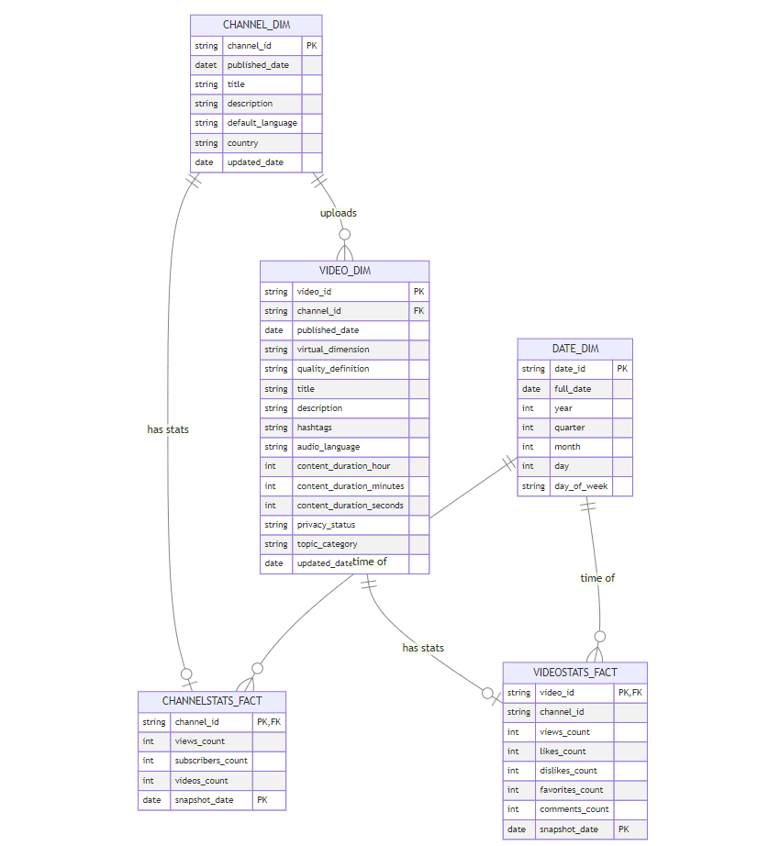
Data Model Schema For YouTube Data Analytics

Slide 8
For the code related information below is the git repo link,
https://github.com/sandeepchandra/youtube-analytics-aws.git

