Slide 1
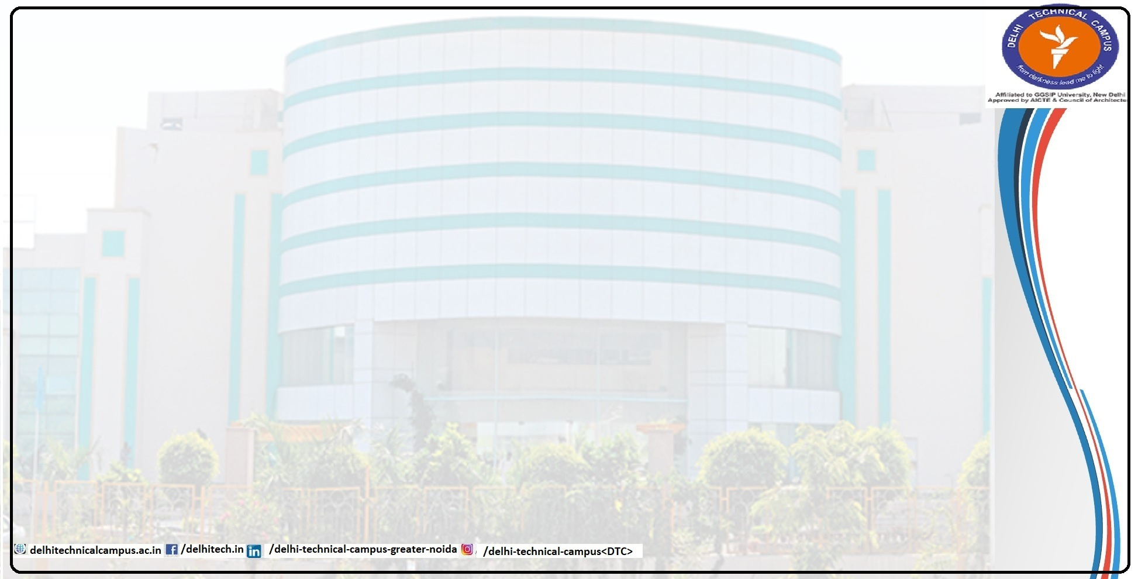
PAPER-2-POD
Presented By
Sandeep Choudhary (05118011621)
Under Guidance:
Dr. Neha Jain

Slide 2

Introduction
The Research Paper to Podcast Converter is designed to enhance accessibility to academic content by transforming PDF-based research papers into audio podcasts. By leveraging advanced technologies in Natural Language Processing (NLP) and Text-to-Speech (TTS), the application automates the summarization and voice generation of research material, making it easier for users to engage with complex information in a more flexible format. This project aims to support auditory learners, busy professionals, and those with visual impairments, allowing academic research to reach a broader audience.

Slide 3
Feasibility Study
1. Technical Feasibility
The project uses reliable, open-source tools and libraries for each key function:
Text Extraction: PyPDF2 extracts text from multi-page PDFs.
Summarization: Hugging Face’s Transformers provide accurate summaries of lengthy academic content.
Sentiment Analysis and TTS: TextBlob adjusts TTS tone, and gTTS generates natural-sounding audio.
Audio Processing: pydub and FFmpeg enable seamless background music integration.

Slide 4
Feasibility Study
2. Operational Feasibility
The user-friendly, web-based interface simplifies the process:
Users can upload PDFs, choose summarization and sentiment options, and add background music.
Output is an audio file for easy download or streaming, making it suitable for students, researchers, and auditory learners with minimal training.
3. Economic Feasibility
The project is cost-effective, utilizing free, open-source tools and APIs with no licensing fees.
Low Initial Costs: It can be deployed locally or in a low-cost cloud environment.
Maintenance: Minimal ongoing costs ensure long-term affordability and scalability.

Slide 5
Objective
Automate Conversion: To convert research papers into podcast-ready audio files.
Enhance Accessibility: Enable easier access to academic research for individuals with visual impairments or those who prefer audio content.
Summarize Content: To provide concise summaries, helping users grasp key insights quickly.
Sentiment-Based Voice Modulation: Adjust the tone and speed based on sentiment analysis for a more engaging experience.
Customizable Output: Allow users to add background music to simulate a professional podcast experience.

Slide 6
Literature Survey
Text Summarization in Transformer Models
Vaswani et al. (2017), "Attention is All You Need"
This foundational paper introduced the Transformer model, which became the basis for many NLP tasks, including text summarization. Transformers employ a self-attention mechanism that allows models to capture relationships between words across large text segments. This project uses a Transformer-based model for summarization, ensuring that even complex research papers are condensed into coherent summaries while retaining critical points.
Liu et al. (2019), "Text Summarization with Pretrained Encoders"
This study explores using pre-trained Transformer encoders for text summarization tasks, demonstrating their effectiveness in producing coherent and accurate summaries. The research highlights that using pre-trained models significantly improves the quality of generated summaries. Following this approach, our project utilizes Hugging Face’s Transformer models to handle lengthy text efficiently and accurately.

Slide 7
Literature Survey
2. Sentiment Analysis in Text-to-Speech Applications
Pang and Lee (2008), "Opinion Mining and Sentiment Analysis"
This paper provides a comprehensive overview of sentiment analysis techniques. It discusses methods for understanding sentiment in text data, a technique we employ to determine tone and pace adjustments in our audio outputs. This approach ensures that the audio presentation aligns with the emotional context of the text.
Socher et al. (2013), "Recursive Deep Models for Semantic Compositionality Over a Sentiment Treebank"
Socher and colleagues introduce recursive neural networks to improve sentiment accuracy, especially in complex text. This work reinforces our use of TextBlob to capture sentiment, enhancing the listening experience by adjusting TTS based on sentiment polarity.

Slide 8
Hardware and Software Requirements
Hardware Requirements:
Processor: Intel Core i5 or higher
RAM: Minimum 8GB (16GB recommended for faster processing)
Storage: At least 2GB of available disk space
Sound Card: Required for audio playback and testing
Software Requirements:
Operating System: Windows 10 or later, macOS, or Linux
Programming Language: Python 3.x
Libraries:
PyPDF2 for PDF text extraction
Hugging Face Transformers for summarization and NLP processing
TextBlob for sentiment analysis
gTTS for Text-to-Speech conversion
pydub for audio processing

Slide 9
Algorithms Used
Text Extraction from PDF:
The application first extracts text from a PDF file using PyPDF2, reading through each page to compile the full text.
2. Summarization:
Transformer-based summarization is applied to break down lengthy research papers into concise segments. A chunking method is used to split the text into manageable portions, and then the summarization model condenses each chunk, focusing on essential points.
3. Sentiment Analysis:
TextBlob is employed to perform sentiment analysis on the summarized text, determining the overall sentiment polarity. Based on the sentiment, the speech speed or tone is adjusted, enhancing the listening experience.

Slide 10
Algorithms Used
4. Text-to-Speech Conversion:
gTTS is used to convert text into speech, allowing listeners to hear the summarized content. The sentiment polarity can adjust parameters such as speech rate to make the audio more engaging.
5. Audio Overlay with Background Music:
The pydub library, along with FFmpeg, is used to merge the synthesized speech with background music, creating a podcast-like experience.

Slide 11
Thank You

