Slide 1
Community Application Stream Processing Analytics
Raza Abbas (2019ad04095)
Sandeep Kumar (2019ad04106)
Shanur Rahman (2019ad04065)
Explanation Video URL
Part 1: https://youtu.be/PosptjOpyr8
Part 2: https://youtu.be/RLEfJ-aNLas

Slide 2



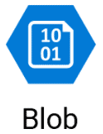
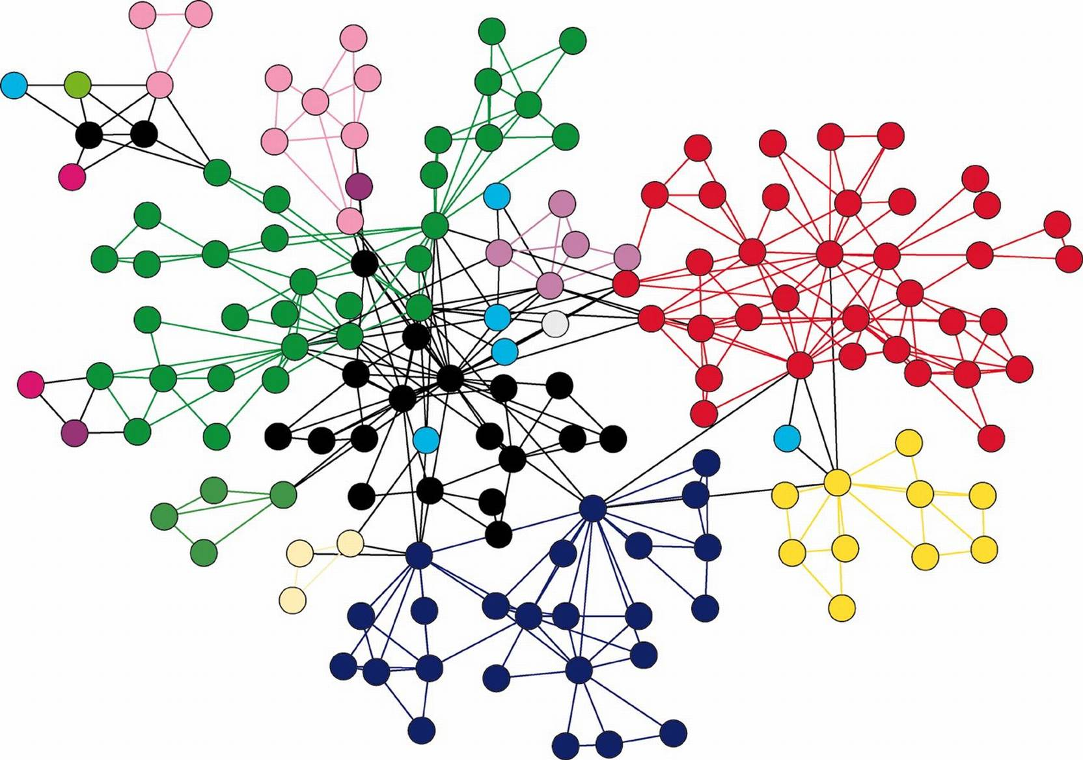







High Level Design
Database / Analytics
Search and Indexing
Frontend/
Clients
API/Load Balancers
Microservices
Memcache
APP and User info tables
WebUI
API Gateway
APP View
Recommendation System
ML Layer/
Collaborative
Filtering
Graph Database
Client Facing API
MQTT Broker
Messenger
User Posted Content
Websockets
Service1
Analytics/
Data Science
. .
Service N
Real time Messaging /
User Session Information
Notes:
<number>

Slide 3
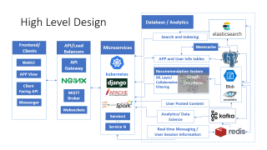
Frontend / Client Tier
These are the only supported access points for users w.r.t application.
Includes:
WebUI
Application View
Messenger
Client Facing API

Slide 4
API / Load Balancer(s) Tier
API Gateway tier aggregates various microservices based on their protocol and function, to multiple APIs.
Type of API gateways:
Rest API based on HTTP(s) with supported operations such as get, post, put.
Websockets to support real time chat applications.
MQTT to support routing and logging of high speed incoming messages to database and other applications. User chats, logs and maintenance.
API gateway also acts as a firewall, delegating authentication to an Internal microservice or API.

Slide 5
Micro Services Tier
Forms the basic application business logic.
Every interaction to application goes through microservices.
These services will write or read content from databases directly or through data models. Such as Django data models.
For frontend UI Django is an ideal choice. This will contain app routing and user authentication logic.
For Backend services Django Rest is an ideal choice. This will contain the queries and routines to be executed in analytics tier.
For serving static resources apache server will be used.

Slide 6
Micro Services Tier
Based on Kubernetes cluster(s).
Each service group contains multiple separate services.
Will have both:
Sync microservices: Data Access, media, routing, authentication, etc.
Async microservices: Background and batch processing.
Authentication within microservices and external requests is based on User session information stored in a REDIS cache database. It will be exposed as an API(Oauth type).
Each microservice has separate compute / network resources, the stack can be scaled by adding more instances (Horizontally scalable).
A service bus will be deployed for inter services communication.

Slide 7
Micro Services Tier
Microservice will also maintain and manage application definition involving:
Application scaling
Application security
Application management
Anomaly detection
One service group will be dedicated to above said functions.

Slide 8
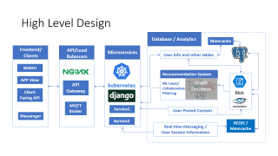
Database Tier

Slide 9
Types of data streams
APP and User info tables
Structured data
User posted content
Unstructured/structured data
Real time Messaging / User Session Information
Unstructured/structured data

Slide 10
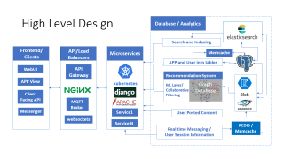
APP and User info tables
Contains user definition information, app definition information, user authentication information and regulatory data. These are stored in form of multiple simple tables.
Some of the tables would be generated using Django models.
As the new users sign up a moderately sized database will build up.
Data is accessed and updated infrequently but high consistency is a requirement. Postgresql is an ideal choice based on the requirements.

Slide 11
APP and User info tables schema
Format
table_name
column_name:datatype:indextype
user_master
user_uuid:string:btree
user_email:string:btree
user_name:string:btree
user_phone:string
user_signup_date:datetime
user_last_logged_in:datetime
user_password_hashed:string

Slide 12

APP and User info tables schema
user_group_master
group_uuid:string
group_name:string
group_user_count:int
group_is_active:Boolean
group_created_on:datetime
group_deleted_on:datetime
user_group_user_list
group_user_index:string
user_uuid:string
user_name:string
is_active:boolean:btree
is_admin:boolean
added_on:datetime
removed_on:datetime

Slide 13
APP and User info tables schema
application_master
app_pods_count:int
app_service_groups_master
service_uuid:string
service_pods_count:int
service_image_id:string

Slide 14
User posted content
User activity such as posts, comments, likes, shares, messages archival, etc.
This has all three essence of big data:
High Velocity
High Volume
High Variety
Here data is:
Accessed frequently
Inserted frequently
Updated infrequently
Highly reliable and Highly available system is required, immediate consistency is not required.
Cassandra is an ideal choice for storing user activity in form of text, small blobs and pointers to big blobs.
Blob Storage for storing big blobs, with a pointer stored in Cassandra to maintain metadata and other activity on the item.

Slide 15
User posted content Why Cassandra ?
Cassandra is an ideal choice for storing user activity in form of text, small blobs and pointers to big blobs.
NoSql format provides flexibility to store complicated user activity data easily.
The datastore is highly available and highly reliable by replicating across various nodes.
The datastore will be not be immediately consistent but eventually consistent. That means updates are slow and it takes time to propagate data updates across nodes.
Casandra will also support ongoing analytics effort for our use case.

Slide 16
User posted content nosql schema
post_master
post_uuid:string
post_name:string
post_author_uuid:string
post_text:string
post_pointers:json
post_url_slug
post_scope
post_share_count
post_comment_count
post_reaction_count
post_comments
comment_timestamp
comment_user
comment_text
post_reactions
reaction_timestamp
reaction_user
reaction_code

Slide 17
User posted content nosql schema
share_master
post_id
author_user_id
share_user_id
share_scope
is_forwarded
Is_reshared
share_comment_count
share_reaction_count
share_comments
comment_timestamp
comment_user
comment_text
share_reactions
reaction_timestamp
reaction_user
reaction_code

Slide 18
User posted content nosql schema
messages_archive
message_uuid:string
user_uuid:string
message_timestamp:datetime
destination_group_uuid:string
destination_user_uuid:string
contains_media:Boolean
Media_pointer:string
reply_list
reply_message_uuid

Slide 19
Real time Messaging / User Session Information
Incoming user messages and user session information is temporarily stored in a highly available REDIS cache. Eventually the data is made persistent in Cassandra for archival and analytics.
These messages are transmitted back to subscribers in form of web socket push. Author and subscribers can be:
One to one (Direct messages)
One to many (Group messages)
Blobs shared in form of media are treated the same way as user posted content. Actual data is delegated to that microservice, but a pointer is stored in chat to be consumed by UI and an integrated experience is served to users.

Slide 20
Real time Messaging / User Session Information
message_master
Message_uuid:string
user_uuid:string
message_timestamp:datetime
destination_group_uuid:string
destination_user_uuid:string
contains_media:Boolean
Media_pointer:string
reply_list
reply_message_uuid

Slide 21
Recommendation System
Generates tailored user feed based on user connections, interests, subscriptions, groups, etc.
Graph dataset pulls in new data from Cassandra and stores in a relationship topology.
The relationships are used to curate content, connections and groups recommendations that the user might be interested in.
These recommendations make the user aware about activity with common interests.
These will be used to generate user feed.

Slide 22
Search
Text based search to discover new content based on query.
Ranks text based on similarity to query.
Pulls in data from Cassandra and postgresql and makes indexes available to search microservice.
Elastic search is an ideal choice

Slide 23
Analytics System
Types of analysis:
Predefined insight charts: handled by scheduled async microservices
Custom analysis: Data scientist/Analyst can use jupyter interface.
Produce reports and Realtime insights in a presentable manner.
Cluster of machines to perform batch analysis.
Pull data from Redis and Cassandra and make it available for analysis.
Kafka, Jupyter, Spark and Python ecosystem seems suitable for the requirements.

Slide 24
Thanks

